Slide 1
Automated choice of models & Auto ML.
Alexey Osipov

Slide 2
Time series modelling.
Trend component.
Seasonal component.
Error component.
Volatility component*.
ETS.

Slide 3
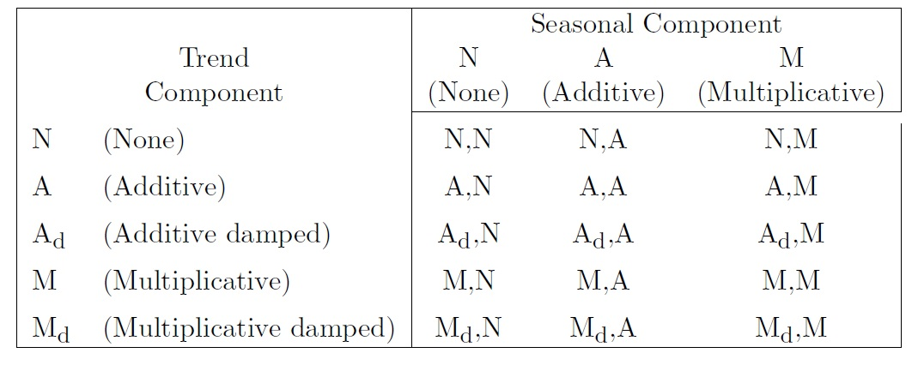
Exponential smoothing models.

Slide 4
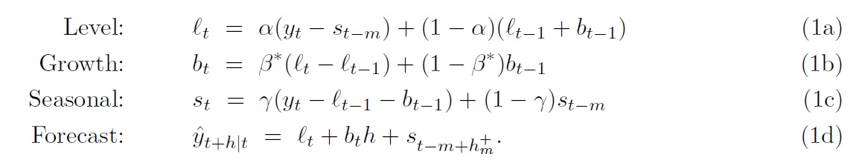
Point forecasts.
Exponential smoothing - Wikipedia

Slide 5

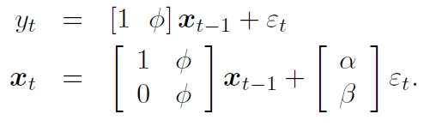
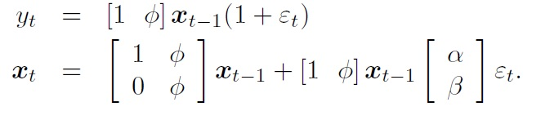
State space models.
ETS(A, A_d, N)
ETS(M, A_d, N)

Slide 6

Model selection.
Hold-out & MSE.
AIC (or BIC).
Prediction intervals: analytical results or simulation (parametric bootstrap or ordinary bootstrap)

Slide 7
Implementation.
ets from forecast R: Exponential smoothing state space model
HoltWinters from stats R: Holt-Winters Filtering

Slide 8



SARIMA
ARMA:
Autoregressive integrated moving average – Wikipedia
ARIMA:
SARIMA

Slide 9

SARIMA optimization
For fixed d and D optimize by AIC:
Likelihood function of the full model is not actually defined. So the values of AIC for different levels are not comparable.
Diffuse prior approach in arima from stats.
Choice of d and D via unit root tests.
Dickey-Fuller test, HEGY test (H0: presence of unit root).
KPSS test, Canova-Hansen test (H0: absence of unit root).

Slide 10
SARIMA: algorithm for model choice.
Step 1. Try 4 simple models. Choose by AIC.
Step 2. Try up to 13 variations on the current model. Choose by AIC.
Step 3. Update current model. Return to Step 2.
Constraints: orders of the models should not be too large.
Models close to being non-invertible are rejected.
Any model with errors on fit is rejected.

Slide 11
SARIMA vs exponential smoothing.
Large overlap.
Exponential smoothing can be non-linear.
For exponential smoothing all is non-stationary.

Slide 12
SARIMA: implementation.
auto.arima in forecast
Arima in forecast, arima in stats.

Slide 13
AUTO ML with H2O.
H2O. Written in Java, connectors to R and Python.
deep learning and stacked ensemble models
library(h2o) invisible(h2o.init()) train_h = as.h2o(train) test_h = as.h2o(test) aml = h2o.automl(x = pred, y = y, training_frame = train_h, max_models = 20, seed = 1, max_runtime_secs = 20)

Slide 14
AUTO ML with automl.
from simple regression to highly customizable deep neural networks either with gradient descent or metaheuristic, using automatic hyper parameters tuning and custom cost function
library(automl) amlmodel = automl_train_manual(Xref = subset(train, select = -c(Species)), Yref = subset(train, select = c(Species))$Species %>% as.numeric(), hpar = list(learningrate = 0.01, minibatchsize = 2^2, numiterations = 60)) prediction = automl_predict(model = amlmodel, X = test[,1:4])

Slide 15
AUTO ML with Remix AutoML (github)
library(RemixAutoML)
remixml = AutoCatBoostRegression(data = train %>% data.matrix()
, TargetColumnName = "Species"
, FeatureColNames = c(1:4)
, MaxModelsInGrid = 1
, ModelID = "ModelTest"
, ReturnModelObjects = F
, Trees = 150
, task_type = "CPU"
, GridTune = FALSE
)
predictions = AutoCatBoostScoring(TargetType = 'regression'
, ScoringData = test %>% data.table::data.table()
, FeatureColumnNames = c(1:4)
, ModelObject = remixml$Model
)

Slide 16
AUTO ML with autoxgboost (github)
find an optimal xgboost model automatically using the machine learning framework mlr and the bayesian optimization framework mlrMBO.
library(autoxgboost) trainTask = makeClassifTask(data = train, target = "Species") ctrl = makeMBOControl() ctrl = setMBOControlTermination(ctrl, iters = 5L) res = autoxgboost(trainTask, control = ctrl, tune.threshold = FALSE)

Slide 17
AUTO ML with others.
autogluon focus on deep learning and real-world applications spanning image, text, or tabular data
autosklearn The slowest one.
autokeras CRAN - Package autokeras (r-project.org)

