Slide 1
CatBoost and other boosting algorithms.
Alexey Osipov

Slide 2
CatBoost features.
Great quality without parameter tuning
Categorical features support
Fast and scalable GPU version
Improved accuracy
Fast prediction

Slide 3
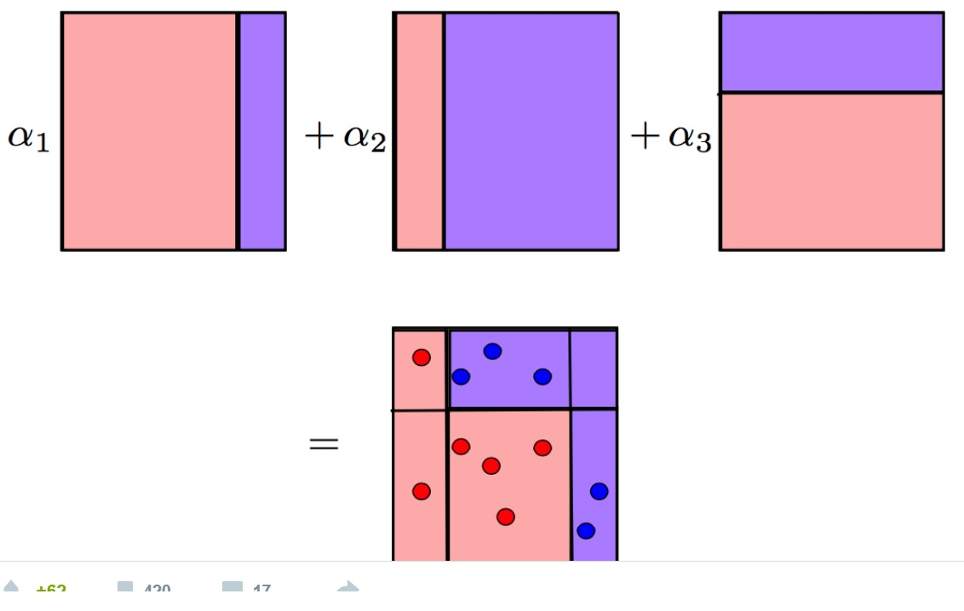
Boosting.
Many weak learners => one strong learner.
Linear combination of simple models with reweighted data.
We give more weight to errors.
Adaboost.

Slide 4
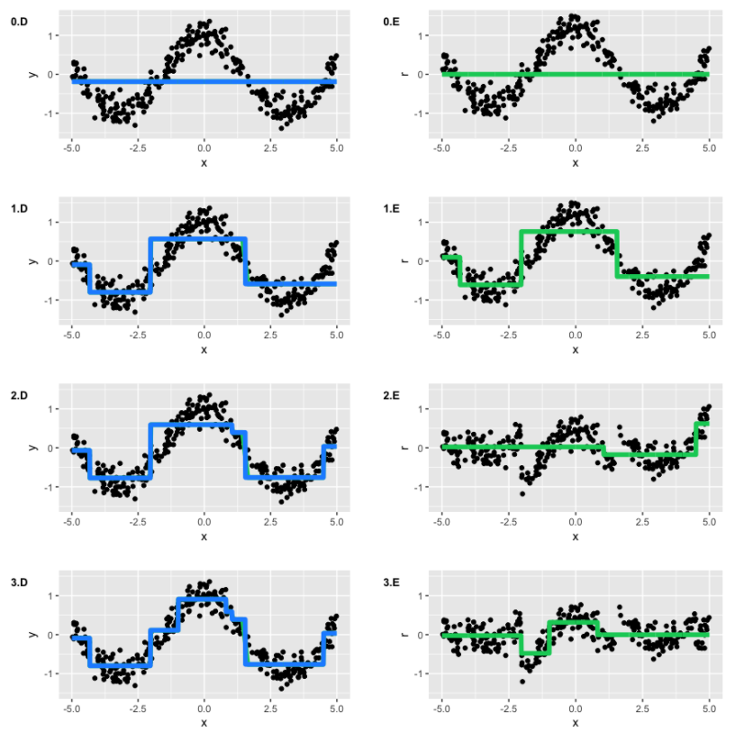
GBM
Difference is in optimization of common gradient.
Implementation on spark exists.

Slide 5
Other boosting algorithms.
Lightgbm
Xgboost
H2O

Slide 6

What to do with categorical features?
One-hot encoding.
Code via some statistics. How not to overfit?
Hold out split for feature rate calculation.

Slide 7

CatBoost ideology.
Random permutations.
P is prior (for low-frequency cases).
Feature combinations as a feature.
Number of appearances in the dataset as means of substitution.

Slide 8
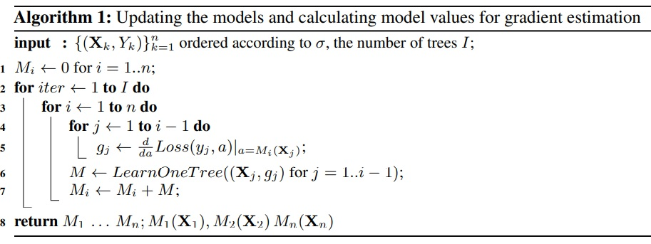
Building the next tree.
Choose new tree structure (choosing the right splits).
Setting values in leafs for the new tree.
Making gradients unbiased. For each X_k, we have a model M_k. We estimate the gradient with M_k, and score the resulting tree.

Slide 9
Usage of permutations.
Calculation of statistics.
Different models M_i for each permutation.
The do not O(sn^2), but O(sn).

Slide 10
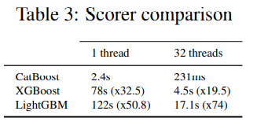
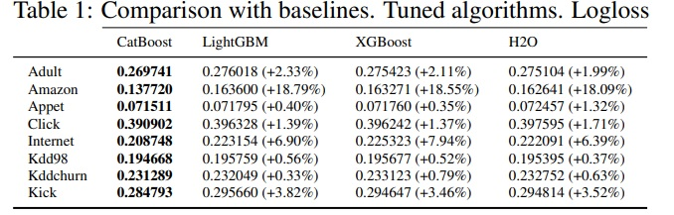
Speed improvements.
Oblivious trees.
Feature discretization.
Fast training on GPU.

Slide 11
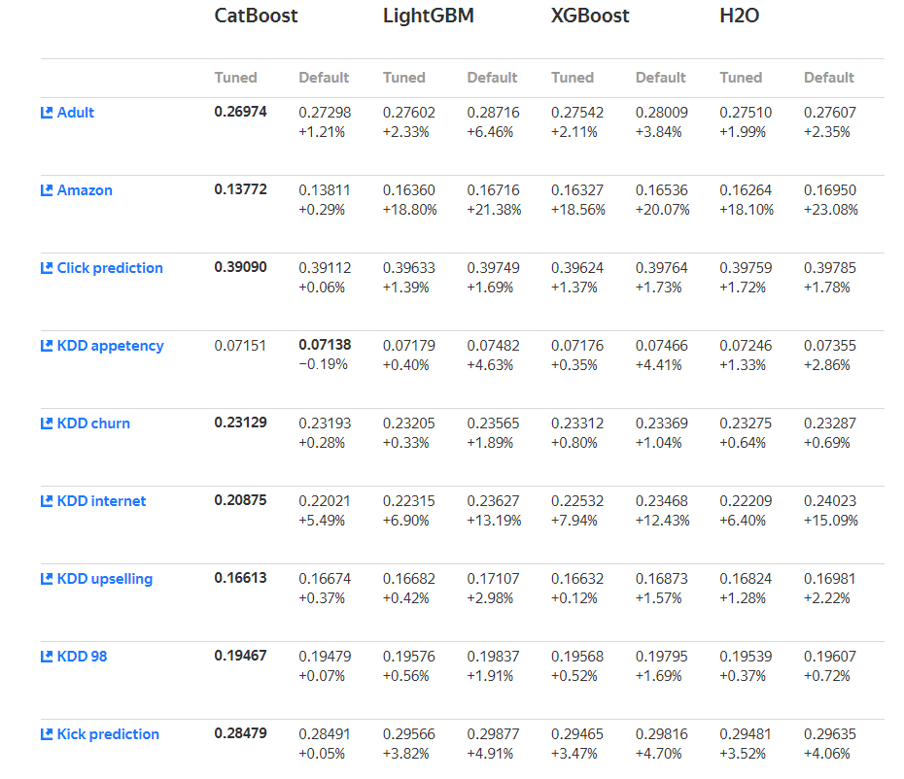
Latest comparison results.

Slide 12
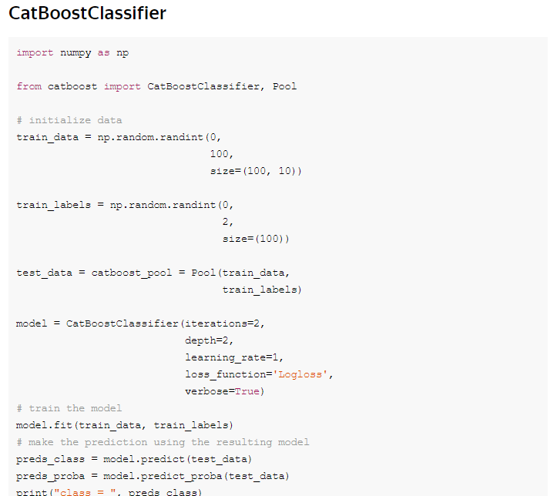
Packages.
Python catboost.
R catboost.

