Slide 1
GPT models.
Alexey Osipov

Slide 2
What is GPT?
Generative Pre-Trained Transformer.
OpenAI.
GPT, 2018.
GPT-2, 2019.
GPT-3, 2020.

Slide 3
Ways of applying the model.
Unsupervised pre-training.
Fine tuning.
Few-shot.
One-shot (Mechanical Turk).
Zero-shot.

Slide 4
Types of tasks.
Translation.
Q&A, common sense reasoning.
Story creation, paper creation.
Identifying the word.
Chat.
Arithmetics.

Slide 5

What is attention?
Hard attention.
Soft attention.

Slide 6
What is transformer?
Encoder blocks and decoder blocks.
Attention mechanism.

Slide 7
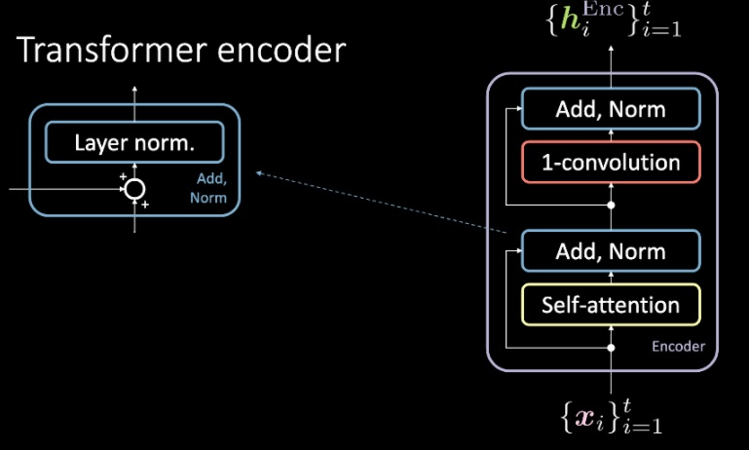
Transformer encoder.

Slide 8
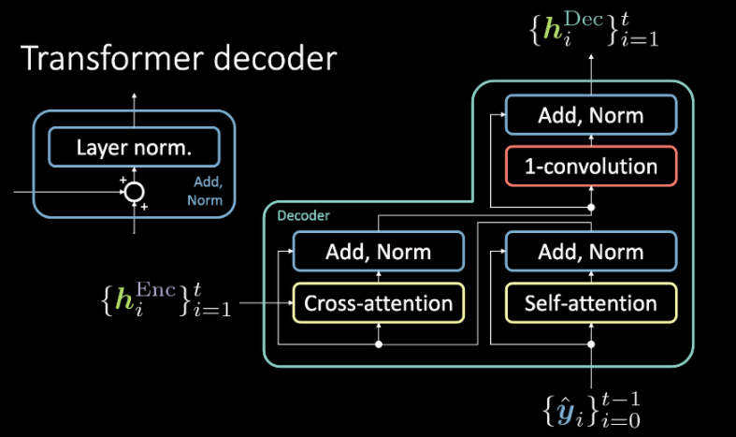
Transformer decoder.

Slide 9
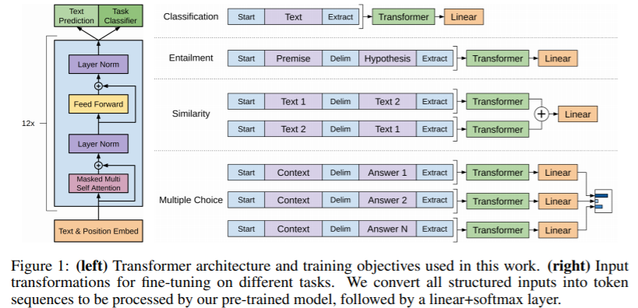
GPT architecture (only decoder).

Slide 10
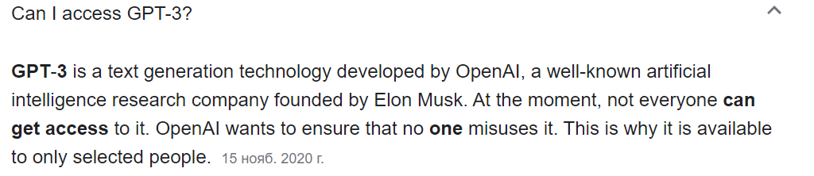
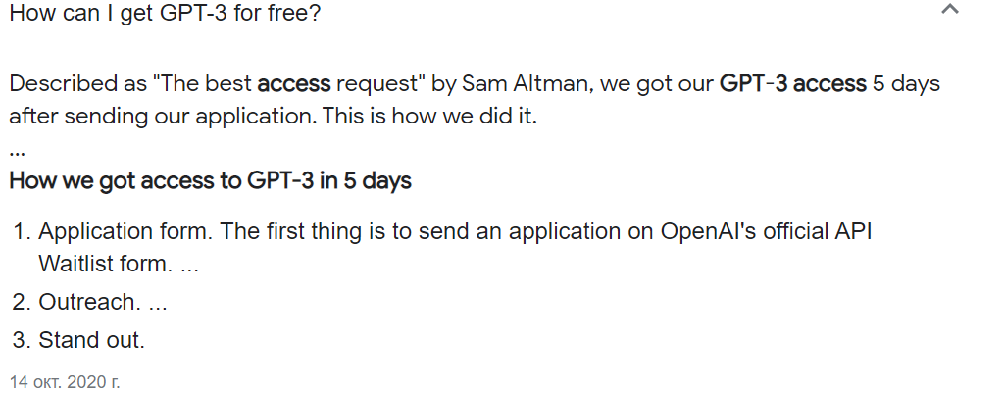
Availability.

