Slide 1
Deep Learning in Finance
Alexey Osipov

Slide 2
Stocks.
Non-stationary time series.
Usually, they have positive trend.
Usually, volatility changes with time.
Usually, they are correlated.
Stocks and commodities.
Index and futures on index.

Slide 3
Setting.
Make a trading strategy basing on Japanese stocks.
Portfolio of stocks with equal weights.
One entry point, one exit point per stock per year.
Buy & hold.
Weekly or daily data. Candles.
21 features divided into 4 groups.

Slide 4
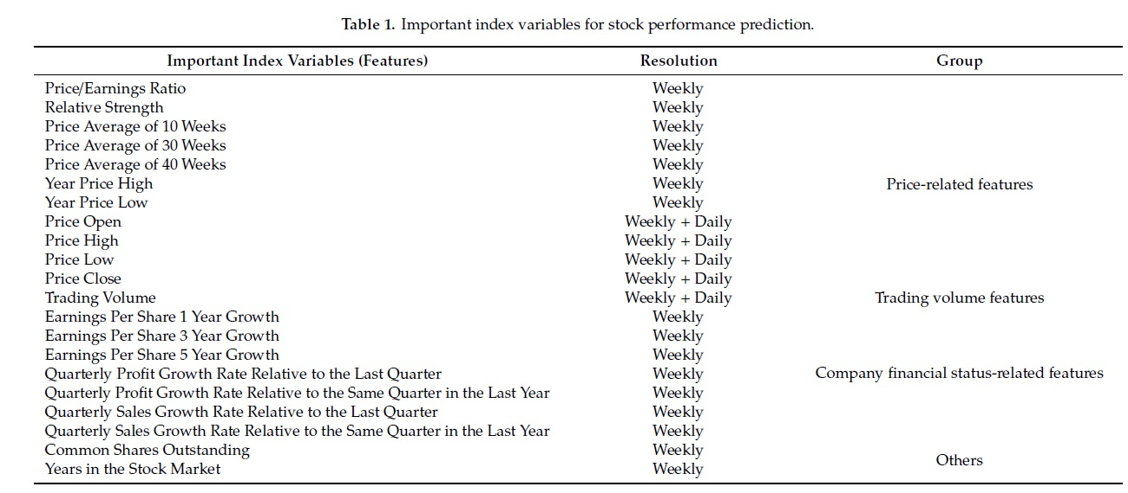
Features.

Slide 5
4 types of portfolio selection.
Constant threshold based: alpha = (highest_next_year – current)/current) >= 0.7
Ranking based. Top 10% by alpha.
Constant threshold based considering volatility. beta = alpha/std(CP_past_year/CP) >= 8
Ranking based considering volatility. Top 10% by beta.

Slide 6
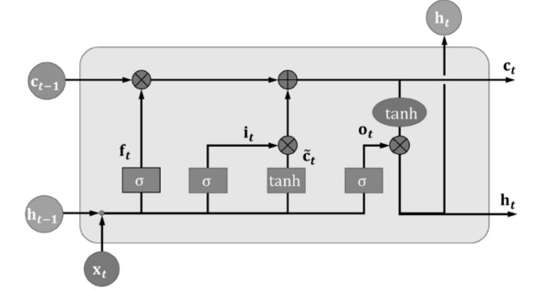
LSTM
i_t = \sigma(W_{x, i}x_t + W_{h, i}h_{t-1} + b_i) \tilde{c} = tanh(W_{x, c}x_t + W_{h, c}h_{t-1} + b_c)
f_t = \sigma(W_{x, f}x_t + W_{h, f}h_{t-1} + b_f) c_t = f_tc_{t-1} + i_t\tilde{c_t}
o_t = \sigma(W_{x, o}x_t + W_{h, o}h_{t-1} + b_{o}) h_t = o_t tanh(c_t)
Input node, input gate, cell state, candidate cell state, forgetting gate, output gate, hidden state.

Slide 7
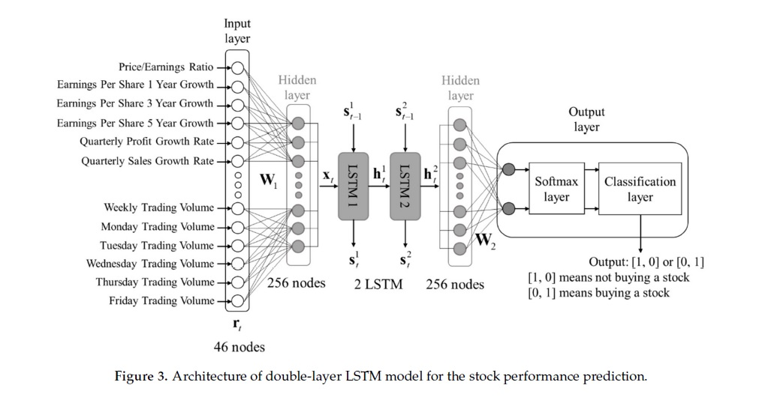
Concatenated Double-Layered LSTM.
(h^1_t, c^1_t) = LSTM1(x_t, h^1_{t-1}, c^{1}_{t-1}, W^1, b^1) (h^2_t, c^2_t) = LSTM2(h^1_{t}, h^2_{t-1}, c^{2}_{t-1}, W^2, b^2)

Slide 8
Loss functions.
Cross entropy: -\Sum T_j(\log(\sigma(P_{j, t})))^T => min
Weighted cross entropy: -\Sum T_j(W_{Loss} \log(\sigma(P_{j, t})))^T => min

Slide 9
Experiment design.
Training set, validation set, test set.
50 epochs
Argmax(Precision) on the validation set.
Evaluation via Recall (TPR), TNR, ACR, Precision.
Average max price rising/decreasing rates of stocks.

Slide 10
Strategy evaluation.
Sharp ratio.
Sharp ratio with risk-free rate.
Sortino ratio.
P&L.
By stopping rule and at the end.
Comparison with the whole market.

Slide 11
Analysis of results.
The signals are rare.
It is best to take into account volatility.
Ranking best is better than threshold based.
They claim that double layered LSTM is better than Logistic regression or SVM.
It makes sense to take into account only 2 groups of features out of 4: price and earnings.

Slide 12
Things not taken into account.
Risk free rate.
Data cleaning and outliers.
Bid & Ask vs candles.
Slippage and other commissions.
Leverage.
Gaps in history.
Liquidity of stocks.
Possible change of credit rate.

Slide 13
Critics
Too few stopping points.
Comparison with classic methods, like Markowitz.
Not only take profit, but also stop loss.
Multiple entrances?
Weights & market.
Company information in features.
GRU?
Robustness?

