Slide 1
Development triangles.
Alexey Osipov

Slide 2
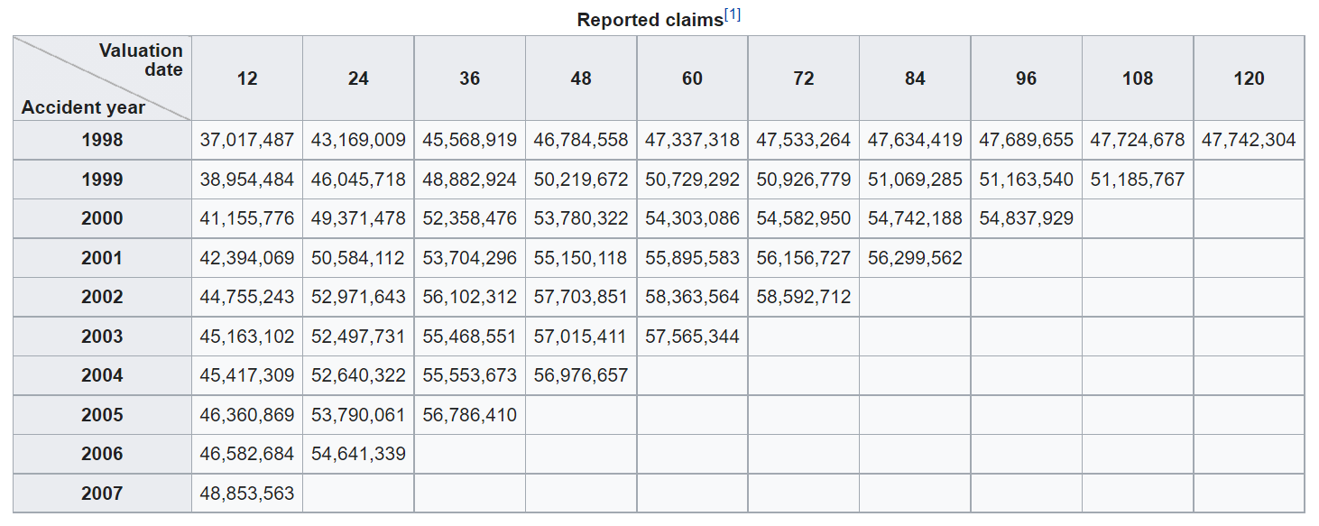
Claims.

Slide 3
Chain ladder.
Age to age factors.
Ultimate age to age factors.
Ultimate claims.
Reserves.

Slide 4
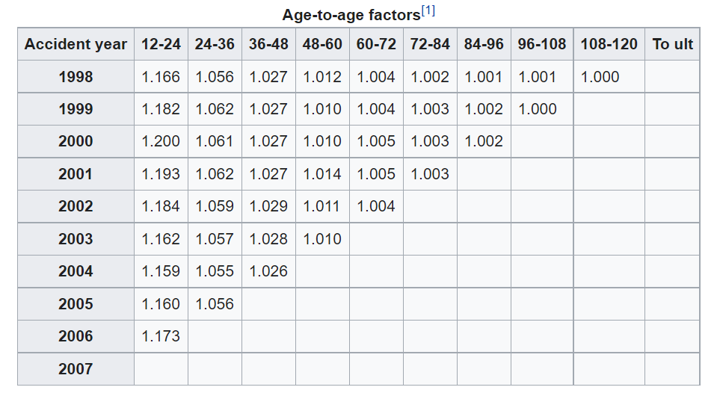
Age to age factors.

Slide 5
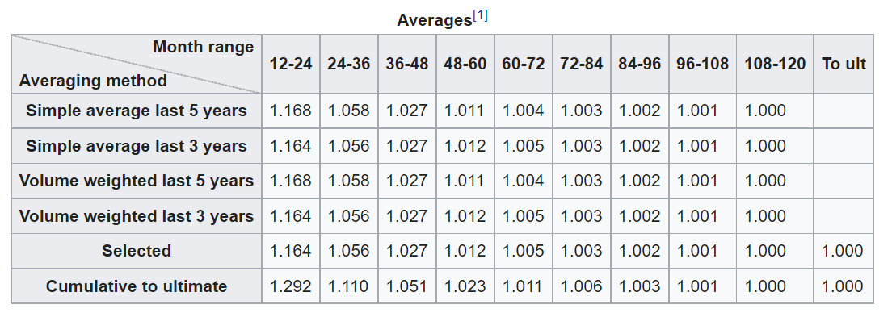
Ultimate age-to-age factors.

Slide 6
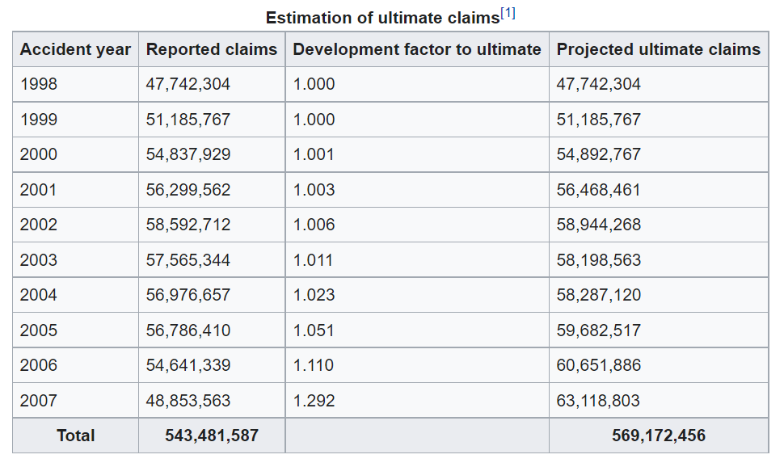
Ultimate claims.

Slide 7
Bornhuetter-Ferguson method.
BF = L + ELR * Exposure * (1-w)
BF = L * LDF * w + ELR * Exposure * (1-w)
L are losses, ELR is expected loss ratio (total losses divided by total premiums) w is estimated percent unreported LDF is loss development factor.
In the second approach losses are first developed to ultimate via chain ladder approach.

Slide 8
Standard chain ladder (chainladder)
Weights (default are one).
Delta (weighting parameter): 0, 1, 2.
Chain ladder is weighted linear regression.
No weights, custom weights, 1/x (standard), 1/x^2.

Slide 9
Bootstrap Chain Ladder (BootChainLadder)
Cumulative claims triangle.
Process distribution (Gamma or over-dispersed Poisson).
Stage 1. Ordinary Chain Ladder.
Bootstrap Pearson residuals, apply ordinary chain ladder to forecast.
Stage 2. Simulate the process error using bootstrap value as mean and the distribution assumed.

Slide 10
Mack Chain Ladder (MackChainLadder)
Cumulative claims triangle, weights, alpha.
Variability estimates (of individual age-to-age factors).
est.sigma for log-linear regression, Mack approximation.
Mack-Method (actuaries.asn.au)

Slide 11
Munich Chain Ladder (MunichChainLadder)
Cumulative paid and incurred triangles.
It is assumed that the Mack model is applicable to both.

Slide 12
MultiChainLadder & MultiChainLadder2.
Multivariate methods, several claims triangles.
Fit.method: SUR & OLS. Seemingly unrelated regressions – Wikipedia
MCL, GMCL

Slide 13
Berquist-Sherman (BS.paid.adj)
Adjusts paid claims by closed claims.
Exponential and linear regression.

Slide 14
GLM based reserving (glmReserve)
Accident year and development lags as predictors.
Analytical and bootstrap methods for error estimation.
Tweedie distributions (var.power, link.power).
cplm

Slide 15
tweedieReserve.
Loss reserving model, GLM.
Var.power, link.power.

