Slide 1
Impressions on User2021.
Alexey Osipov

Slide 2
R spatial.
maps
spatstat
spdep
maptools
GIStools
The Best Spatial Analysis Packages to Use in R | by Nick Sokol, PhD | Jun, 2021 | Towards Data Science
sp, rgdal, rgeos, raster, sf, starts, terra
Top 10 World Map Projections – The Future Mapping Company (futuremaps.com)

Slide 3
R packages & dependencies.
RcppDeepState RcppDeepState | R-bloggers
riskmetric riskmetric.pdf (r-project.org)
poorman
openmetrics openmetrics.pdf (r-project.org)

Slide 4
R & Big Data
Apache Arrow Integration to Apache Arrow • Arrow R Package
kafkaesque GitHub - petermeissner/kafkaesque: R package that allows to access Kafka

Slide 5
Algorithm fairness & related topics.
Algorithm fairness: detect unfair.
Algorithm fairness: make fair.
DALEX CRAN - Package DALEX (r-project.org)
fairmodels fairmodels: Flexible Tool for Bias Detection, Visualization, and Mitigation (r-project.org)
Paper of Achim Zeileis on EURO-2021 prediction.

Slide 6
Unheard talks.
httrex gergness/httrex: Create code examples that include http requests version 0.0.0.9000 from GitHub (rdrr.io)
modelStudio CRAN - Package modelStudio (r-project.org)
arenar CRAN - Package arenar (r-project.org)

Slide 7
Unheard talks on R packages
autotest autotest in R — autotest 0.1 documentation (autotest-docs.readthedocs.io)
tinytest CRAN - Package tinytest (r-project.org) loo.pdf (r-project.org)
fusen Build a Package from Rmarkdown File • fusen (thinkr-open.github.io)

Slide 8
ML related packages
mlr3automl GitHub - a-hanf/mlr3automl: Automated machine learning in mlr3
triplot CRAN - Package triplot (r-project.org)
R packages for efficiency analysis trees EAT: Efficiency Analysis Trees (r-project.org)

Slide 9
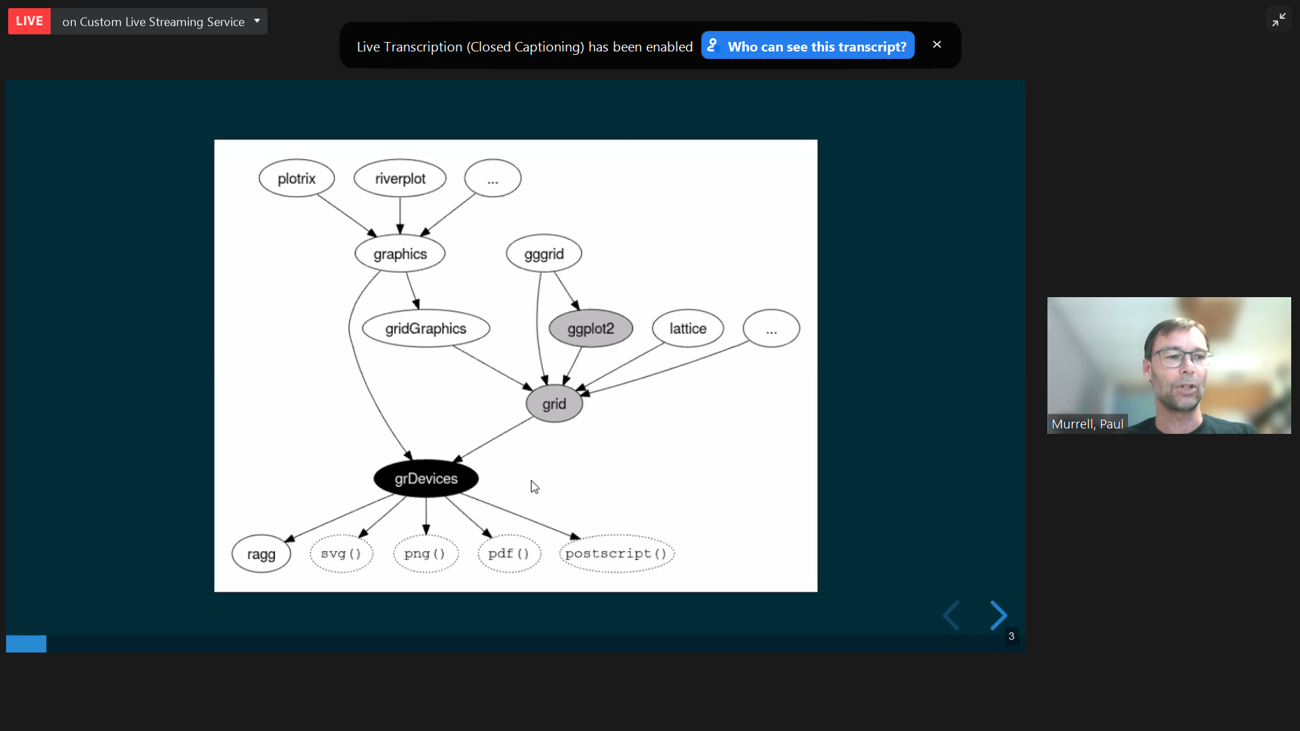

Slide 10
Mixed Integer Optimization
miesmuchel
GitHub - mlr-org/miesmuschel: Flexible Mixed Integer Evolutionary Strategies
EVCO_a_00059-Li_HR (silverchair.com)

Slide 11
Mathematical & statistical models.
diseq The R Package diseq: Estimation Methods for Markets in Equilibrium and Disequilibrium (r-project.org)
maars GitHub - shamindras/maars
dobin Introduction to dobin (r-project.org) dobin.pdf (r-project.org)
lookout lookout.pdf (r-project.org)

Slide 12
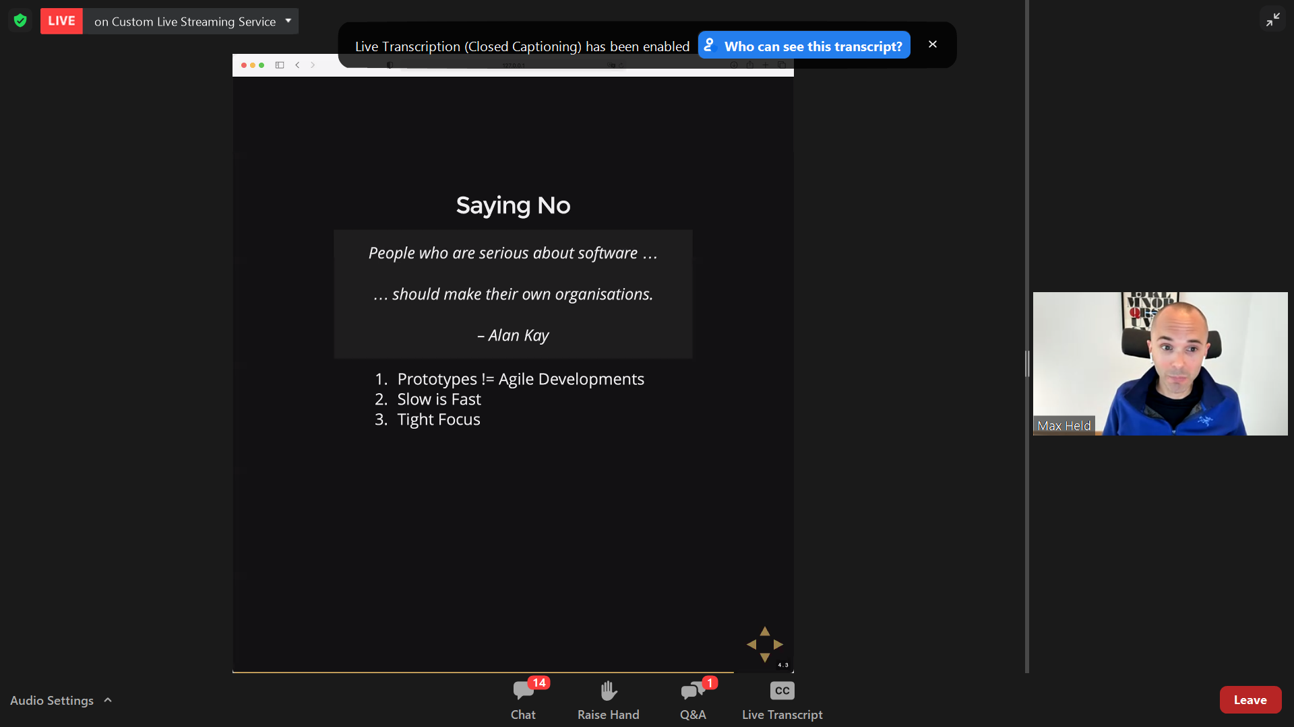

Slide 13
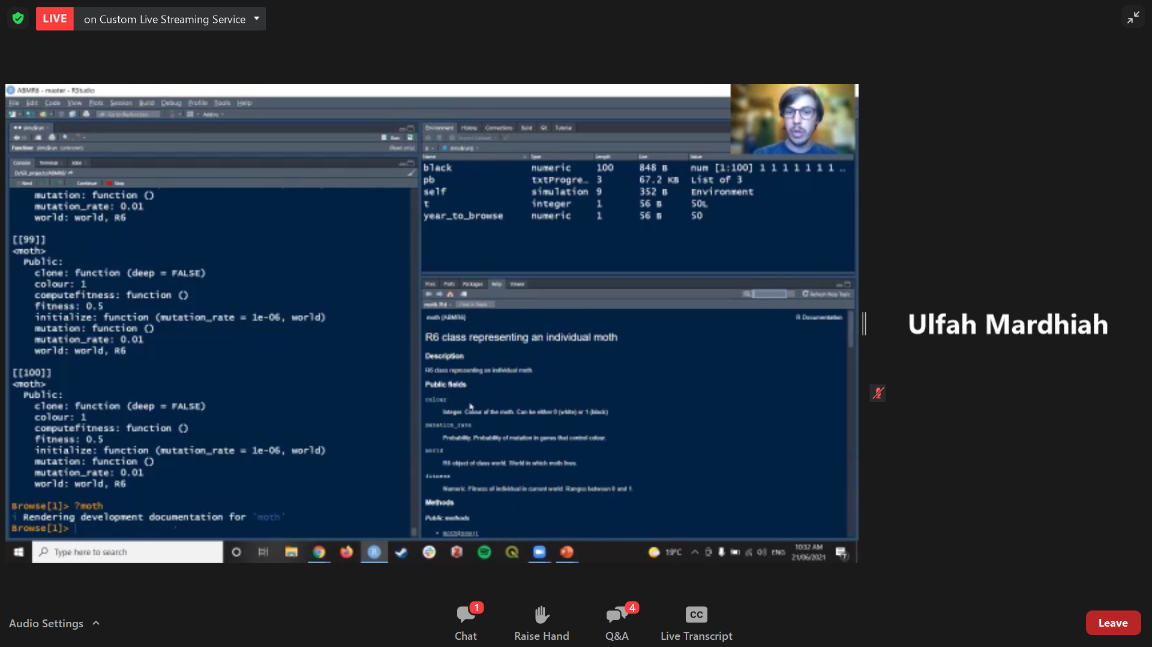

Slide 14
Shiny PoC to Production Application in 8 steps
renv, docker Introduction to renv • renv (rstudio.github.io)
ymls, styler styler 1.0.0 (tidyverse.org)
R6, plumber
data.validator, drake GitHub - Appsilon/data.validator: validate your data and create nice reports straight from R The drake R Package User Manual (ropensci.org)
testthat, cypress, shinytest Test Shiny Apps • shinytest (rstudio.github.io)
css/js
saas/bslib CRAN - Package bslib (r-project.org)
shiny.fluent Microsoft Fluent UI for Shiny Apps • shiny.fluent (appsilon.github.io)

Slide 15
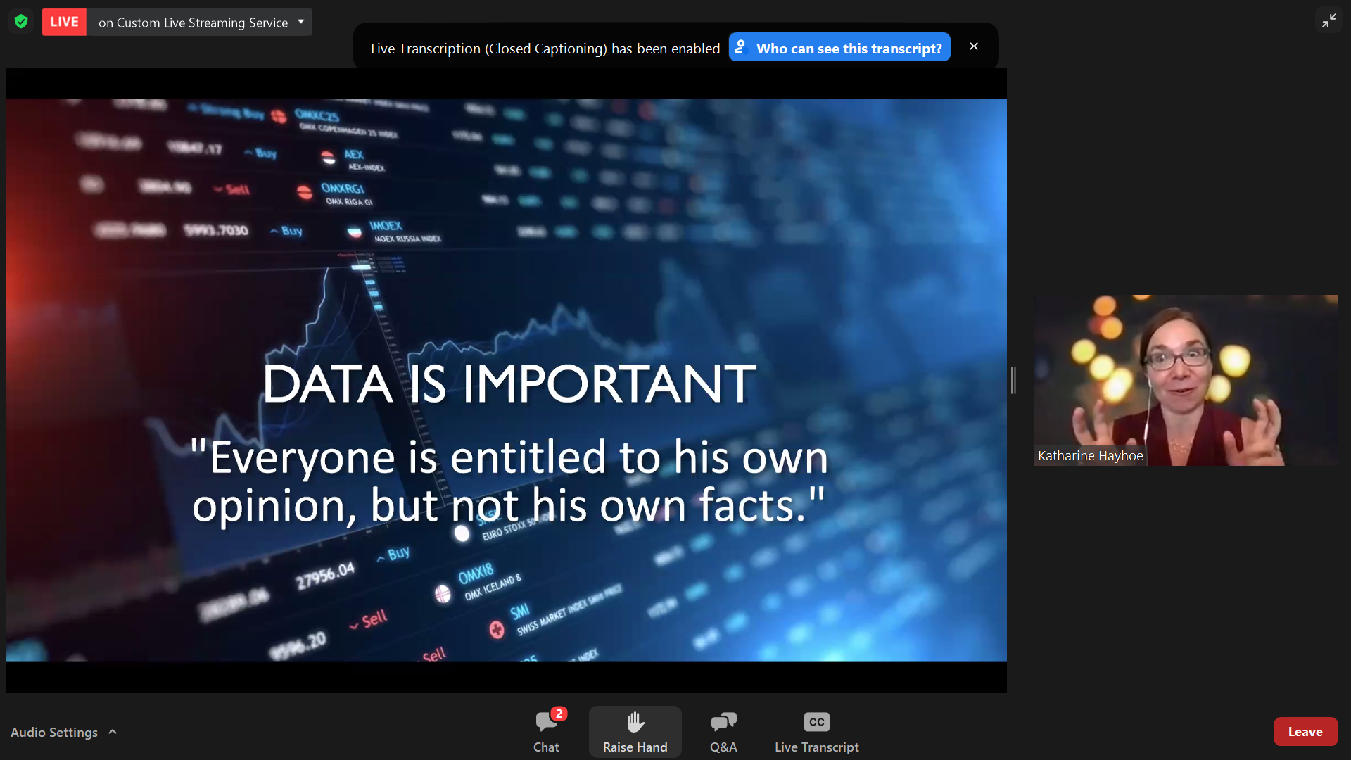
Making presentations on R.

Slide 16
