Slide 1
Associative dictionaries in R.
Alexey Osipov.

Slide 2
What is an associative dictionary?
{"Pride and Prejudice": "Alice", "Wuthering Heights": "Alice", "Great Expectations": "John"}
Hash table implementations (O(1), O(n))
Tree based implementations (O(log n))

Slide 3
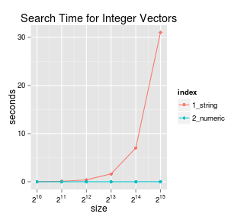
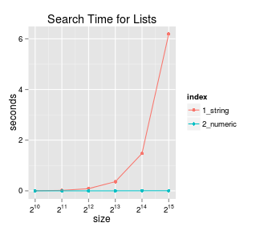
Inefficient implementations of hash table.
Vector based.
List based.

Slide 4
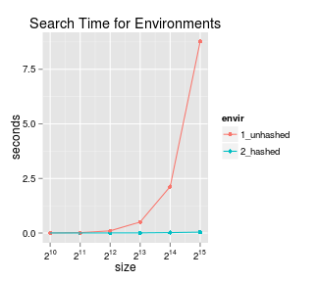
Environment based.
myenv <- new.env() myenv$a <- ‘val’
hash=TRUE
pass by reference

Slide 5
Package Dict.
R6 classes.
Dict

Slide 6
Package hash.
S4 classes.
hash
Considered to be faster than Dict.

Slide 7
Package r2r
S3 classes
hashmap
arbitrary keys and values.
Slower than hash, but more flexible.

Slide 8
Package data.tree
Introduction to data.tree (r-project.org)
R6 classes
Formally binary search trees are not present there.

Slide 9
Binary search trees in R.
GitHub - tarakc02/rbst: Persistent balanced binary search trees in R
rbst

