Slide 1
SparkR vs sparklyr.
Alexey Osipov.

Slide 2
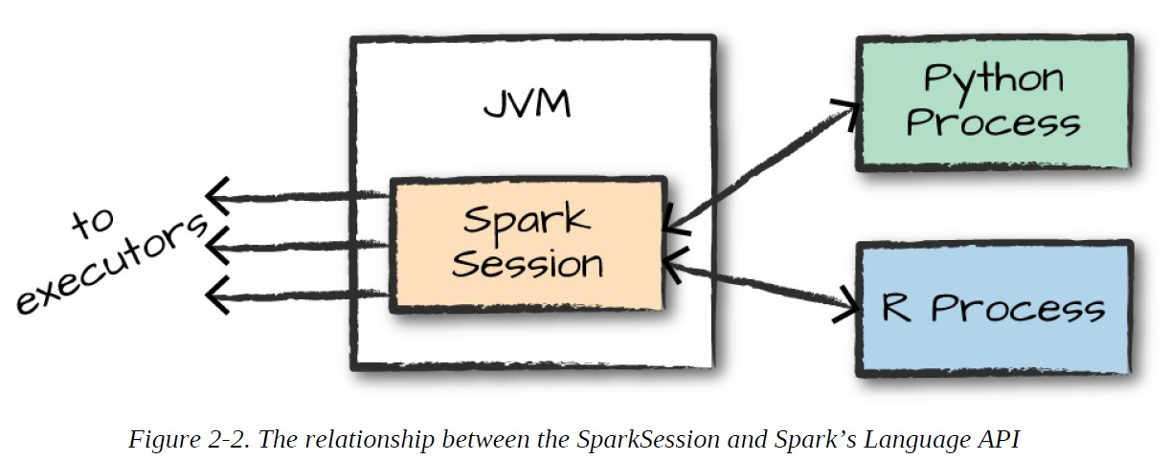
Things in common.
Provide R interface for work with Spark.
Do not support RDDs (SparkR has some classes for it).
Support MLlib.

Slide 3
Main differences.
Criteria | SparkR | sparklyr
CRAN | Was on CRAN. | Is on CRAN.
Maintainer. | Spark team. | R studio team.
Style. | Fits well with Spark. | Fits well with R packages.
Integration with other packages. | Masks a lot of functions from other packages. | Consistent with other packages.
UDFs. | Several types. | One UDF.
Class system. | S4 | S3
Extensions | No known. | About a dozen.
Key config concepts. | sparkSession | spark_connect
Same model can be used in different modes. | No. | Yes, in extensions.
Support of pipelines. | No. | Yes.

