Slide 1

Gradient conjugate priors.
Alexey Osipov.

Slide 2
Motivation.
Bridge between neural networks and dynamical systems.
People from FU Berlin I worked with.
Applications of math that I know.

Slide 3
Basics.
Example with a biased coin.
What is prior?
What is posterior?
What does conjugate mean?

Slide 4

Normal gamma model.
X condition on T is N(\mu, 1/(\nu * T) ), where \tau = \nu * T.
T is Gamma(\alpha, \beta).
(X, T) is NormalGamma(\mu, \nu, \alpha, \beta)

Slide 5
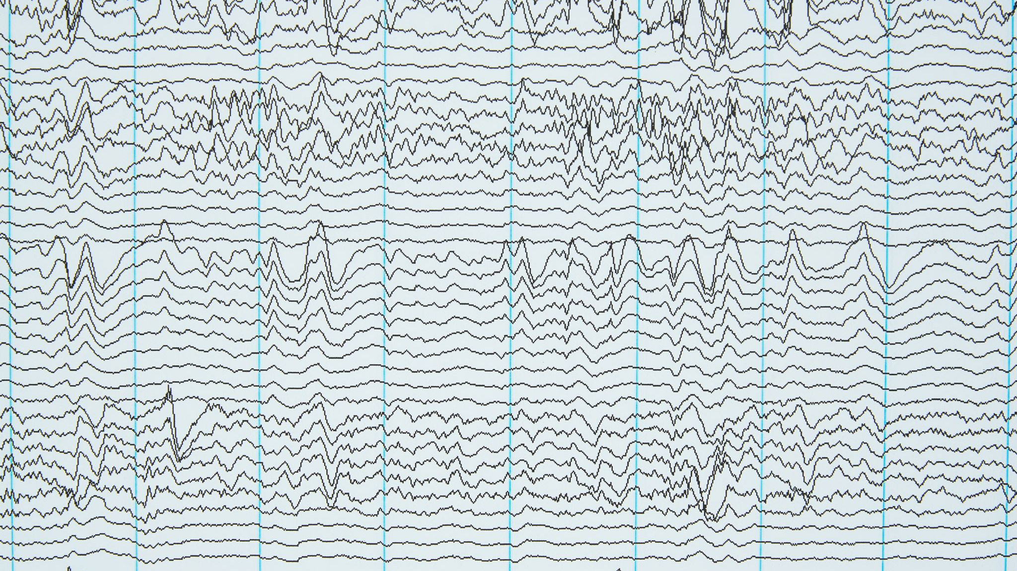
Bayesian learning of neural networks.
Reconstruct probability distributions via NNs.
Weights as normally distributed variables.
Prior distribution is prescribed, posterior distribution is found condition on the data.
The distributions are approximated.
Epistemic (lack of data) and aleatoric (noise in data) uncertainty.

Slide 6
GCP approach.
Learn q(y|x) using neural networks (target condition on data).
Assume q(y) is normally distributed with unknown parameters.
Neural networks are used to learn the four parameters of the normal-gamma model.
The weights of the neural networks are deterministic.
The predictive distribution is a Student distribution (parameters are explicitly determined by the outputs of the neural networks).

Slide 7
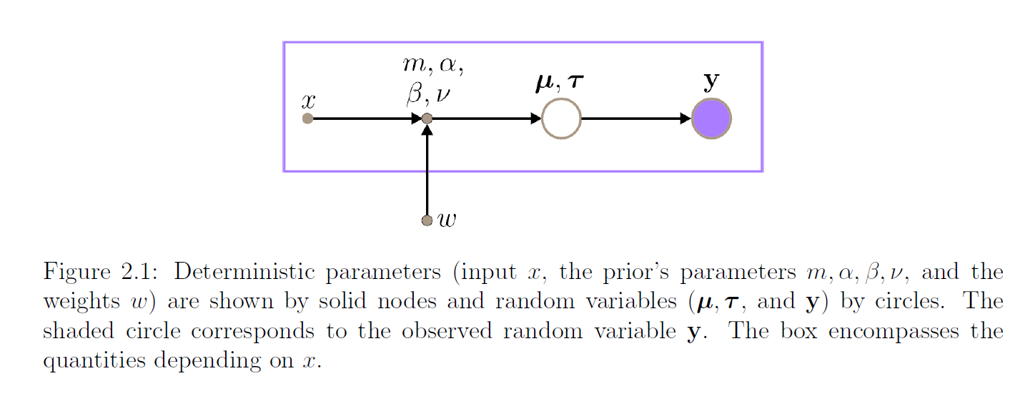
General scheme.

Slide 8
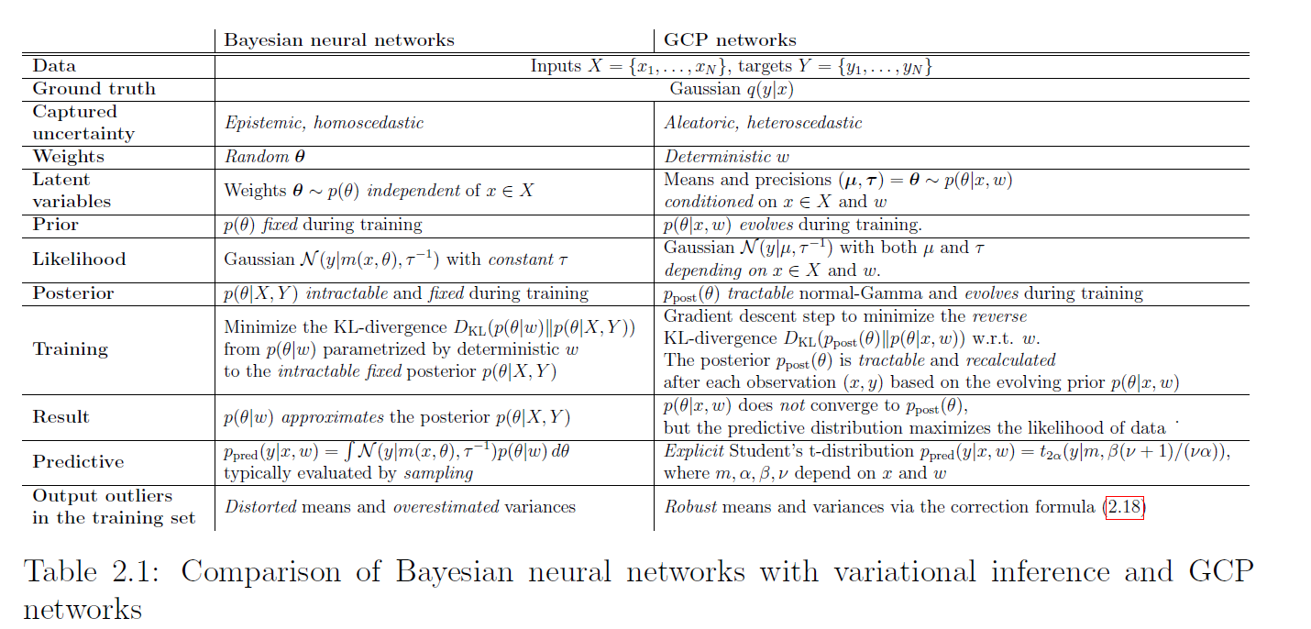
Comparison of 2 approaches.

Slide 9
CP & GCP update.
Observation => the posterior distribution for the mean and the variance (the normal-gamma model).
We update not distribution parameters, but weights of the neural networks.
The KL-divergence from prior to posterior is minimized, we make a gradient descent step.
Observation => GCP update.
GCP update => dynamical system.

Slide 10
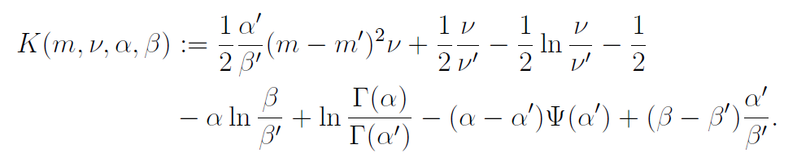

Conjugate prior update.

Slide 11
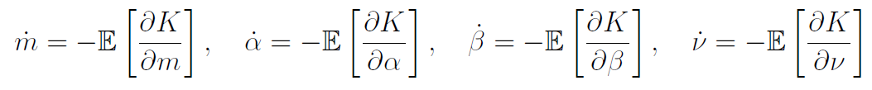
Gradient conjugate prior update.
The approximating dynamical systems:

Slide 12
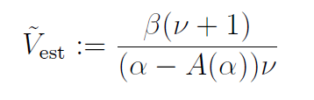
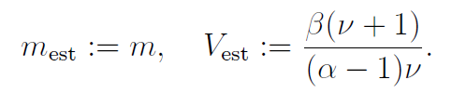
Practical approach.
The parameters of the prior are approximated by 4 NNs.
The NNs are trained by the GCP update until the convergence.
The Student distribution, mean and variance:
The variance correction.

Slide 13
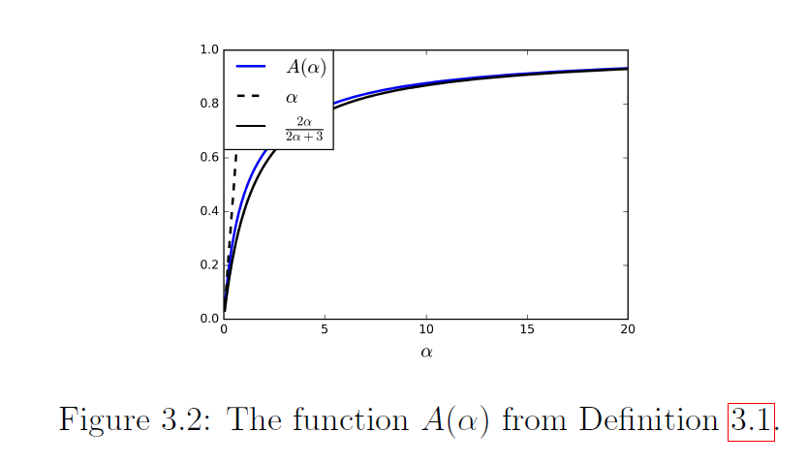
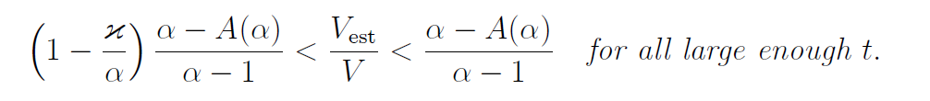
Properties of the dynamical system.
The equation for \mu has a unique equilibrium, which is stable.
For the case of variance there is an absorbing set.

Slide 14

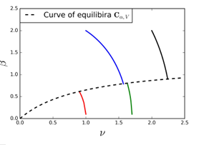

Adjustment for the variance.
\alpha is fixed, dynamics of m, \beta, \nu.
The system has a globally attracting curve of equilibria.

Slide 15
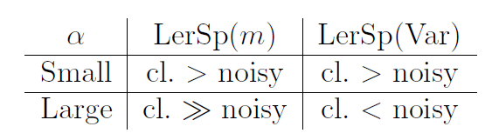
Role of fixed \alpha.
Sensitivity to outliers (robustness).
Learning speed in clean and noisy regions.

Slide 16
Methods used in experiments.
GCP method (with and without of the correction formula).
The Max Likelihood method.
The Density Power Divergence method.
The Bayesian Max Likelihood method.
Stein variational gradient descent.
The Probabilistic Back Propagation.
GCP, ML, DPD --- aleatoric heteroscedastic. SVGD, PBP --- aleatoric homoscedastic and epistemic heteroscedastic. ML_Bayes --- aleatoric and epistemic heteroscedastic

Slide 17
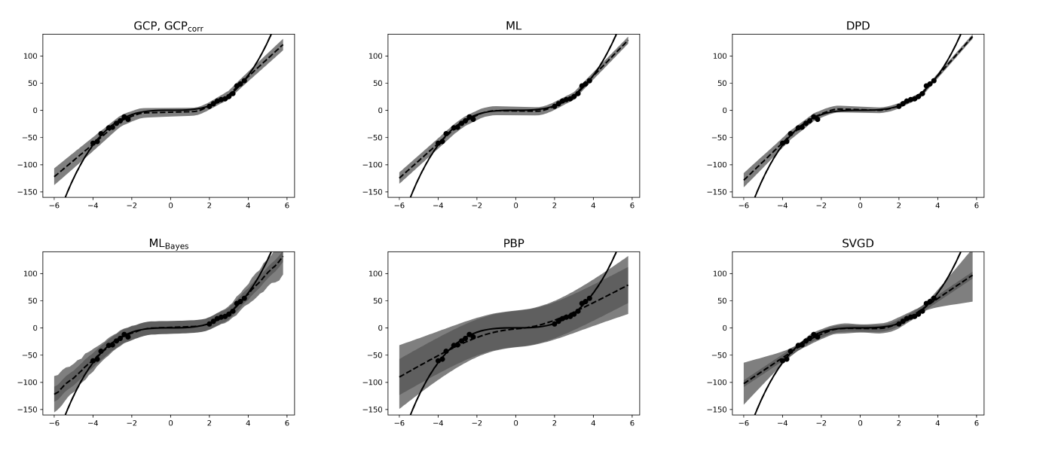
Experiments on synthetic datasets.
NNs with 1 hidden layer, 100 hidden units.

Slide 18
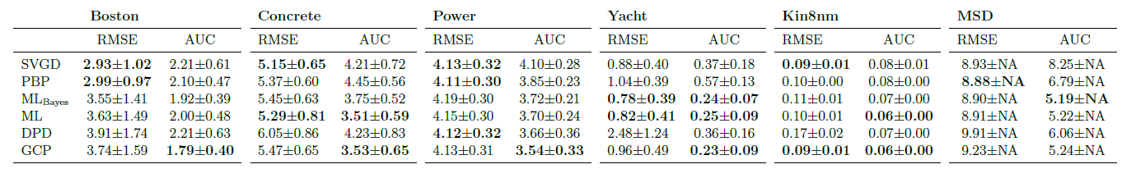
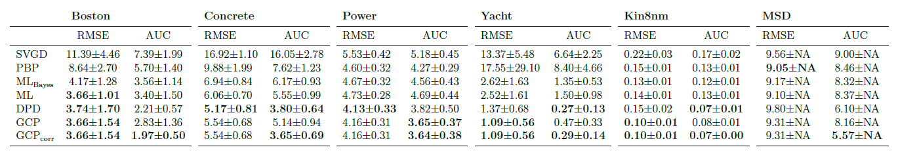
Experiments on real world datasets.
NNs with 1 hidden layer, 50-100 hidden units, dropout, relu.
They could have used any architecture of NNs.
With outliers:

