Slide 1
Outlier detection in R.
Alexey Osipov

Slide 2
What is an outlier?
Observation that is distant from the other observations.
Extreme values and mistakes.
Often, they are removed, or imputed, or treated differently.
Weak (noise) and strong (anomalies) outliers.
What is normal? We need a data model.

Slide 3
Using descriptive statistics.
summary(ggplot2::mpg$hwy)
hist(ggplot2::mpg$hwy, breaks = sqrt(nrow(ggplot2::mpg)))
ggplot(mpg) + aes(x=hwy) + geom_histogram()
boxplot
ggplot(mpg) + aes(x="", y=hwy) + geom_boxplot()
boxplot.stats(mpg$hwy)$out

Slide 4
Common definitions of outliers.
The suspects are outside of this interval:
The suspects are less than q_{0.025} or more than q_{0.975}
Z-score is high.

Slide 5

Hampel filter.
args(mad)
function (x, center = median(x), constant = 1.4826, na.rm = FALSE,
low = FALSE, high = FALSE)

Slide 6
Statistical tests (for normally distributed data)
Grubbs’s test.
Dixon’s test.
Rosner’s test.

Slide 7
Grubbs’s test.
H0: the highest (the lowest) value is NOT an outlier.
n>6.
outliers::grubbs.test
Values of type (10, 11, 20).
The test is based on calculation of the outlier score. Alternative is to calculate ratio of variances (with and without).
qgrubbs, pgrubbs are used to obtain critical values.

Slide 8
Dixon’s test.
H0: the highest (the lowest) value is NOT an outlier.
Sample size must be in range 3-30.
outliers::dixon.test
Values of type (0, 10, 11, 12, 20, 21).
sort
Q = (x[3] - x[1])/(x[n - 2] - x[1])
pdixon, qdixon are used to get critical values.

Slide 9



Rosner’s test.
It is used to detect several outliers at once.
It is recommended to be used for n>=20.
Max number of possible outliers is given.
Natural statistics without of some of them are calculated.

Slide 10
Multivariate outliers.
mvoutlier::aq.plot(as.matrix(mpg[, c("cyl", "hwy")]))
mvoutlier: Multivariate Outlier Detection Based on Robust Methods (r-project.org)
Mahalanobis distance - Wikipedia

Slide 11
LOF based techniques.
Calculate LOF (local outlier factor).
Works only for numeric data.
Use KNNs to calculate distances.
How to choose right k?
DescTools::LOF(mpg[, c("cyl", "hwy")], 5)
dbscan::lof(mpg[, c("cyl", "hwy")])
DDoutlier::LOF(mpg[, c("cyl", "hwy")])
Rlof::lof(mpg[, c("cyl", "hwy")], 5)

Slide 12
LOCI based techniques.
Calculate LOCI (Local Correlation Integral).
DDoutlier.pdf (r-project.org)
SMLoutliers::LOCI(mpg[, c("cyl", "hwy")], 0.5)
DDoutlier::LOCI(mpg[, c("cyl", "hwy")])

Slide 13
Cluster based approach.
Take any cluster algorithm.
Outliers are any clusters that have small size.

Slide 14
Projection approach.
Project into the 2-dimensional space (PCA, Sammon’s mapping, SOM, T-SNE).
Mark outliers basing on the picture.

Slide 15
Model based approach.
Make a model (lm or glm)
Use car::outlierTest (Bonferroni Outlier Test).

Slide 16
Supervised ML approach.
Make a labelled dataset: normal and abnormal.
Naturally, it will be imbalanced.
Apply suitable supervised ML algorithms.

Slide 17
Isolation trees.
isotree:isolation.forest
Random splits, outliers are easy to be isolated.
Anomaly score is calculated.
solitude::isolationForest
Isolation forest - Wikipedia

Slide 18
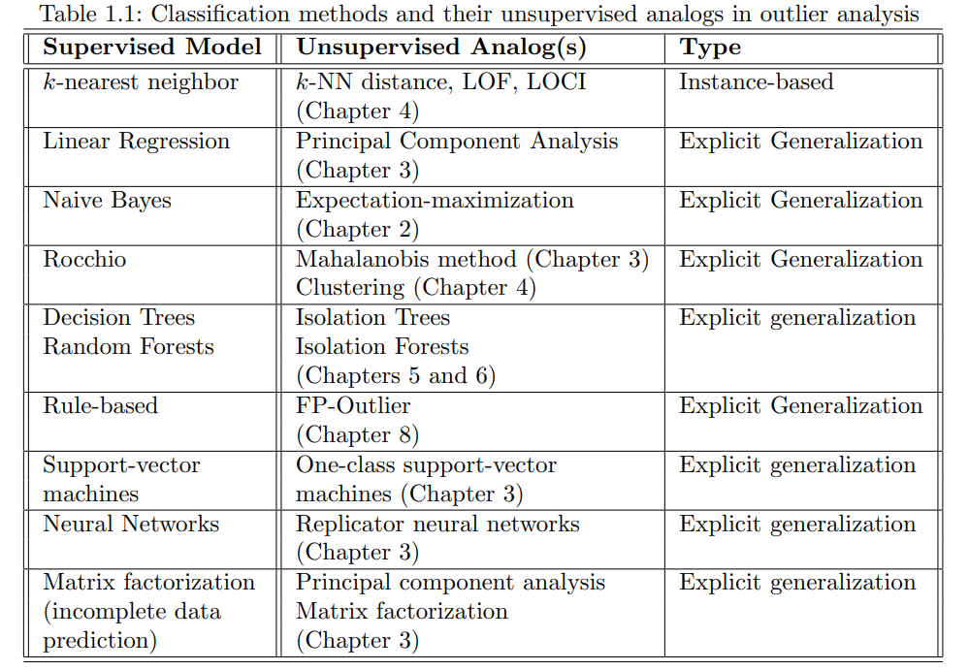
Comparison table.

Slide 19
Book of Aggarwal.
Outlier Analysis, bookmain.dvi (charuaggarwal.net)

Slide 20
Applications.
Fraud detection.
Backtesting.
Algorithmic trading.
Medicine.
Betting.
Insurance.

