Slide 1
Semi-supervised learning.
Alexey Osipov.

Slide 2
Types of problems.
Supervised learning.
Unsupervised learning.
Semi-supervised learning.
Reinforcement learning.
Active learning.

Slide 3
When to go semi-supervised?
It is difficult to get labelled data.
It is easy to get unlabeled data.
Unlabeled dataset is much larger than the labeled one.

Slide 4
Assumptions of semi-supervised learning.
It works when the unlabeled data is meaningful for the classification problem.
Smoothness assumption.
Cluster assumption.
Low density separation.

Slide 5
The LED use case.
2 datasets of events (date, location, description, scenario as features).
Crossproduct => distances between features.
Predict if the event is the same or not.
We have some labelled dataset.
Problem: crossproduct is very large, it is highly imbalanced.

Slide 6
The use case from rumors (2017-2018).
Bitcoin clustering.
Small start-up.
They implemented a custom algorithm based on an unsupervised clustering.

Slide 7
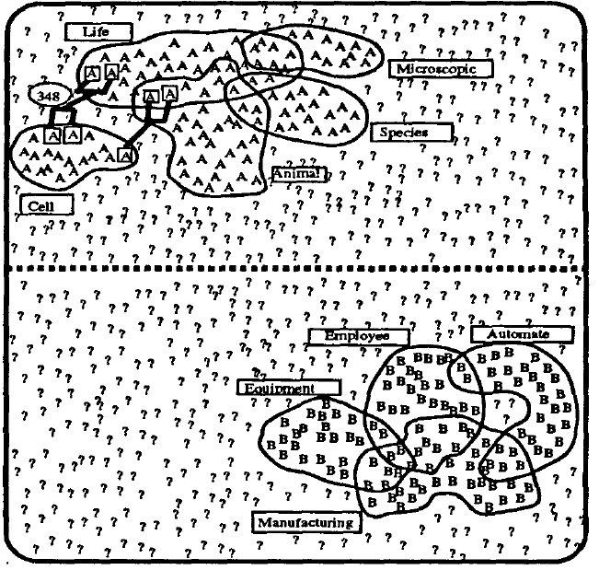
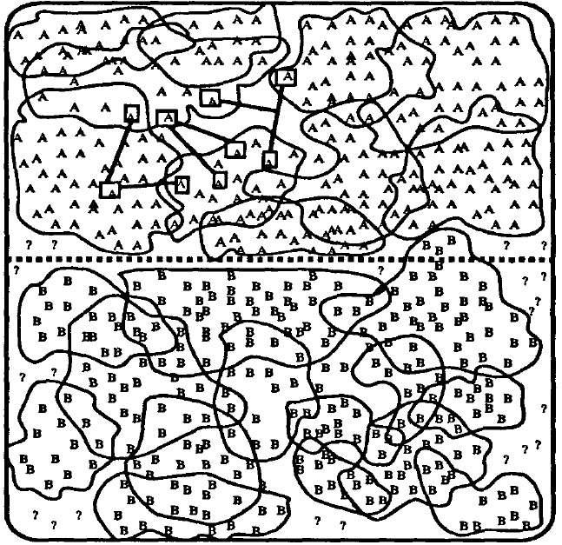
Algorithm of Yarowsky (SelfTrainingClassifier)
Unsupervised word sense disambiguation rivaling supervised methods.
Can be applied to any supervised algorithm.

Slide 8
Book on semi-supervised learning.
524 pages, 2006.
Graph-based methods.
LabelPropagation.
LabelSpreading.

Slide 9
Combination.
Use semi-supervised to produce labels for a moderate part of the dataset.
Use supervised learning afterwards.
The cross-product split should be done in a good way.

Slide 10
Better resolution of LED use case.
Entity resolution – linking problem.
1) reduce dimension of the problem (filter out the bad cases), CAN BE DONE BETTER
2) try to link, DONE
3) cluster results, NOT DONE

