Slide 1
Test task on regression

Slide 2
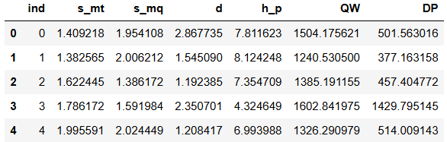
Goal
We are given a dataset with 500 rows and structure that can be seen on the picture to the right.
We would like to predict columns QW and DP using columns s_mt, s_mq, d, and h_p.
Column ind is just an index column, it will be deleted.
We need to use coefficient of determination as a quality metric. We also need to assess influence of sample size on the model quality.

Slide 3
EDA for features
We see that the features take all the values from the range in which we would like to build the model.
It means that we can safely using gradient boosting.
Basically the features do not depend on each other.

Slide 4
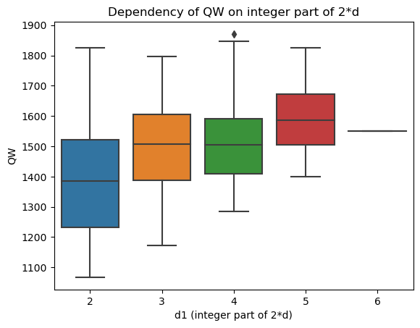
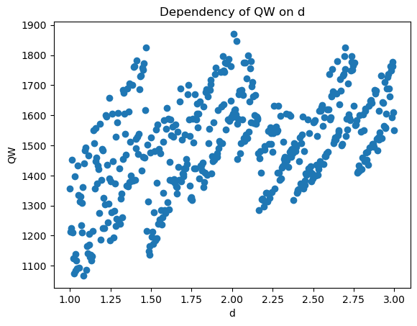
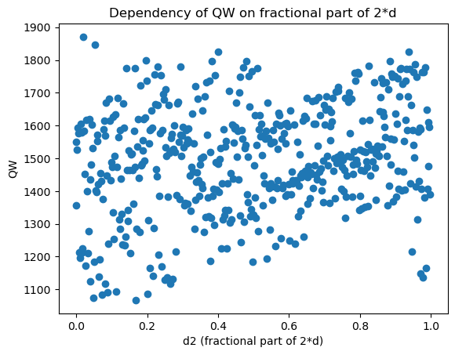
Dependency of QW on d
We see that dependency of DW on d is rather complicated. If we split d on integer part of 2*d and something like a fractional remainder, we will see that both of them are relevant.

Slide 5
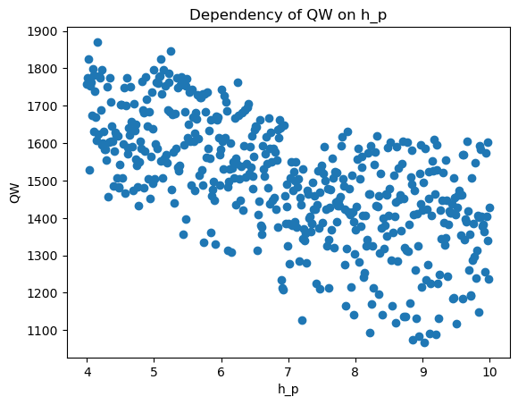
Dependency of QW on h_p
We see a linear dependency between QW and h_p.
Columns s_mt and s_mq seem not to have any reasonable impact on QW.

Slide 6
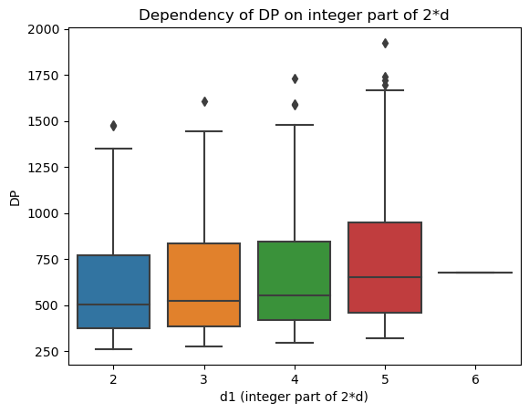
Dependency of DP on d
As before we split d on the integer part of 2*d and something like a fractional remainder.
This tome we have a reasonable dependency only for the integer part.

Slide 7
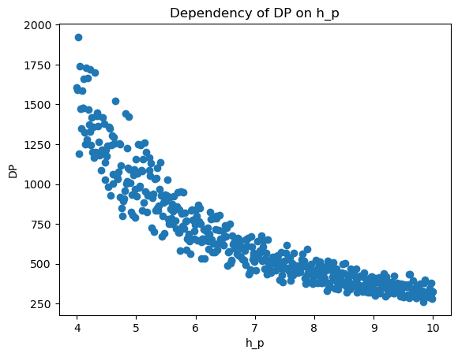
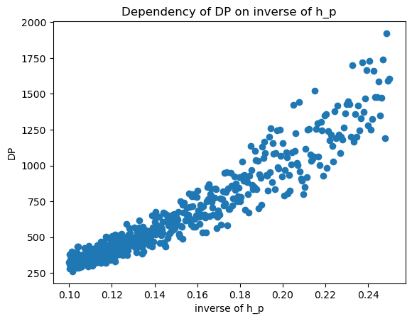
Dependency of QW on h_p
We see a linear dependency between DP and inverse of h_p.
Columns s_mt and s_mq seem not to have any reasonable impact on DP.

Slide 8
Conclusions of EDA

Slide 9
Interpretable model for QW
We are using a hold-out test set (size 20%), and we are splitting the rest into training and validation sets (80% and 20%).
We consider a ridge regression model with features d1, d2, h_p. We are applying standard scaling to this features basing on the train set.
We are using the validation set to choose alpha for ridge regression.
It turns out that the model has poor quality: the coefficient of determination is about 38%.
That is why it makes sense to consider a non-interpretable model.

Slide 10
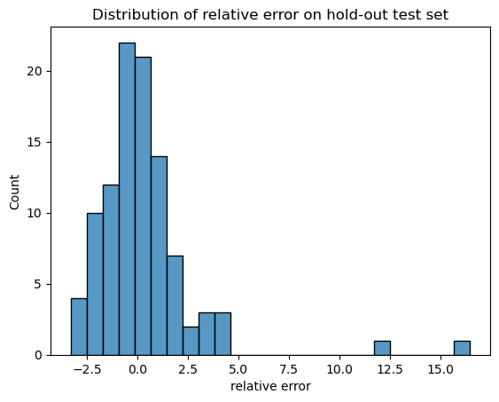
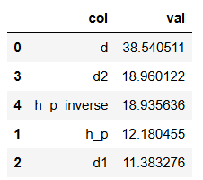
Non-interpretable model for QW
We are using a hold-out test set (size 20%), and we are splitting the rest into train an validation sets (80% and 20%).
We start from adding a random feature based on the uniform distribution. After training catboost on the training set we see that s_mt and s_mq have quality comparable with the random feature. That is why we do not include them into the model.
We use the validation set to choose the number of trees for catboost.
The model has a good quality in terms of r^2 (99.91% on train, 96.36% on validation, 92.89 on test).
We see that the most influential features are d and d2, and that the distribution of relative errors is pretty fine.

Slide 11
Interpretable model for DP
We are using a hold-out test set (size 20%), and we are splitting the rest into training and validation sets (80% and 20%).
We consider a ridge regression model with features d1 and h_p_inverse. We are applying standard scaling to this features basing on the train set.
We are using the validation set to choose alpha for ridge regression.
It turns out that the model has good quality: the coefficient of determination is about 90.94% on the validation set.
However let us consider a non-interpretable model.

Slide 12
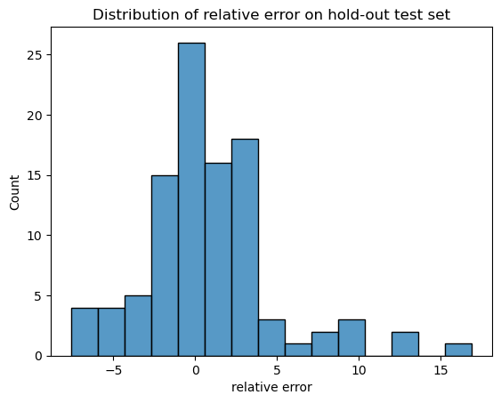
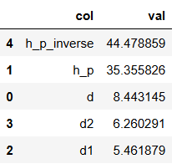
Non-interpretable model for DP
We are using a hold-out test set (size 20%), and we are splitting the rest into train an validation sets (80% and 20%).
We start from adding a random feature based on the uniform distribution. After training catboost on the training set we see that s_mt and s_mq have quality comparable with the random feature. That is why we do not include them into the model.
We use the validation set to choose the number of trees for catboost.
The model has a good quality in terms of r^2 (99.99% on train, 98.57% on validation, 98.82 on test).
We see that the most influential features are h_p_inverse and h_p, and that the distribution of relative errors is pretty fine.

Slide 13
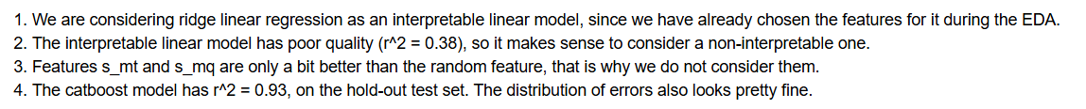
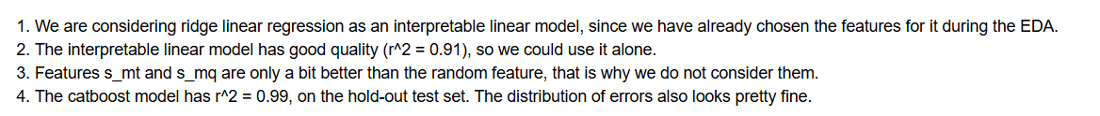
Conclusions on models for QW and DP

Slide 14
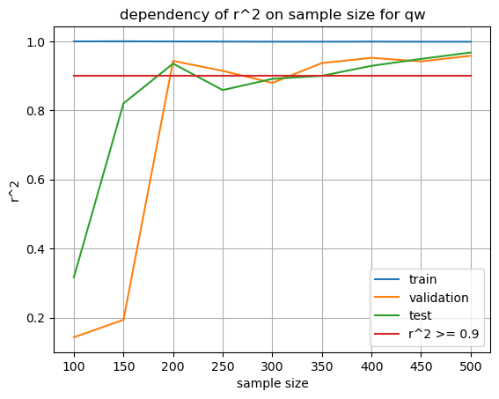
Stability of model for QW
We see that the boosting model works fine starting from samples of size 200.

Slide 15
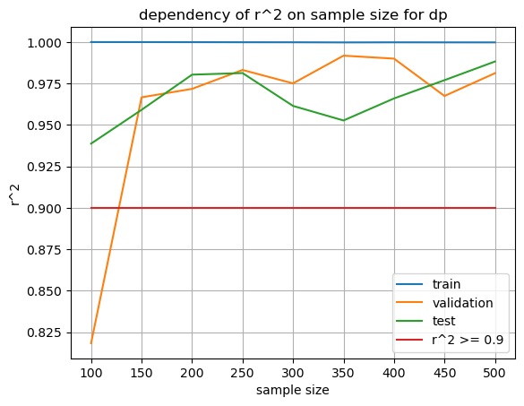
Stability of model for DP
We see that the boosting model works fine starting from sample size of 150.

Slide 16
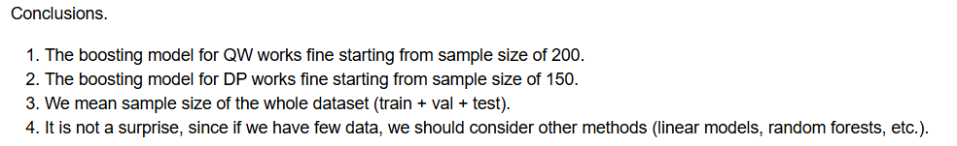
Conclusions on stability

