Slide 1
Delivery of App to AWS S3 Bucket

Slide 2
Project steps:
Raise two instances in AWS EC2 for master and worker
Raise two AWS S3 Buckets for file sharing and static website
Raise Jenkins inside Docker
Create two jobs for generating .jar files and delivering them to AWS S3 Bucket
Create WordPress site on AWS Lightsail and make link to .jar file
Set up Webhook on Github for starting jobs in Jenkins by push request

Slide 3
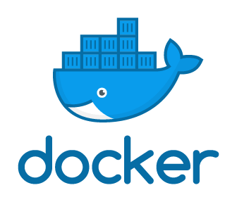




Used tools:

Slide 4
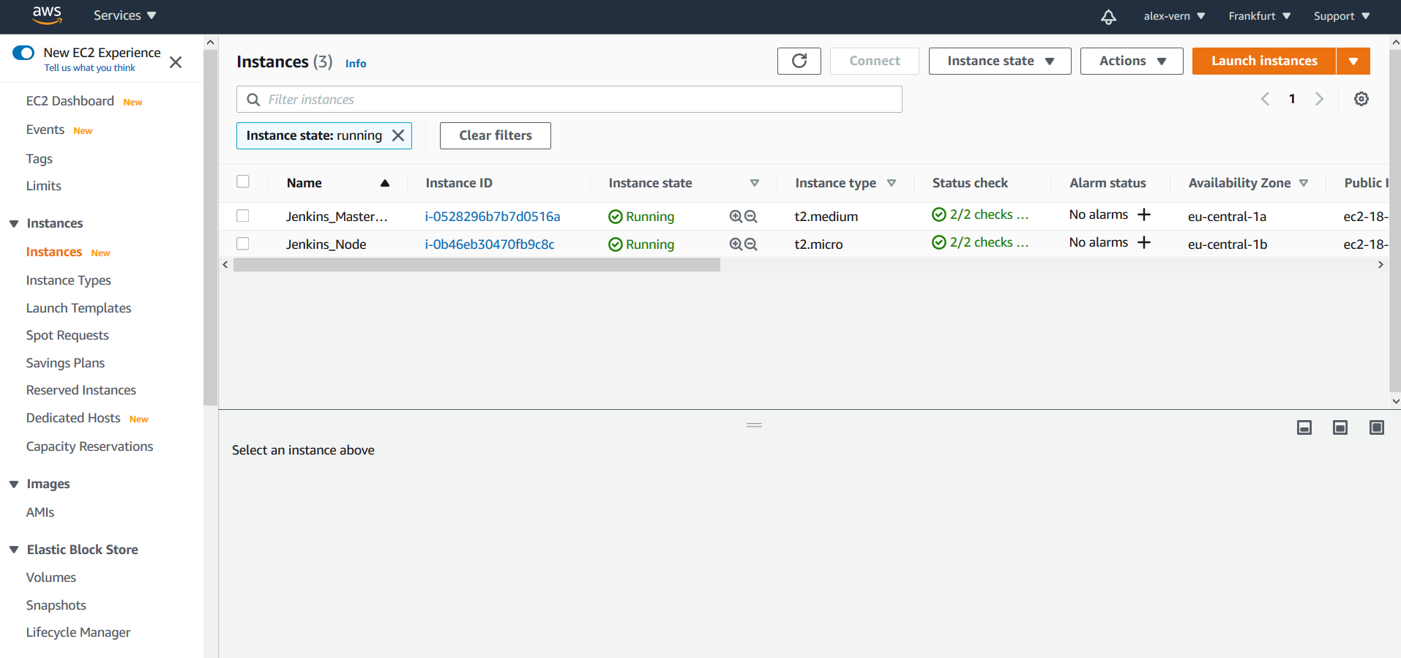
Raising of two instances in AWS EC2

Slide 5
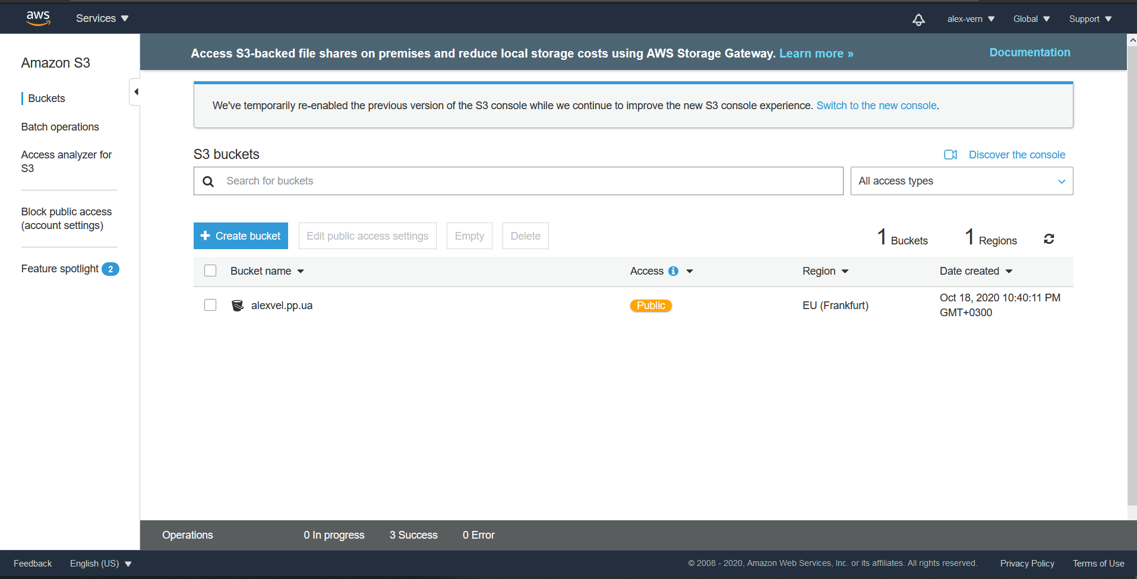
Raising of AWS S3 Bucket for .jar file uploading

Slide 6
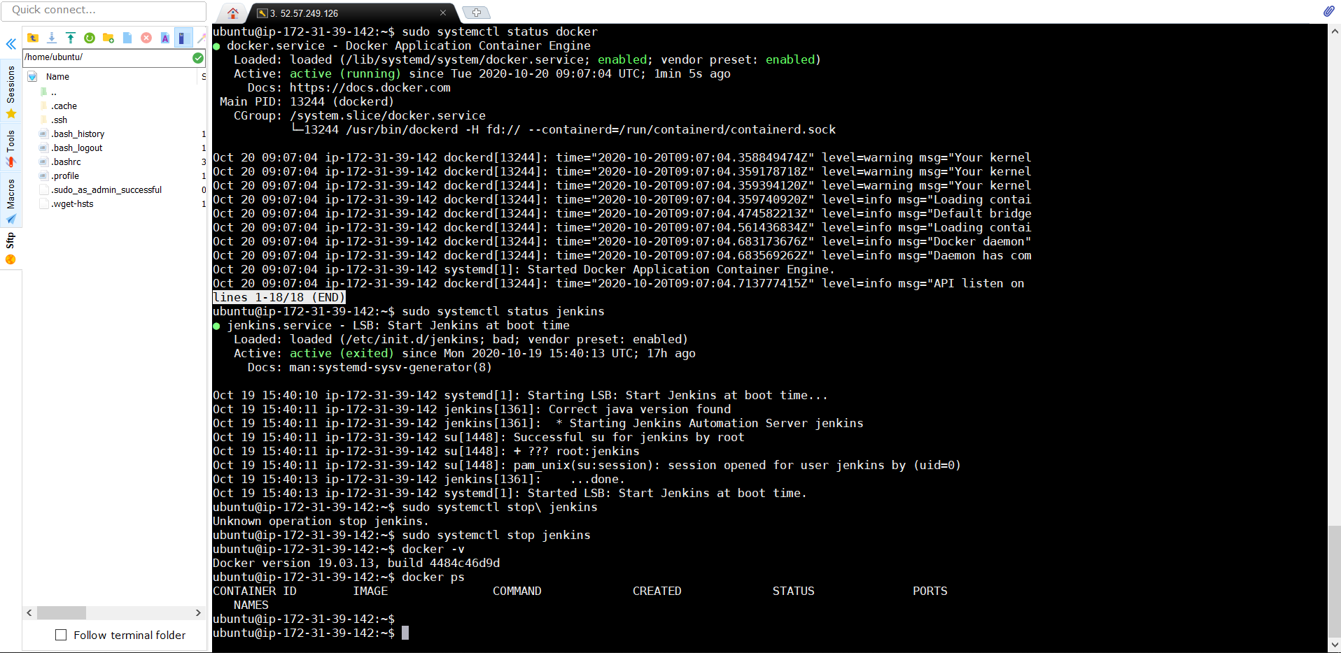
Raising Jenkins inside Docker

Slide 7
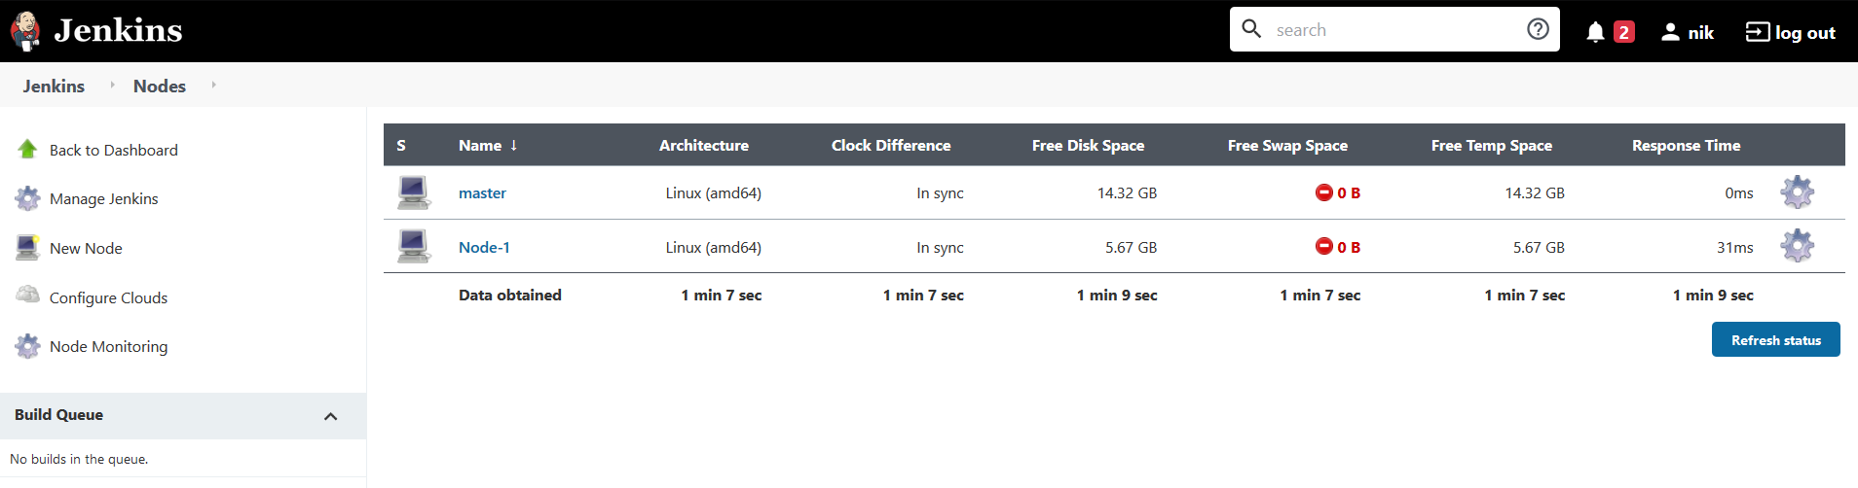
Creating two nodes

Slide 8
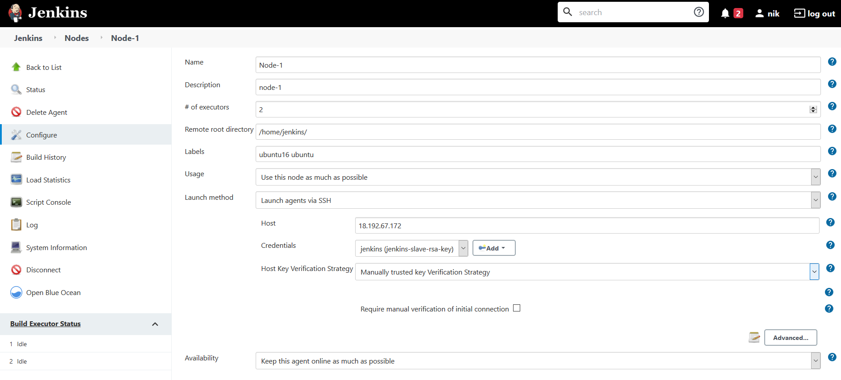
Connecting 2nd node for tasks execution

Slide 9
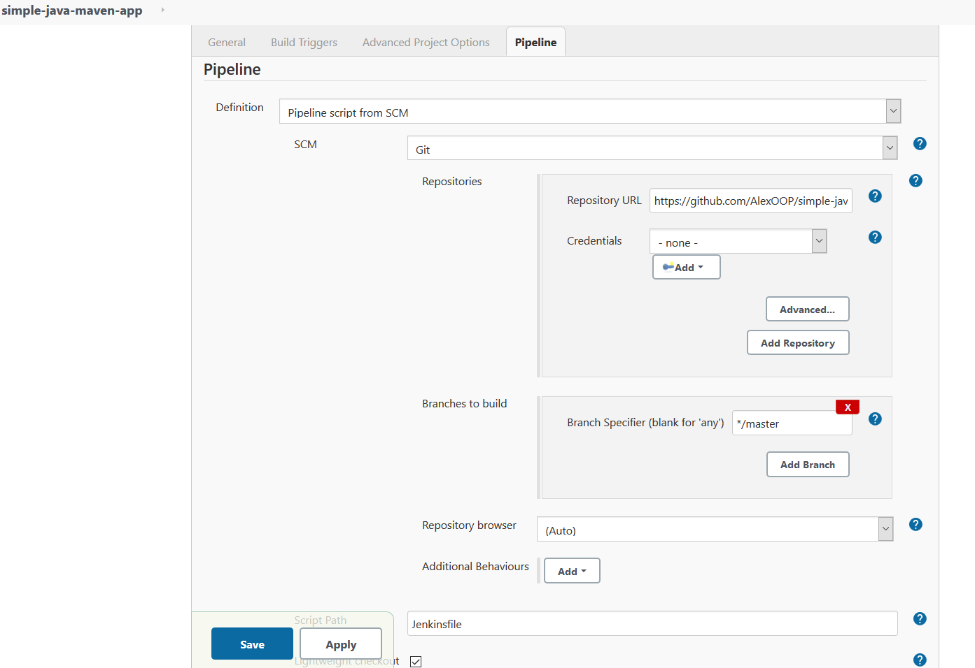
Setting up 1st job

Slide 10
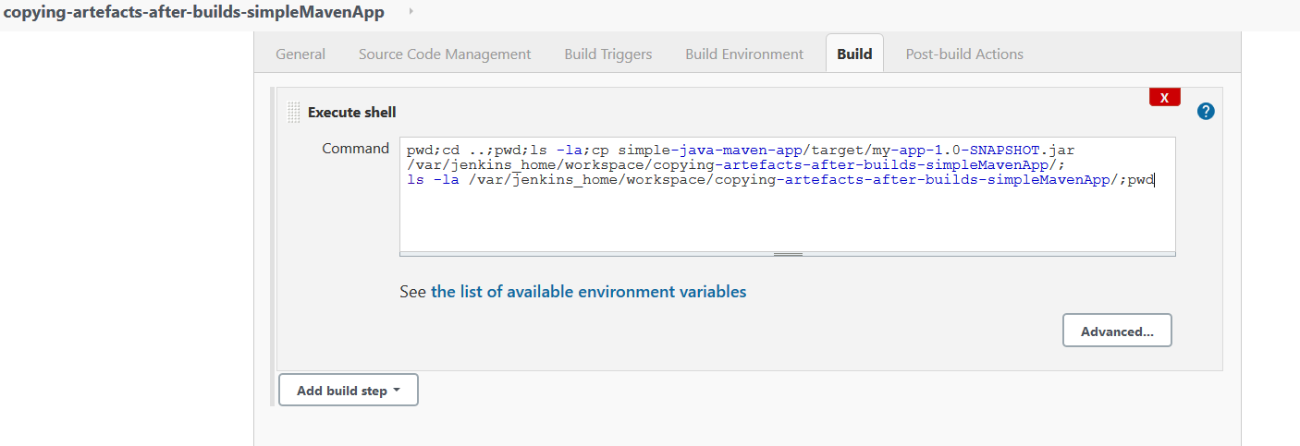
Copying generated .jar file to workspace of 2nd job

Slide 11
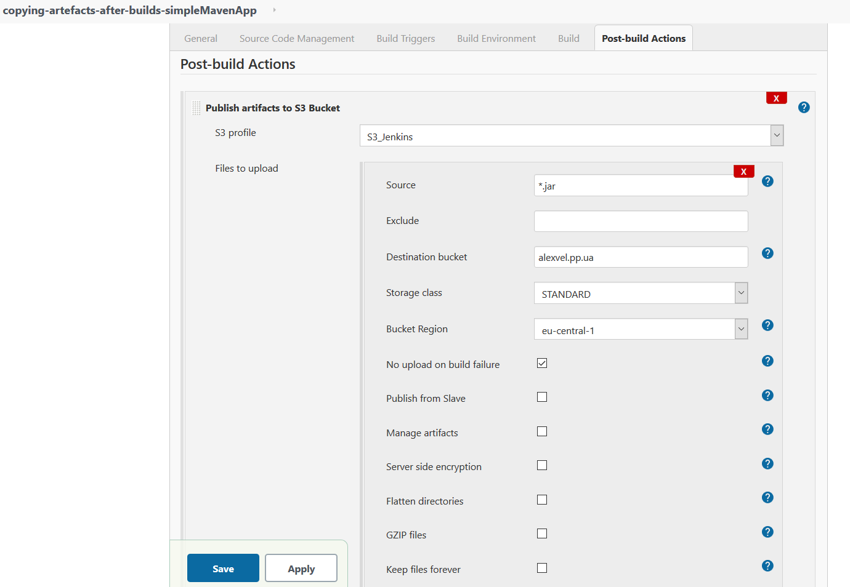
Uploading .jar file to AWS S3 Bucket

Slide 12
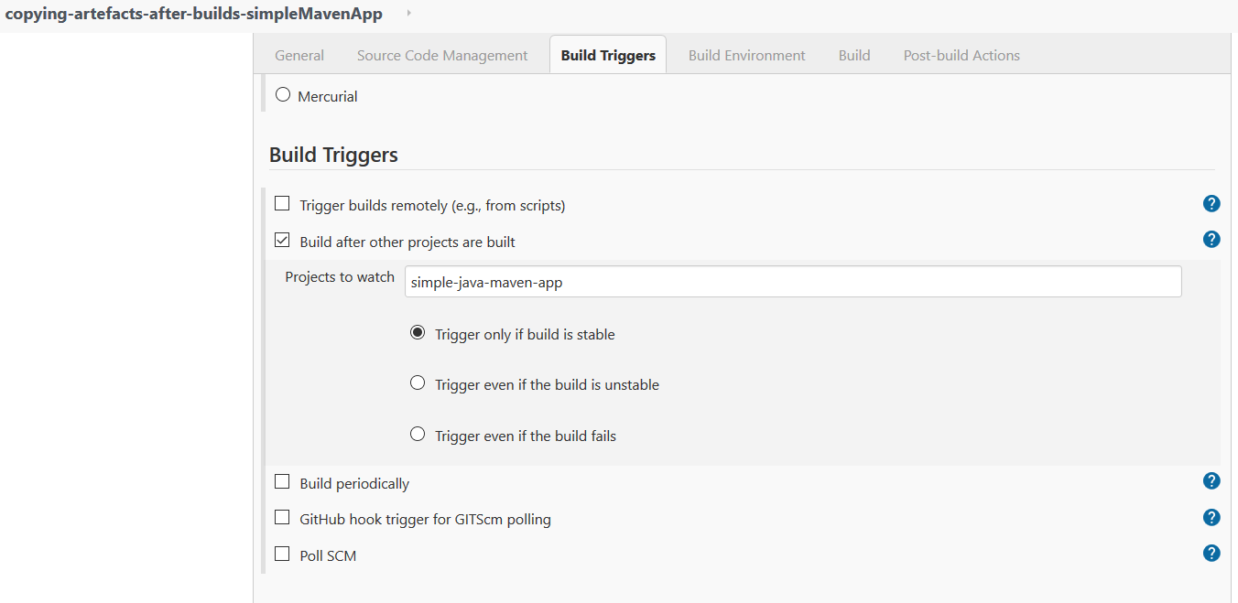
Trigger configuration for 2nd job

Slide 13
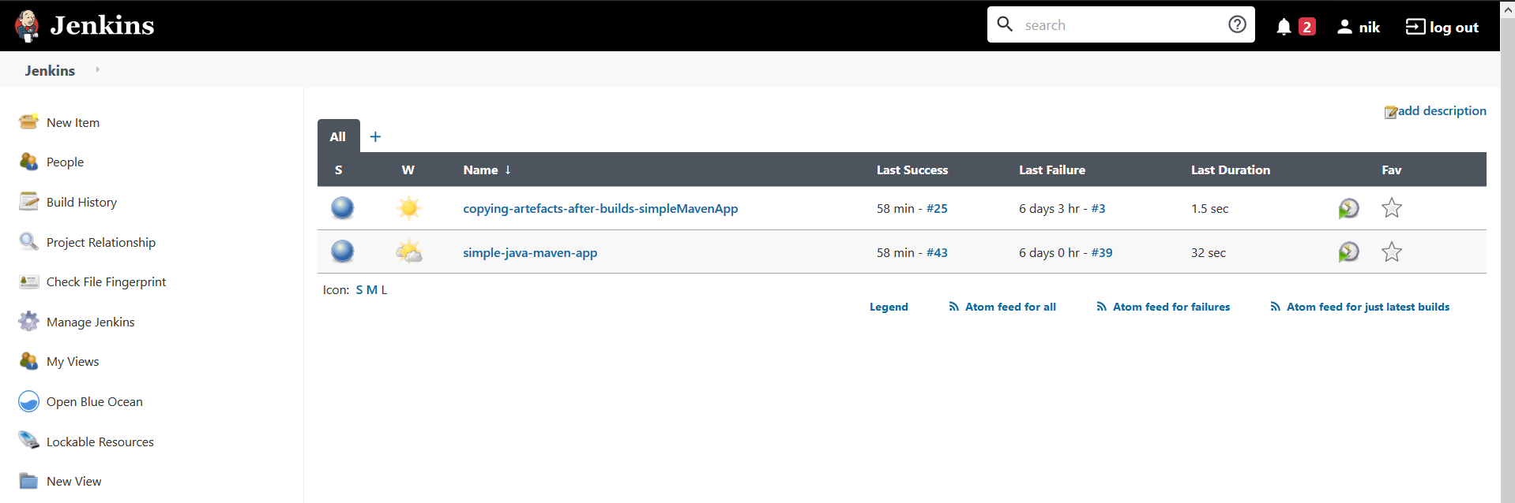
Two Jenkins jobs

Slide 14
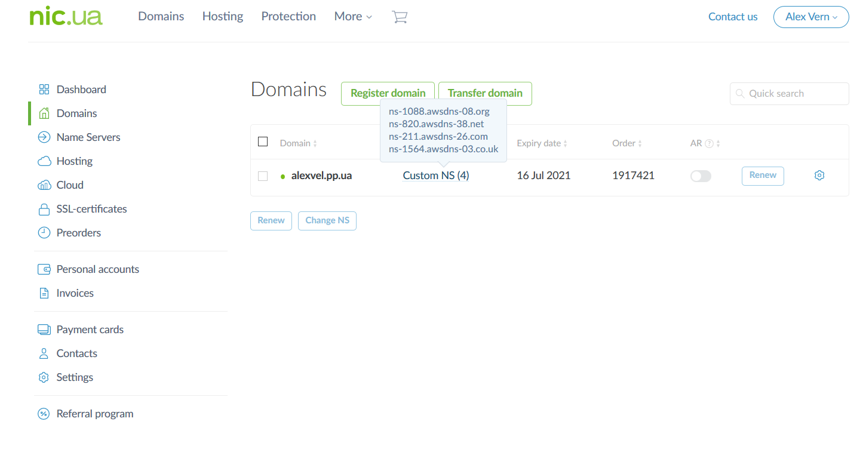
Registration of domain name

Slide 15
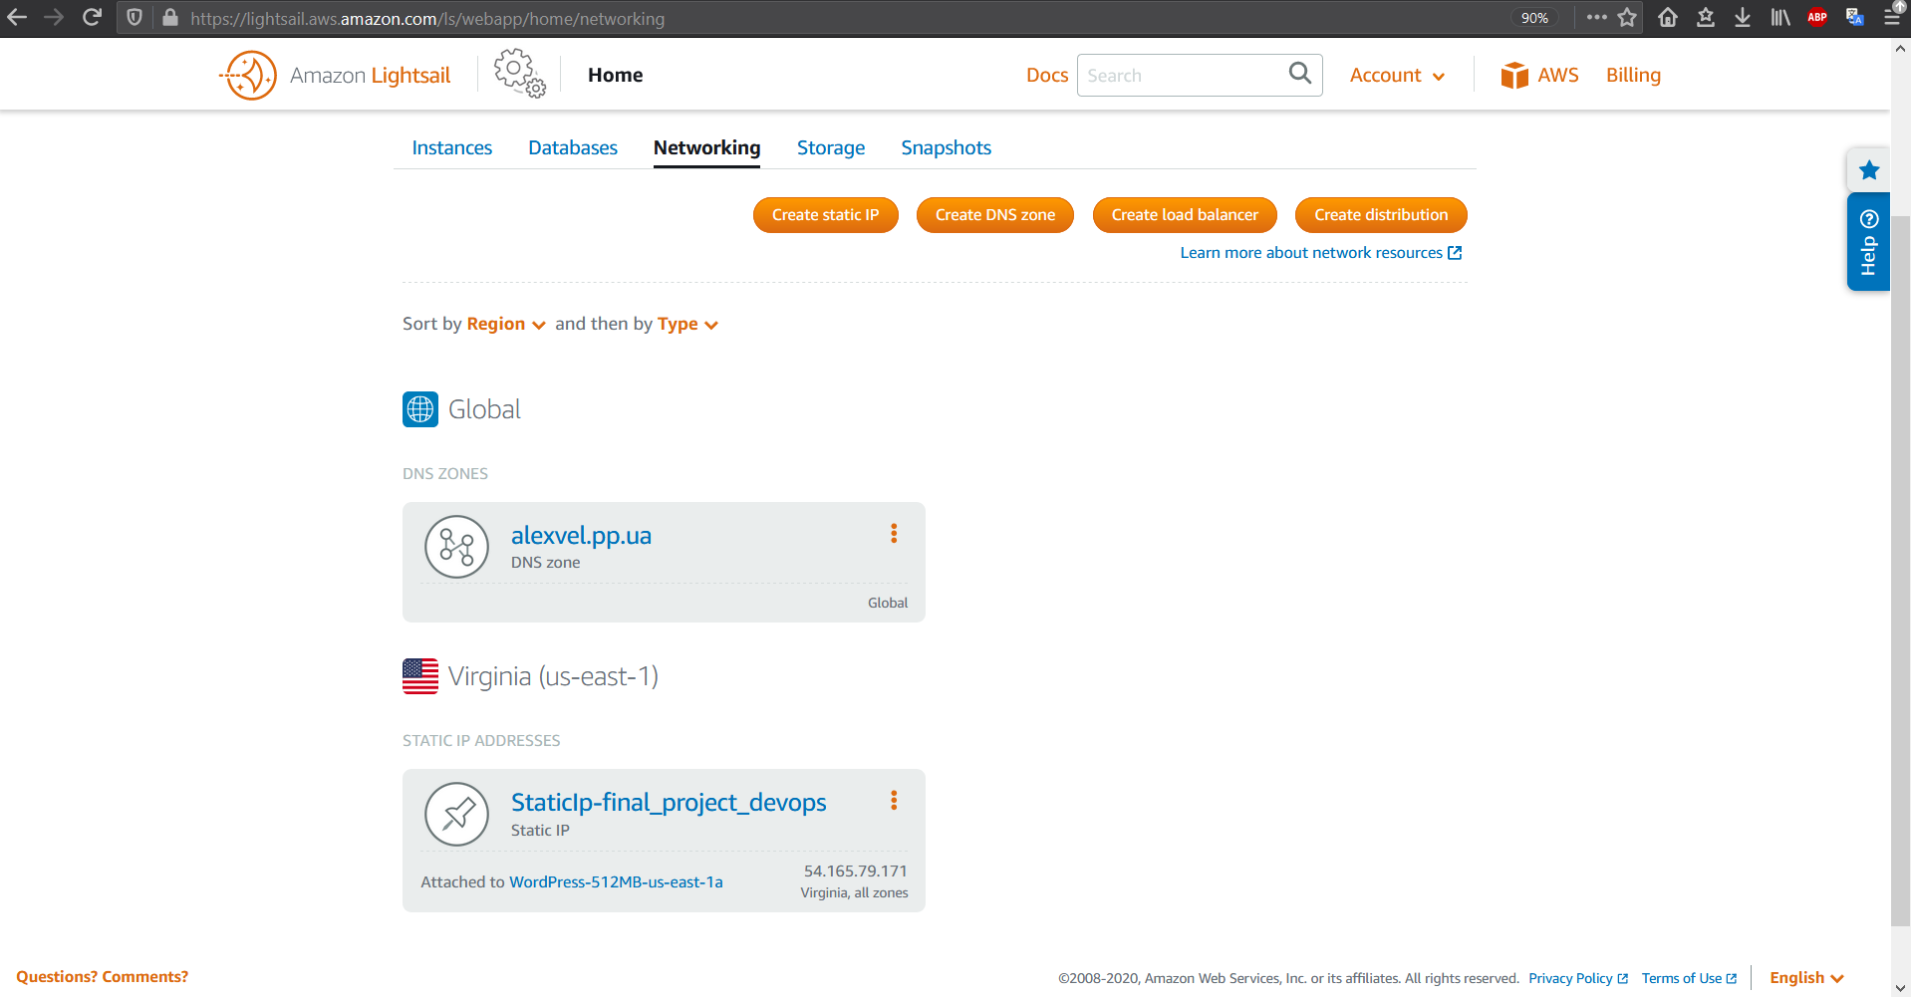
Creating WordPress website and static IP in AWS Lightsail

Slide 16
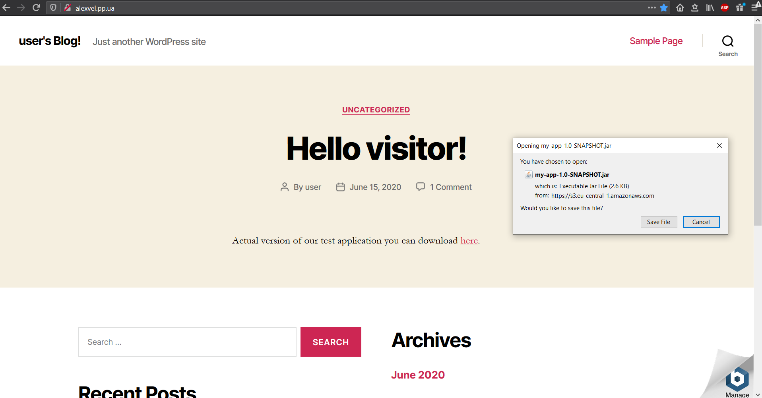
WordPress website

Slide 17
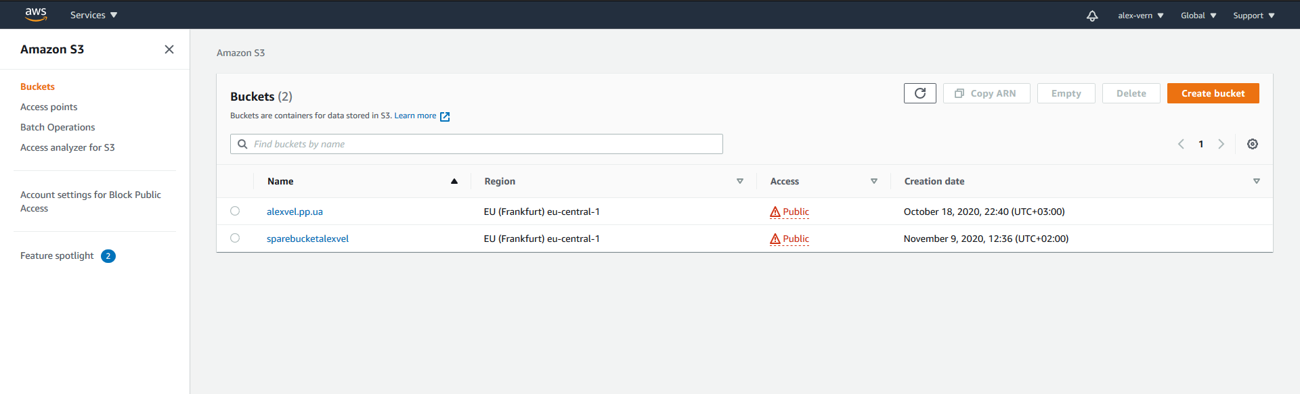
2nd AWS S3 Bucket

Slide 18
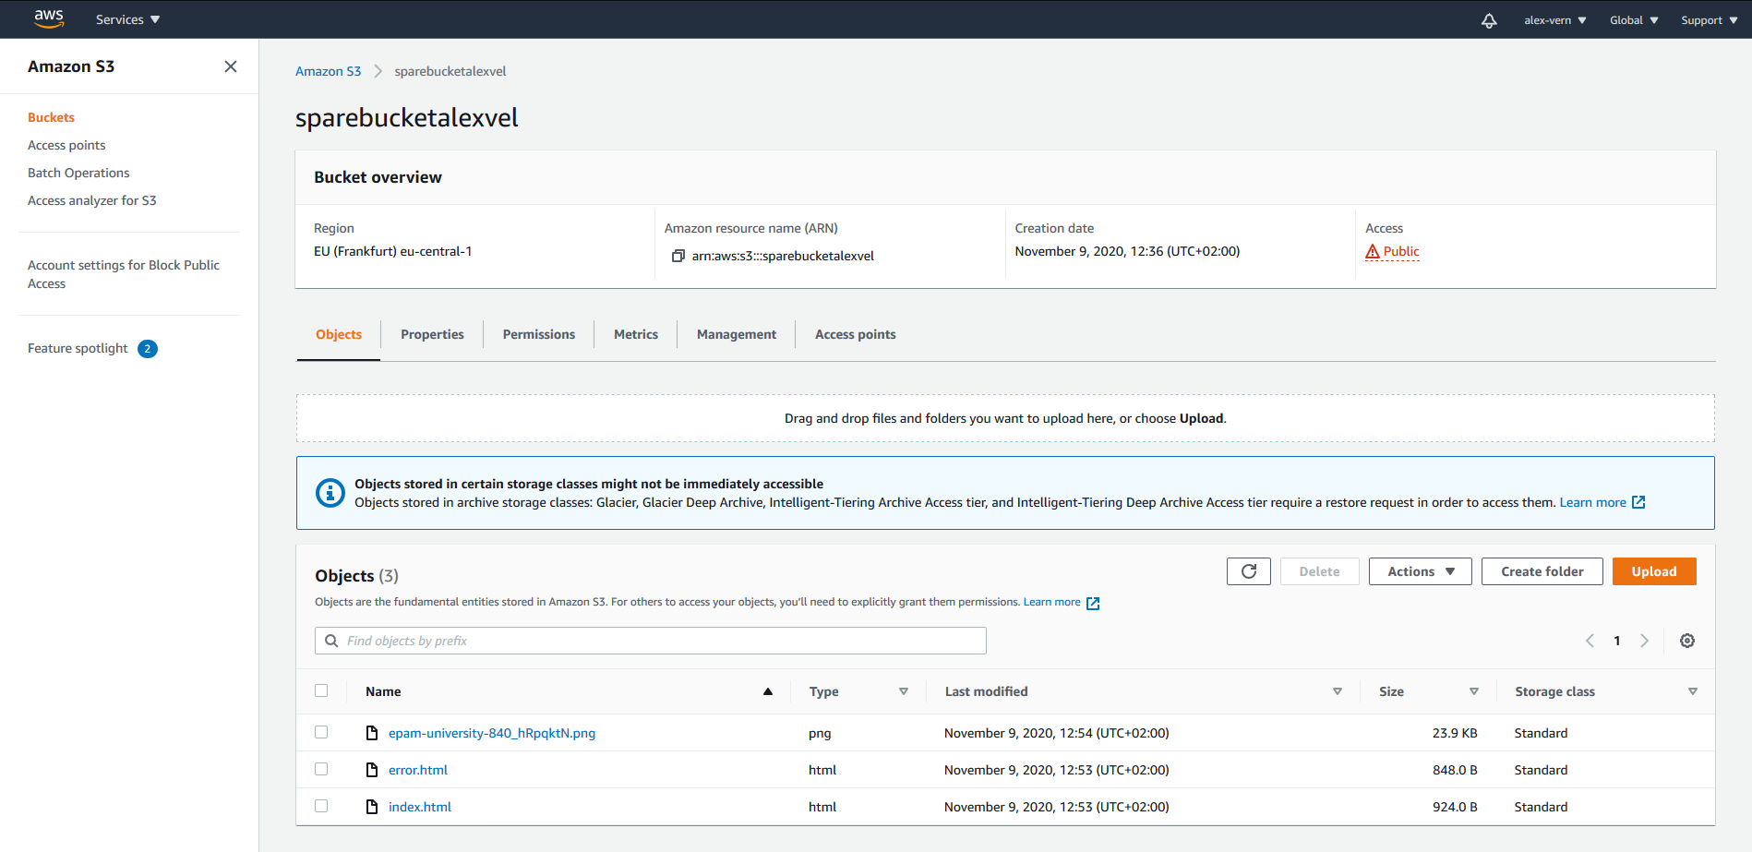
Configuration of 2nd AWS S3 Bucket

Slide 19
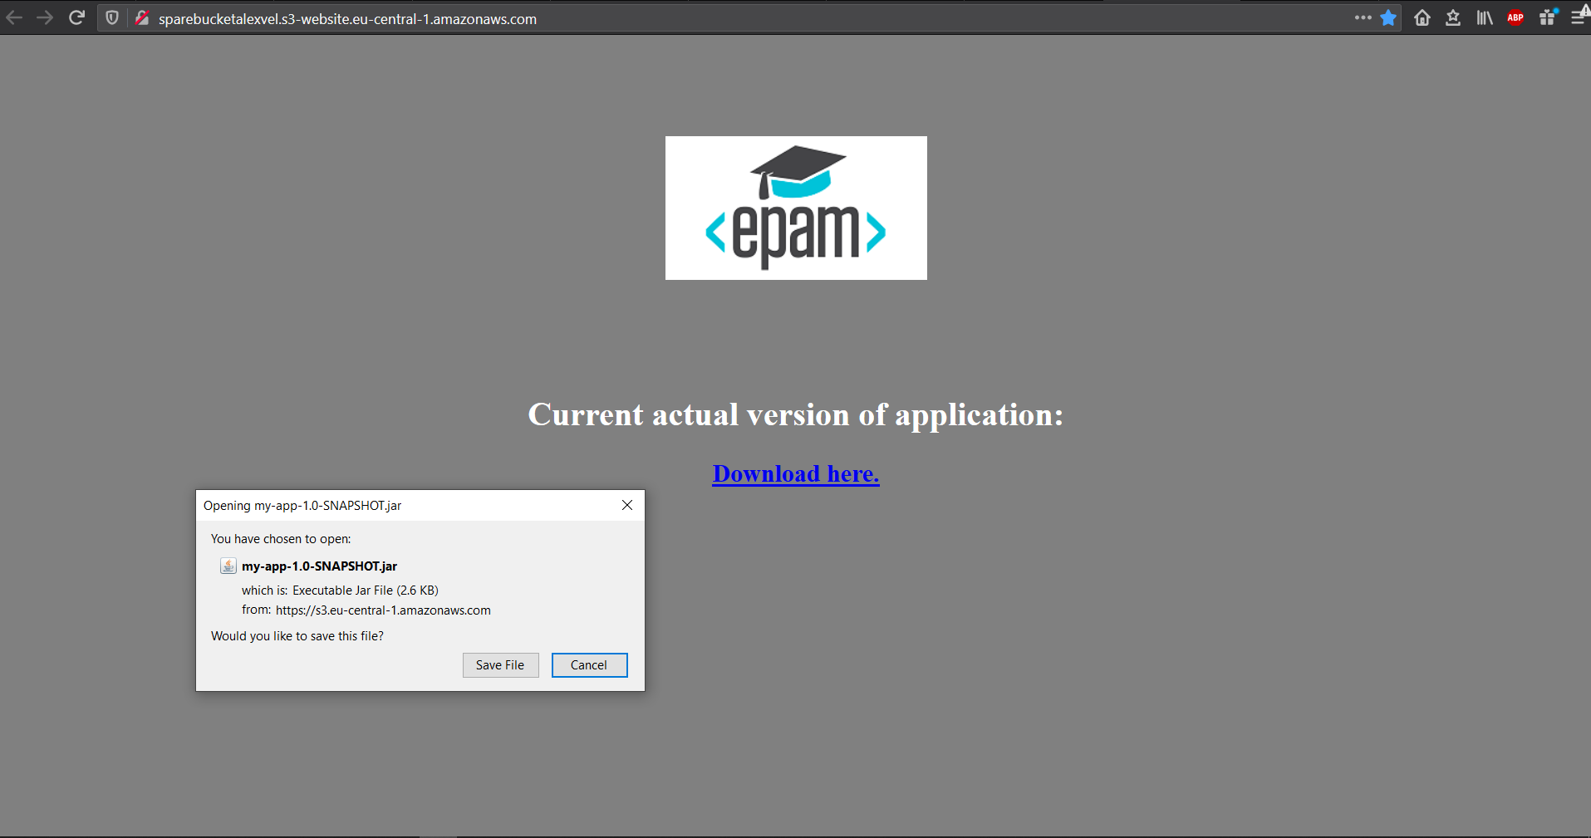
Static website at 2nd AWS S3 Bucket

Slide 20
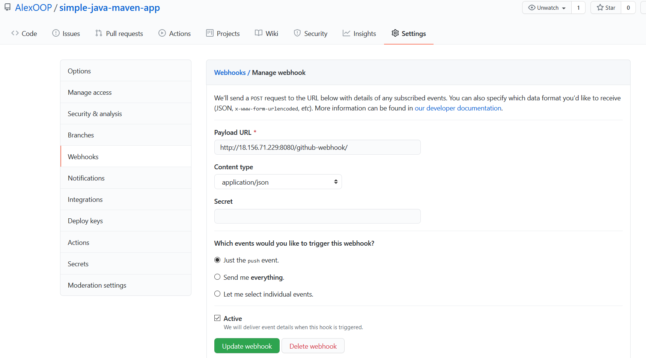
GitHub Webhook configuration

Slide 21
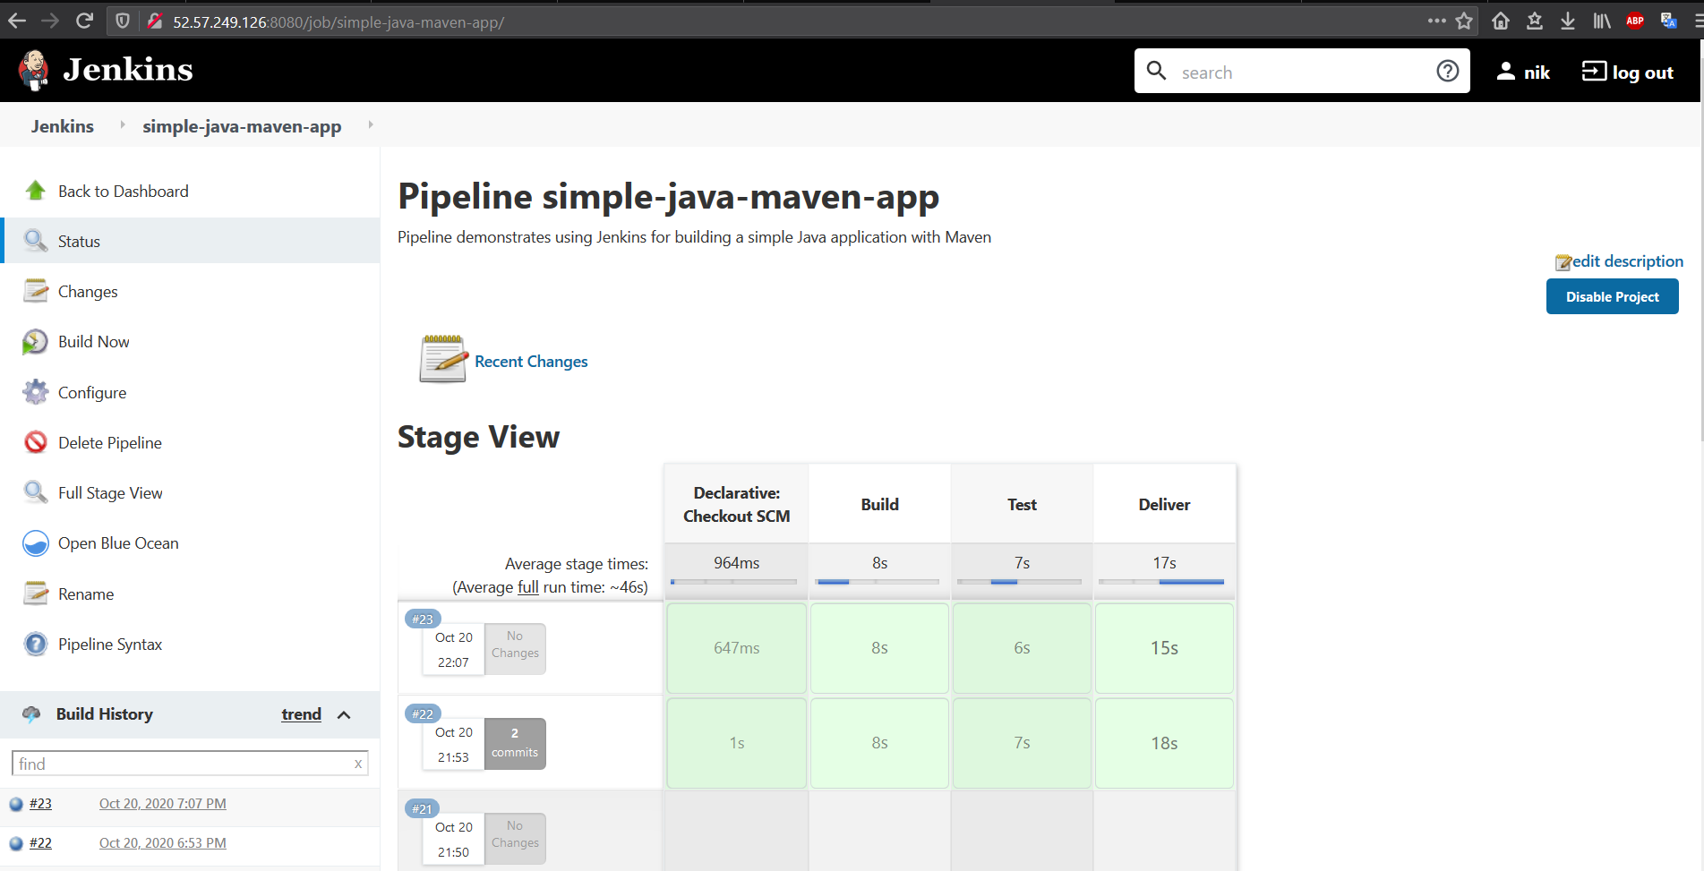
Common stage view of 1st job

Slide 22
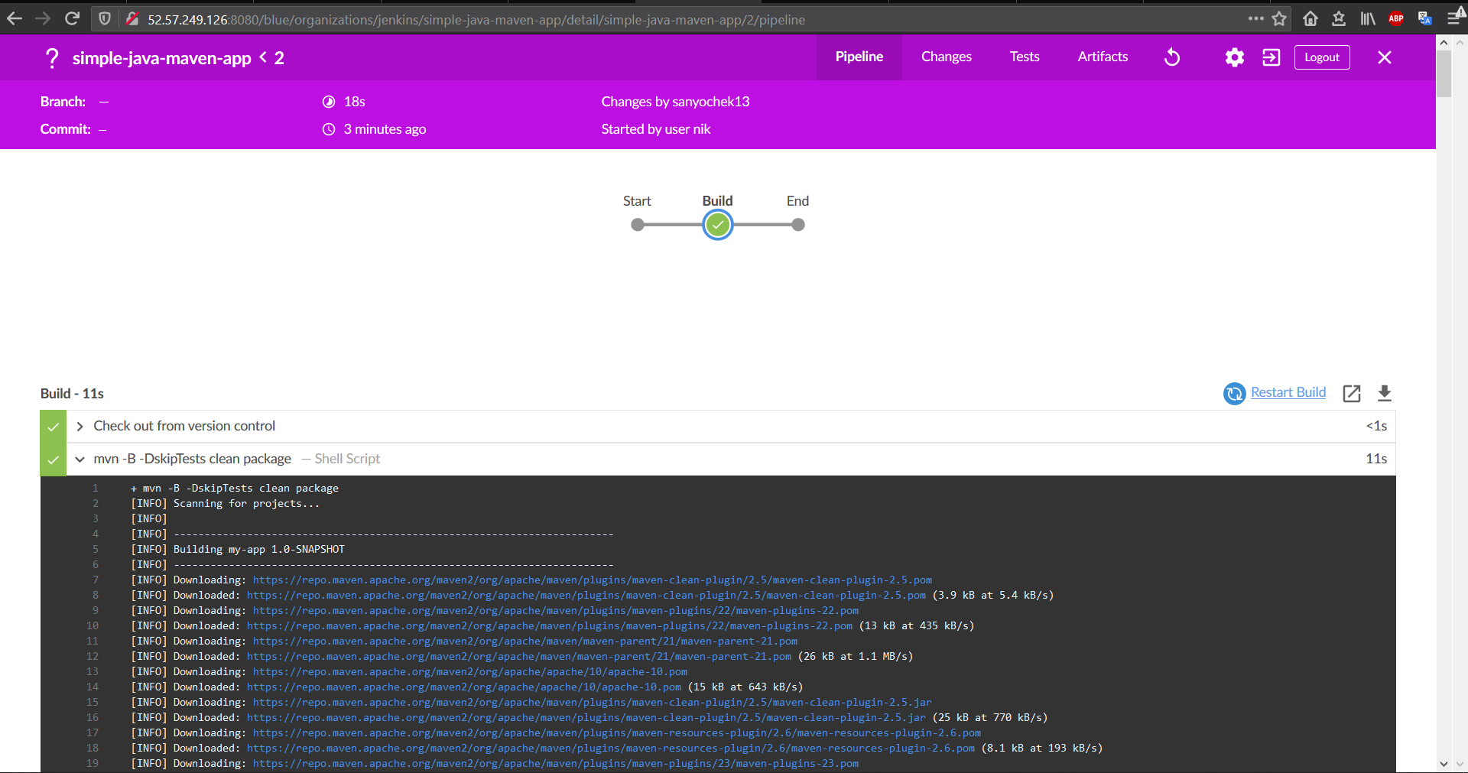
Build stage

Slide 23
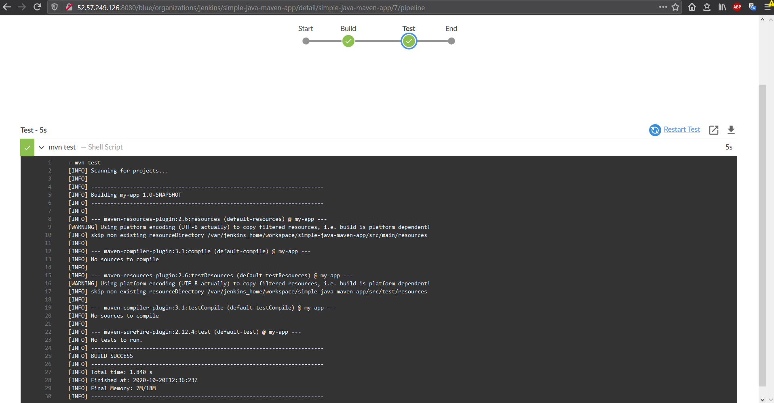
Test stage

Slide 24
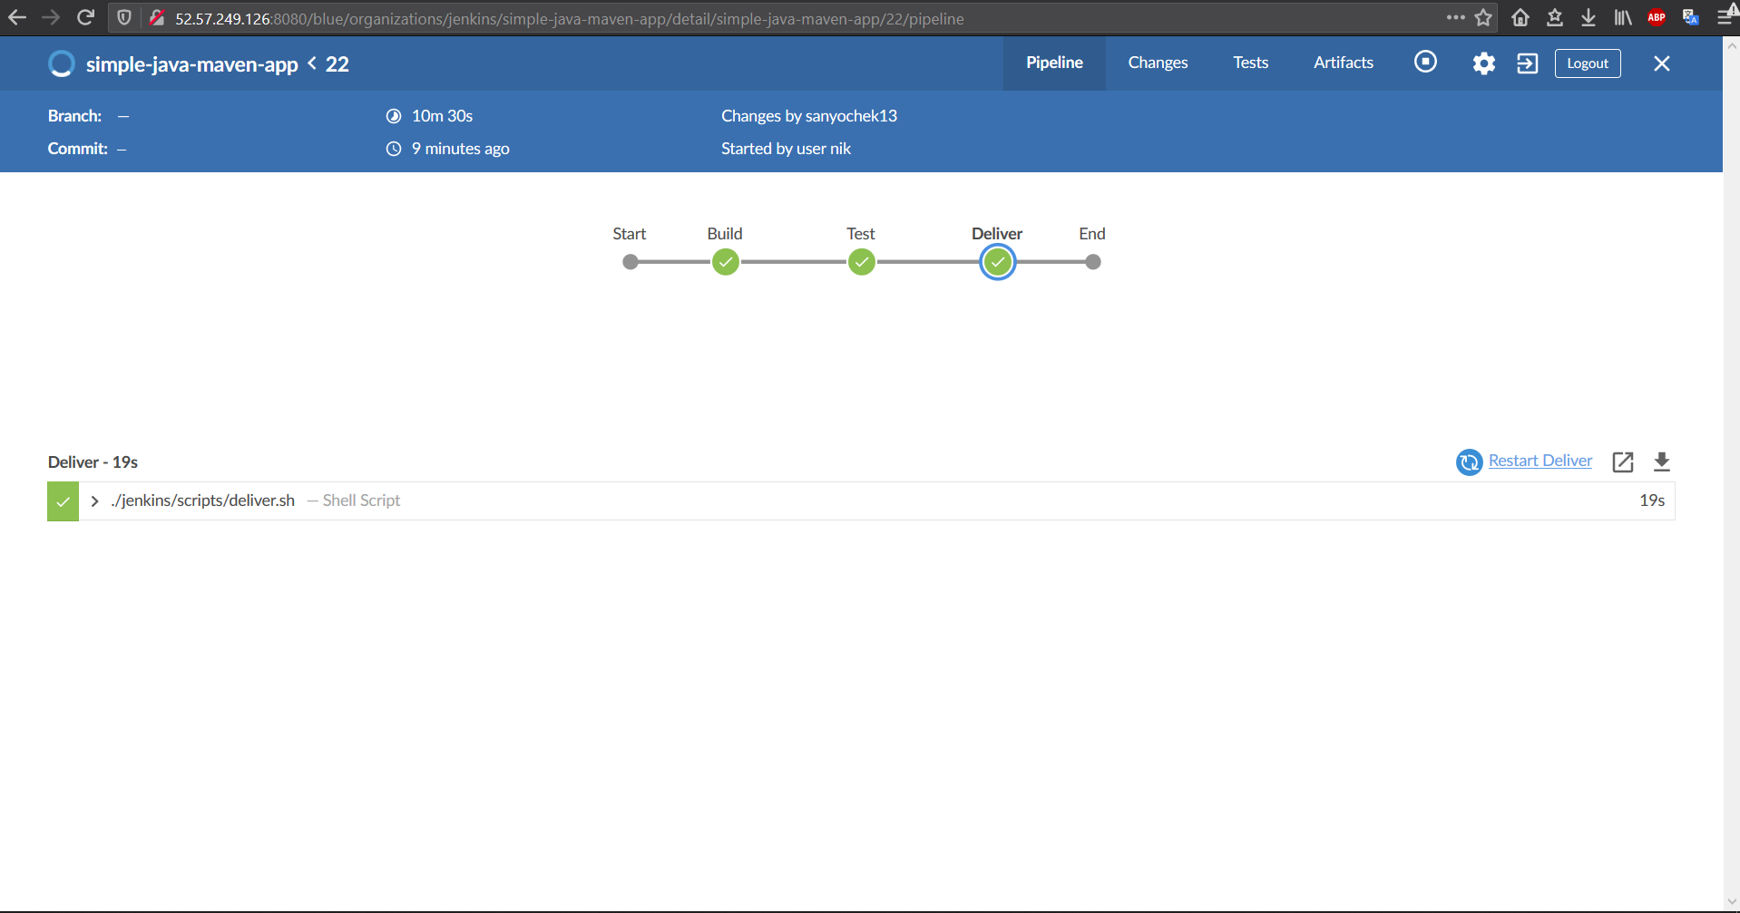
Delivery stage

Slide 25
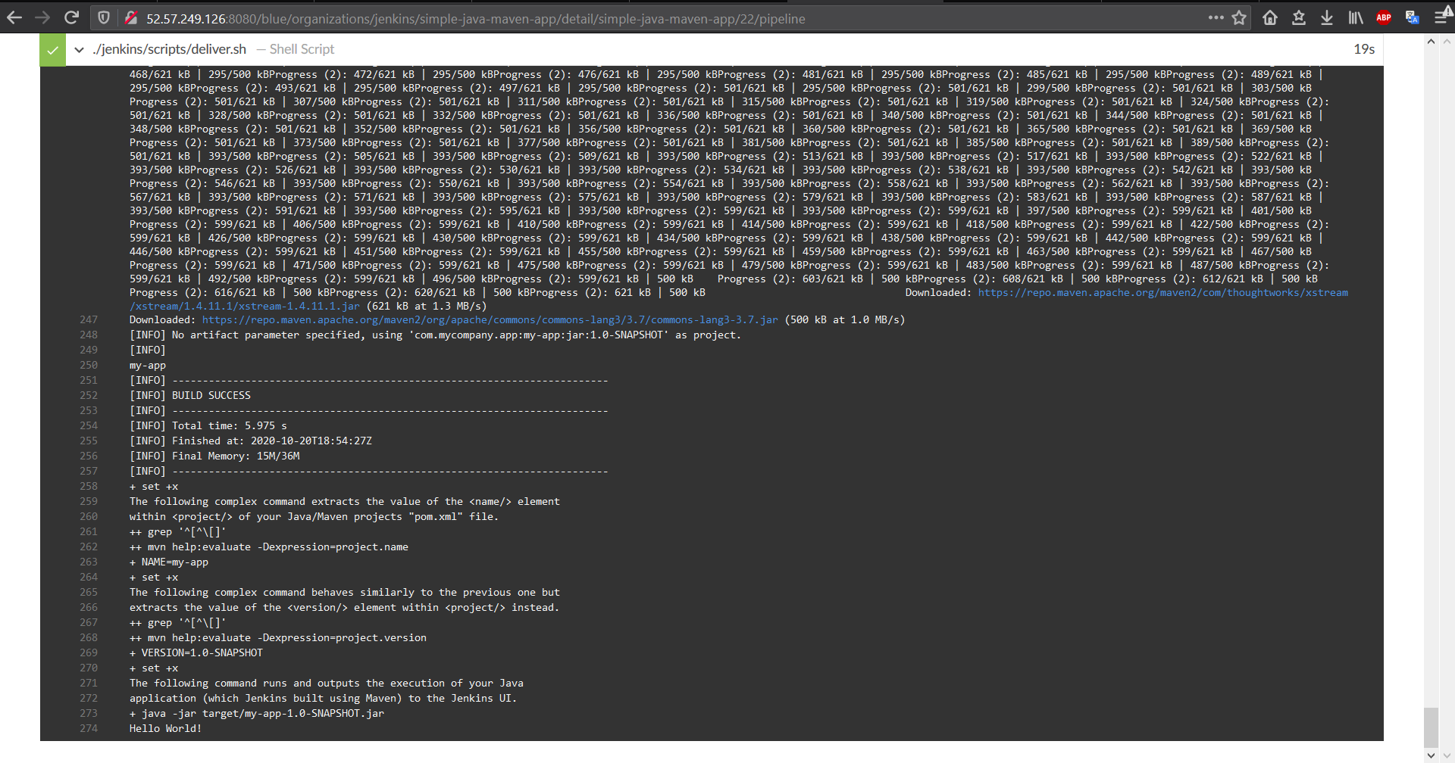
All stages log

Slide 26
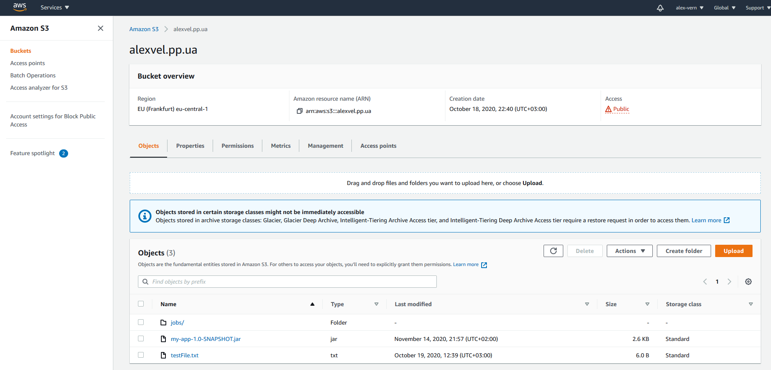
1st AWS S3 Bucket with uploaded .jar file

Slide 27
Delivery of App to AWS S3 Bucket is done ☺
by Oleksandr Chanov

