Slide 1

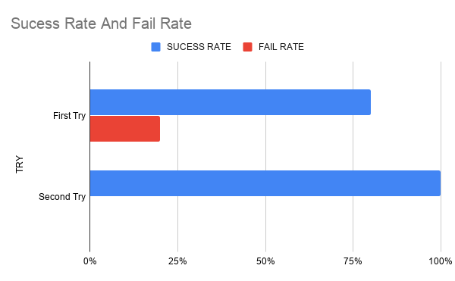
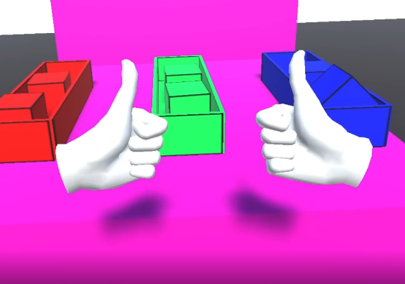
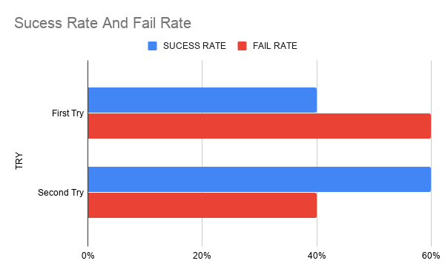
Memory Puzzle / Skill Game
using the Oculus Quest VR headset.
Alex O’Toole
Introduction
Methods
Results
Conclusions
This project is a Virtual Reality puzzle / skill game that will run on the Oculus Quest. This game heavily focuses on the user's memory. This game analyses the effect multitasking has on memory
To gather this data I observed a small group of five users with a age ranging from 21 to 44 years old. The mean age of the user group was 26.6 years old. To gather the data the users were observed playing level one and level three and the success and fail rates of their first and second try were recorded.
Based on the bar charts below. In this instance it does appear that multitasking does affect memory.
In conclusion the quantitative research finds that it is in fact more difficult to memorize a list of items when you have to multitask compared to only having to memorize a list of items.
Bibliography
Unity Learn.2020.accessed online: 11/11/2019.[available]: https://learn.unity.com/course/oculus-vr

