Slide 1
DAY 9 · CONSULTING RECOMMENDATION
Should Riverside Malls roll out 25 smart trolleys — and at what price?
Yes — at £200 per trolley per month.
£1,000 / month profit · 6-trolley margin of safety · break-even at 18.75 trolleys
Knull Work Experience Programme · Confidential to participants

Slide 2
01 · SITUATION
2 / 8
Riverside Malls is exploring a smart-trolley pilot
Riverside Malls wants a tech-forward differentiator and is considering a fleet of 25 smart trolleys to give shoppers a frictionless cart and ops a shopper-flow signal.
SITUATION
Hardware + telematics + support is real money. A naive rollout could lose money every month — or worse, prove the unit economics don't work before the next budget cycle.
COMPLICATION
Should we go ahead with 25 trolleys, and at what price per trolley per month?
QUESTION
Yes — at £200 per trolley per month. £1,000/month profit with a 6-trolley margin of safety above break-even.
ANSWER
Day 9 · Riverside Malls · Smart Trolley Pilot

Slide 3
02 · THE QUESTION
3 / 8
Two numbers decide everything
What price per trolley per month turns a 25-trolley pilot into a profitable one?
REVENUE (per trolley / month)
COST (monthly)
Operator fee: P £
v = £40 · F = £3,000 · T = 25
• Charged per active trolley, billed monthly. • Only revenue counted in the base case. • £1/visit shopper hire and ad slots are upside — called out, not booked.
• v = variable cost per trolley (maintenance, telematics, support). • F = fixed monthly cost (platform, depot, on-call). • T = fleet size in the pilot = 25 trolleys.
THE FORMULA
Monthly profit = T × (P − v) − F Break-even trolleys n* = F / (P − v)
Change one number, every cell updates. (See unit_economics.xlsx — Assumptions sheet.)
Day 9 · Riverside Malls · Smart Trolley Pilot

Slide 4
03 · RECOMMENDATION
4 / 8
Run the pilot. Charge £200 per trolley per month.
MONTHLY PROFIT
BREAK-EVEN TROLLEYS
HEADROOM TO NEXT TIER
£1,000
18.75
+30%
at £200 / trolley / month
vs. 25 in the pilot → 6-trolley safety
before £250 is needed
WHY NOT £150?
At £150 the pilot loses £250/month — break-even needs 27.3 trolleys but we only have 25. Penetration pricing doesn't work until the fixed cost is amortised across more units.
Day 9 · Riverside Malls · Smart Trolley Pilot

Slide 5
04 · THE NUMBERS
5 / 8
Unit economics across 4 price tiers
Price tier
Price (£)
Contribution (£)
Monthly profit (£)
Break-even trolleys
Floor (£150)
£150
£110
£-250
27.3
Base (£200)
£200
£160
£1,000
18.75
Premium (£250)
£250
£210
£2,250
14.3
Aspirational (£300)
£300
£260
£3,500
11.5
WORKED EXAMPLE · £200
contribution = P − v = 200 − 40 = £160
monthly profit = T × (P − v) − F = 25 × 160 − 3,000 = £1,000
break-even trolleys n* = F / (P − v) = 3,000 / 160 = 18.75 → pilot clears break-even with 6.25 trolleys to spare.
Day 9 · Riverside Malls · Smart Trolley Pilot

Slide 6
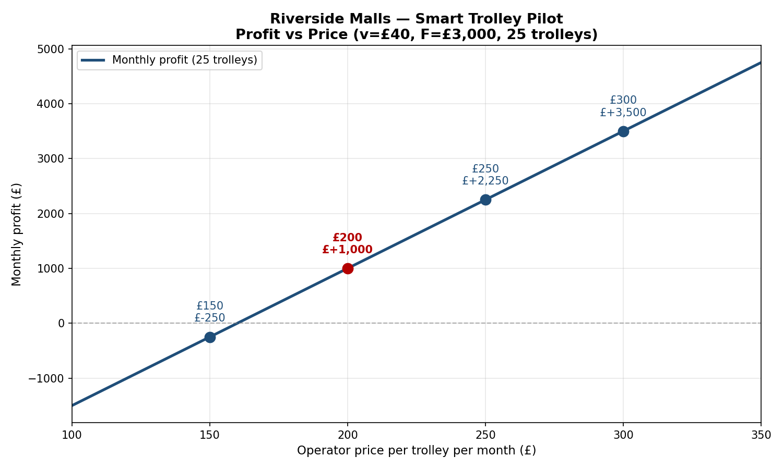
05 · THE CURVE
6 / 8
£200 is the knee of the curve — and the only price with margin
READ
The red dot is £200 — the first price at which the pilot turns green. Below it, every month is a loss. Above it, every extra £50/trolley adds another £1,250/month in profit.
GUARDRAIL
If price falls to £160 or below, profit goes negative. Anchor the sales conversation at £200 — don't negotiate on the headline number without a fleet-size concession.
Day 9 · Riverside Malls · Smart Trolley Pilot

Slide 7
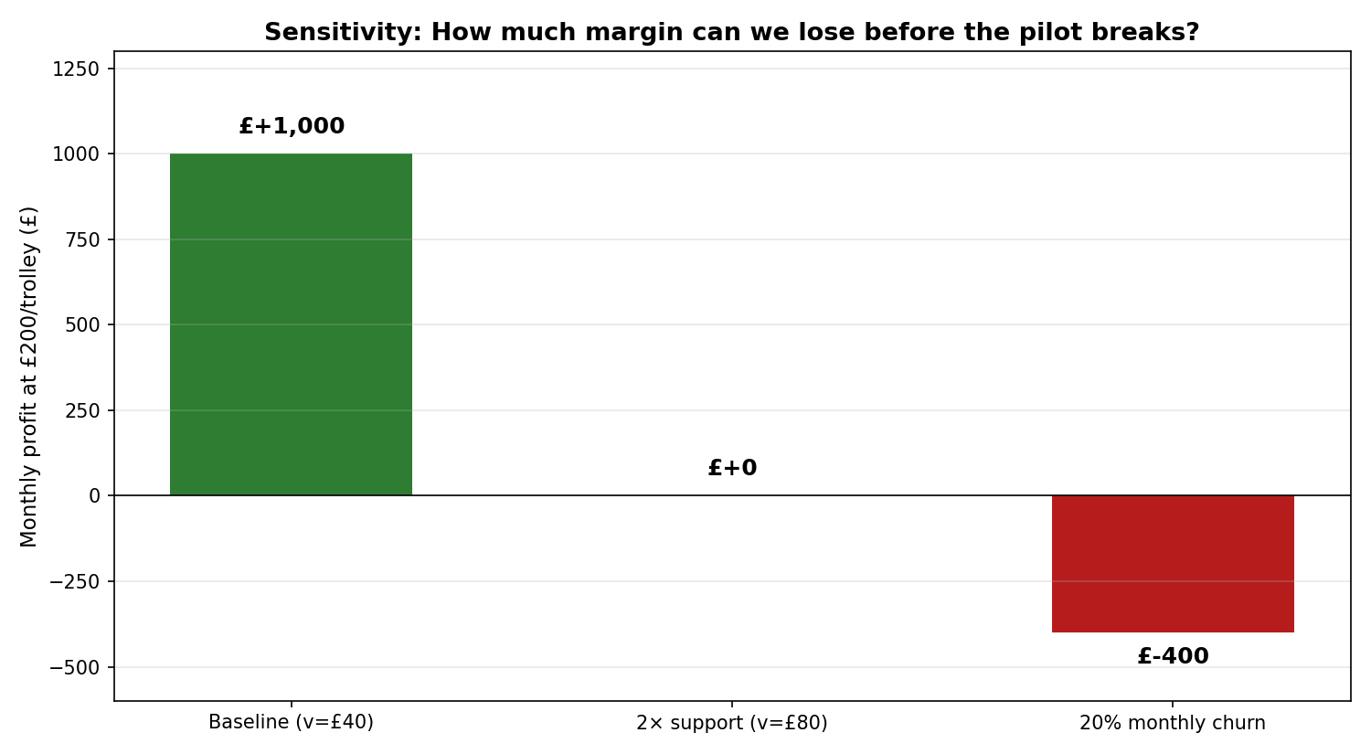
06 · RISKS
7 / 8
The pilot survives 2× support cost — but not 20% monthly churn
Support cost doubles
We drop to exactly £0 profit. We must monitor cost-to-serve weekly in the first 90 days.
20% monthly trolley churn
Lose £400/month. A re-deployment + refurb capex plan is non-negotiable before we go live.
Trolley under-utilisation: if <18.75 trolleys are active, the pilot loses money. Recovery playbook + operator co-marketing required.
Day 9 · Riverside Malls · Smart Trolley Pilot

Slide 8
07 · NEXT STEPS
8 / 8
Three things to validate before we sign the contract
Confirm cost-to-serve
1
Shadow-quote support and telematics for 4 weeks with a real depot. The £40 variable cost is an estimate — moving it to £60 changes break-even from 19 to 25 trolleys.
Pilot a 5-trolley shadow fleet
2
Run a no-charge 4-week shadow deployment to measure actual utilisation and churn. Use the real data, not the model assumption of 100% utilisation.
Lock the £200 headline price
3
Set the operator-fee schedule at £200/trolley/month with a contractual volume clause: any sub-19-trolley month triggers a price-floor review.
Day 9 · Riverside Malls · Smart Trolley Pilot

