Slide 1
PROBLEM
Phishing triage is still too manual.
User-reported suspicious emails still turn into scattered checks across mail clients, URL tools, sandboxes, SIEM searches, and tickets.
Repetitive analysis
• Analysts repeat the same evidence-gathering steps for each reported email.
• Similar emails are often handled one by one instead of as one wave.
Defensible decisions
• The job is not only a verdict; it is rationale, artifacts, and clean closure.
• Documentation and auditability add real workload.
Regulated friction
• Cloud-first tooling is harder to adopt when email content should stay local.
• A focused on-prem workflow is easier to discuss than a broad suite replacement.
Hypothesis: the sharper problem is not better phishing detection alone. It is faster evidence gathering, categorization, and documentation for reported email.
Founder context: Alexander Huelsmann · MSc thesis on AI-assisted phishing triage
Triagent · 1/6

Slide 2
VALIDATION
What I validated so far.
Current evidence comes from interviews, follow-up chats, and AI-assisted Reddit workflow research. Buyer validation is the next open risk.
7
Interviews
Direct analyst and operator workflow conversations completed
5
Follow-up chats
Additional validation conversations across the same problem area
AI
Reddit research
AI-assisted scraping and synthesis of analyst pain and workflow patterns
Recurring learnings
• Reported phishing handling is a daily analyst task and still largely manual.
• On-prem / privacy constraints matter; a smaller focused tool is easier to discuss than a broad cloud suite.
• URL shorteners and attachment edge cases still require analyst review. Black-box automation is not enough.
• The wedge shifted from better detection to better analyst workflow.
Open validation question
• The analyst pain is clear, but buyer sponsorship still needs proof.
• Next step: validate whether SOC managers or MSSPs will back a pilot.
• Target outcome: 1-3 design partners with real workflow access.
Triagent · 2/6

Slide 3
SOLUTION
Triagent: analyst-in-the-loop phishing triage.
Triagent does not replace the analyst. It removes repetitive evidence collection and packages the decision.
01
Ingest reported email
Start from the original message or the Outlook add-in.
02
Auto-categorize
Separate likely benign reports from analyst-worthy cases.
03
Enrich evidence
Headers, URLs, attachments, auth signals, and context are collected.
04
Assist draft + analyst review
Triagent drafts a resolution, but the analyst approves the decision.
05
Export the case
Generate evidence reports, IOCs, and audit-ready history.
Automatic categorization protects analyst time; evidence-first review makes the remaining cases faster and more defensible.
Triagent · 3/6

Slide 4
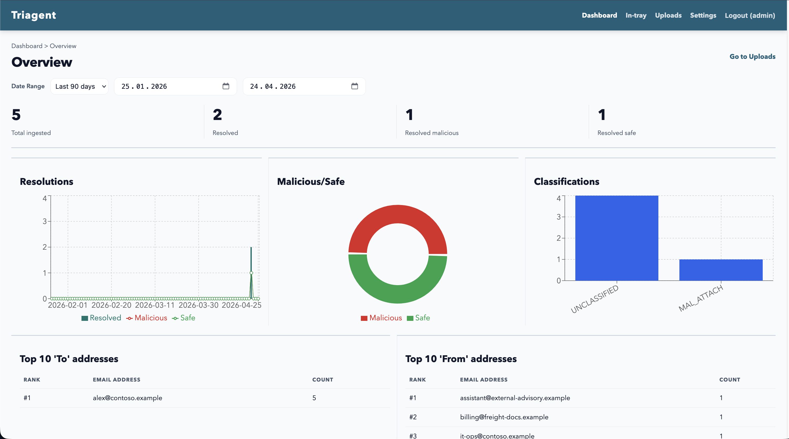
PROGRESS
From idea to working prototype.
The goal of the last weeks was not polish; it was to turn the concept into something demoable and testable.
Already working today
• .eml / .msg intake and Outlook add-in path
• In-tray, report workspace, and analyst resolution
• URL, attachment, auth, transmission, and raw-source analysis
• Local assist draft with flagged artifacts
• PDF / IOC export and tamper-evident audit log
• Synthetic corpus plus one-command demo reset
Current status: validation-grade prototype, not yet an enterprise-ready platform. Next goal: test one complete workflow on real or semi-real cases.
Triagent · 4/6

Slide 5
MARKET / MODEL / USP
Beachhead first, not broad cyber.
The initial market is narrow on purpose: phishing triage workflows in regulated SOCs and MSSPs.
Beachhead customer
• Internal SOC / SecOps teams with recurring phishing mailbox volume
• MSSPs serving regulated or privacy-sensitive clients
• Likely champion: SOC manager, MSSP service lead, or CISO
Business model
• Design-partner pilots first
• Then annual on-prem licence or managed deployment fee
• Focus on workflow pull before optimizing pricing
Alternatives / USP
• Alternatives today: manual workflow, broad suites, SOAR, phishing-analysis tools
• USP: on-prem, workflow-first, evidence-report-first
• Campaign clustering is part of the product direction
Biggest commercial question: will buyers pay for this narrower workflow wedge, or treat it as just a feature?
Triagent · 5/6

Slide 6
ROADMAP / CTA
Next milestone: 3 design partners.
This is a progress pitch: I am not claiming PMF yet. I am asking for access to test the workflow in real settings.
Next 2 weeks
Polish one complete reported-email triage workflow for repeatable demos.
What I’m looking for
• Introductions to SOC managers, MSSP operators, and IT security leads
• 30-minute workflow interviews
• 1-3 design-partner or shadow-pilot opportunities
• Network and validation support before capital
Next 4 weeks
Run shadow pilots on real or semi-real reported phishing cases.
Next 8 weeks
Measure time saved, report quality, and willingness to pay.
Current status: founder-market fit + early analyst validation + working prototype. Next step: buyer access.
Triagent · 6/6

