Slide 1

Product Deduplication

Slide 2

Introduction
When working with large datasets, it happens to have duplicates because LLMs can extract the same product from different sources. In this case, it’s necessary to remove duplicated products.
The format used to store such large datasets is called Parquet. Parquet it’s an open source file format built to handle flat columnar storage data formats. Parquet operates well with complex data in large volumes. It is known for its both performant data compression and its ability to handle a wide variety of encoding types.
For large datasets, Parquet file it’s better because of efficient storage, better compression, schema and type information, parallel processing and his structure that allows to work with big data ecosystems.
Oprea Alexandru-Ionuț

Slide 3
Python programming language
In project, the programming language used it’s Python because of his libraries that hill help us work with large datasets. Python is a programming language that is widely used in web applications, software development, data science, and machine learning (ML). Developers use Python because it is efficient and easy to learn and can run on many different platforms. Python software is free to download, integrates well with all types of systems, and increases development speed.
Python has a library created specially for data analysis called pandas. Pandas it’s a library that has predefined functions to read a parquet file and to analyze and even change the data frame.
Oprea Alexandru-Ionuț

Slide 4
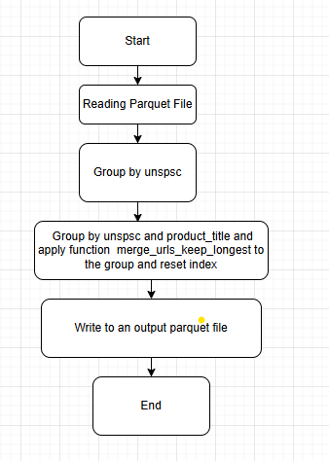
Solution Deployment
To effectively deploy a solution, I have identified the unique columns which are “product_title” and “description”. To make an efficient deduplication, we want to drop the duplicate that has a shorter description because the longer one has more informations. To do this efficiently, we must group by “unspsc” and “product_title”. Then we will apply the function to merge the urls and remove the duplicates with shorter description.
Oprea Alexandru-Ionuț

Slide 5
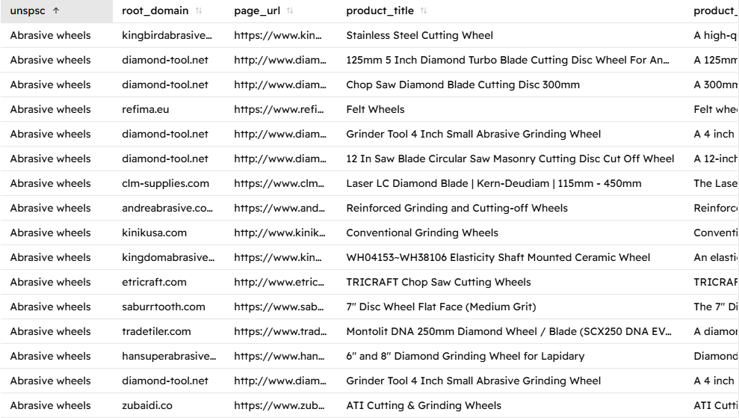
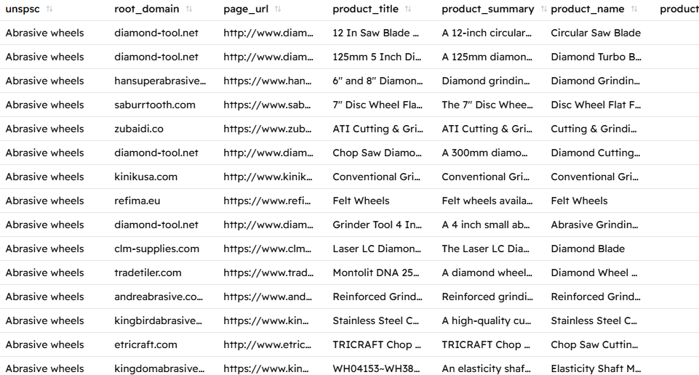
Results
If we look closely, we can see, that the duplicated “Grinder Tool 4 Inch Small Abrasive Grinding Wheel” have been removed, the only difference being that the new output file has been sorted alphabetically by the unspsc and then by title.
Oprea Alexandru-Ionuț

Slide 6
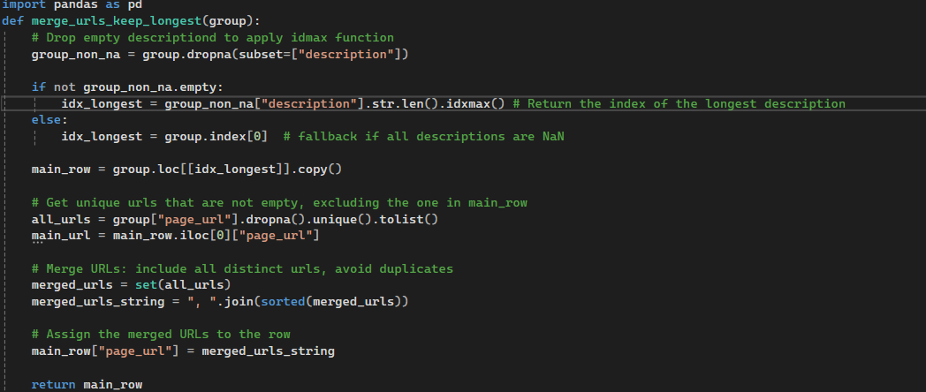
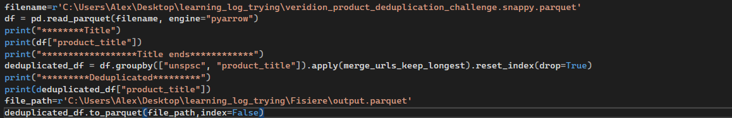
Code Explanation
First line, we import pandas as pd to make a dataframe out of our parquet file. The function merge_urls_keep_longest(group), keep the longest description of a group and the shorter one it’s removed, and it’s url merged to the kept row. First, we apply the function idmax to rows with non-empty descriptions, otherwise we keep the first one. The function idmax return the value of the longest description. Then, we merge urls and apply set to make sure duplicated urls are removed. Main row will only keep the merged urls and the longest description of the group.
In the main program we will use pandas function read_parquet to read the parquet file through defined path. Pyarrow engine it’s used to improve the performance of the function. After seeing all titles, we group our dataframe by unspsc and product title and apply for each row the function we defined to return the row with the longest description. In this case, it will remove the duplicates that are having the same unspsc and title and keep an unique object with longest description. Function reset_index is updating the index after the function have been applied. After doing this we apply the function to_parquet to write the new data frame to other parquet file.
Oprea Alexandru-Ionuț

