Slide 1

Product Deduplication

Slide 2
Introduction
When working with large datasets, it happens to have duplicates because LLMs can extract the same product from different sources. In this case, it’s necessary to remove duplicated products.
The format used to store such large datasets is called Parquet. Parquet it’s an open source file format built to handle flat columnar storage data formats. Parquet operates well with complex data in large volumes. It is known for its both performant data compression and its ability to handle a wide variety of encoding types.
For large datasets, Parquet file it’s better because of efficient storage, better compression, schema and type information, parallel processing and his structure that allows to work with big data ecosystems.

Slide 3
Python programming language
In project, the programming language used it’s Python because of his libraries that hill help us work with large datasets. Python is a programming language that is widely used in web applications, software development, data science, and machine learning (ML). Developers use Python because it is efficient and easy to learn and can run on many different platforms. Python software is free to download, integrates well with all types of systems, and increases development speed.
Python has a library created specially for data analysis called pandas. Pandas it’s a library that has predefined functions to read a parquet file and to analyze and even change the data frame. Another library used it’s sentence_transformers which it’s used for state-of-the-art sentence, text and image embeddings.

Slide 4
Solution Deployment
To effectively deploy a solution, we must remove the rows with similar descriptions, merge their urls and root domains and keep the longest description. After doing this, by the unique identifier “product_title”, we can see that although descriptions are not so similar, the object it’s the same, so we need to to keep the one with longest descriptions and drop the other and also merge their urls and root domains.

Slide 5
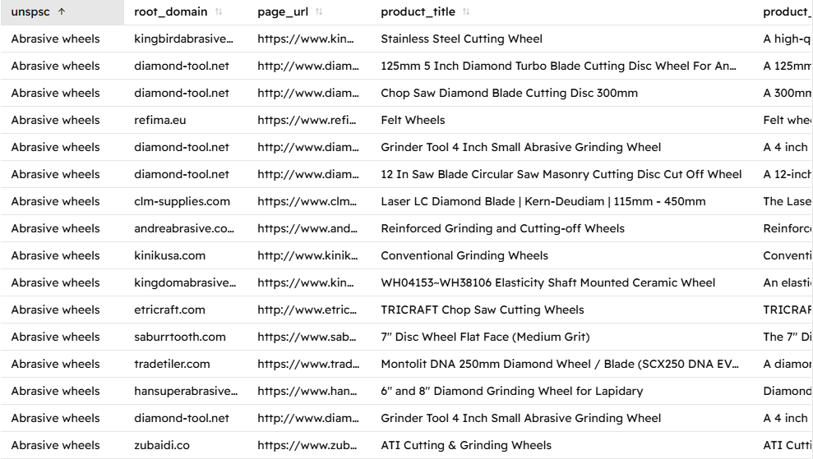
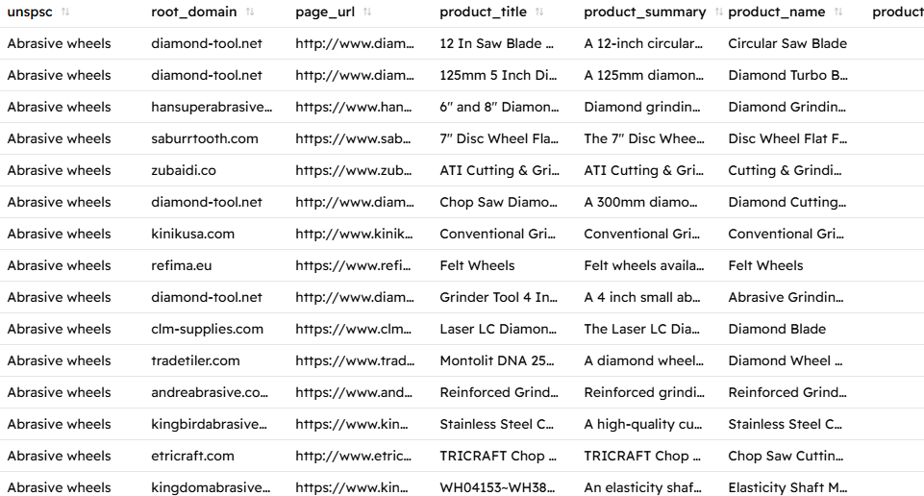
Results
If we look closely, we can see, that the duplicated “Grinder Tool 4 Inch Small Abrasive Grinding Wheel” have been removed, the only difference being that the new output file has been sorted alphabetically by unspsc and title.

Slide 6
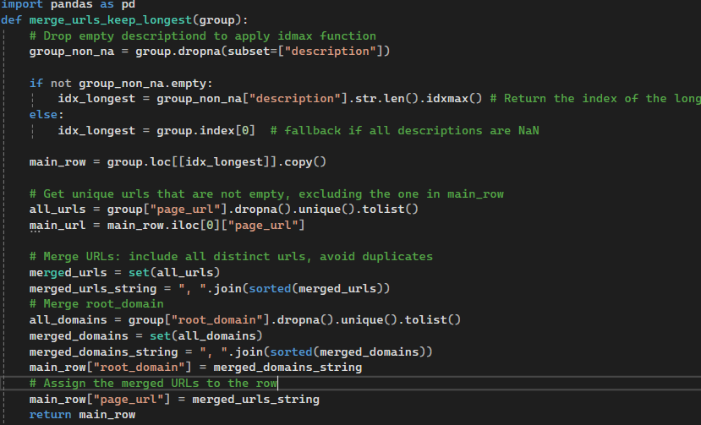
Code Explanation-Function merge_urls_keep_longest
First line, we import pandas as pd to make a dataframe out of our parquet file and second we import sentence_trasnformers to check similarity between descriptions.. The function merge_urls_keep_longest(group), keep the longest description of a group and the shorter one it’s removed, and it’s url merged to the kept row. First, we apply the function idmax to rows with non-empty descriptions, otherwise we keep the first one. The function idmax return the value of the longest description. Then, we merge urls and root domains and apply set to make sure duplicated urls and root domains are removed. Main row will only keep the merged urls and root domains and the longest description of the group.

Slide 7
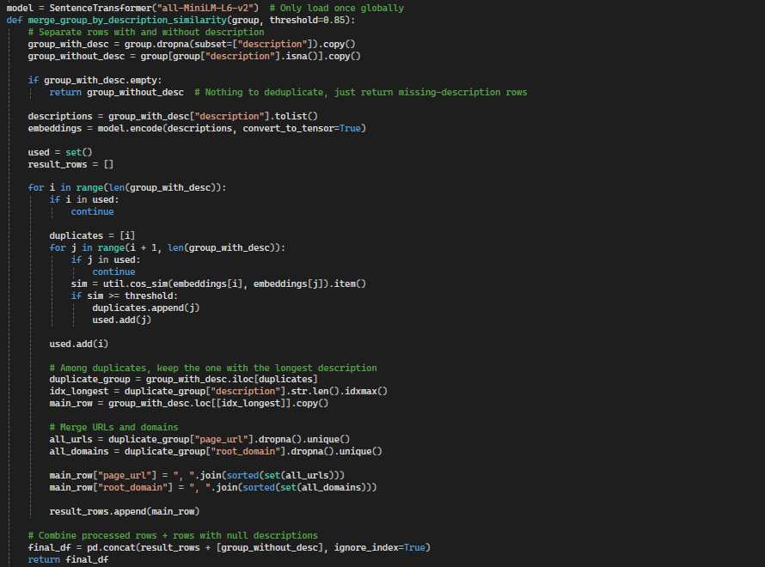
Code Explanation-Function merge_group_by_description_similarity
First, we define a global model. Model all-MiniLM-L6-v2 it’s a sentence-transformer used for semantic search, clustering and identifying sentence similarity. all-MiniLM-L6-v2 it’s a powerful model trained to generate high quality embeddings from sentences.
In the defined function, our model will encode all descriptions that are not empty. The term embeddings refers to a vector representation of the information. The variable used keeps track of the description that have already been compared. Variables i and j goes through each row one by one. If i had been processed as part of another duplicated, skip it. The variable sim calculates the cosine similarity between the rows i and j. If similarity it’s bigger than the threshold we mark i as duplicate of i and i as processed. After this, a variable will extract all duplicates using their indices, and the main row will hold only the one with the longest description. Similar to anterior function, we will add urls and and root domains to the main row with the longest description. The final step it’s to add empty description rows to the final dataframe.

Slide 8
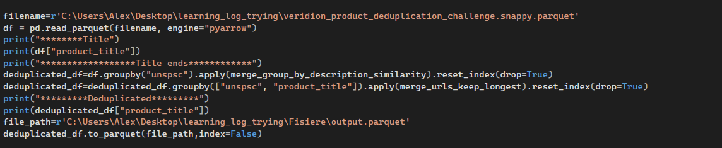
Code Explanation-Main program
In the main program we will use pandas function read_parquet to read the parquet file through defined path. Pyarrow engine it’s used to improve the performance of the function. After seeing all titles, we group our data frame by unspsc and product title and apply for each row the function we defined to return the row with the longest description. In this case, it will remove the duplicates that are having the same unspsc and title and keep an unique object with longest description. Function reset_index is updating the index after the function have been applied. Similar we apply the function to check for similarity, keep the longest description and merge urls and root domain. After doing this function to_parquet it’s applied to write the final data frame to a new parquet file.

