Slide 1

College Dropout Predictor Triet Tran Alex Ordonez Subaranjana Giridharan Chris Nicols

Slide 2
AGENDA
The Problem
Dataset and the need for Dimension Reduction
Dimension Reduction through 3 steps
Applying models
Logistic Regression
CART
Neural Network
Predictive Performance Comparison & Conclusion

Slide 3
The Problem

Slide 4
The Problem
Getting started in College level academia can be difficult for many students
Due to a lack of support, we see many students dropout in the early stages of the college careers
Can we create a predictive model based on student information at the time of their enrollment/and end each semester that would determine their likelihood of dropping out?
This model like this could potentially help Universities guide students to support programs or academic counseling to help them succeed

Slide 5
Dataset and the need for Dimension Reduction

Slide 6
Dataset
Undergraduate students doing different programs of Polytechnic Institute of Portalegre, Portugal from 2008 to 2018/2019
Information is captured at multiple stages:
Right after enrollment,
After the first and second semesters
End of the standard duration of their respective programs
final status is recorded as either dropout, graduate or enrolled
for our binary problem, we consider dropout as 1 and graduate & enrolled as 0

Slide 7
Dataset
Target class distribution
 | Dropout (1) | Non Dropout (0)
Percentage | 32.12 (1421) | 67.88 (3003)
Target class is somewhat imbalance but we will go ahead with it

Slide 8
Independent Variables Overview
Variables describes the following aspects of a student
Demographic information at the time of enrollment
Program at the university
1st semester information
2nd semester information
Some selected variables are shown on the next slide for each type

Slide 9
Independent Variables Overview
Demographic Information |  | unemployment_rate | unemployment rate of student’s nation at the time of application
nationality | nationality of the applicant | First Semester Information
marital_status | indicates the marital status of the applicant | curricular_units_1st_sem_credit | transferred credit for 1st semester
mother's_qualifications | educational qualification of the applicant’s mother | curricular_units_1st_sem_evaluations | # tests in 1st semester
mother's_occupations | occupation of the applicant’s mother | curricular_units_1st_sem_approved | # units earned after 1st semester
previous_qualifactions | type of qualification help by the applicant | curricular_units_1st_sem_enrolled | # credits enrolled for 1st semester
GDP | GDP of student’s nation at the time of application | curricular_units_1st_sem_grade | grade average of 1st semester between 0 - 20

Slide 10
Dimension Reduction
Original Data
# records: 4424 observations
# independent variables: 36
Categorical variables: 32
Many have more than 10 classes
Numerical variables: 4
Data is too sparse! We need Dimension Reduction.
Dimension Reduction through Exploratory Data Analysis

Slide 11
Dimension Reduction through 3 steps

Slide 12
Exploratory Data Analysis
Reduction is done through 3 steps
Grouping classes based on meaning of variables – using domain knowledge
Grouping classes based on distribution over target variable – using statistical methods
Removing columns

Slide 13
Grouping classes based on meaning of variables
Examining variables meaning and the number of classes in each variable
Process:
Reviewed the meaning and structure of the variables
Based on the findings, certain variable classes can be grouped into meaningful class groups

Slide 14
Example Breakdown
0 - Student 1 - Representatives of the Legislative Power and Executive Bodies, Directors, Directors and Executive Managers 2 - Specialists in Intellectual and Scientific Activities 3 - Intermediate Level Technicians and Professions 4 - Administrative staff 5 - Personal Services, Security and Safety Workers and Sellers 6 - Farmers and Skilled Workers in Agriculture, Fisheries and Forestry 7 - Skilled Workers in Industry, Construction and Craftsmen 8 - Installation and Machine Operators and Assembly Workers 9 - Unskilled Workers 10 - Armed Forces Professions 90 - Other Situation 99 - (blank) 101 - Armed Forces Officers 102 - Armed Forces Sergeants 103 - Other Armed Forces personnel 112 - Directors of administrative and commercial services 114 - Hotel, catering, trade and other services directors 121 - Specialists in the physical sciences, mathematics, engineering and related techniques 122 - Health professionals 123 - teachers 124 - Specialists in finance, accounting, administrative organization, public and commercial relations 131 - Intermediate level science and engineering technicians and professions 132 - Technicians and professionals, of intermediate level of health 134 - Intermediate level technicians from legal, social, sports, cultural and similar services 135 - Information and communication technology technicians 141 - Office workers, secretaries in general and data processing operators 143 - Data, accounting, statistical, financial services and registry-related operators 144 - Other administrative support staff 151 - personal service workers 152 - sellers 153 - Personal care workers and the like 154 - Protection and security services personnel 161 - Market-oriented farmers and skilled agricultural and animal production workers 163 - Farmers, livestock keepers, fishermen, hunters and gatherers, subsistence 171 - Skilled construction workers and the like, except electricians 172 - Skilled workers in metallurgy, metalworking and similar 174 - Skilled workers in electricity and electronics 175 - Workers in food processing, woodworking, clothing and other industries and crafts 181 - Fixed plant and machine operators 182 - assembly workers 183 - Vehicle drivers and mobile equipment operators 192 - Unskilled workers in agriculture, animal production, fisheries and forestry 193 - Unskilled workers in extractive industry, construction, manufacturing and transport 194 - Meal preparation assistants 195 - Street vendors (except food) and street service providers
Original classes of father’s_occupation variable

Slide 15
Grouping classes based on distribution over target variable
Classes further grouped based on distributions of each class over target binary variable.
Those with similar distributions affect prediction similarly => grouped together.
Process
Examining stacked bar chart to spot seemingly similar distributions over target variables
Examining exact figures with frequency table

Slide 16
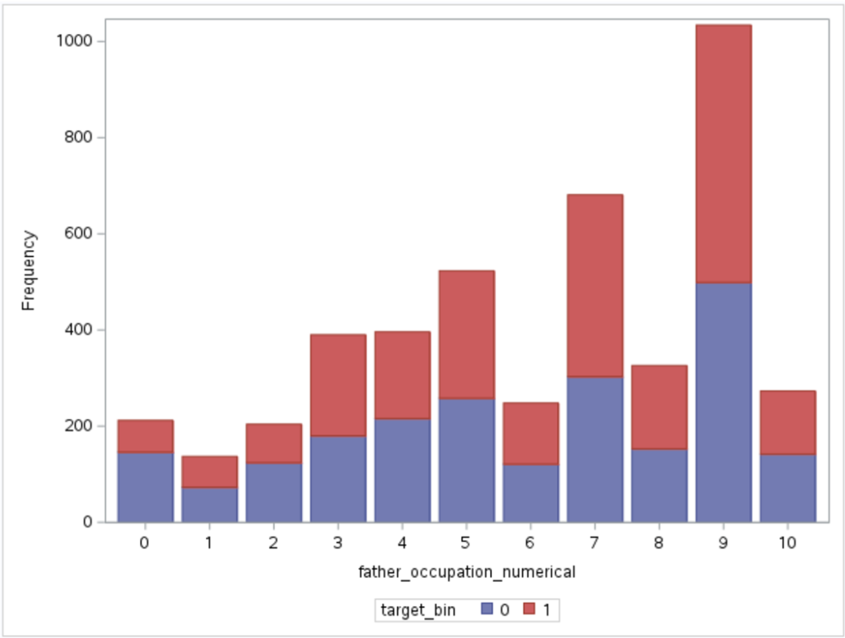
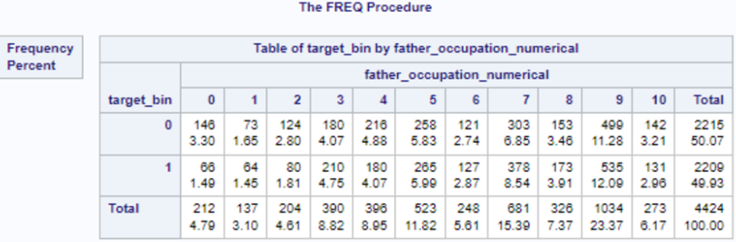
Example Breakdown
Distribution of father’s_occupation over classes of the target variable

Slide 17
Removing Variables
Columns are removed if
Unclear interpretation
Similar distributions over target variable
Removed because they do not provide information to distinguish between classes of the target variable
Variables removed: 5 - nationality, educational_special_needs, international, CU1Sem_Credit, CU2Sem_Credit

Slide 18
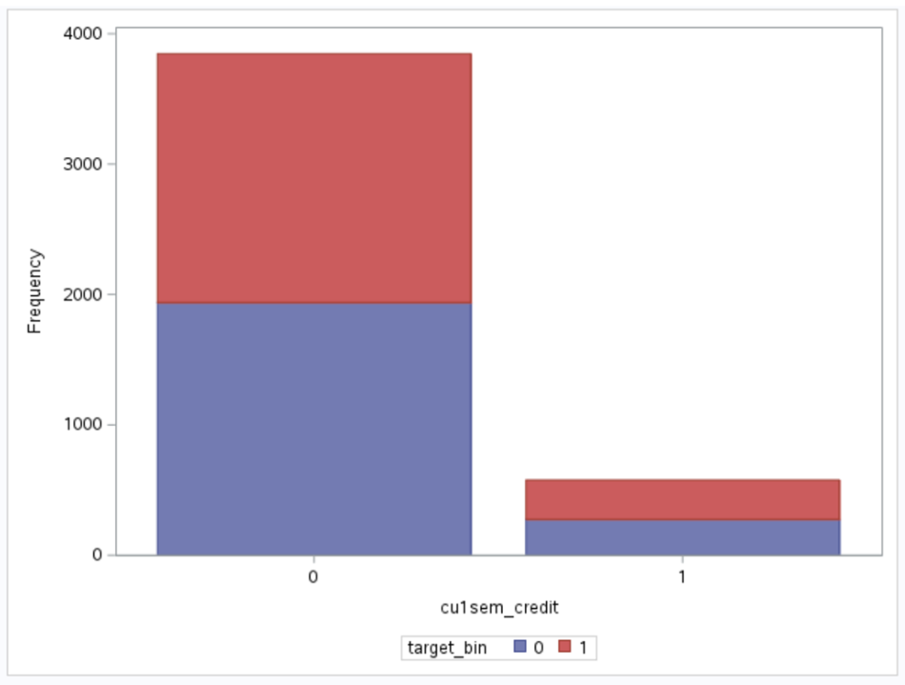
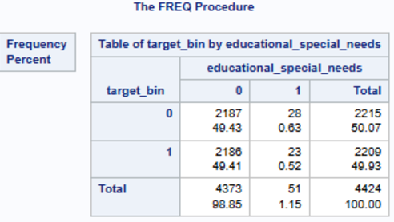
Example Breakdown
Distribution of cu1sem_credit over classes of the target variable

Slide 19
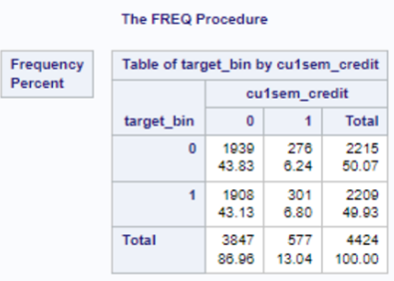
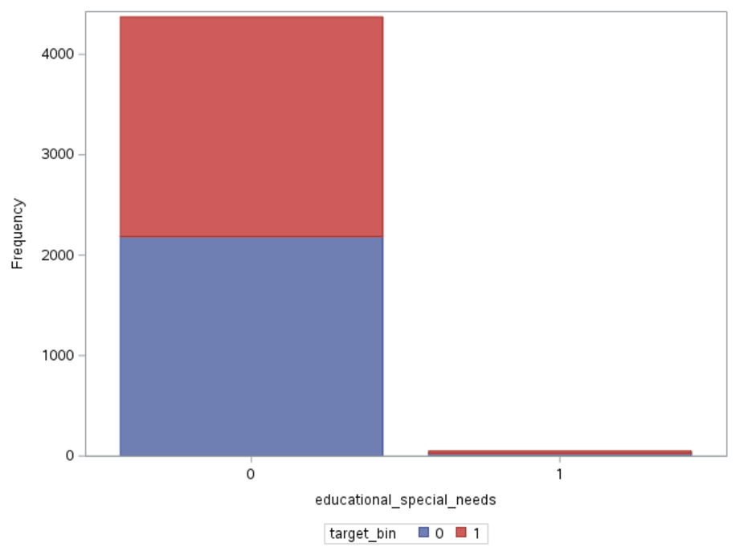
Example Breakdown
Distribution of educational_special_needs over classes of the target variable

Slide 20
Exploratory Data Analysis Conclusion
 | Before Reduction | After Reduction | % Reduction
# of Independent Variables | 36 | 30 | 16.67%
# of independent Variables after one-hot Coding | 517 | 73 | 85.88%

Slide 21
Exploratory Data Analysis
We will refer to the list of variables after reduction through EDA as “VarsEDA”

Slide 22
Applying the Models

Slide 23
Logistic Regression
Ran Logistic Regression model with VarsEDA using selection methods
End up with 3 models
Backward
Forward
Stepwise

Slide 24
Logistic Regression
The following results show the performance of each regression model selection method on validation set
 | Backward | Forward | Stepwise
AUC | 91.58 | 91.36 | 91.34
Sensitivity | 74.54 | 74.54 | 73.80
Specificity | 93.96 | 93.96 | 93.47
# Variables | 51 | 49 | 49
Forward selection is best in measurements, also most parsimonious

Slide 25
CART
Ran CART with VarsEDA with Entropy and GIni
Each model will produce a list of important variables
Run each model with their respective list of important variables
We end up with 4 models
CART Gini with VarsEDA
CART Gini with vars reduced by CART Gini
CART Entropy VarsEDA
CART Entropy with vars reduced by CART Entropy

Slide 26
CART
CART models performance on Validation Set
 | Entropy VarsEDA (1) | Entropy (reduced) (2) | Gini VarsEDA (3) | Gini (reduced) (4)
AUC | 88.26 | 85.34 | 86.68 | 86.37
Sensitivity | 71.22 | 65.31 | 69.74 | 66.79
Specificity | 92.99 | 94.94 | 93.47 | 94.29
# Leaves | 22 | 15 | 13 | 10
Best Prediction - 1; Most Parsimonious - 3
Since comparing Logistic Regression - CART - Neural Networks models based on predictive capability, not parsimony, (1) is deliberately chosen
Notes:
However, since we will compare between different types of model (Logistic Regression, CART and Neural Networks), the only universal comparison is in terms of predictive capability, not parsimony, here we deliberately chose the one with best predictive power (1)

Slide 27
Neural Network
Uses VarsEDA
Three architectures:
1 hidden layer of 32 neurons
2 hidden layer of 32 and 16 neurons
2 hidden layer of 32 and 48 neurons

Slide 28
Neural Network
Neural Network models performance on Validation Set
 | 32 (1) | 32 - 16 (2) | 32 - 48 (3)
Sensitivity | 73.06 | 70.85 | 73.80
Specificity | 93.80 | 94.78 | 94.45
Misclassification | 12.56 | 12.56 | 11.88
Best Prediction - 3; Most Parsimonious - 1
Since comparing Logistic Regression - CART - Neural Networks models based on predictive capability, not parsimony, (3) is deliberately chosen

Slide 29
Predictive Comparison & Conclusion

Slide 30
Comparison Logistic Regression - CART - Neural Network
Predictive models performance on Validation Set
 | Logistic Regression Forward Selection (1) | CART Entropy VarsEDA (2) | NN 32 - 48 (3)
Sensitivity | 74.54 | 71.22 | 73.80
Specificity | 93.96 | 92.99 | 94.45
Misclassification | 11.99 | 13.69 | 11.88
Best Prediction - 1
Emphasis is given for Sensitivity so even though (3) scores best in two categories, (1) is still chosen

Slide 31
Conclusion
Best model for classification
Logistic Regression
all models perform well (difference of ~1%)
Can we accurately predict student dropouts?
The logistic regression model can accurately predict the likelihood of student dropout to 74.5%
We have to conclude for a university to implement this, it would not be accurate enough (Tell us the exact students that will drop).
This can be used with other information to make judgements on which students should receive early support

