Slide 1

Weather Data Analysis & Forecasting
TechAssessment Data Scientist
March 21, 2025
By Alex Ordonez

Slide 2
Mission
By making industry-leading tools and education available to individuals from all backgrounds, we level the playing field for future PM leaders. This is the PM Accelerator motto,
as we grant aspiring and experienced PMs what they need most – Access. We introduce you to
industry leaders, surround you with the right PM ecosystem, and discover the new world of AI
product management skills.

Slide 3
Introduction
Goal: Analyze the 'Global Weather Repository.csv' dataset to forecast future weather trends.
Showcase data science skills using various techniques.
Dataset contains 59,633 records with 41 columns related to global weather conditions.

Slide 4
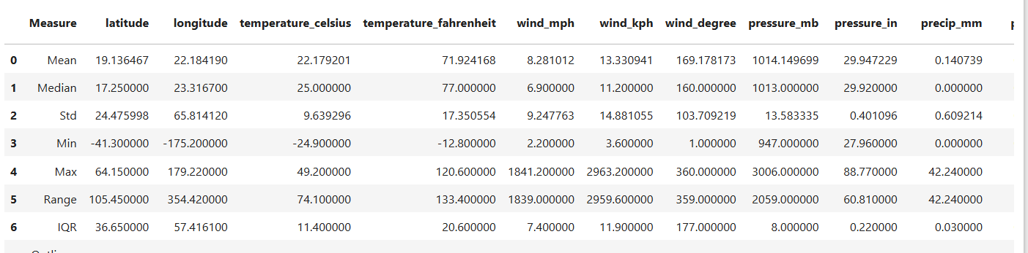
Data Exploration
• Dataset contains country, location, latitude, longitude, timezone, temperature, wind, air quality, and celestial data.
• Data inspection showed no missing values.
• Key variables include temperature, wind speed, air quality indices, and moon illumination.
•Calculated measures to get a glimpse of the overall data.

Slide 5
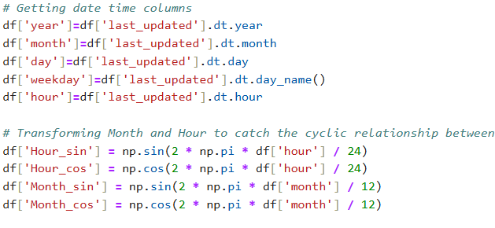
Data Cleaning & Preparation
• Converted timestamp to datetime format.
• Extracted year, month, day, weekday, and hour.
• Transformed cyclic features for hours and months.
• Scaled numerical values using MinMaxScaler.

Slide 6
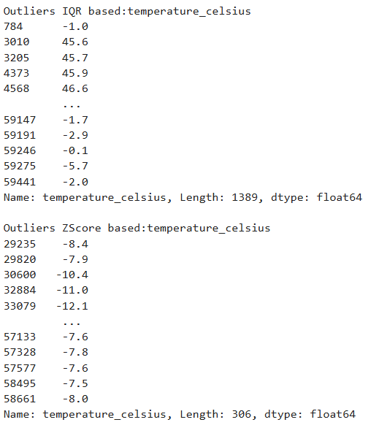
Outlier Detection
• Used IQR (1.5 * IQR) and Z-score (±3 std) methods.
• Detected anomalies in temperature, wind speed, pressure, and air quality indices.
• Addressed extreme values in data preprocessing.

Slide 7
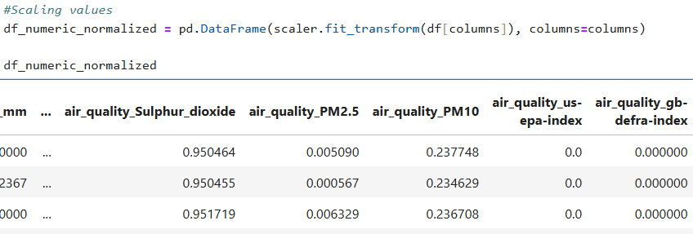
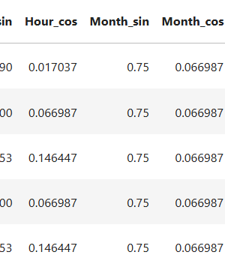
Feature Engineering
• Added new features: month, hour, cyclic transformations.
• Normalized numerical variables for better model performance.
• Converted categorical time-related fields (sunrise, sunset, etc.) to numerical format.

Slide 8
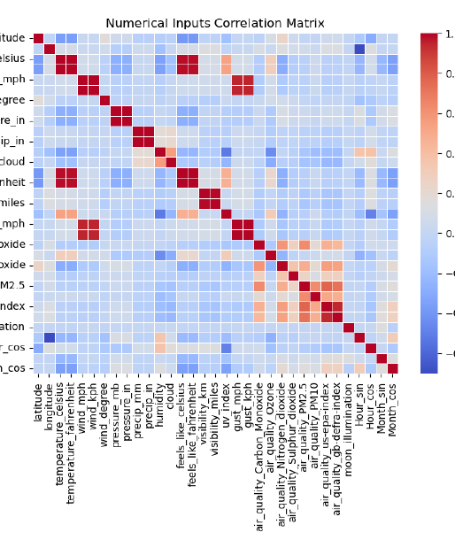
Correlation Analysis
• High correlation between same measures with different units.
• Air quality indicators show dependencies on environmental factors.
• Wind speed and gusts are strongly related.

Slide 9
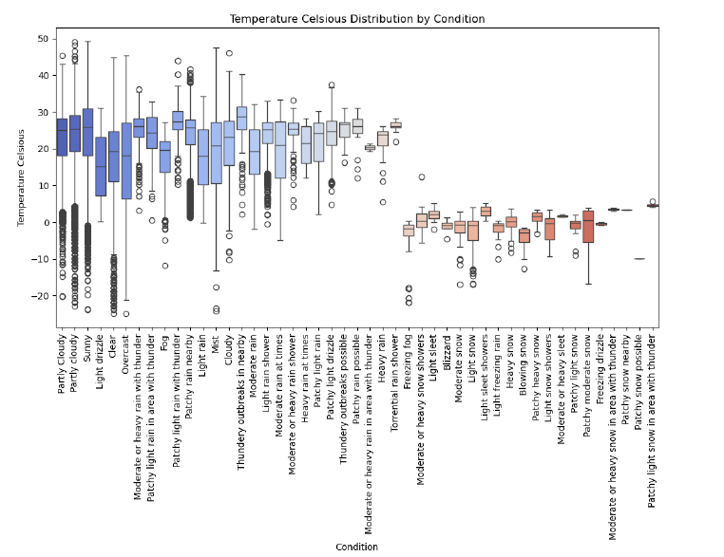
Plots

Slide 10
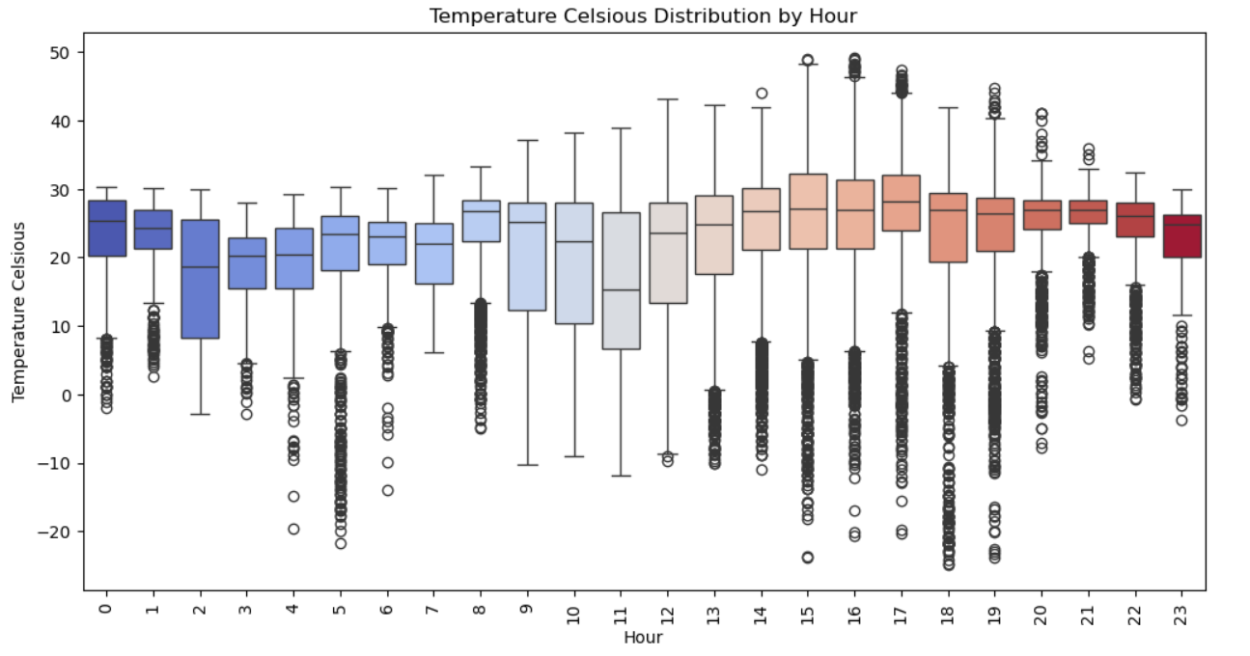
We can see that the condition and also the hour of the day can influence the temperature

Slide 11
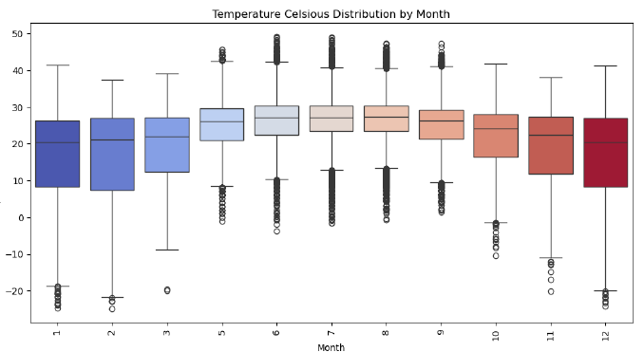
We can see that the month can influence the temperature mainly that it gets hotter in the months in between, summer time.

Slide 12
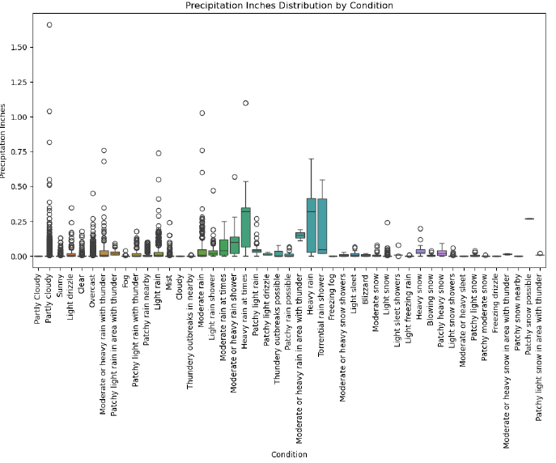
The Condition also has influence in the precipitation

Slide 13
Weather Forecasting Models
• Implemented LSTM & Random Forest model for time series forecasting.
• Implemented Random Forest & linear regression as Stacked meta models combining predictions of previous models
• Evaluated performance using MAE, RMSE, and R² scores.
• Used different methods for feature importance random forest variable importance & SHAP

Slide 14
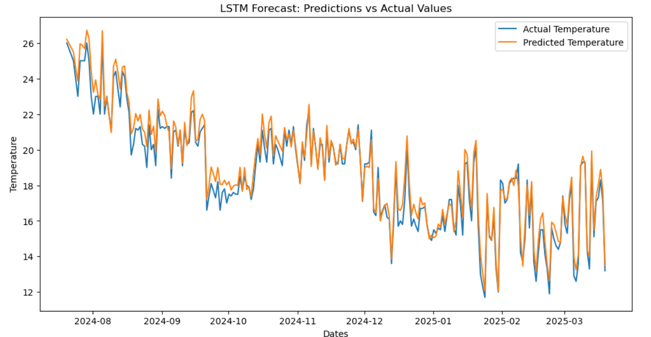

Fit LSTM Measures
The training went well and it seems that the model is apparently a good fit (just looking a temperature)

Slide 15
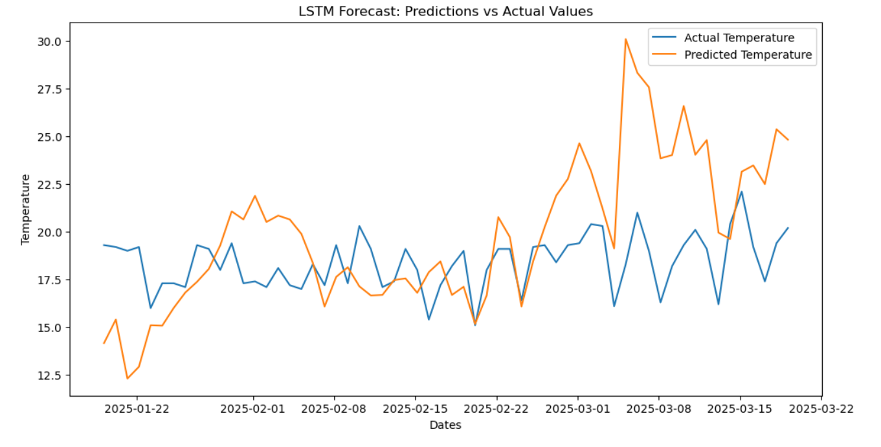

Test LSTM Measures
In the test set the performance is not that good but the model tries to simulate the temperature trend.

Slide 16
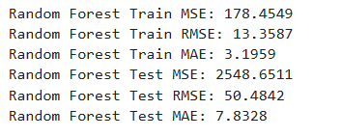
Train/Test Random Forest Measures
Good Measures for the Training and validation sets. Compared to the LSTM the training is better in the NN but in the test set the random forest is better.

Slide 17
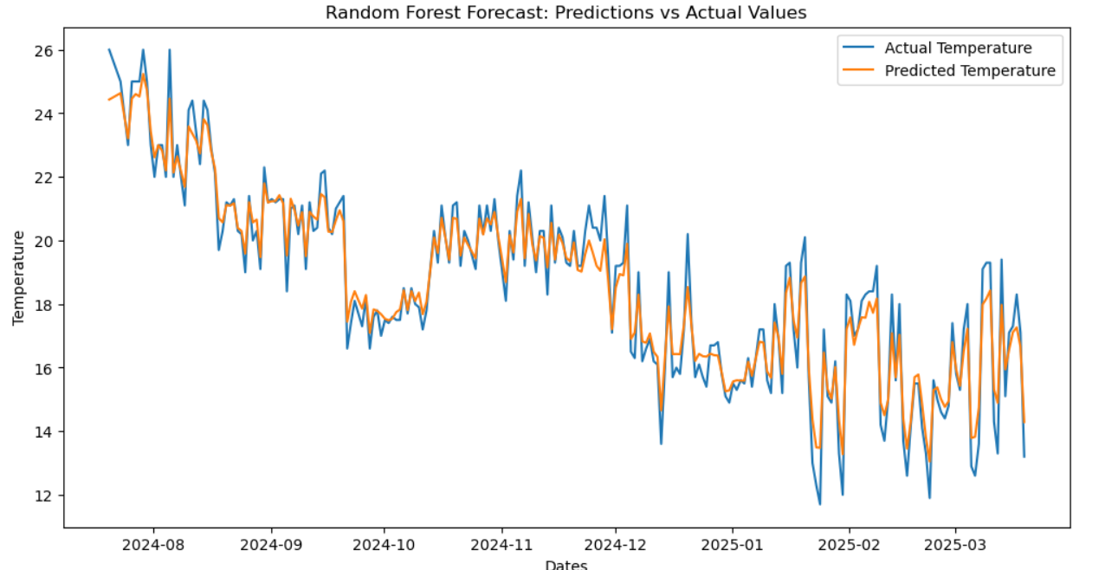
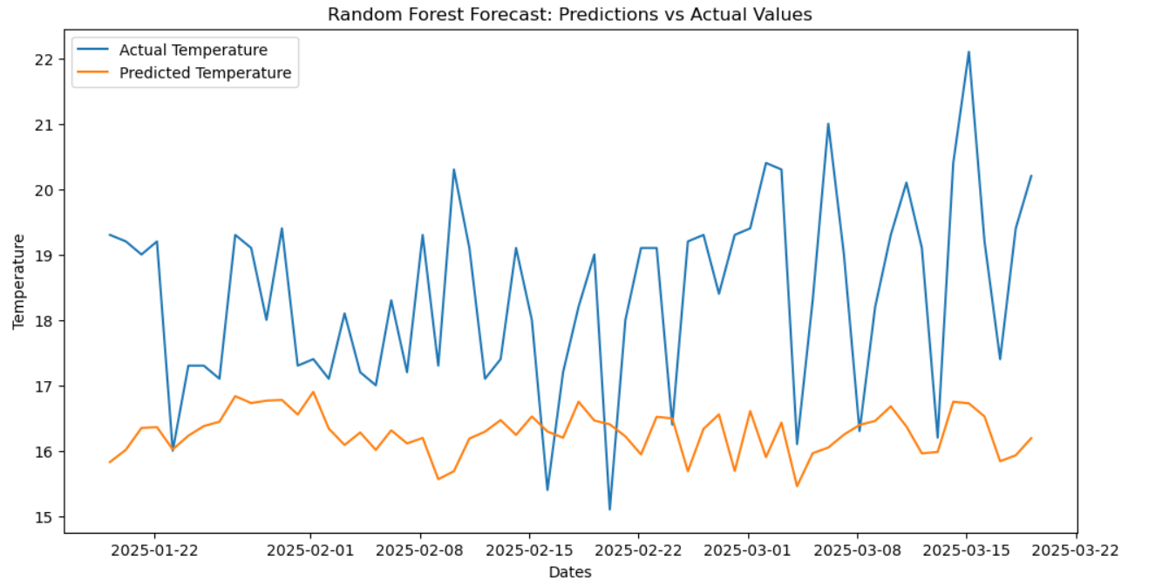
Train/Test Random Forest
Following the plots in the training it performs very well and in the test it gets closer but it is not catching very well the complexity of the temperature trend

Slide 18
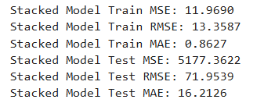
Train Linear Regression Stacked Model Measures
I combined the predicted values from the previous 2 models and used them as input for the linear regression model. The model in the trainning set performs very well and in the validation in comparison with the LSTM is better but not than the Random Forest.

Slide 19
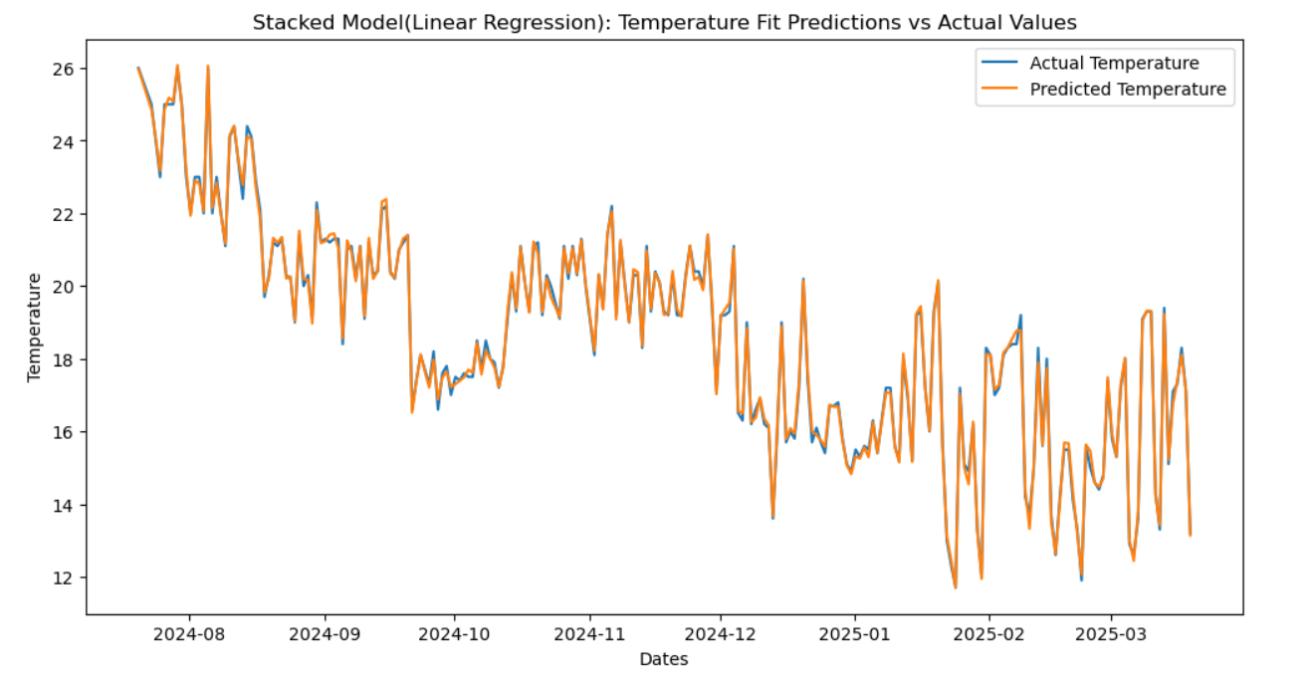
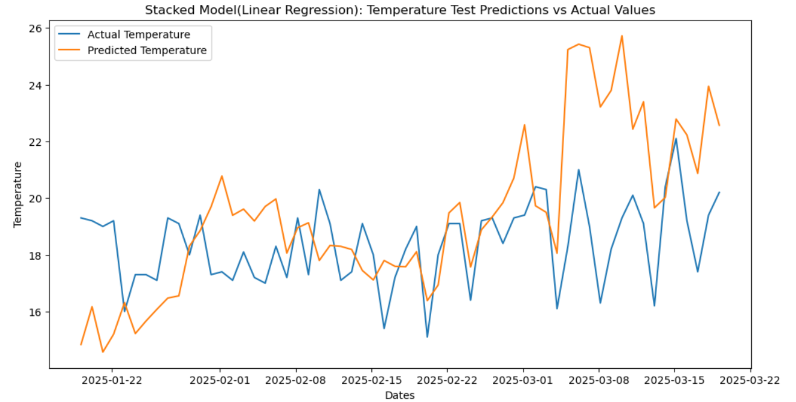
Test Linear Regression Stacked Model
We can see in the fit plot that is almost perfect, and in the validation it got better.

Slide 20
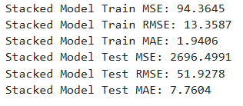
Train Random Forest Stacked Model Measures
I combined the predicted values from the previous 2 models and used them as input for the Random Forest model. The model in the trainning set performs very well and in the validation it is the best.

Slide 21
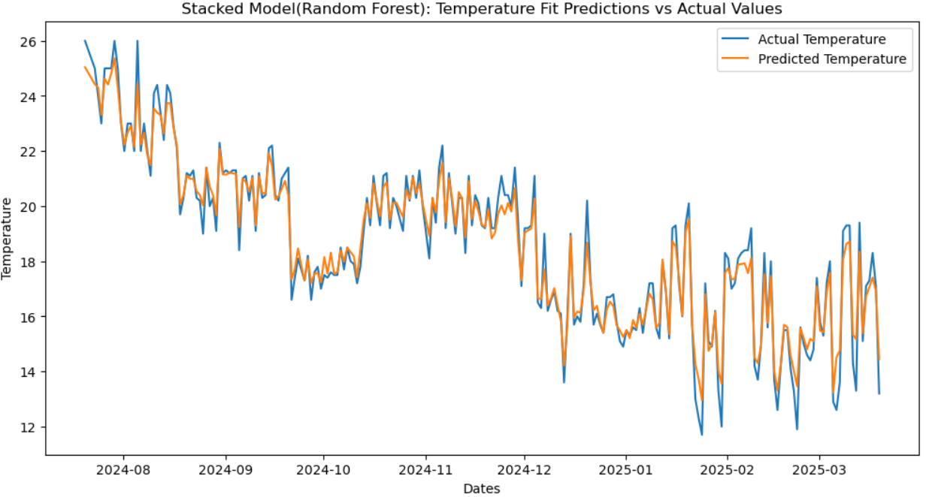
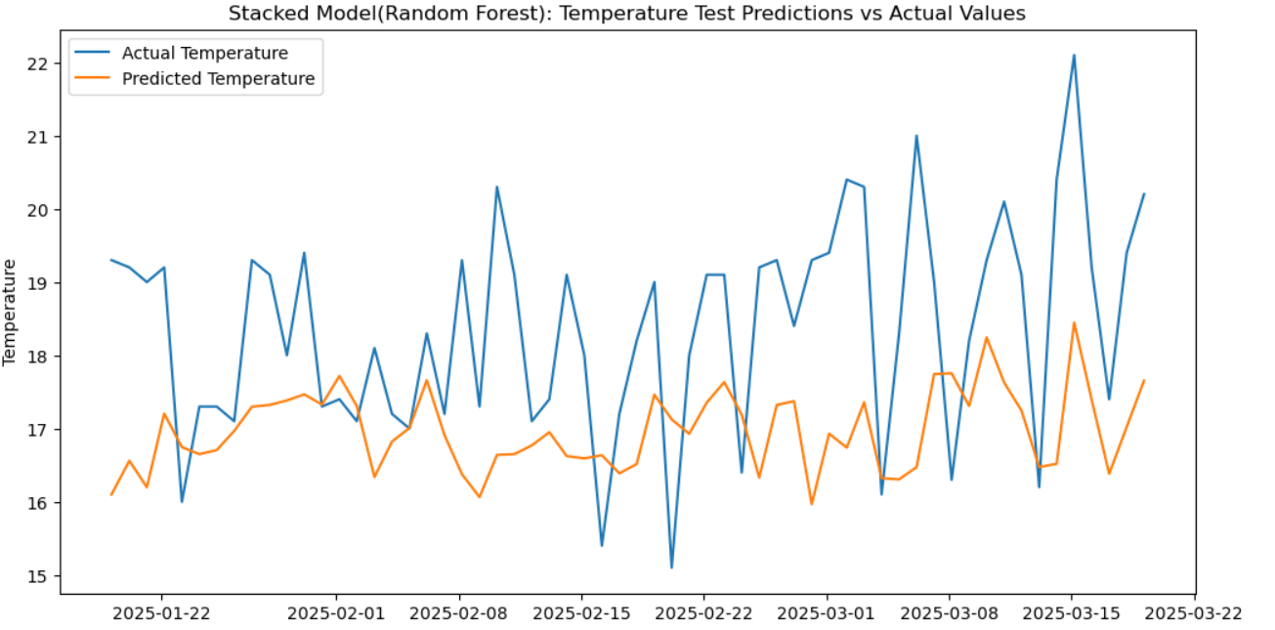
Test Random Forest Stacked Model
We can see in the fit plot that is really good but not as with the stacked linear regression, and in the test set is better.

Slide 22
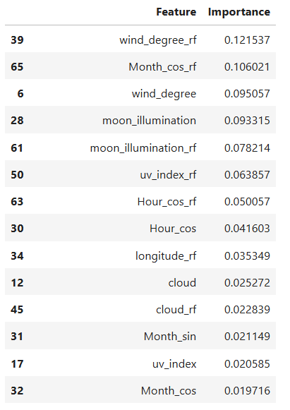
Variable importance Random Forest

Slide 23
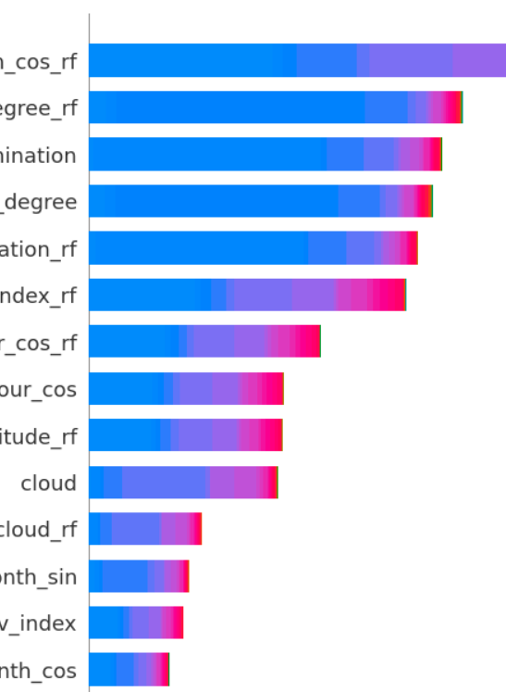
Variable importance Random Forest using SHAP

Slide 24
Conclusion & Next Steps
• Successfully cleaned, explored, and analyzed the dataset.
• Built predictive models for temperature and weather conditions.
• Future work: Fine-tune models, add more model types to the ensemble model stack, and deploy for real-time forecasting.

