Slide 1

Midterm 4
Continual Learning with Deep Generative Replay
Pasquali Alex

Slide 2
The setting
Deep learning is the state-of-the-art tool to solve many complex tasks.
The trend has been to go towards more and more complicated problems, but in narrow domains.
The scenario was usually offline learning, where the training data is all available prior to the deployment of the model.
This creates problems in terms of adaptability and versatility of the model, as well as of scalability and feasibility in some real-world applications.
Continual Learning
Continual learning is a framework where the model learns sequentially from a stream of experiences.
Data can become available during time
No access to previously encountered data is necessary (depends on the approach)
Constant computational and memory resources (depends on the approach)

Slide 3
The problem
“Attempts to train a comprehensive artificial intelligence capable of solving multiple tasks have been impeded by a chronic problem called catastrophic forgetting” [1]
Catastrophic Forgetting
Problem where the model’s performance on previously learnt tasks degrades when the model is trained on a new task because the parameters are optimized for the new one without considering the previous knowledge.
Stability vs plasticity tradeoff
It is not sustainable to train the model from scratch for every new experience
Some solution approaches
Regularization-based
Elastic weight consolidation (Kirkpatrick et al, 2017)
Learning without forgetting (Li et al, 2018)
Rehersal-based
Rehearsal and Pseudorehersal (Robins, 1994)
More advanced replay strategies
Generative Replay (Shin et al, 2017)
Distilled Replay (Rosasco, Carta, Cossu, Lomonaco, Bacciu, 2021)
[1] Hanul Shin, Jung Lee, Jaehong Kim, Jiwon Kim. Continual Learning with Deep Generative Replay, 2017

Slide 4
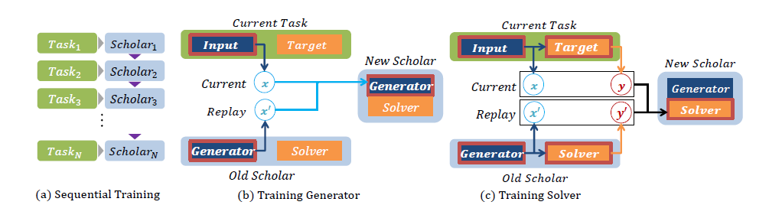
Deep Generative Replay
Scholar model
capable of learning a new task and teaching its knowledge to other networks.
Composed by a generator and a solver
Generator
Deep generative model → GAN
Adversarial training of generator and discriminator
Generator learns to mimic real data distribution
Discriminator learns to distinguish between real and generated data
Solver: Task-solving model (neural network)
Training
Sequential training on scholar model
Train current scholar while referring to recent copy of the network → current scholar learns from past one
Equivalent to train a sequence of scholars
1) Generator training
New generator (G) receives current task’s input (x) and replayed inputs from previous tasks (x’)
x’ generated by the previous scholar’s generator
G learns to reconstruct cumulative input space
2) Solver training
New solver (S) learns to couple inputs and targets from mix of real and replayed data
Replayed targets are past solver’s response to replayed inputs

Slide 5
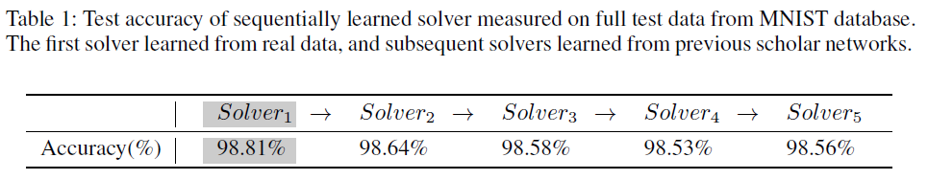
More in depth
Previous generator
r is the ratio between the importance of the new task compared to the older ones
Loss of the solver with real data and real targets
Loss of the solver where the data is generated by the previous generator and the targets are the previous solver’s response to those same inputs
At test time, no self-generated inputs are used
Cumulative distribution of past data
Preliminary experiment
A trained scholar model alone suffices to train an “empty” network.
It’s shown that scholar models transfer knowledge without loosing information.

Slide 6
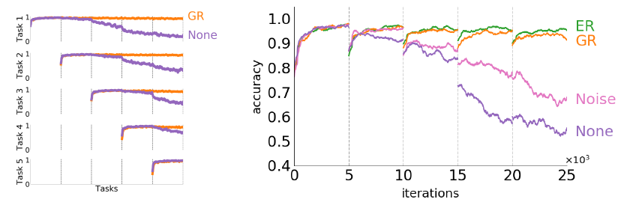
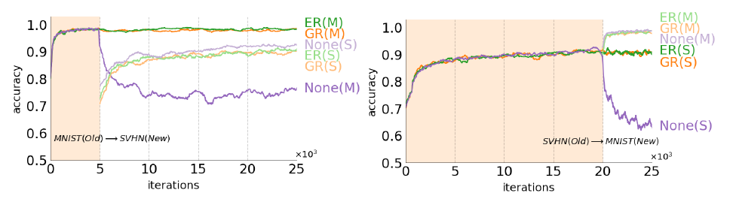
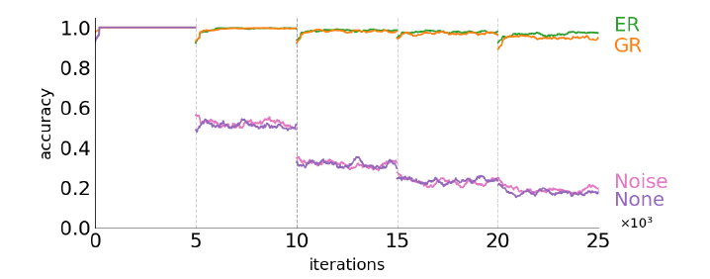
Experiments
Independent tasks
Image classification on MNIST
Pixels shuffled by permutation unique to each task
Solver must classify permuted inputs to original class
Learning new domains
Model sequentially trained to classify MNIST and SVHN numbers
Learning new classes
Model sequentially trained on mutually exclusive subsets of classes
Solver must eventually classify examples from all classes

Slide 7
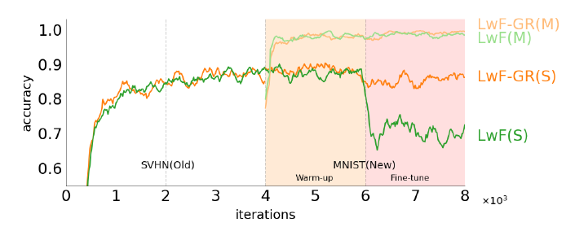
Conclusion
GR has the advantage of not needing any memory
Unlike rehearsal strategies
Maintain former knowledge solely from input-target pairs produced by the saved network
Ease of balancing performances on former and new tasks, but old tasks are balanced as a whole
GR has a constant computational time
No extra parameters for each task like in LwF, where training time linearly increases for each new task
GR is not regularization-based
Approaches such as EWC might suffer from the tradeoff between performances on old tasks and new tasks
The quality of GR heavily depends on the quality of the generator
But improvements in training generative models can be directly reflected into improvements in GR
Generated samples can represent well the data distribution
But they might be less dense of information compared to Distilled Replay, thus more samples would be necessary to mitigate forgetting
LwF needs context about the task that’s being performed (to use a task-specific output layer), GR does not.
GR can be used to augment LwF, adding samples similar to former tasks inputs (instead of using only current task’s inputs to revoke past knowledge)

Slide 8
Thank you for your attention
Pasquali Alex

