Slide 1

Midterm 2 – assignment 3
Restricted Boltzmann Machine &
Deep Restricted Boltzmann Network
Pasquali Alex

Slide 2
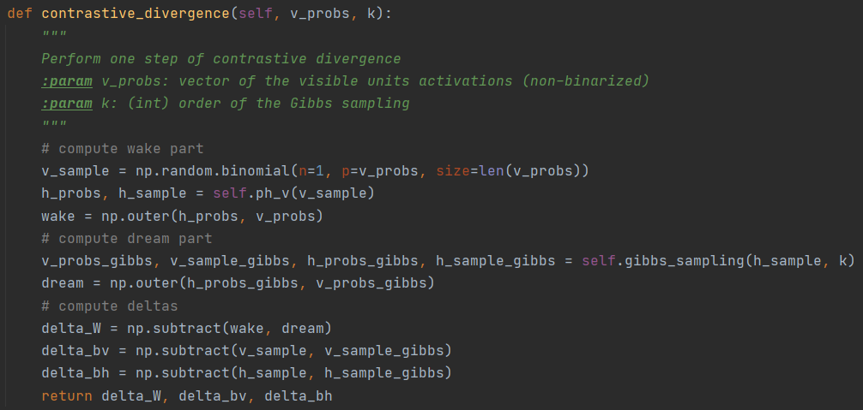
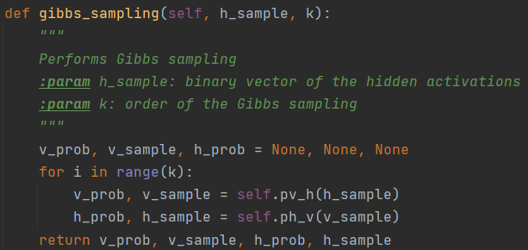
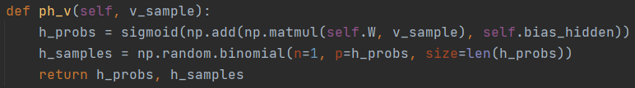
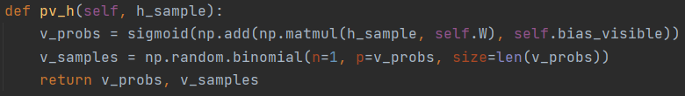
RBM
training
code

Slide 3
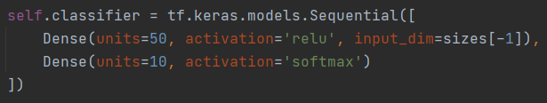
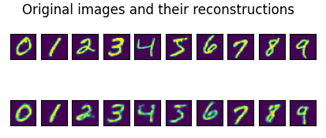
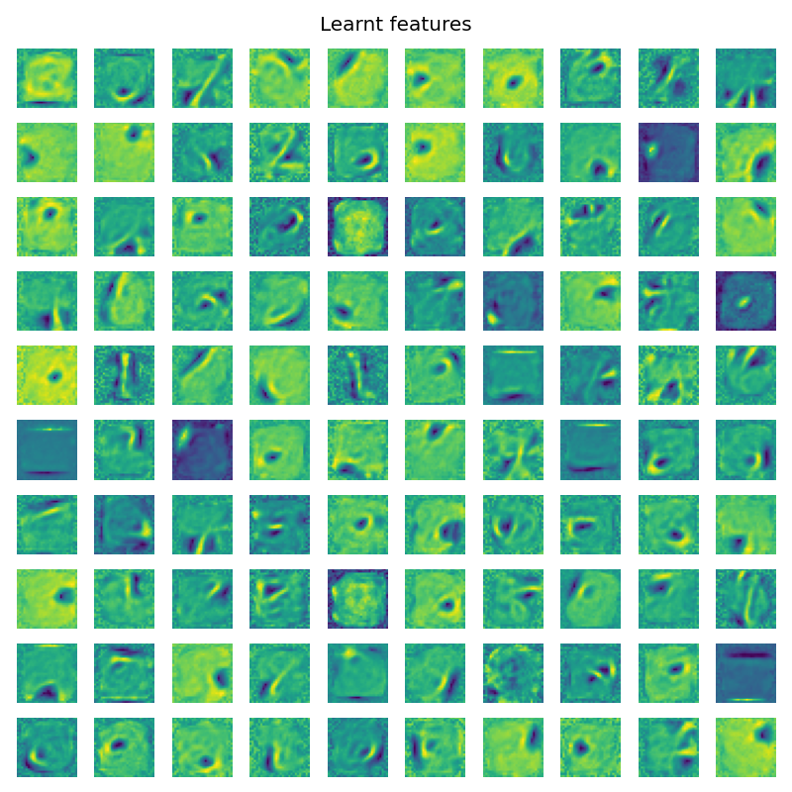
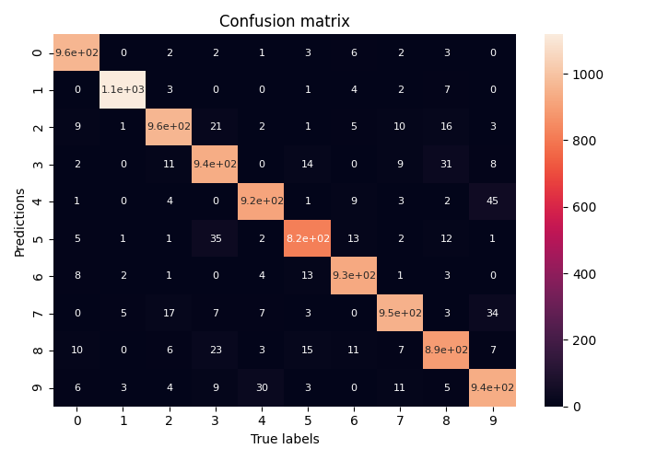
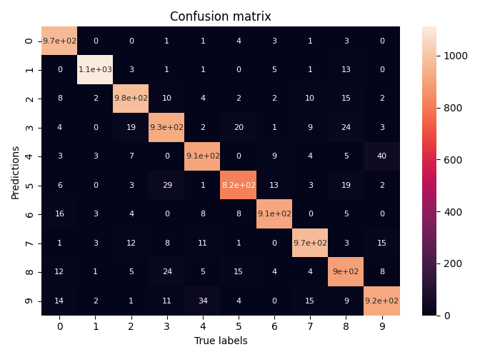
RBM results
Classifier’s architecture:
Contrastive divergence
Epochs = 1, lr = 0.1, k = 1
94.61% accuracy
Persistent contrastive divergence
Epochs = 5, lr = 0.05, k = 1
94.48% accuracy
(2008 – Tieleman)

Slide 4
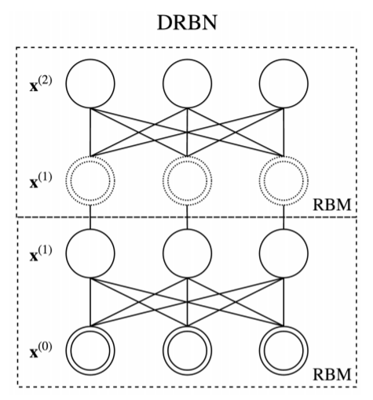
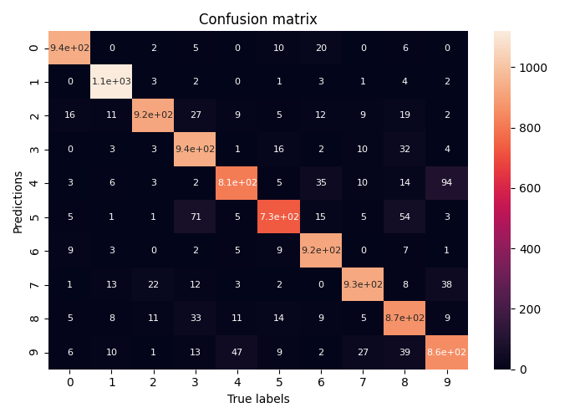
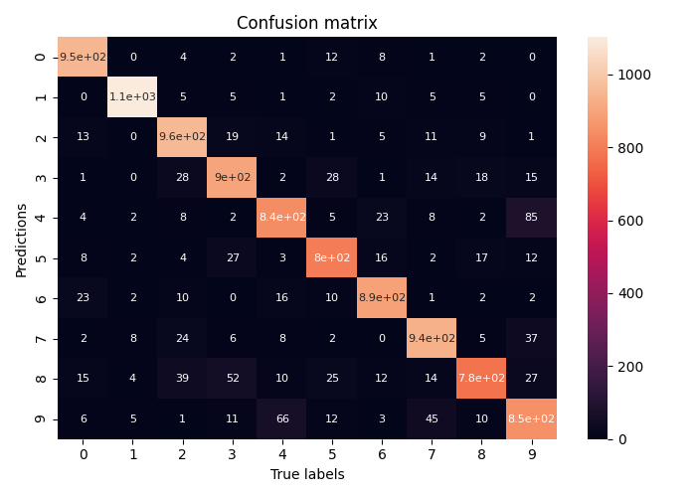
Deep Restricted Boltzmann Network (DRBN)
(2016 - Hengyuan Hu, Lisheng Gao, Quanbin Ma)
Neural network where each layer is an RBM
Hidden units at each layer are also the visible units in the next layer
All RBMs in the network are trained jointly
Persistent contrastive divergence
Architecture: (784, 1000, 500), epochs = 2, lr = 1e-4, k = 1
90.32% accuracy
Contrastive divergence
Architecture: (784, 1000, 500), epochs = 2, lr = 1e-4, k = 1
90.27% accuracy

Slide 5
Possible improvements
Implement a multi-chain PCD
Hu at al. use a batch size of 100 and suggest to use a Gibbs chain for each pattern in a minibatch
Make a comparison between resetting or not the Gibbs chains
Tieleman says that it’s possible to reset the chains at regular intervals, but suggests to never do it
Implement a decay of the learning rate and a weight decay
Tieleman suggests to use both a linear decay of the learning rate and a weight decay
Merge the concepts of Convolutional RBM with Deep Restricted Boltzmann Networks
(2016 - Hengyuan Hu, Lisheng Gao, Quanbin Ma)

Slide 6
Thank you for your attention
RBM & DRBN – Pasquali Alex

