Slide 1
Midterm 1 - Assignment 1
Autoregressive analysis
Alex Pasquali

Slide 2
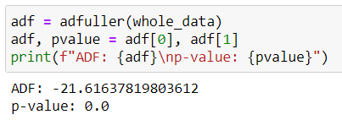
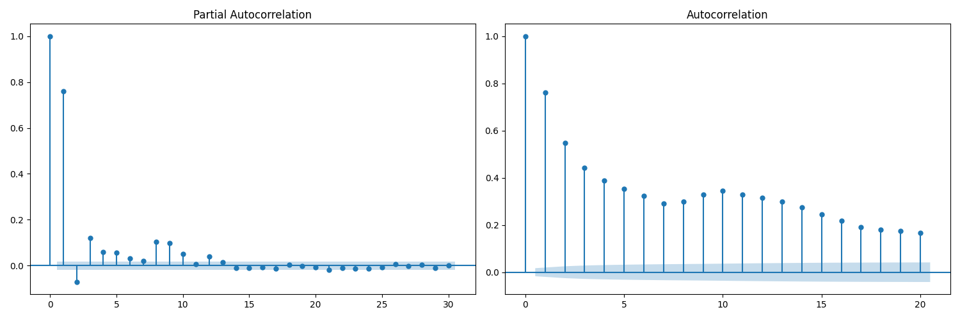
Check if the series is stationary: use Augmented Dickey-Fuller test (ADF)
Plot autocorrelation and partial autocorrelation to understand visually which lags have more influence on the current value y_{t}
It looks like an AR model is a good choice

Slide 3
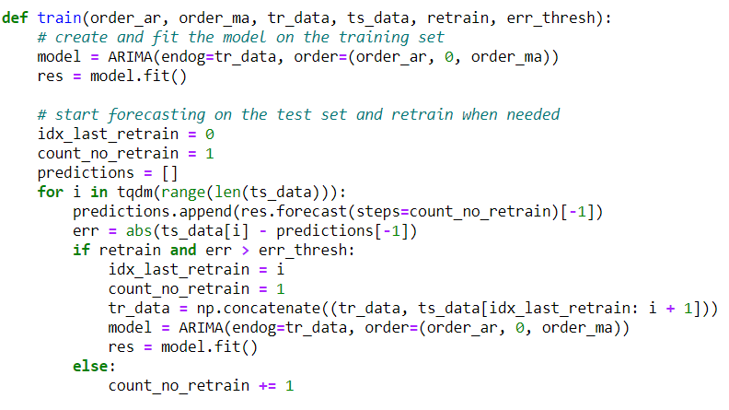
Training and model selection:
AR: try the following orders: 2, 3, 5, 10
ARMA: try AR(3) + MA(1)
Error (E) measured in terms of Mean Absolute Error (MAE)
retraining schedules:
Retrain after every prediction
Retrain when E > 10
Retrain when E > 50
Retrain when E > 100

Slide 4
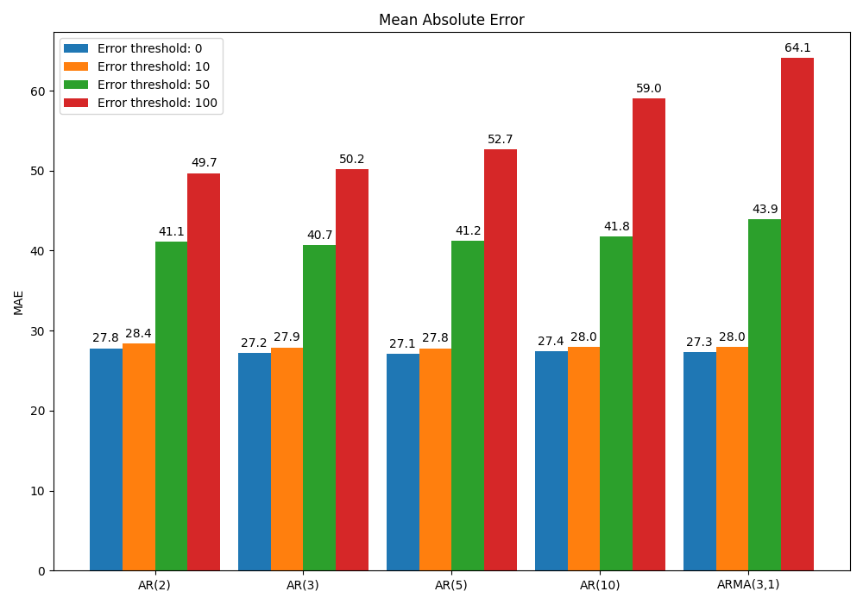
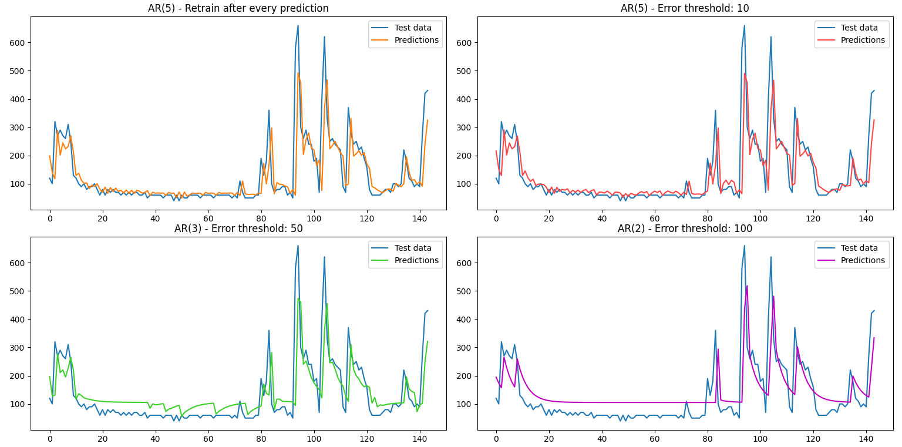
Results

Slide 5
Final considerations
With a retraining after every prediction all the models provide similar results, even though the best one is AR(5)
With less frequent retraining, simpler models tend to predominate
The ARMA model was not the best one with any retraining policies
Still, it was good with frequent retraining
The training time was considerably longer than in the other models
With more rare retraining, it is noticeably worse than the others
Overall, it was not worth it for this specific time series

Slide 6
Thank you for your attention
Alex Pasquali

