Slide 1

Design and Manufacturing of Low-Cost Antennas for Early Alzheimer’s Detection via Medical Microwave Sensing of the Neck
Alex Peirano

Slide 2
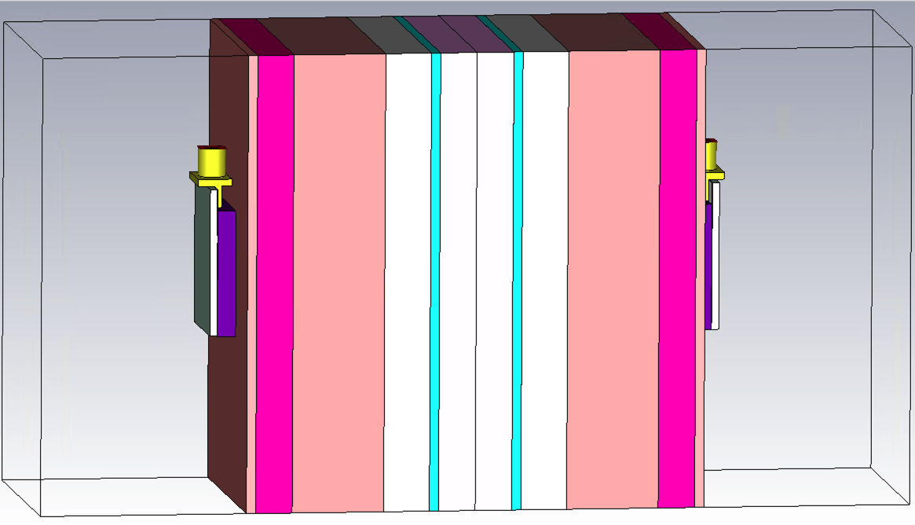
MultiTissue block
CST Model
Coupling
Medium
6 cm, 0.2 λ
LAYERS | THICKNESS
Coupling Medium | 0.4 cm
Skin | 0.14 cm
Fat | 0.67 cm
Muscle | 3.0 cm
Bone | 0.6925 cm
CSF | 0.22 cm
Spinal Cord | 1 cm
/ λ
0.013
0.005
0.022
0.1
0.023
0.007
0.033
10 cm, 0.3344 λ
Skin
Fat
Muscle
Bone
Spinal Cord
CSF
* Lambda computed at 1GHz considering μr = 1 and ɛrair = 1

Slide 3
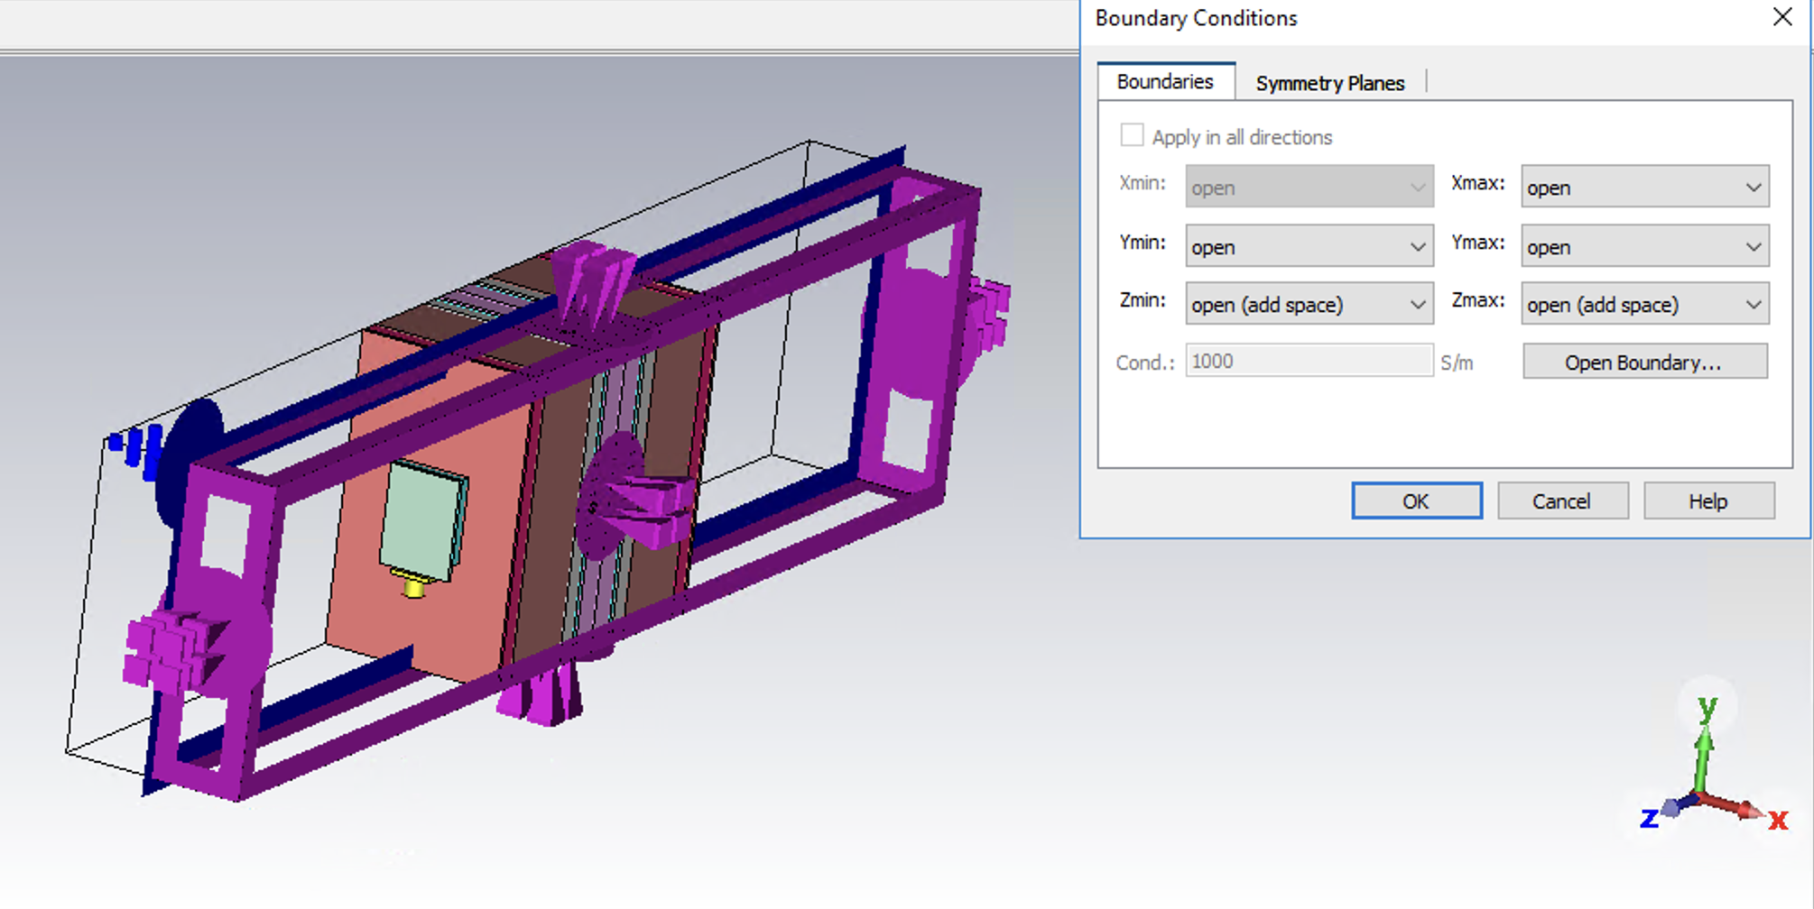
Simulations
Boundary conditions

Slide 4
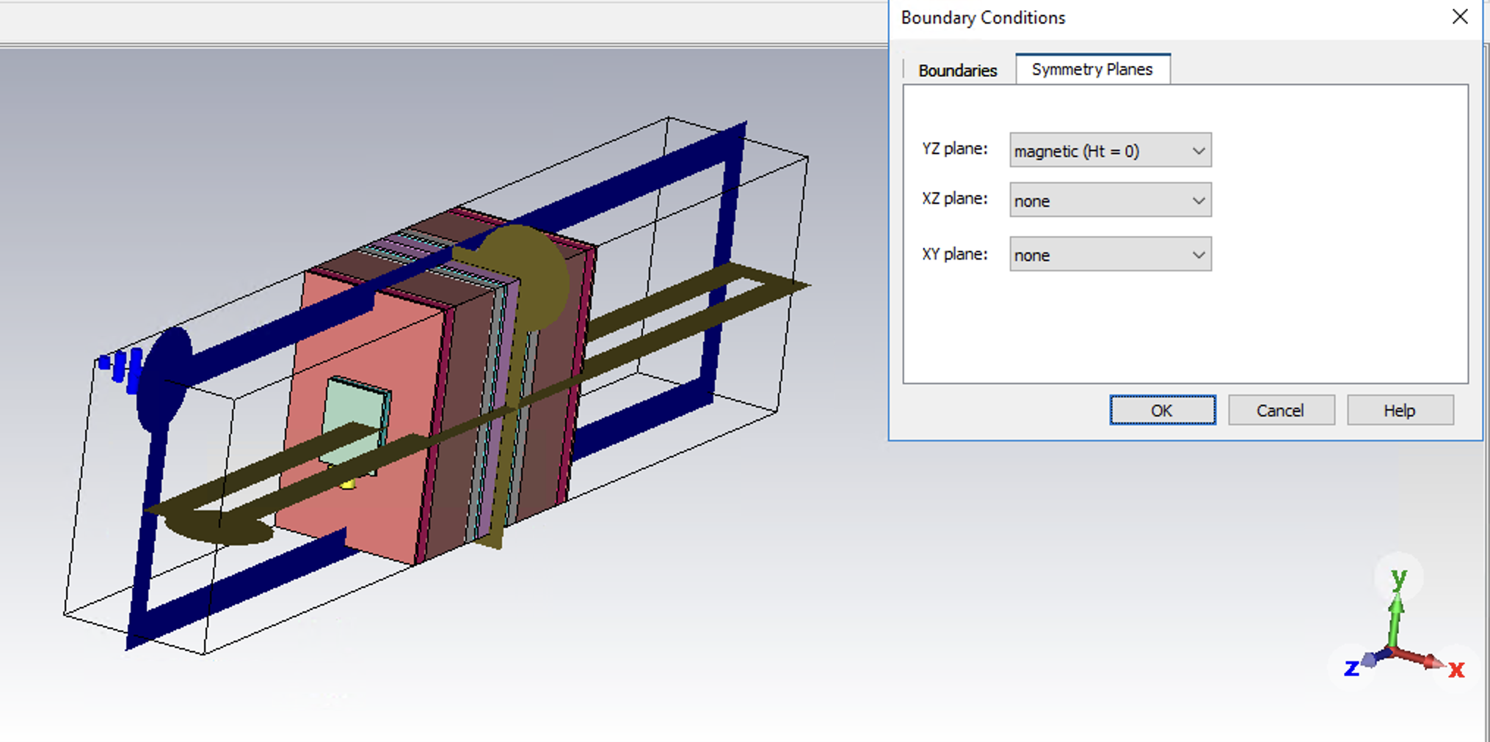
Simulations
Boundary conditions

Slide 5
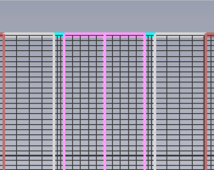
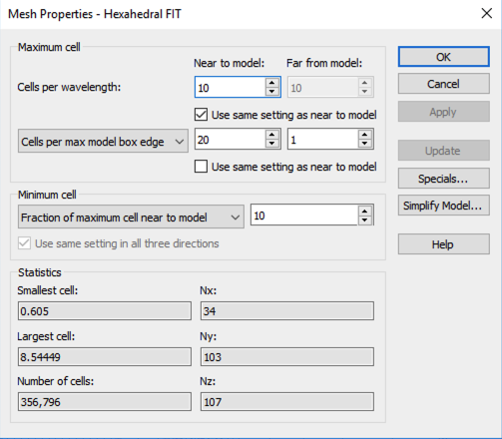
Simulations
Refining the mesh
3x increase in the number of cells
Notes:
Mettre ici photo de la symlmetry YZ

Slide 6
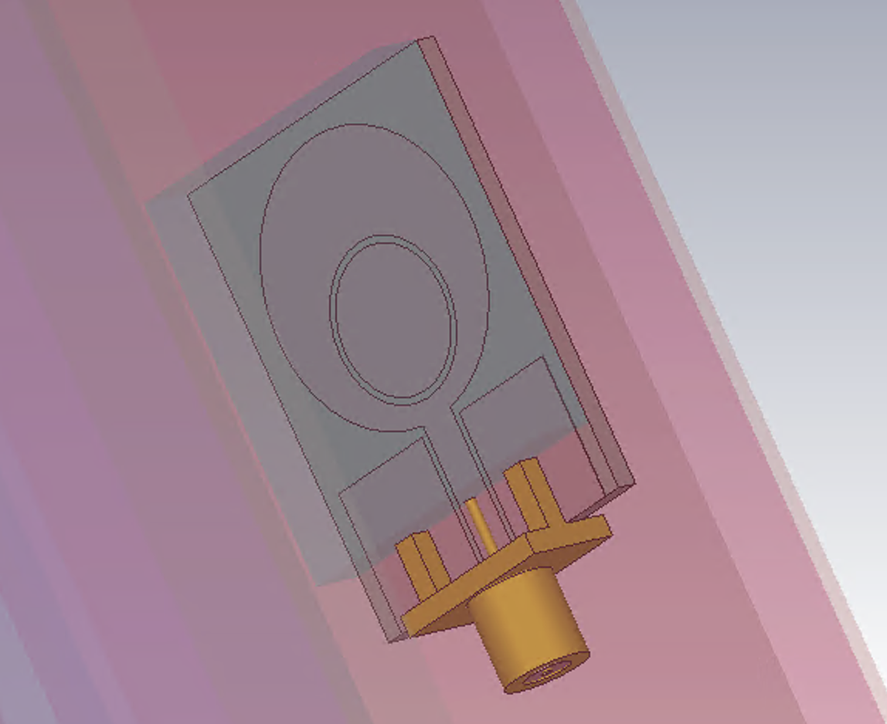
Optimized Antenna
Ring topology
24 mm
Thickness of the copper: 0.035mm
VARIABLES | DIMENSION
wfeed | 2.9 mm
Lgap | 0.5 mm
Wgnd | 10 mm
Lgnd | 10 mm
32 mm
Wfeed
Lgnd + Lgap + 1
Lgap
1.6 mm
Lgnd
13 mm

Slide 7
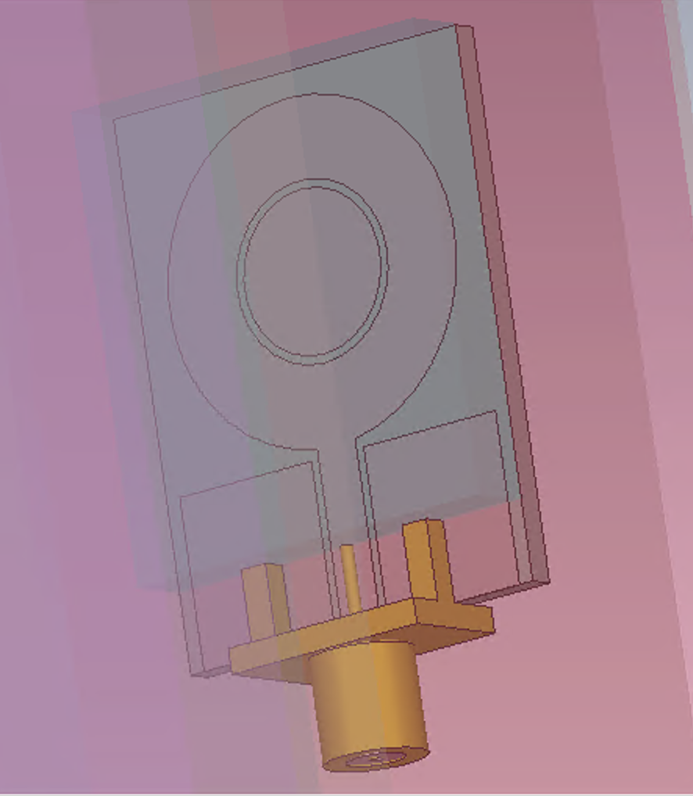
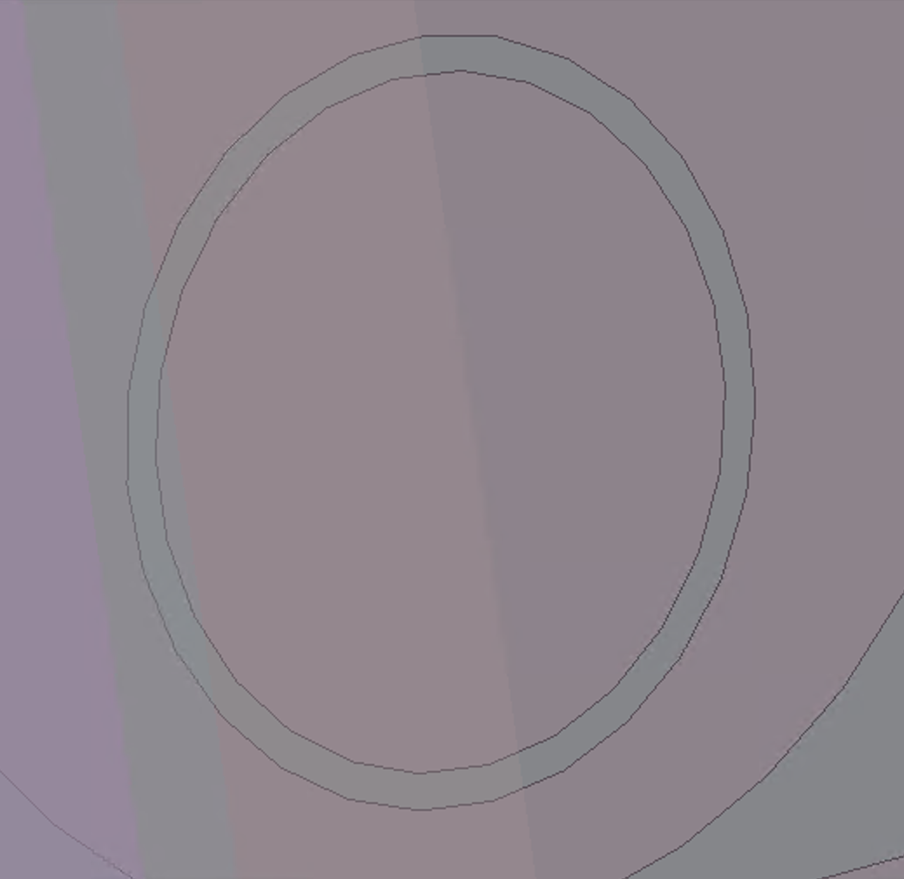
Optimized Antenna
Ring topology
LAYERS | DIMENSION
R_ext | R_m - w_slot/2
R_int | R_m + w_slot/2
R_m | 4.03 mm
w_slot | 0.5 mm
R_m
R_int
R_ext

Slide 8
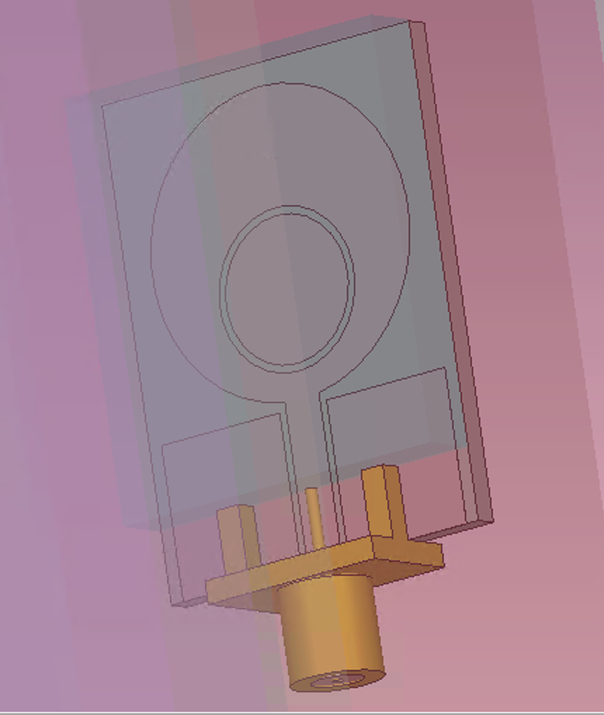
Optimized Antenna
Ring topology
Y_offset
LAYERS | DIMENSION
R_ext | 5.25 mm
R_int | 4.75 mm
R_m | 5 mm
w_slot | 0.5 mm
y_offset | 1 mm

Slide 9

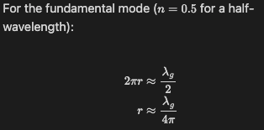

Preliminary computations
Ring Topology
Choice of the 0.5 for the fundamental mode because of size restriction :
For n = 1 we get a mean radius of 8mm,
but the patch radius is 10mm
Source : (1) See last citation slide

Slide 10
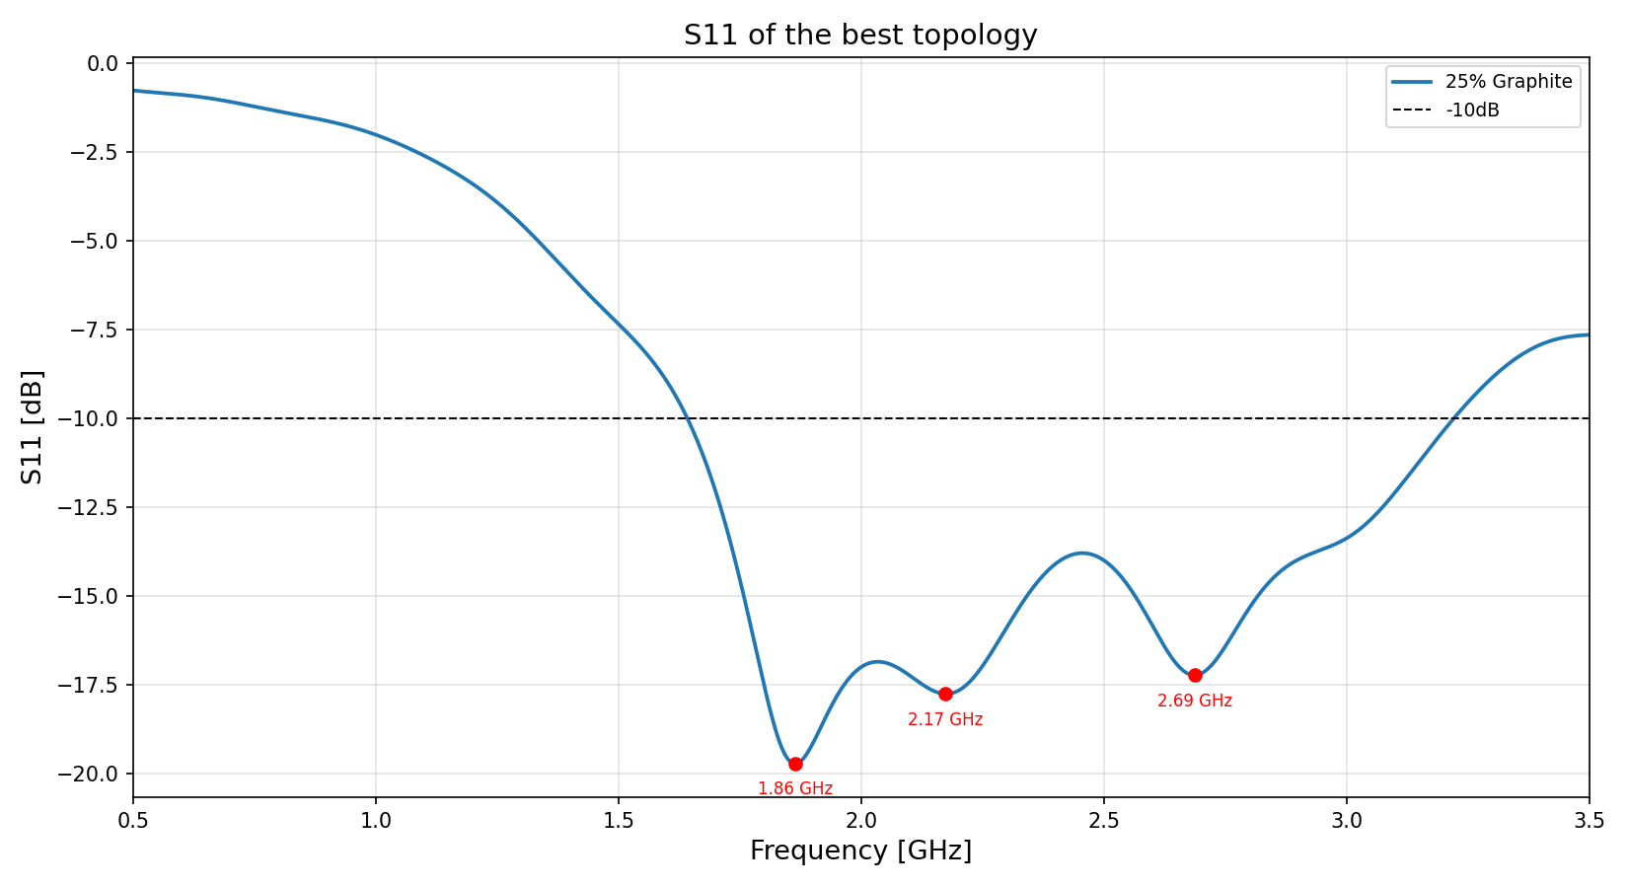
Simulations
Ring topology
Source : (1) S(1,1) of the current antenna, highlighting the adaptation valleys

Slide 11
Source : Surface current visualisation in dB and linear units

Slide 12
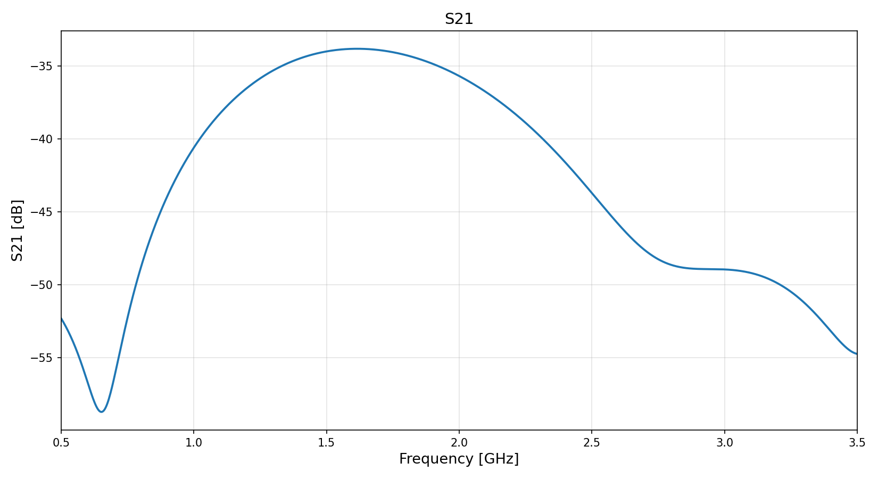
Simulations
Ring topology
Source : (1) S(2,1) for the current updated antenna topology

Slide 13
Simulations
Electric Field (dB)
Source : Electric field visualisation in dB

Slide 14
Simulations
E-field (linear)
Source: E-field visualisation in linear units

Slide 15
Simulations
Normalized E-field (dB)
Source : E-field normalized by it’s maximum value in dB

Slide 16
Simulations
Normalized E-field visualization
Source : E-field normalized by it’s maximum value in linear units

Slide 17
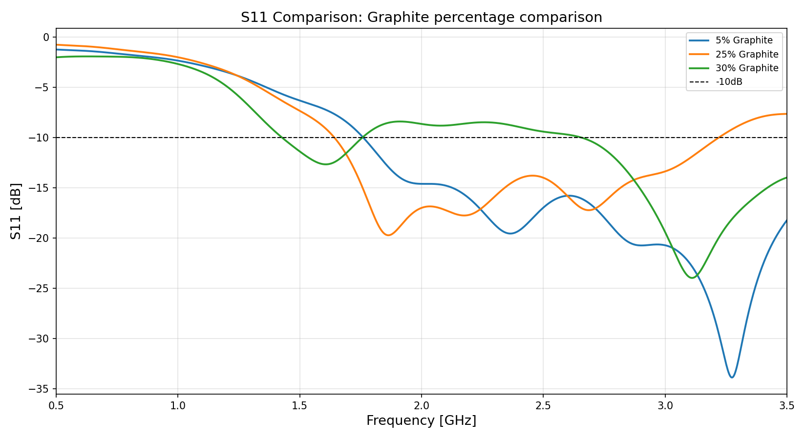
Simulations
Changing the % of graphite
Source : (1) S(1,1) of different % of graphite for the material used in the coupling medium

Slide 18
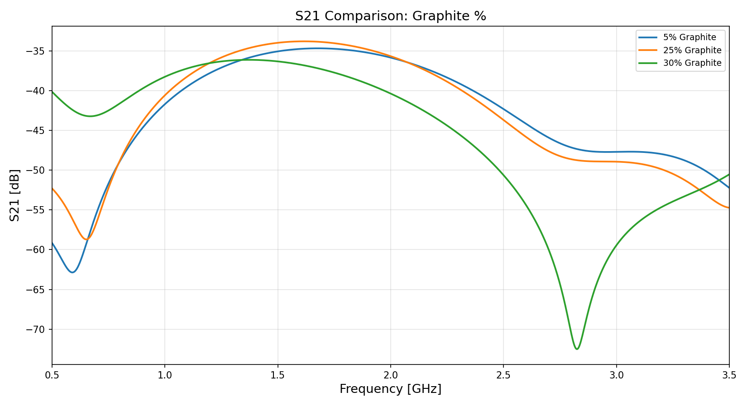
Simulations
Changing the % of graphite
Source : (1) S(2,1) of different % of graphite for the material used in the coupling medium

Slide 19
Neck thickness
Maximum value : 13.35cm
Current value: 12.3cm (average from (1) )
 | NORMAL | AVERAGE | OVERWEIGHT
Study 1 | 11.05cm | 12.3cm | >12.35cm
Study 2 | 11.09cm | 11.3cm | >11.52cm
Study 1 : Neck Circumference May Be a Better Alternative to Standard Anthropometric Measures
Healthy Hispanics (no diabetes or cardiovascular diseases)
Study 2 : Neck circumference as a useful marker of obesity: A comparison with body mass index and waist circumference
Pakistani dental students
Source : (1) See last citation slide

Slide 20
MultiTissue block
Thicker models
Coupling
Medium
Fat & Muscle * 1.15
LAYERS | THICKNESS
Fat | 0.67 -> 0.77
Muscle | 3.0 -> 3.45 cm
/ λ
0.025
0.11
Fat & Muscle * 1.5
LAYERS | THICKNESS
Fat | 0.67 -> 1.005cm
Muscle | 3.0 -> 4.5 cm
/ λ
0.033
0.15
Skin
Fat & Muscle * 2.0
LAYERS | THICKNESS
Fat | 0.67 -> 1.34cm
Muscle | 3.0 -> 6.0 cm
/ λ
0.045
0.2
Fat
Muscle
Bone
Spinal Cord
CSF
* Lambda computed at 1GHz considering μr = 1 and ɛrair = 1

Slide 21
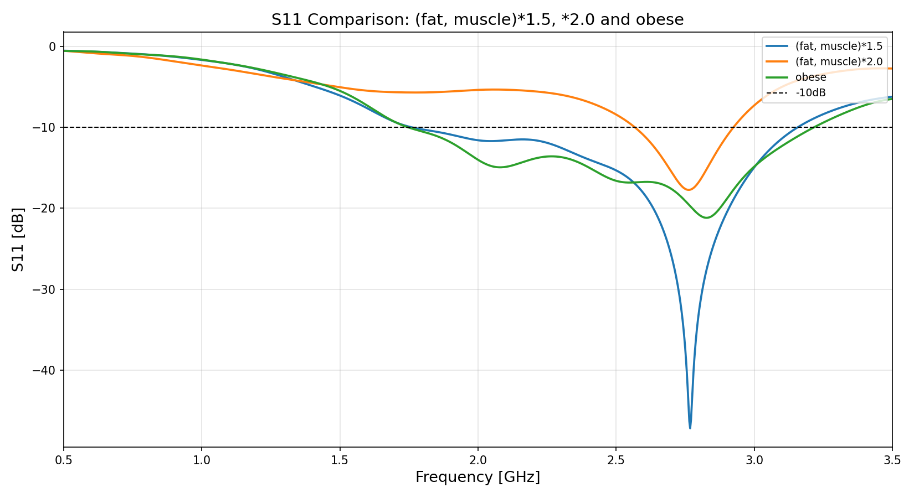
Simulations
Thicker necks
Source : (1) S(1,1) comparision of the first thicker model (*1.5), the second one (*2.0) and realistic obese model

Slide 22
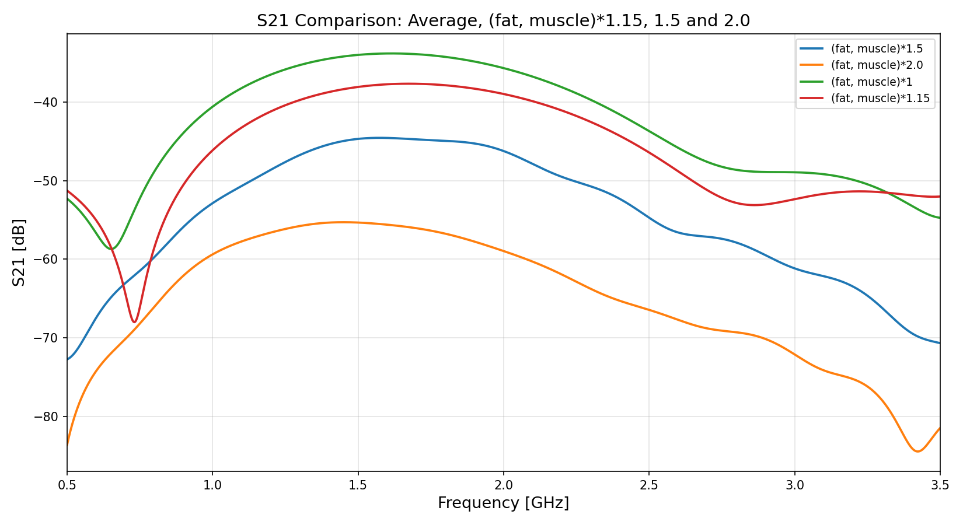
Simulations
Thicker necks
Source : (1) S(2,1) comparision of the first thicker model (*1.5), the second one (*2.0) and realistic obese model

Slide 23
Simulations
Electric Field (dB) realistic obese
Source : Electric Field in dB for the realistic obese model

Slide 24
Simulations
Electric Field (linear) realistic obese
Source : Electric Field in linear units for the realistic obese model

Slide 25
Simulations
Normalised Electric Field (dB) realistic obese
Source : Normalised Electric Field in dB for the realistic obese

Slide 26
Simulations
Nomalised Electric Field (linear) realistic obese
Source : Normalised Electric Field in linear units for the realistic obese model

Slide 27
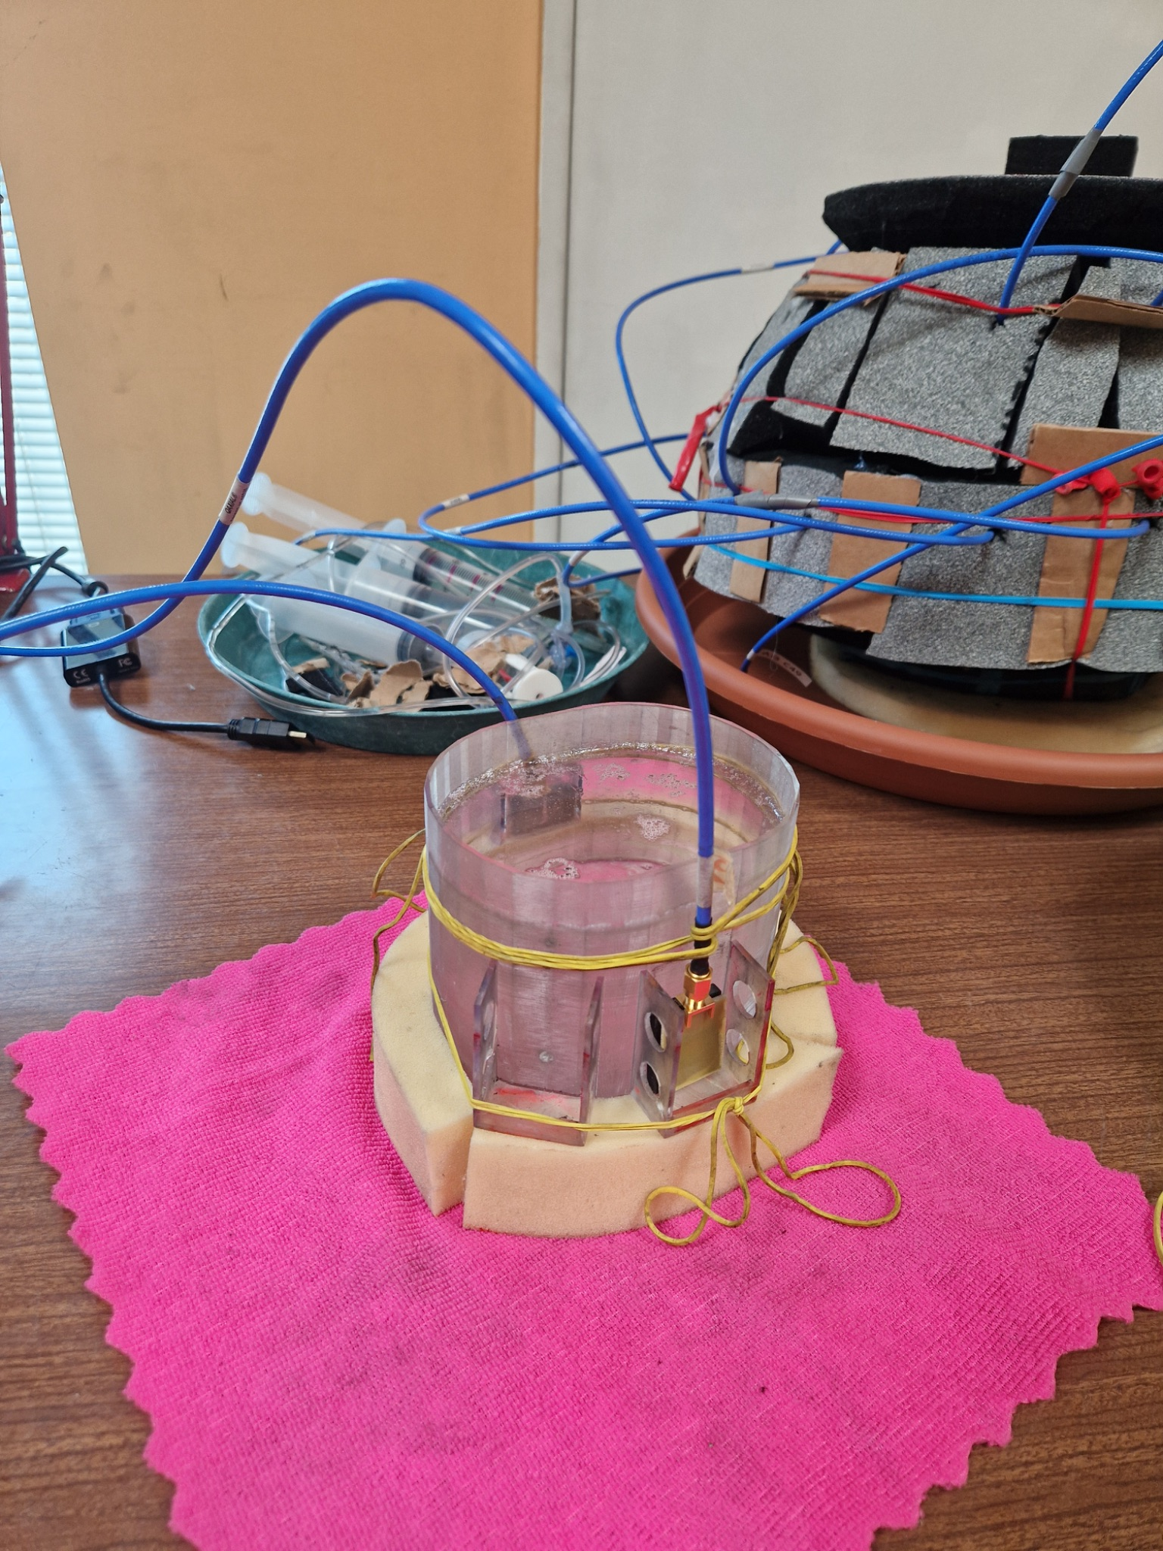
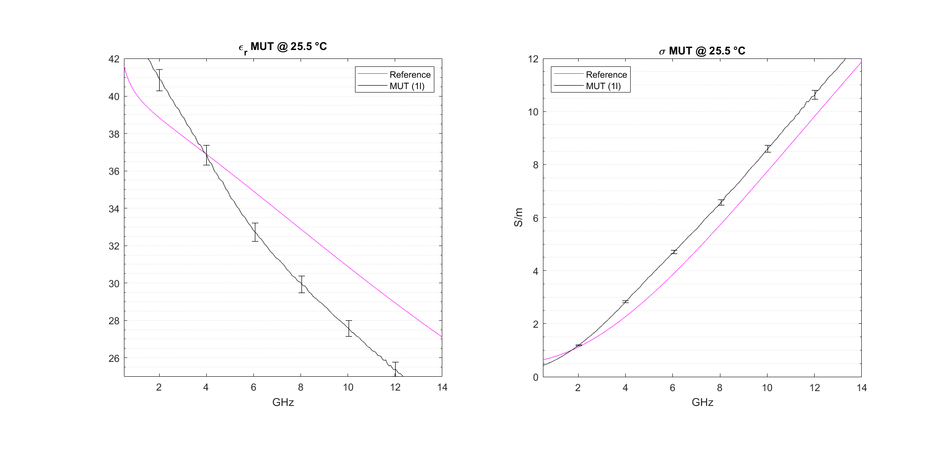
Experiments
2)
Average Neck
1)
Source : (1) Epsilon r and sigma of the liquid mimicking the average neck’s dielectric properties (2) bench setup

Slide 28
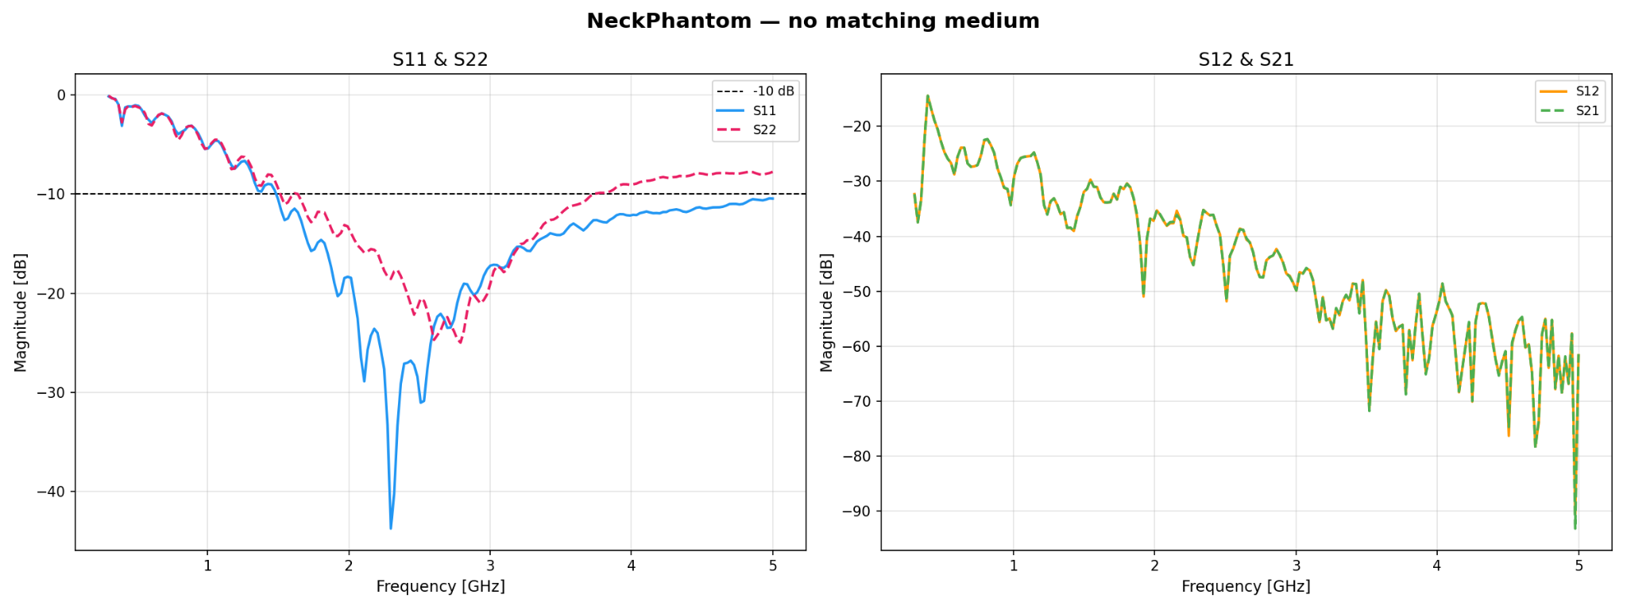
Experiments
Neck Phantom
Source : Reflection and transmission parameters for the experiment on the Neck Phantom, without a coupling medium layer

Slide 29
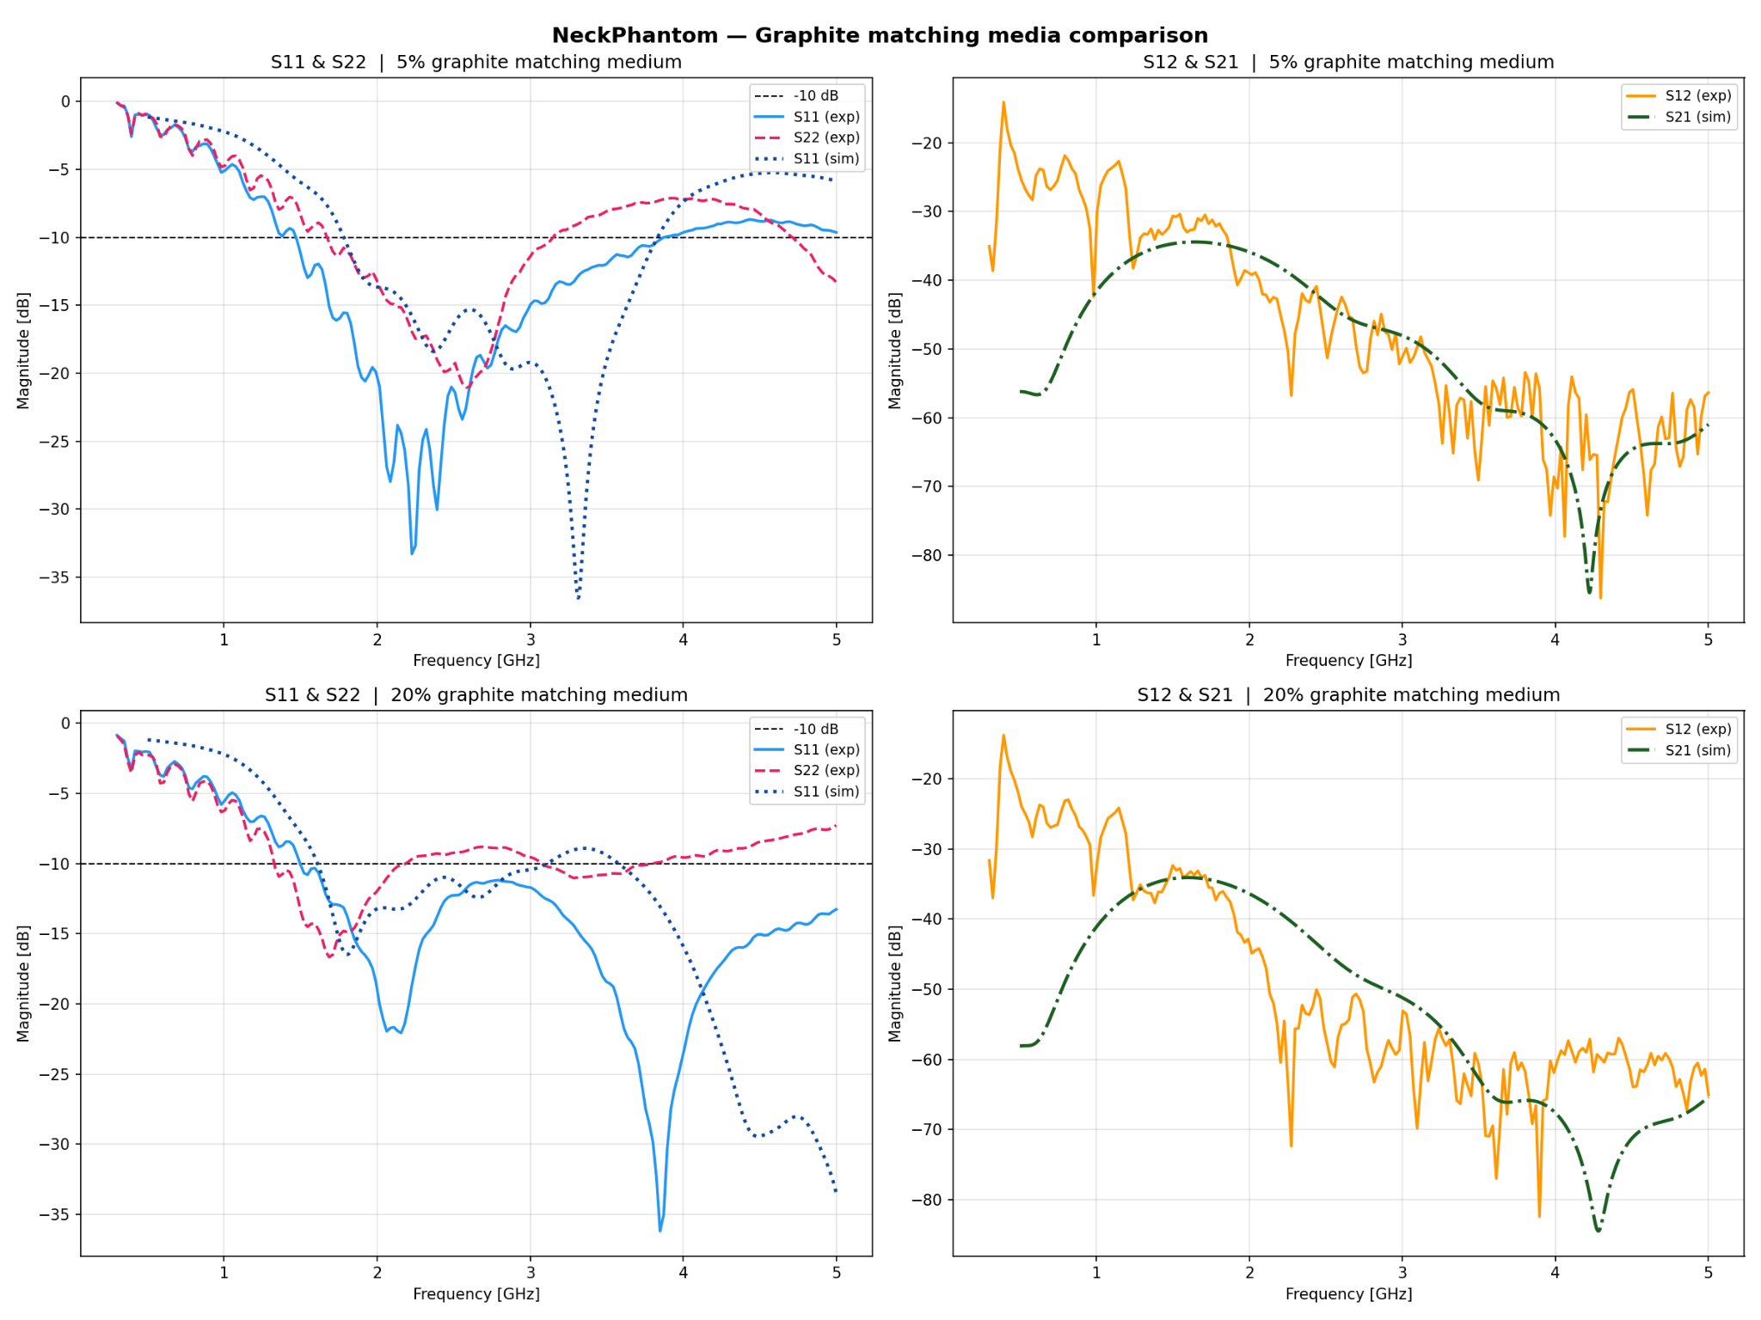
Source : Reflection and transmission parameters for the experiment on the Neck Phantom with a coupling medium layer made of either 5 or 20 % graphite

Slide 30
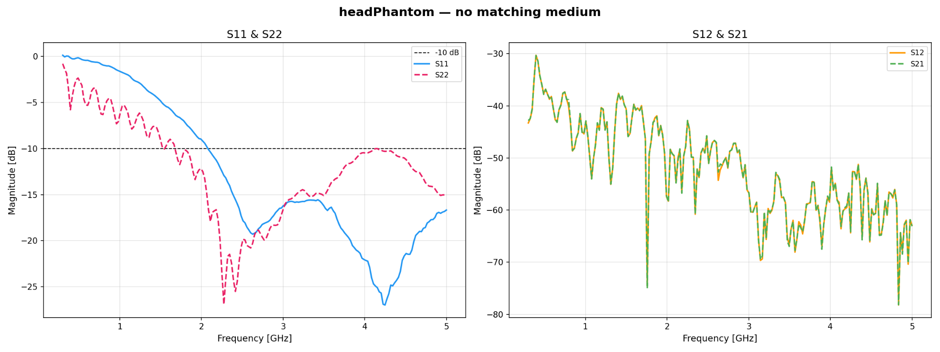
Experiments
Head Phantom
Source : Reflection and transmission parameters for the experiment on the Head Phantom, without a coupling medium layer

Slide 31
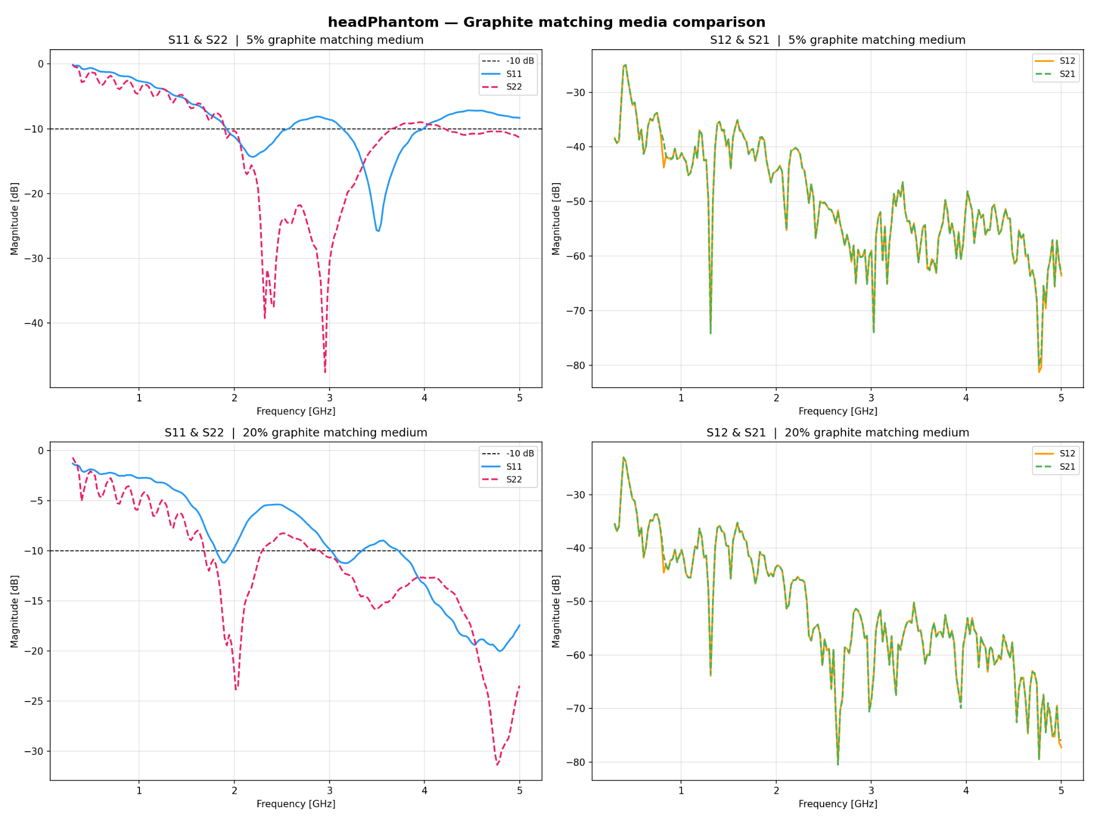
Source : Reflection and transmission parameters for the experiment on the Head Phantom with a coupling medium layer made of either 5 or 20 % graphite

Slide 32
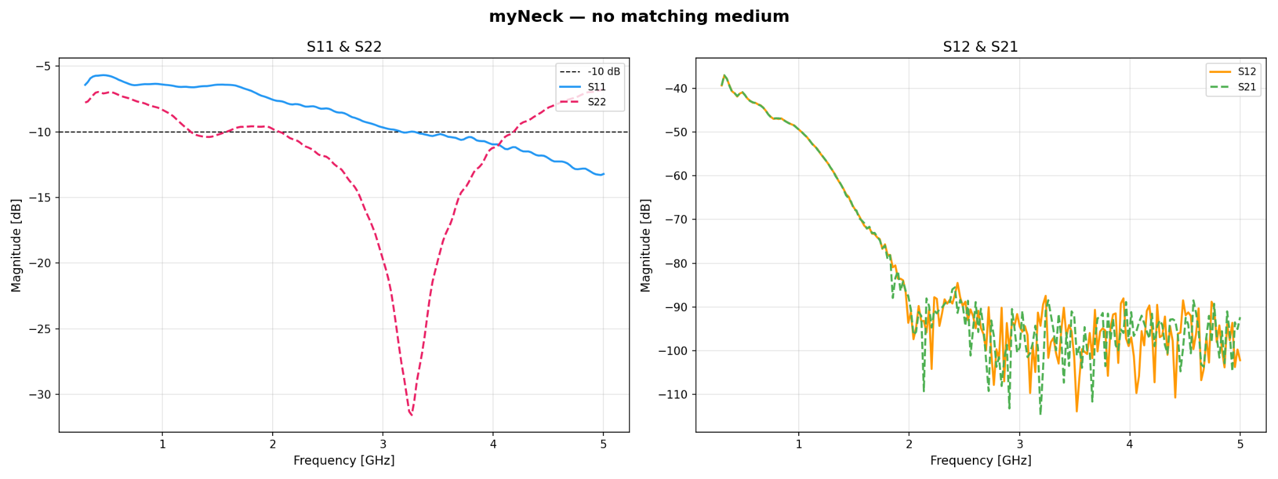
Experiments
Real Neck
Source : Reflection and transmission parameters for the experiment on the human neck, without a coupling medium layer

Slide 33
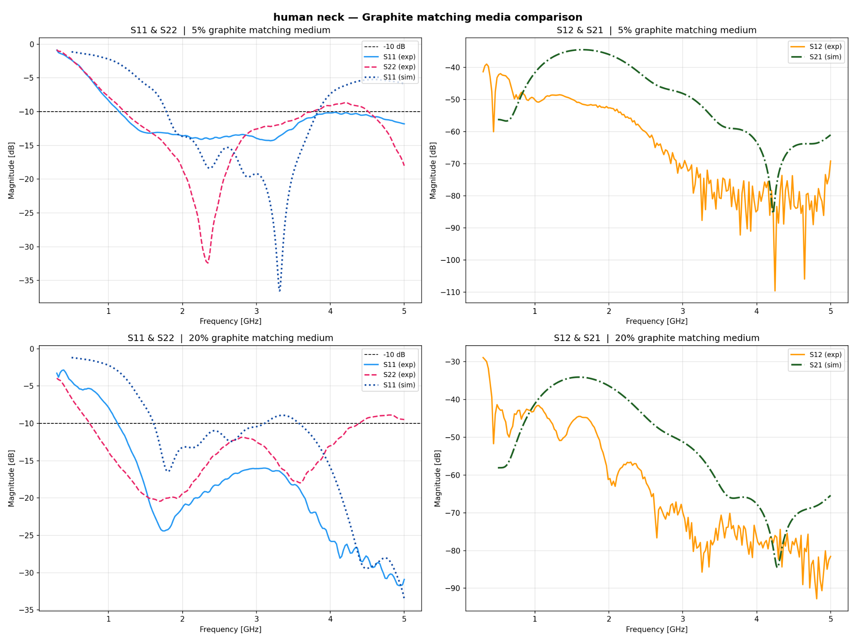
Source : Reflection and transmission parameters for the experiment on the human head with a coupling medium layer made of either 5 or 20 % graphite

Slide 34
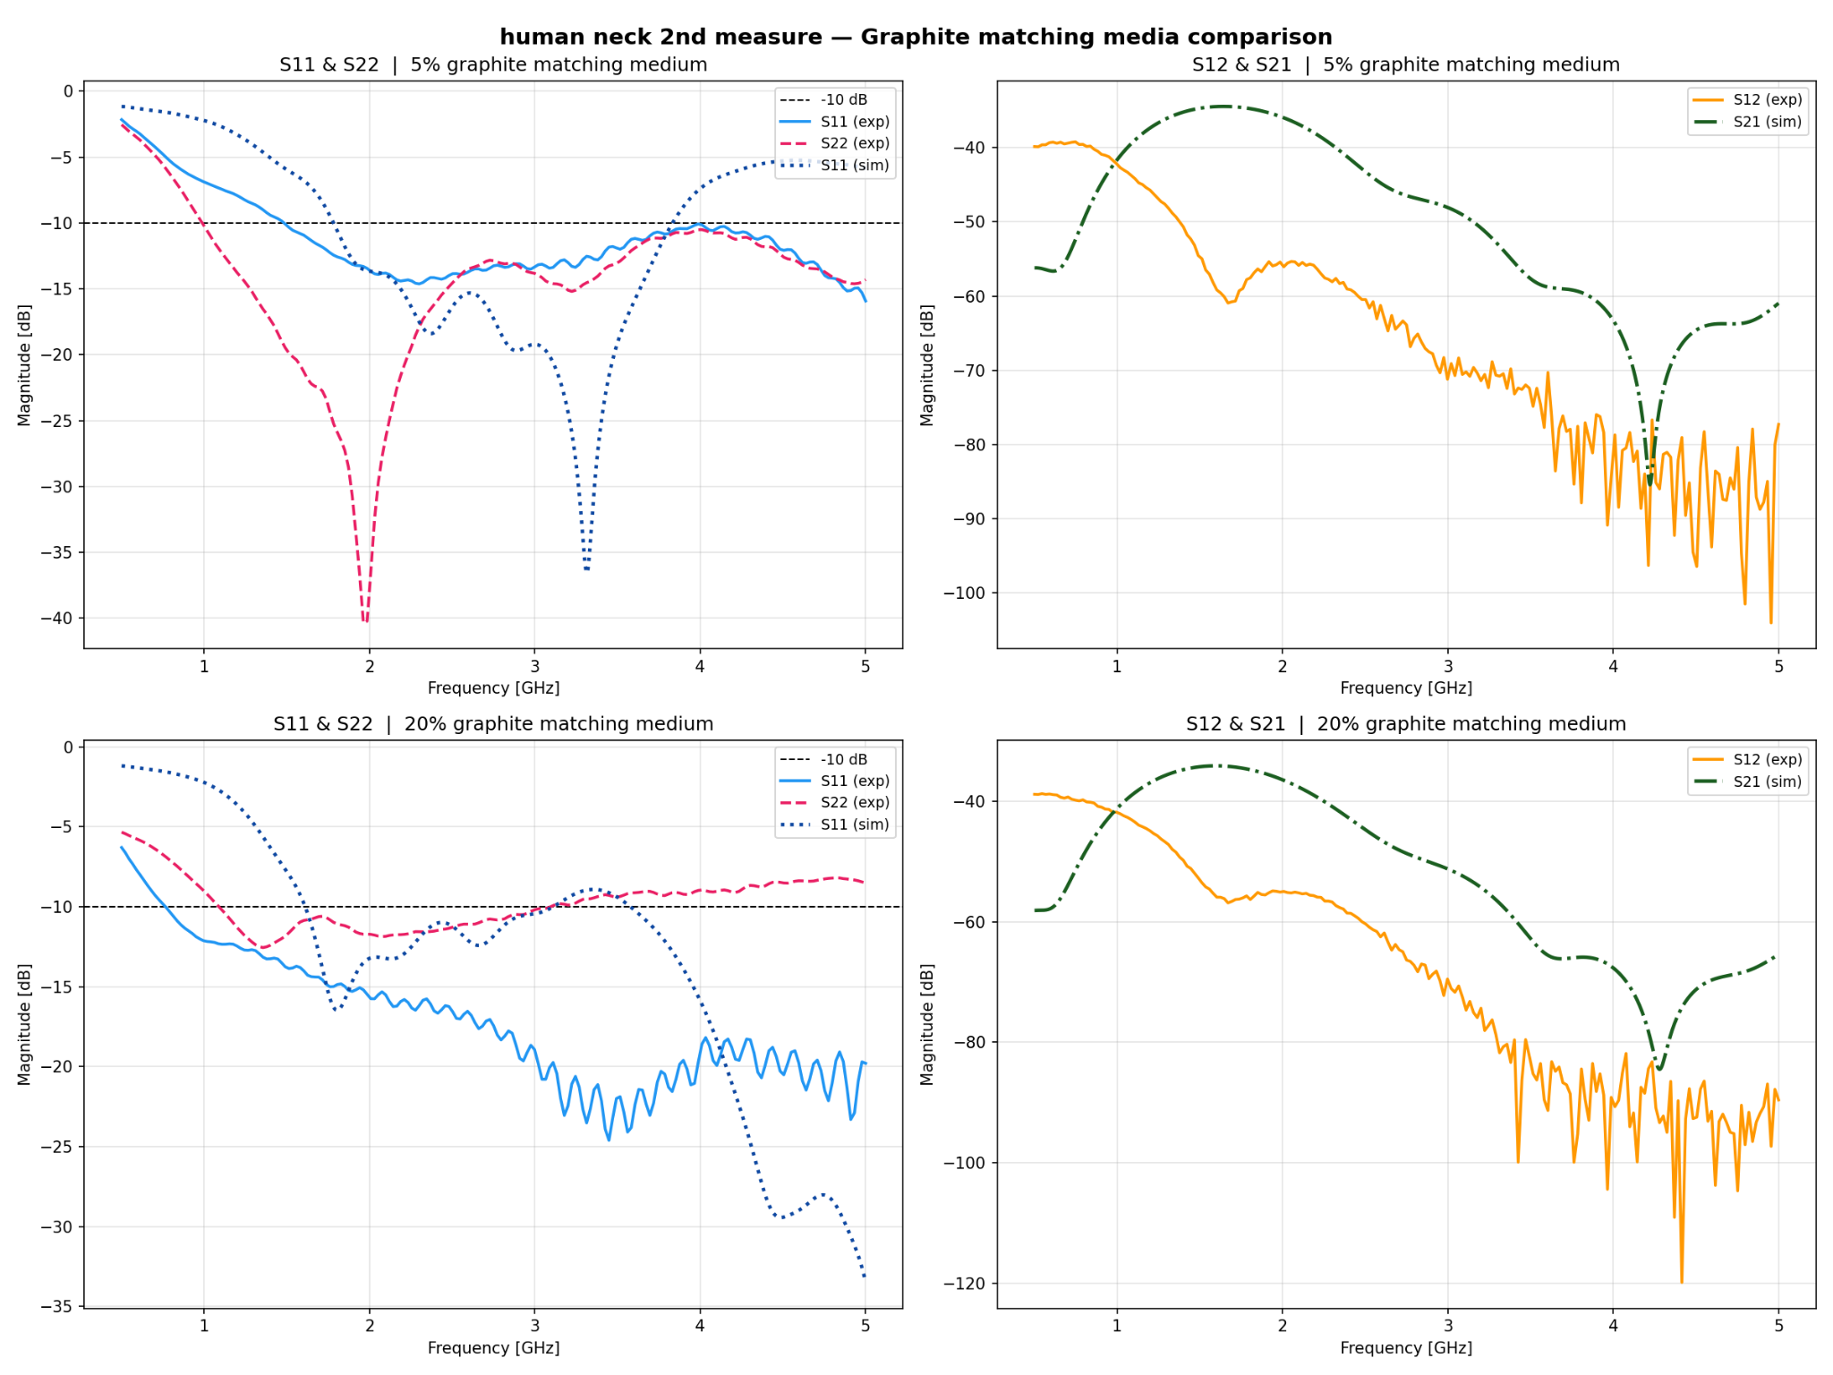
Source : Reflection and transmission parameters for the experiment on the human head with a coupling medium layer made of either 5 or 20 % graphite, 2nd batch of measurments

Slide 35
Citations
Slide 19:
(1) Joshipura K, Muñoz-Torres F, Vergara J, Palacios C, Pérez CM. Neck Circumference May Be a Better Alternative to Standard Anthropometric Measures. J Diabetes Res. 2016;2016:6058916. doi: 10.1155/2016/6058916. Epub 2016 Feb 11. PMID: 26981543; PMCID: PMC4766356.
(2) Hingorjo MR, Qureshi MA, Mehdi A. Neck circumference as a useful marker of obesity: a comparison with body mass index and waist circumference. JPMA. The Journal of the Pakistan Medical Association. 2012 Jan;62(1):36-40. PMID: 22352099.
Slide 9:
(2) K. Chang and L.-H. Hsieh, Microwave Ring Circuits and Related Structures, 2nd ed. Hoboken, NJ, USA: John Wiley & Sons, 2004.

