Slide 1
The map-coloring game
Present work by A. Audoin, C. Badiola, S. Da Silva, A. Perrot, C. Ritlewski
Client : Paul Dorbec
TD supervisor : Philippe Narbel
Original Article by Tomasz Bartnicki, Jarosław Grytczuk, H. A. Kierstead and Xuding Zhu

Slide 2
Some graph coloring reminders
Old problem (first results in 1852)
Proper coloring if any two adjacent vertices have different colors
χ(G) = least number k for which G is k-coloriable
Deciding if a graph is k-coloriable is NP-complete

Slide 3
The map-coloring game
Two players compete to color the graph
Alice wants to achieve a proper coloring
Bob tries to prevent Alice from winning
The game is played with a fixed number of colors

Slide 4
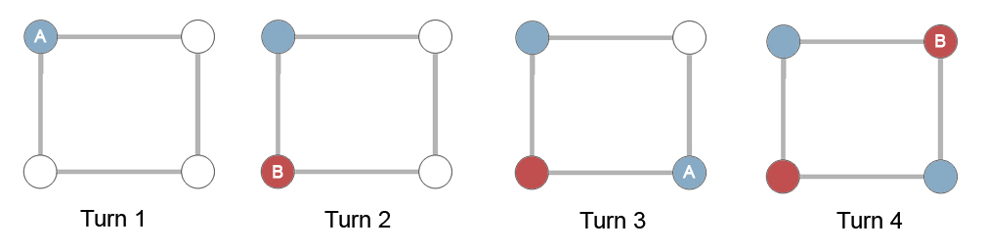
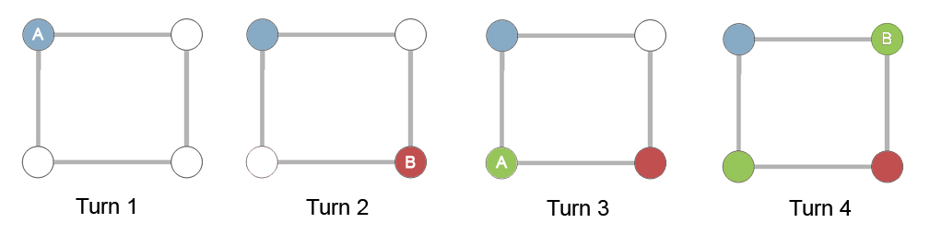
A sample game
Game 1 : Alice won with 2 colors
Game 2 : Alice can't win with 2 colors but she can win with 3 colors

Slide 5
Game chromatic number
χg (G) is the least number of colors for which Alice has a winning strategy regardless of Bob's strategy
Several strategies have been created to find upper bounds to this number

Slide 6
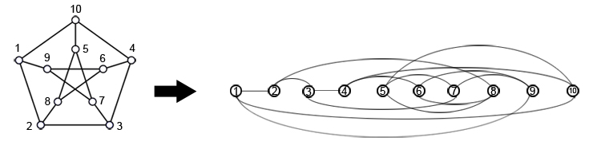
First Strategy
Based on a graph ordering satisfying col2(G)

Slide 7
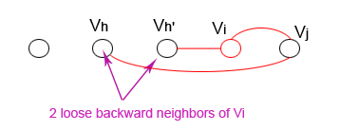
First Strategy
Based on a graph ordering
Loose backward neighbors :

Slide 8
First Strategy
Based on a graph ordering
Loose backward neighbors
When Bob colors a vertex v, Alice colors the minimum loose backward neighbor of v

Slide 9
Upper bounds
First strategy: χg (G) ≤ χ(G) × (1 + col2(G))
Second strategy: χg(G) ≤ a(G) × (a(G) + 1)
Third strategy: χg (G) ≤ 3 × col2 (G) − 1
Fourth strategy: χg (G) ≤ 18 for planar graphs

Slide 10
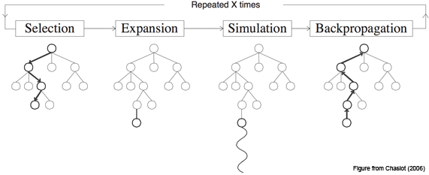
Monte-Carlo Tree Search
Based on Monte-Carlo methods
4 steps:

Slide 11
UCB-1
Multi-armed bandit algorithm
Computes an upper confidence bound for each move
Selects the move whose value + bound is the highest
The bound is reduced with each simulation

Slide 12
Work
Various particular graphs
Parameterizable program
1K simulations per choice
1K games per graph per color

Slide 13
Results
Graph | Chromatic number | Strategy 1 | Strategy 2 | Strategy 3 | Experimental results
Chain (odd) | 2 | 6 | 6 | 5 | 3
Chain (even) | 2 | 6 | 6 | 5 | 3
Cycle (odd) | 3 | 12 | 12 | 8 | 3
Cycle (even) | 2 | 8 | 12 | 8 | 3
Grid 2x5 | 2 | 6 | 12 | 5 | 3

Slide 14
Results
Graph | Chromatic number | Strategy 1 | Strategy 2 | Strategy 3 | Experimental results
Grid 5x5 | 2 | 10 | 12 | 11 | 5
Grid 5x5 tor | 3 | 5 | 5 | 5 | 5
Binary tree | 2 | 6 | 6 | 5 | 4
Petersen | 3 | 18 | 12 | 14 | 4
Icosahedron | 4 | 32 | 20 | 20 | 5
Grotzsch | 4 | ? | ? | ? | 4

Slide 15
Conclusion

