Slide 1
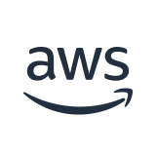
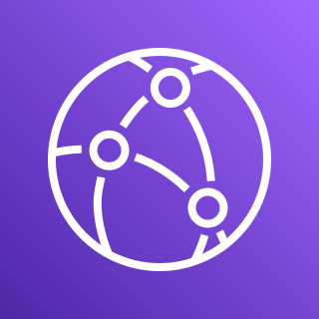


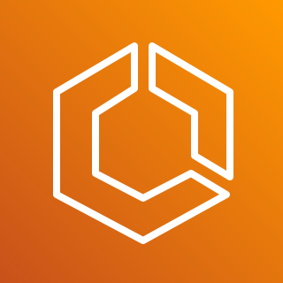
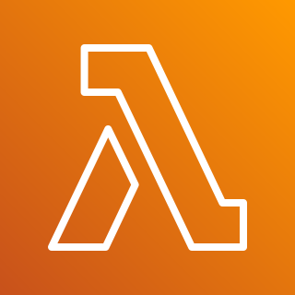


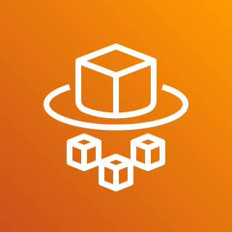
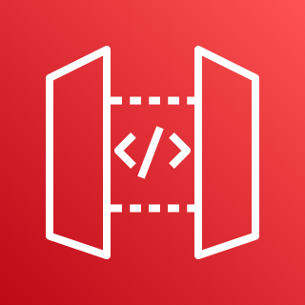

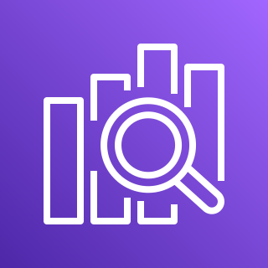
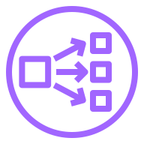

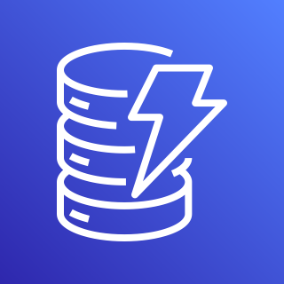

Serverless Chat Architecture
AWS Cloud
CloudFront
App Runner Service VPC
Customer VPC
Amazon ECS
Private subnet
Private subnet
AWS Lambda
AWS Fargate
AWS Fargate
API Gateway
SearchChat
Amazon OpenSearch
Private subnet
Envoy Proxy
Private subnet
Application Load Balancer
Amazon DynamoDB
AWS Lambda
AWS Fargate
AWS Fargate
Message Table
Indexer

Slide 2
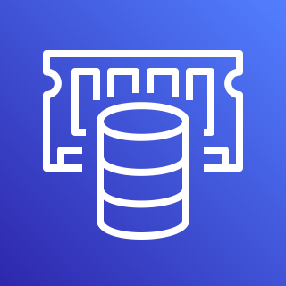
Data persistence
Amazon ECS
Durable state
Private subnet
Traffic Ingress
Ephemeral data
Amazon DynamoDB
AWS Fargate
Application Load Balancer
Private subnet
Amazon ElastiCache
Message Table
AWS Fargate
User Table
Data persistence

Slide 3

Query search index
Traffic Ingress
AWS Lambda
Amazon API Gateway
SearchChat
Amazon OpenSearch
Insert chat message into search index
Durable state
Event on message create or update
Amazon DynamoDB
AWS Lambda
Message Table
DynamoDB Stream
Indexer

Slide 4

App Runner Service VPC
Private subnet
Traffic Ingress
App Runner
Envoy proxy (App Runner managed)
Private subnet
App Runner

Slide 5

Location Two
Location One
Location Three
Traffic Ingress
Amazon CloudFront
/search*
Amazon API Gateway
AWS Lambda
/socket.io*
Application Load Balancer
AWS Fargate
* (default route)
Envoy proxy (App Runner managed)
AWS App Runner

