Slide 1

PriceHub
Progressive web app

Slide 2
Progressive Web Apps
A Progressive Web App (PWA) is a collection of technologies, design concepts, and Web APIs used to deliver an app-like experience to users on the mobile web.
Progressive
Features we expect from native apps to the mobile browser
Served over HTTPS
App-like
Installable without the app store via Manifest

Slide 3
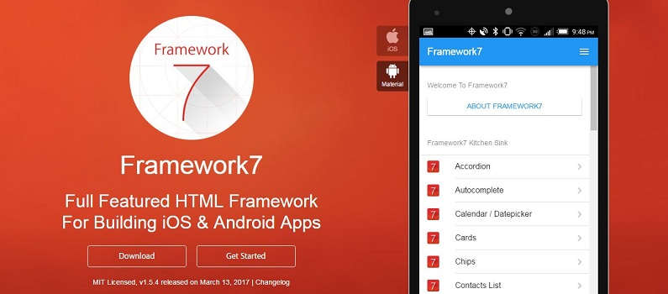
Framework7
HTML framework for building iOS and Android apps

Slide 4
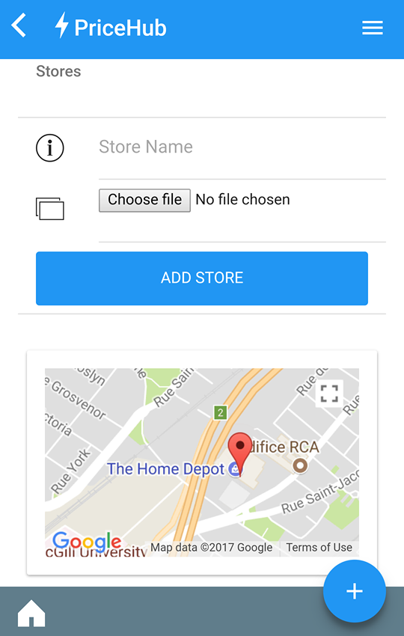
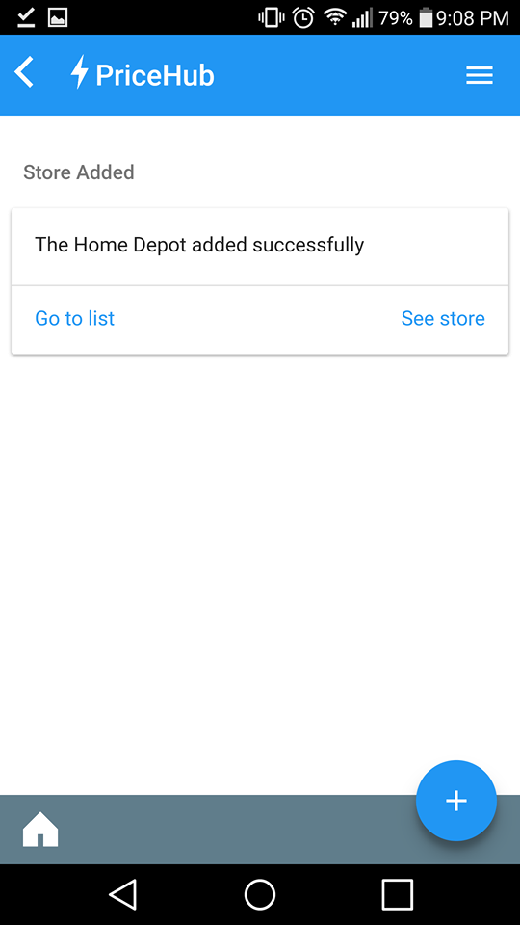
Adding A Store
User enters store name
Chooses a saved image or takes a photo of store's logo
App finds user's geolocation

Slide 5
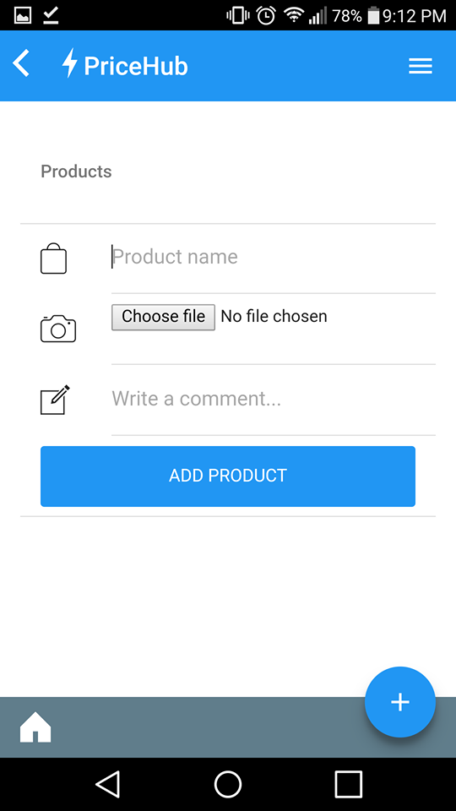
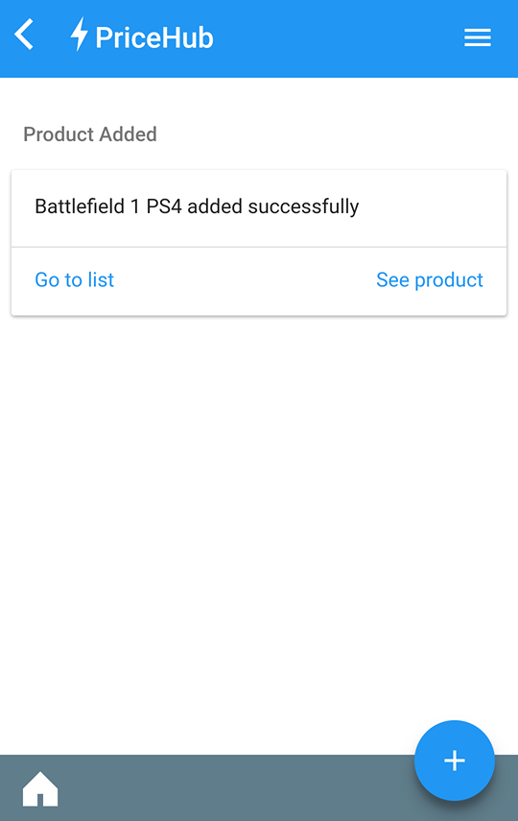
Adding A Product
User enters product name
Chooses a saved image or takes picture with camera
Adds a comment about the product

Slide 6
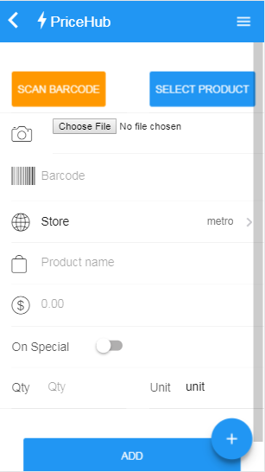
Adding a Price

Slide 7
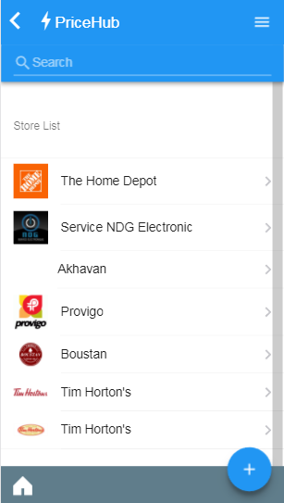
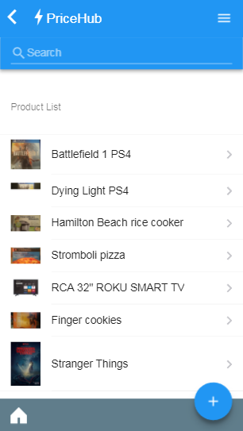
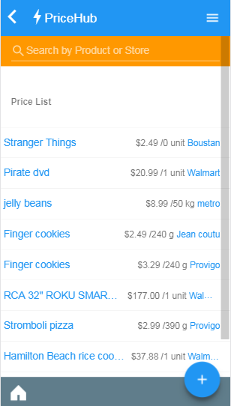
Lists, Lists, Lists
Infinite Scroll
Ajax Search

Slide 8

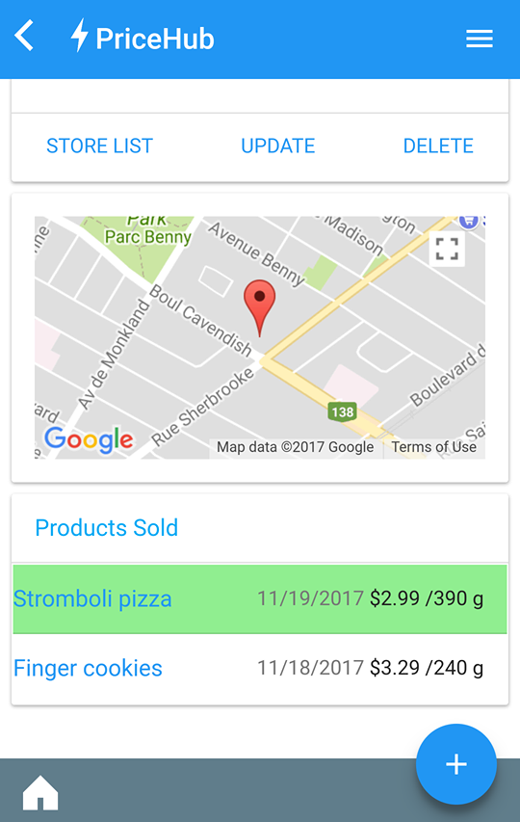
Store View
Displays logo
Location on map
Update/Delete
List of products sold

Slide 9

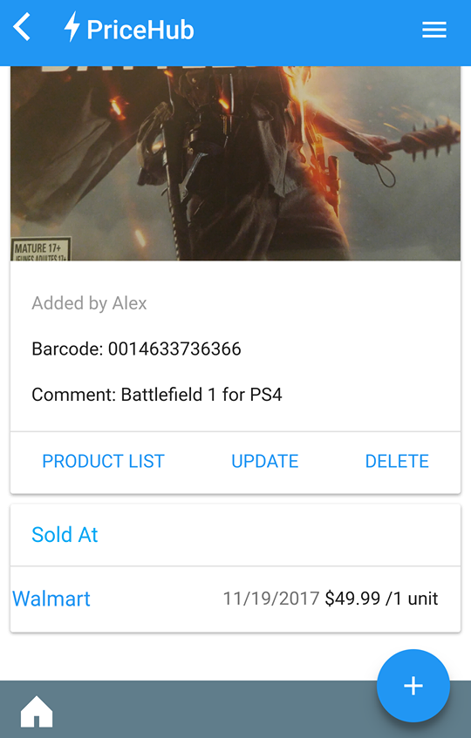
Product View
Displays product image
User who added can update/delete
Barcode & comment
List of stores sold at

Slide 10
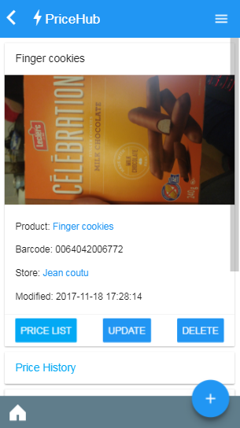
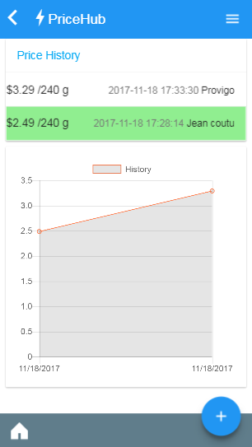
Price View
Display details on the product and price
List of all prices for that current product
Chart to track trends

Slide 11
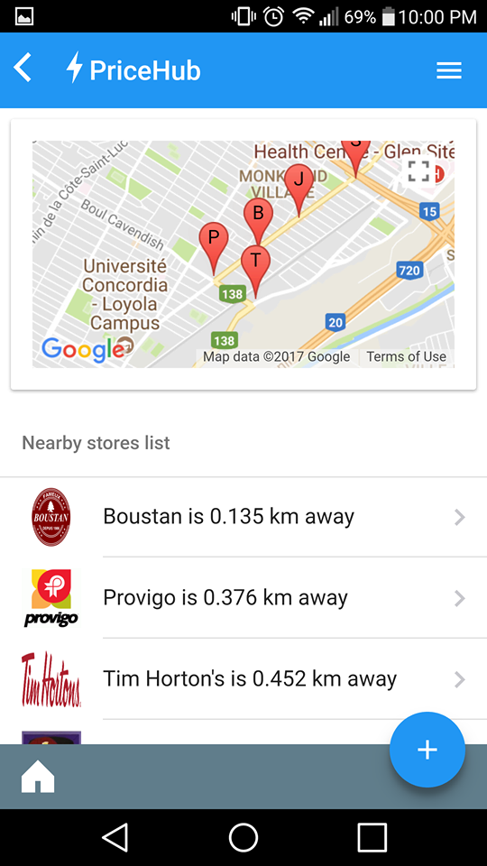
Nearby Stores
User's geolocation is the center of the map
Map shows 15 closest stores in a 5km radius
Markers indicating first letter of store name
List of stores with links to store views

Slide 12
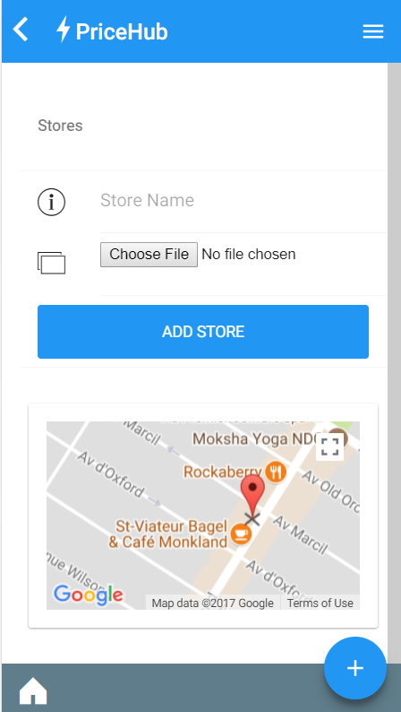
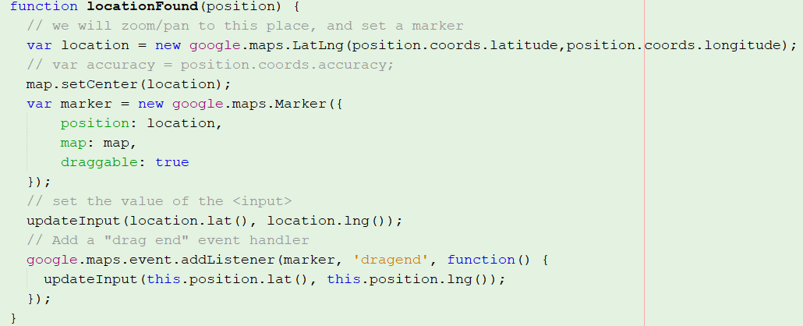
Finding User's location(while accounting for error)
Google Maps API
Geolocation with Movable marker

Slide 13
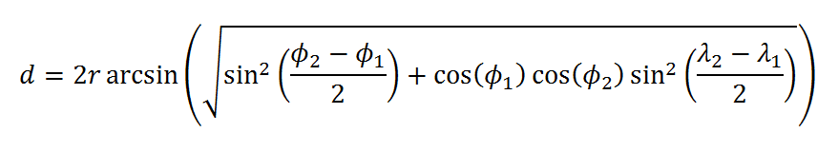

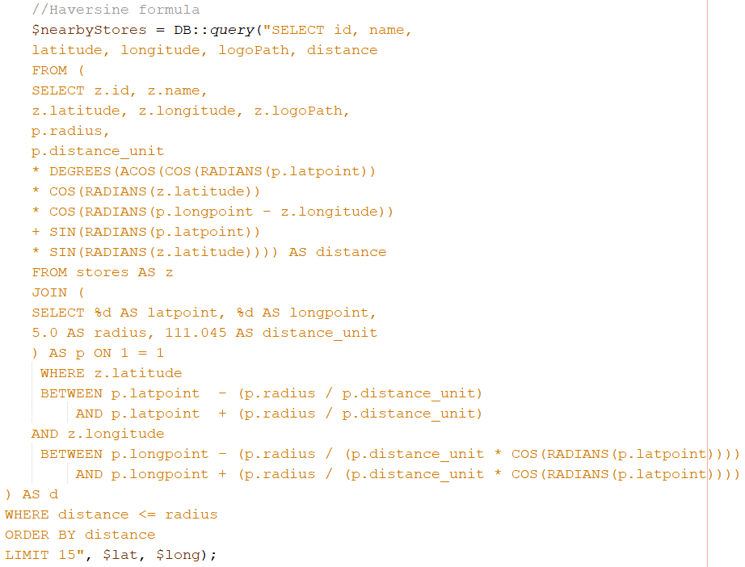
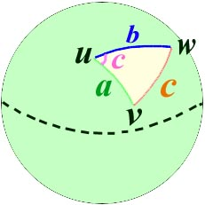
Nearby Saved Stores with Haversine Formula

Slide 14
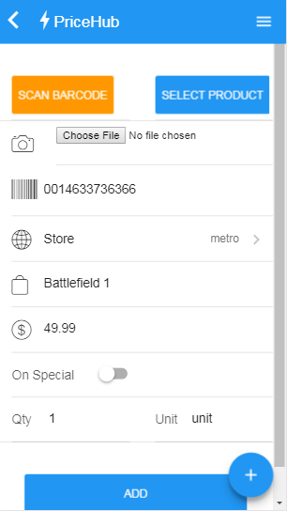
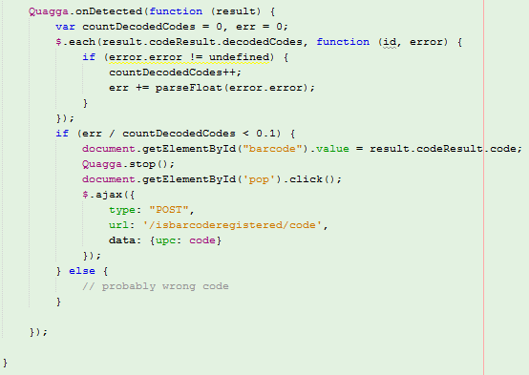
QUagga.js
A barcode-scanner entirely written in JavaScript
Uses getUserMedia to get direct access to the user’s camera stream

Slide 15
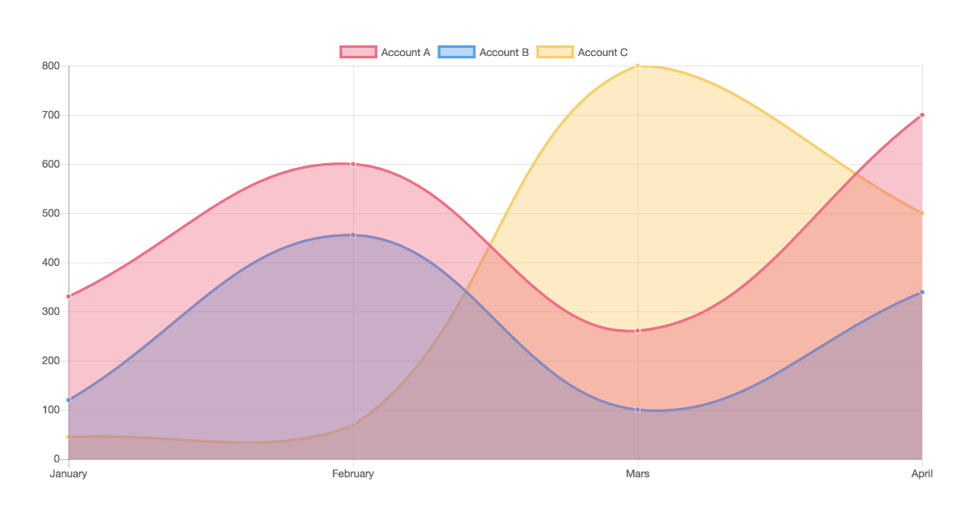
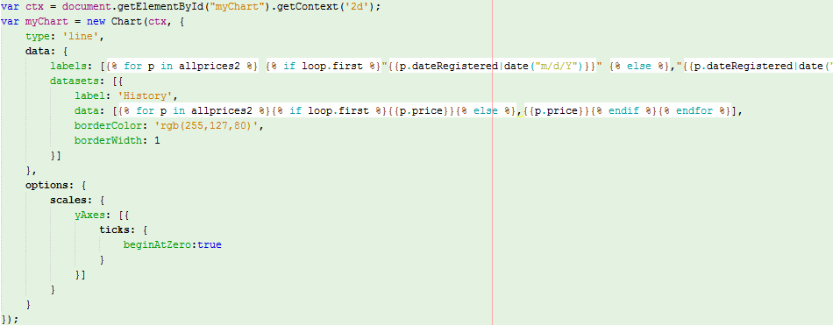
Chart.js
A barcode-scanner entirely written in JavaScript
Uses getUserMedia to get direct access to the user’s camera stream

Slide 16
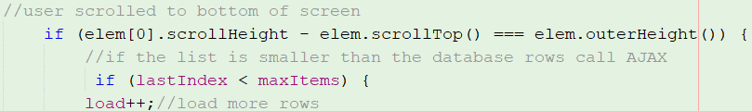
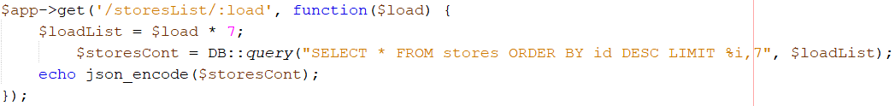
Infinite Scroll – Pagination of the mobile era
First load- only load a bit from table, remember total
Pass load variable with AJAX, multiply to load 7 more

Slide 17
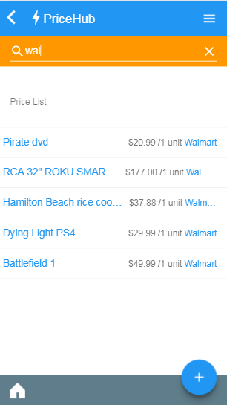
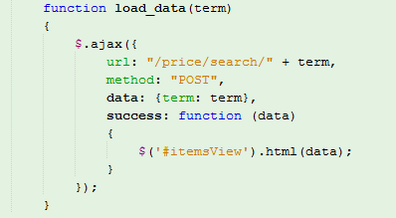

Ajax Search bar
Queries the database by product or store name

Slide 18
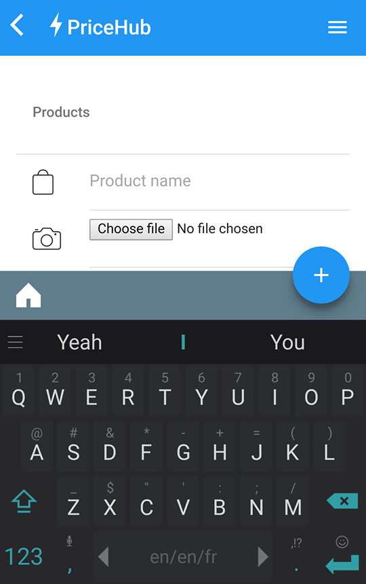
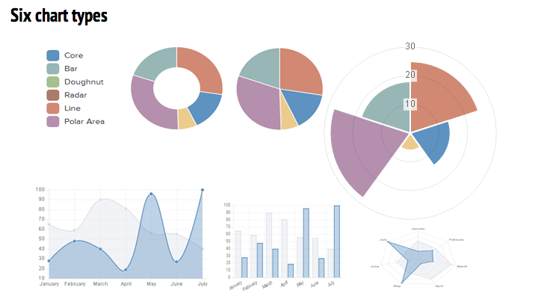
Future Work
Fix keyboard issue on mobile
Various list sorting options
Variety of graphs and charts

