Slide 1









TASKIO
Setting goals made fun!
By
Shelby El-rassi
&
Alexander Qiang

Slide 2
Purpose
We at Taskio believe in the power of setting good goals and pushing ourselves forward.
The app is made to simplify our daily tasks schedule and build good habits.
A gamified version just adds a modern-day fun spin on a standard task tracker.

Slide 3
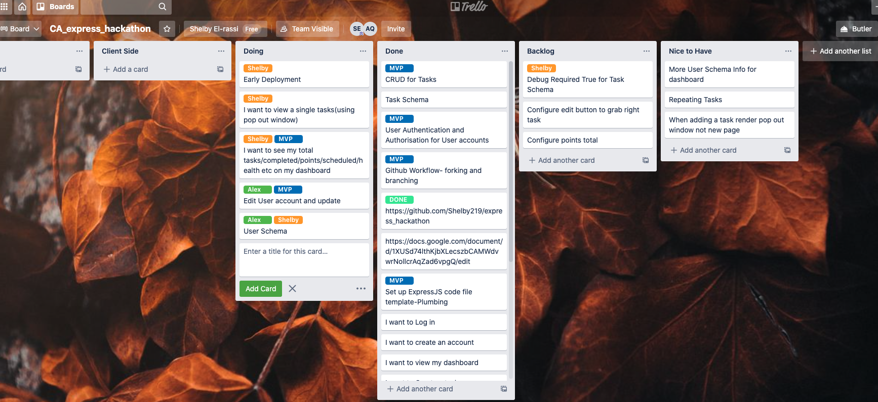
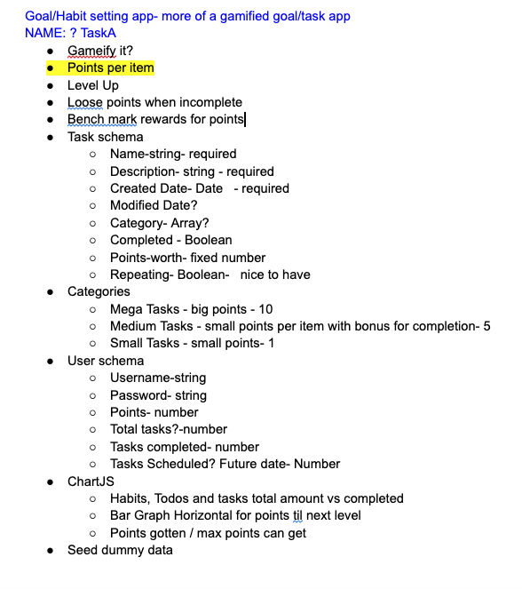

Workflow
Trello for planning
First day google notes
Basic Wireframe
Git Workflow
Main Repository, created on Shelby’s Github.
Alex forked from the main.
We both used branches for current features/work we were working on.
Then once happy with the branch, we pulled latest from main.
Then made a pull request to merge with main.
Workflow was smooth and merge conflicts were resolved with ease.

Slide 4
Technology
JavaScript
MongoDb
Express JS
Node JS
Mongoose
Pug JS
Chart JS
HTML
CSS
Node Packages
Express
Cors
Mongoose
Passport
Pug
Passport-remember-me
Express-session
Connect-Mongo
Method-override
Node-fetch
Path
Trello
Google Docs
Figma

Slide 5
Features
CURRENT
User can Register and Login
User can add their name and avatar through edit user
View User Dashboard (authenticated)
Add new tasks, edit and delete
Mark Tasks as Completed which accumulates points
View Total Points on Dashboard
View total and completed task tally on nav bar
FUTURE
Health and Ability Earnings
Implement Reward Shopping
Advance Task functions, future dating, repeating, category sorting.
Advanced User account details
Profile image upload file. (not string URL)
Oauth with account access.
Show total tasks that are getting close to due date.

Slide 6
Specific Challenges
Setting up a remember me with passport-remember-me.
Processing a delete route, discovered the process is an event listener on button then fetch call.
Put route for updating task. Issue as HTTP in browsers is only GET and POST. So we discovered NPM method override. Can override a POST method to become PUT.
Handlebars ew, so pug JS was utilized. Integrating client side with PUG rendering.
Updating task and user was wiping data.
Not going overboard with too many features we wanted in the short time.

Slide 7
THANK YOU

