Slide 1


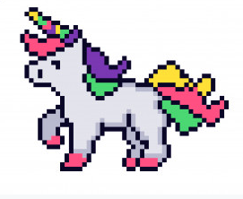






TASKIO
Setting goals made fun!
By
Shelby El-rassi
&
Alexander Qiang

Slide 2
Purpose
The app is made to simplify our daily tasks schedule and build good habits.
A gamified version just adds a modern-day fun spin on a standard task tracker.
We at Taskio believe in the power of setting good goals and pushing ourselves forward.

Slide 3
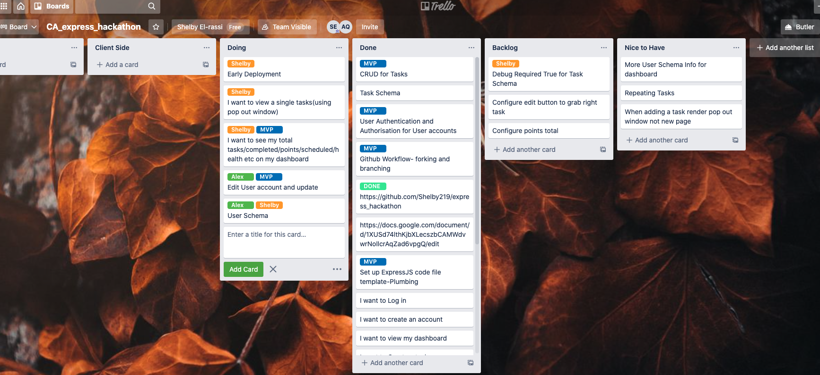
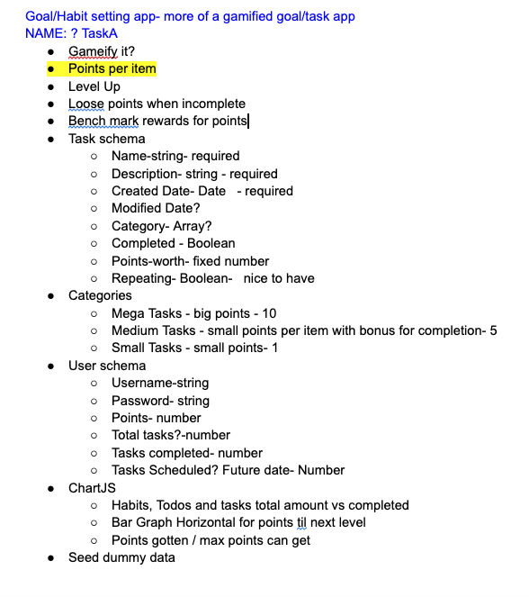

Workflow
Trello for planning
Google notes with initial ideas.
Basic Wireframe
Git Workflow
Main Repository, created on Shelby’s Github.
Alex forked from the created repo.
We both used branches for current features/work we were working on.
Then once happy with the branch, we pulled latest from main.
Then made a pull request to merge with main.
Workflow was smooth and merge conflicts were resolved with ease.

Slide 4
Technology
JavaScript
MongoDb
Express JS
Node JS
Mongoose
Pug JS
Chart JS
HTML
CSS
Postman
Trello
Google Docs
Figma
Heroku
Font Awesome
Node Packages
Express
Cors
Mongoose
Passport
Passport-remember-me
Express-session
Connect-Mongo
Method-override
Path

Slide 5
Features
CURRENT
User can Register and Login (and remember user)
User can add their name and avatar through edit user
View User Dashboard (authenticated)
Add new tasks, edit and delete
Mark Tasks as Completed which accumulates points.
View Total Points on Dashboard.
View total and completed task tally on nav bar.
FUTURE
Health and Ability Earnings via the ChartJS.
Implement Reward Shopping (the pixel art)
Advance Task functions, future dating, repeating, category sorting.
Advanced User account details.
Profile image upload file. Oauth with account access.
Show total tasks that are getting close to due date(the timer in the nav bar).
Search task function.

Slide 6
Specific Challenges
Setting up a remember me with passport-remember-me.
The processing of DELETE and PUT routes.
Handlebars EW, so pug JS was used for rendering.
Updating task and user was wiping data all the data.
Not going overboard with too many features we wanted in the short time.
Stronger focus on error handling for future.
Automated testing focus next time. We used manual testing this time.
Console logging EERRRRYthing is key.

Slide 7
THANK YOU

