Slide 1
APPLICATION OF
PAIRS TRADING STRATEGY:
A MACHINE LEARNING APPROACH

Slide 2
Presentation Outline
1.0 ------- Pairs Trading
2.0 ------- Strategy Implementation
3.0 ------- ML Algorithms

Slide 3
1.0 Pairs Trading
A key quantitative trading concept is mean reversion – when a time series displays a tendency to revert to a historical mean value.
This is exploited to generate trading strategies as a trade can be entered when a price series is far from the mean.
To assess if a time series is mean-reverting, a statistical test is performed to see if it differs from the behaviour of a random walk or Geometric Brownian Motion (GBM) random walk.

Slide 4
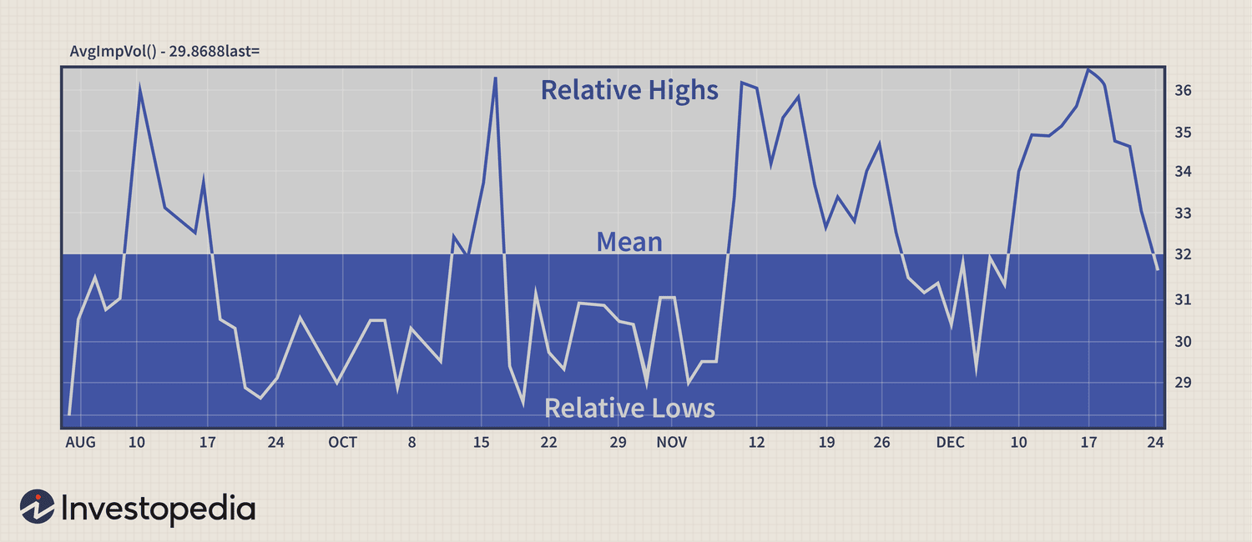
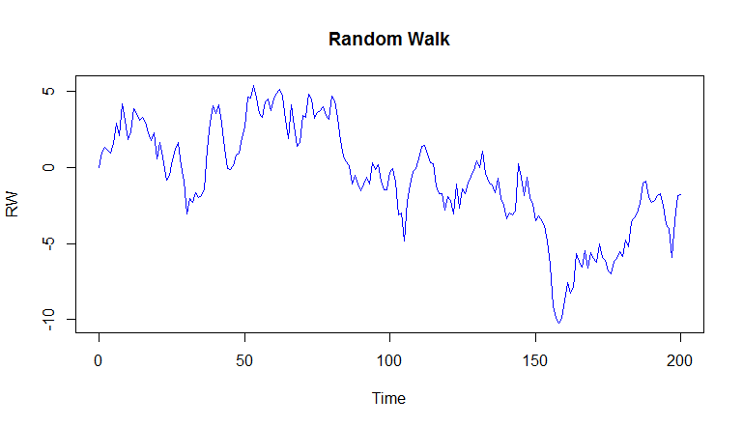
1.0 Pairs Trading
Mean-reverting TS -
displays a tendency to revert to a historical mean value
Random walk TS-
next directional movement is completely independent of any past movements

Slide 5
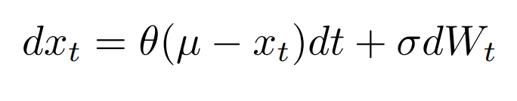
1.0 Pairs Trading
Mathematically, a mean-reverting time series is referred to as an Ornstein-Uhlenbeck process.
Ornstein-Uhlenbeck differential equation:
If it can be shown statistically that a price series behaves like an Ornstein-Uhlenbeck series, then it will be possible to design a trading strategy around it.
In this project, the Statsmodels python library is used to test for mean-reversion.

Slide 6

1.0 Pairs Trading
One such test is the Augmented Dickey-Fuller Test
A model for a time series known as a linear lag model of order p is shown below:
The change in the value of the time series is proportional to a constant, the current time and the previous p values of the time series, along with an error term.
The role of the ADF hypothesis test is to check whether γ = 0, which would indicate (with α = β = 0) that the process is a random walk and thus non mean reverting.
The test considers the null hypothesis that γ = 0.

Slide 7
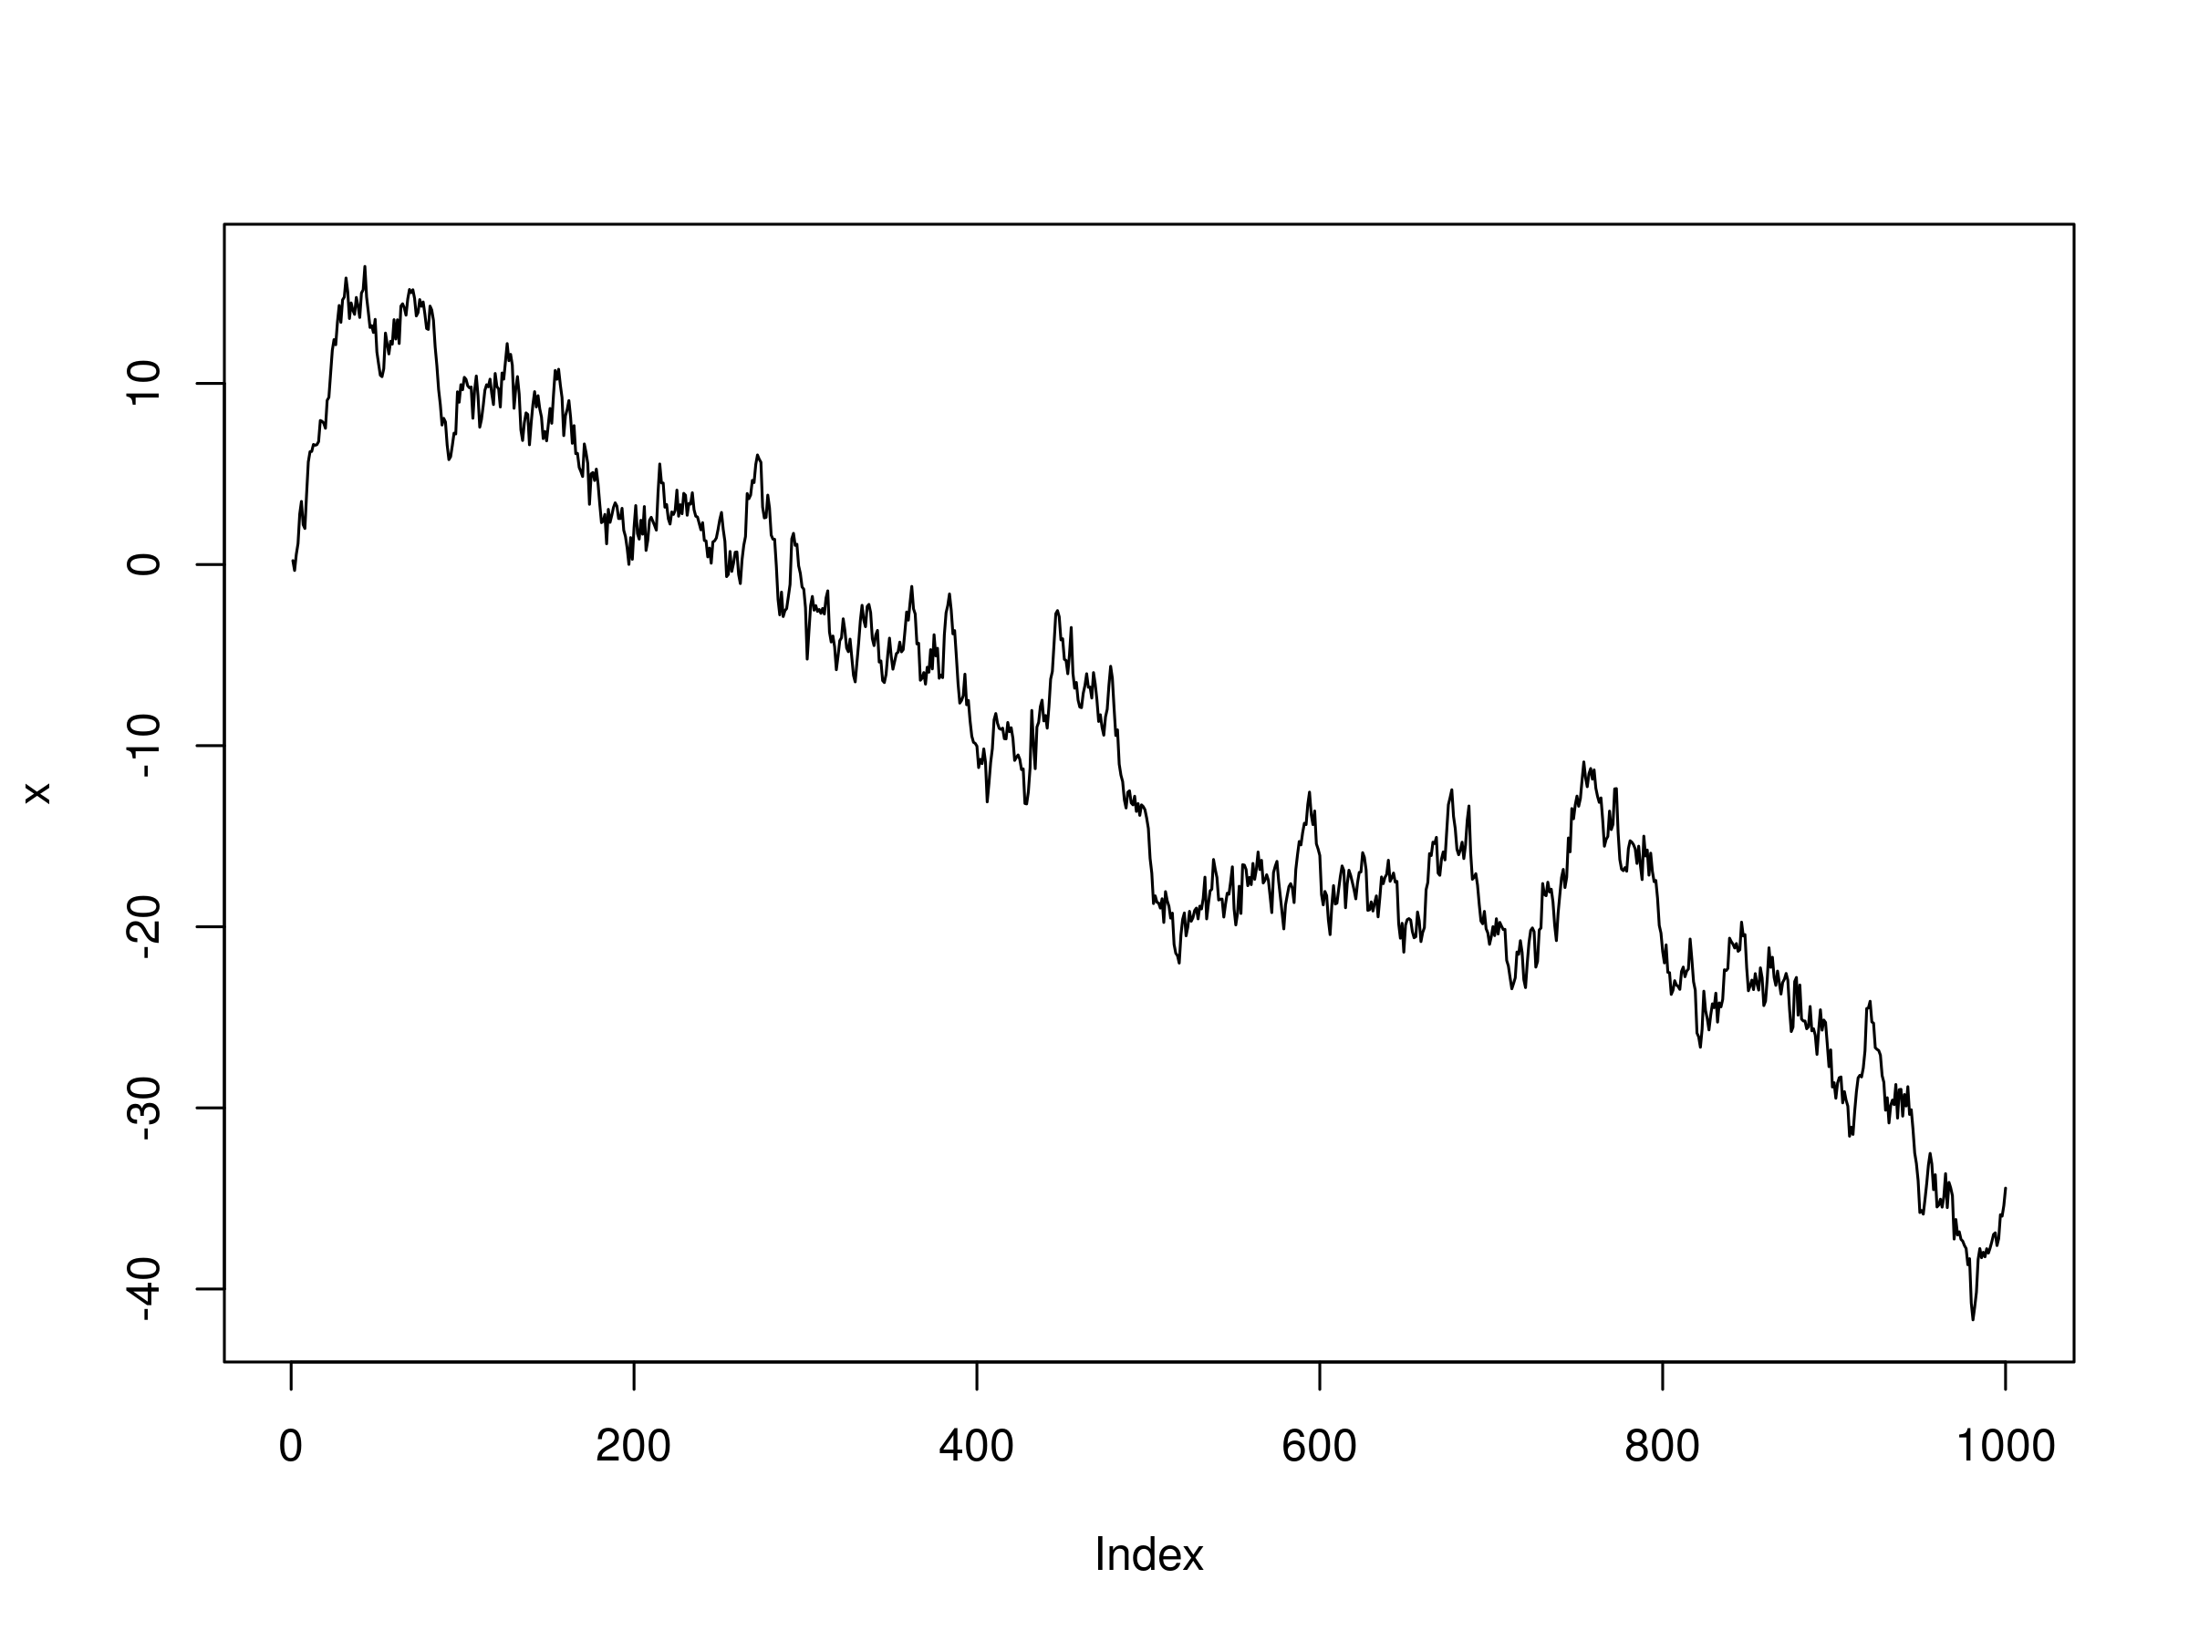
1.0 Pairs Trading
Upon performing the test on time series such as the one below, the null hypothesis of γ = 0 cannot be rejected and thus the series is unlikely to be mean reverting.
This is in line with intuition as most equities behave like to Geometric Brownian Motion (GBM) random walk
However, an alternative method for detecting mean-reversion can be implemented particularly via the concept of stationarity

Slide 8
1.0 Pairs Trading
A time series (or stochastic process) is stationary if its joint probability distribution is invariant under translations in time or space.
It is difficult to find a tradable asset that possesses mean-reverting behaviour, as equities tend to behave like GBMs
However, we can create a portfolio of price series that is stationary.
The simplest form of mean-reverting trade strategies is the classic “pairs trade”, which usually involves a dollar-neutral long-short pair of equities.

Slide 9
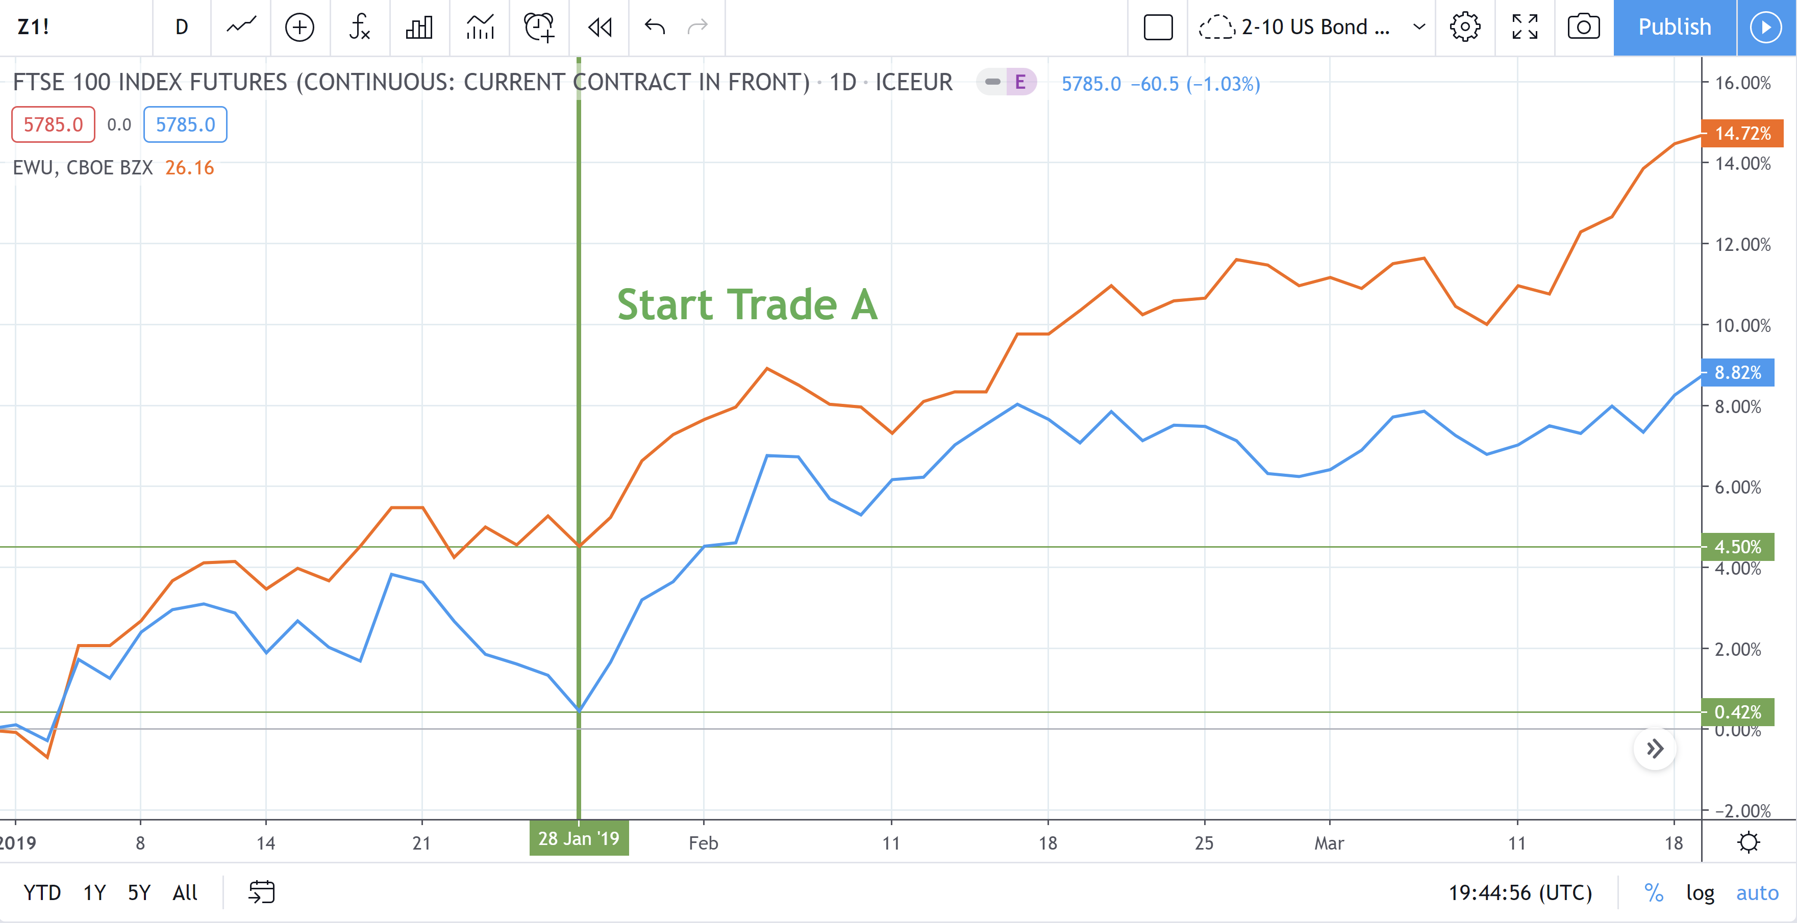
1.0 Pairs Trading
Two companies in the same sector are likely to be exposed to similar market factors, thus exhibiting cointegration.
Occasionally their relative stock prices will diverge due to certain events that affect one but not the other and their price differences will eventually revert to the long-running mean.

Slide 10
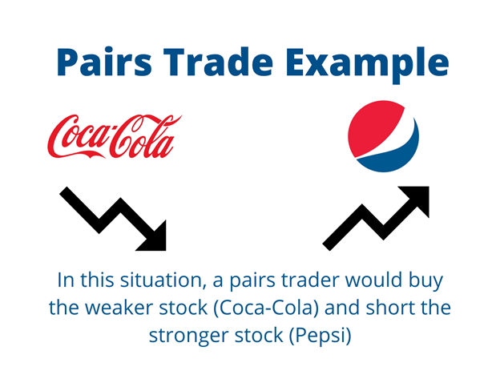
1.0 Pairs Trading
Two companies in the same sector are likely to be exposed to similar market factors, thus exhibiting cointegration.
Occasionally their relative stock prices will diverge due to certain events that affect one but not the other and their price differences will eventually revert to the long-running mean.

Slide 11

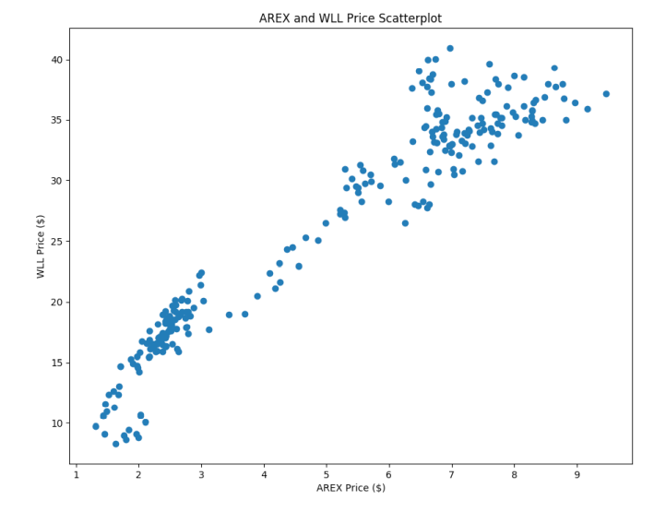
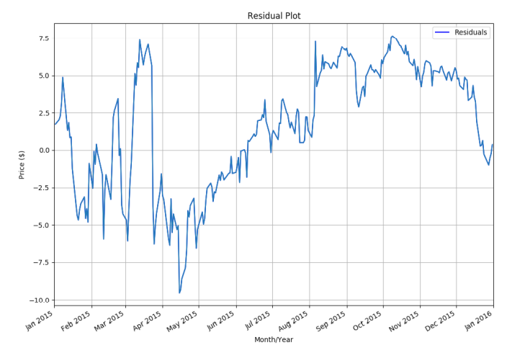
1.0 Pairs Trading
Pairs trade construction:
The Cointegrated Augmented Dickey-Fuller Test (CADF) determines the optimal hedge ratio by performing a linear regression against the two time series and then tests for stationarity under the linear combination

Slide 12
2.0 Strategy Implementation
Steps followed:
  Data import and storage
  Selection of trading pair
  Pairs Trade Strategy execution and assessment

Slide 13
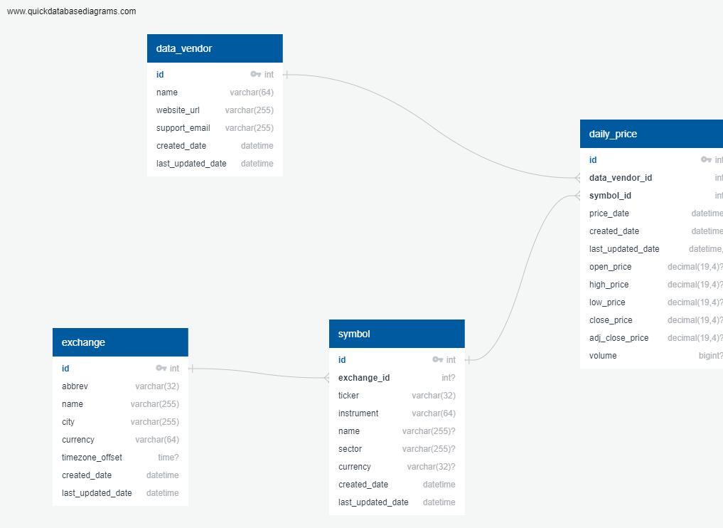
2.0 Strategy Implementation
Data import and storage
A database (securities_master) was created in PostgreSQL using the schema shown below:
  Symbol
  Daily Price
  Data vendor
  Exchange

Slide 14
2.0 Strategy Implementation
Data import and storage
The list of all S&P500 tickers was obtained and downloaded to the the Symbol table using the ticker_fetch.ipynb
  Uses bs4.BeautifulSoup(response.text) to convert table into text
price_import_to_db.ipynb imports daily prices for the last 3 years for all 503 tickers to the database via financialmodelingprep API.
All data was then accessible from the securities_master

Slide 15
2.0 Strategy Implementation
2) Selection of trading pair
All possible combinations for the top 20 tickers were assessed using the itertools library
A CADF test for each of the ticker pairs' time histories was performed to assess cointegration
Next, the correlation and the corresponding hedge ratio for each pair of the cointegrated pairs was calculated.
The residuals for each pair were also calculated

Slide 16
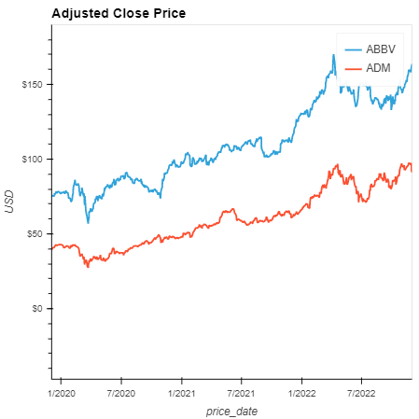
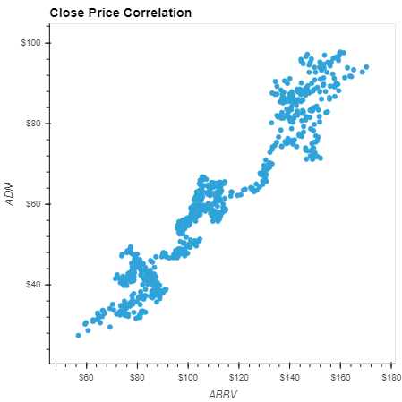
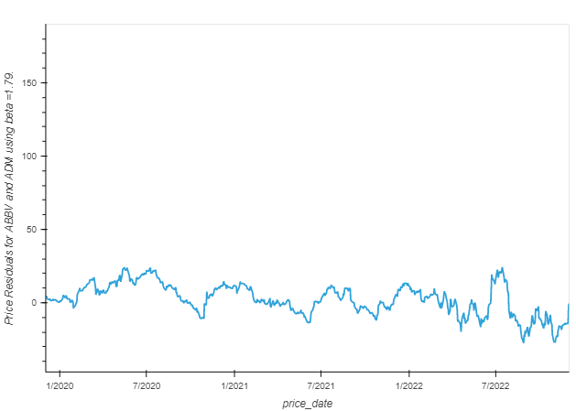
2.0 Strategy Implementation
2) Selection of trading pair
The highest correlated pair was selected as part of the strategy

Slide 17
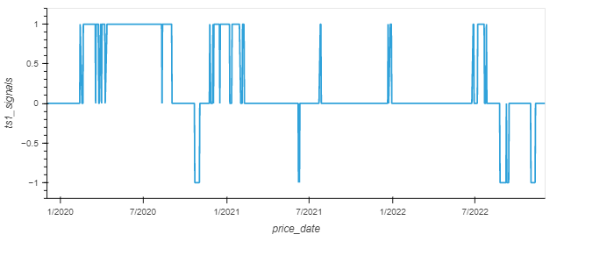
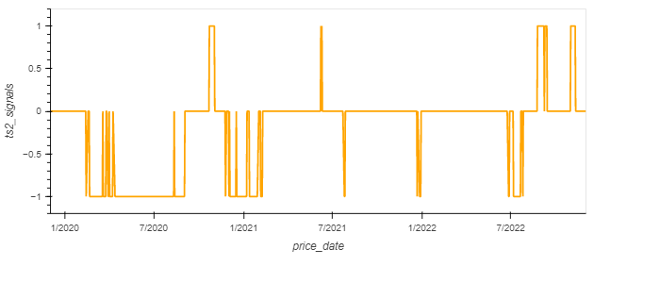
2.0 Strategy Implementation
3) Pairs Trade Strategy execution and assessment
Mean-reversion of the residuals (+/1 1 std) was leveraged in the strategy creating signals to buy long (-1), sell short (1), or do nothing (0) for each TS in the pair

Slide 18
2.0 Strategy Implementation
3) Pairs Trade Strategy execution and assessment
To assess performance of the strategy a comparison was made against an original portfolio with 50 shares invested in each stock.
This baseline portfolio will not change number of shares.
In contrast, the strategy will sell/buy 40 shares from stock to the other based on the trading strategy.

Slide 19
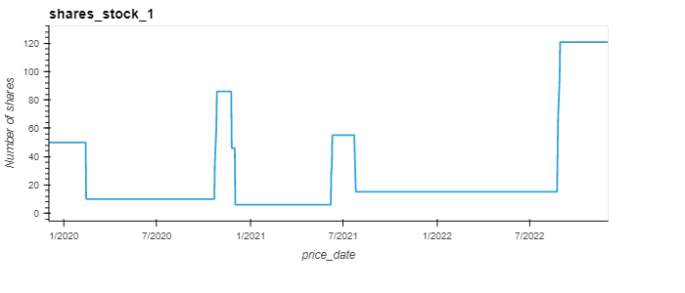
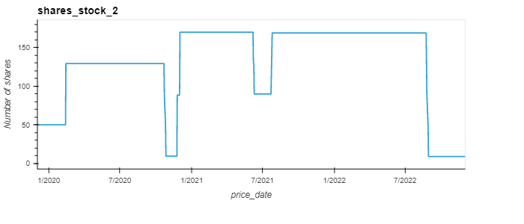
2.0 Strategy Implementation
3) Pairs Trade Strategy execution and assessment
As shown below, the number of shares in each stock varies according to the strategy signals.

Slide 20
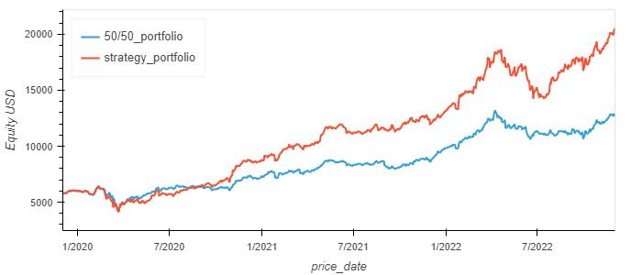

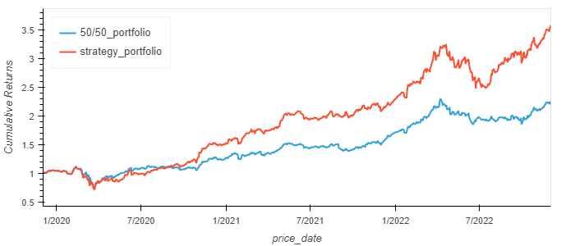
2.0 Strategy Implementation
3) Pairs Trade Strategy execution and assessment
Performance was assessed by looking at the differences in equity curves and cumulative returns

Slide 21
3.0 ML Algorithms
Three ML classifiers were employed to help automate implementation of the pair trade strategy
  Support Vector Classifier
  Random Forest Classifier
  Quadratic Discriminant Analysis
The three year price data for the pair was split into a training dataset and a testing dataset (1 yr and 2 yr, respectively)

Slide 22


3.0 ML Algorithms
Residual data were used as the single feature in the X dataframes, which scaled prior to use in the ML strategy.
Strategy signals were selected as the ML target values.
The training data was observed to be heavily imbalanced, so oversampling of the training set was employed.

Slide 23
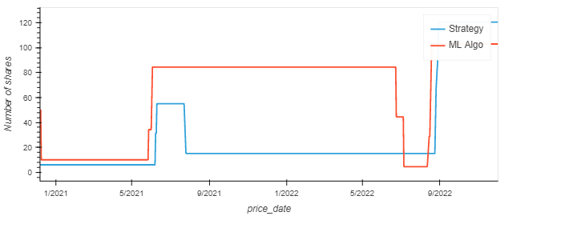
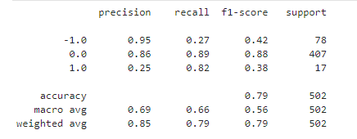
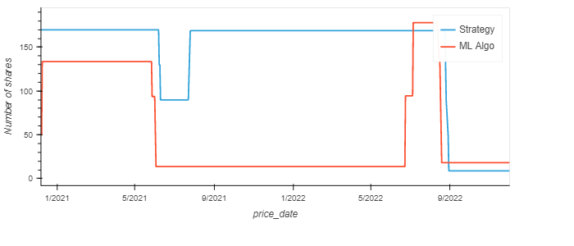
3.0 ML Algorithms
SVC

Slide 24
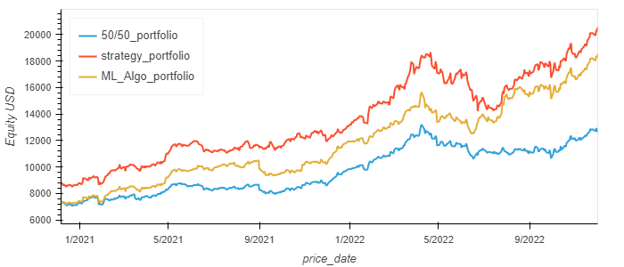
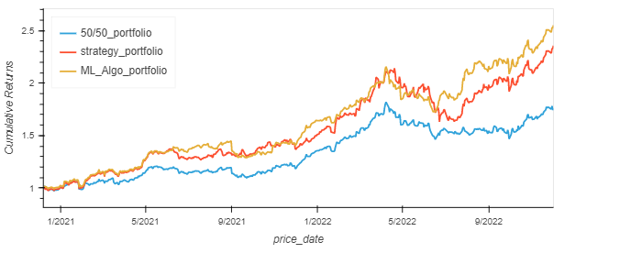
3.0 ML Algorithms
SVC

Slide 25
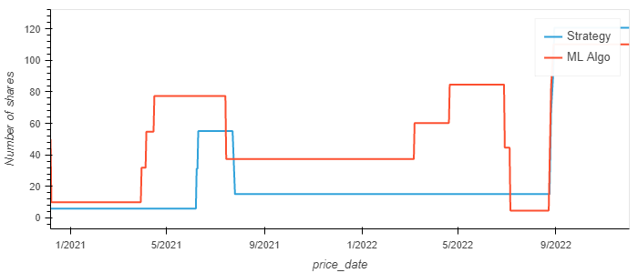
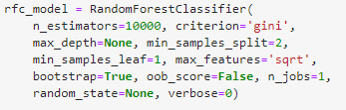
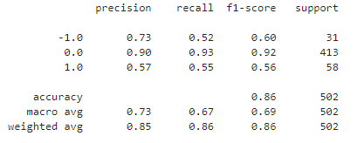
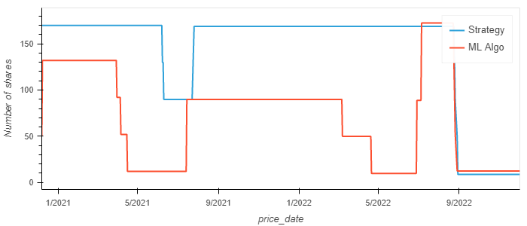
3.0 ML Algorithms
Random Forest

Slide 26
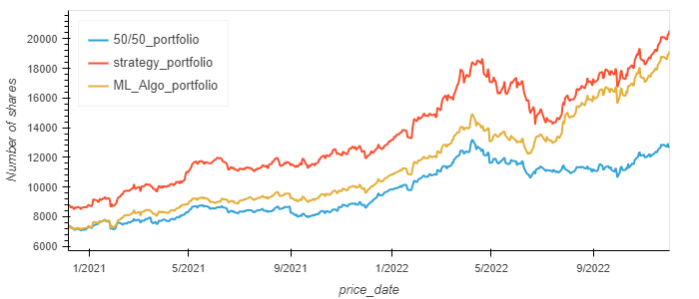
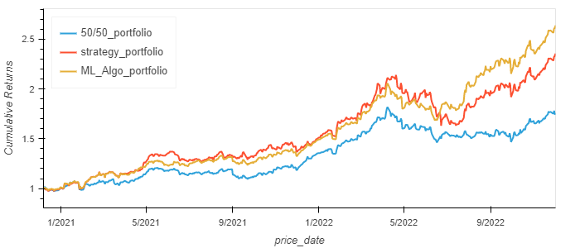
3.0 ML Algorithms
RFC

Slide 27
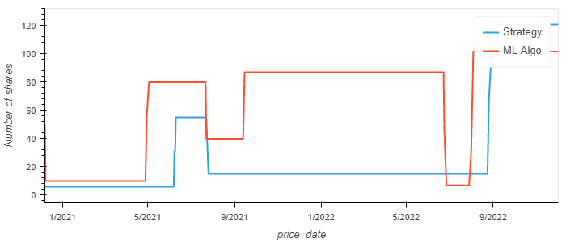
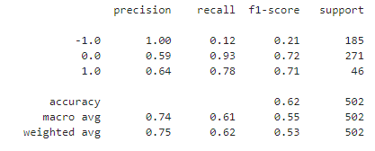
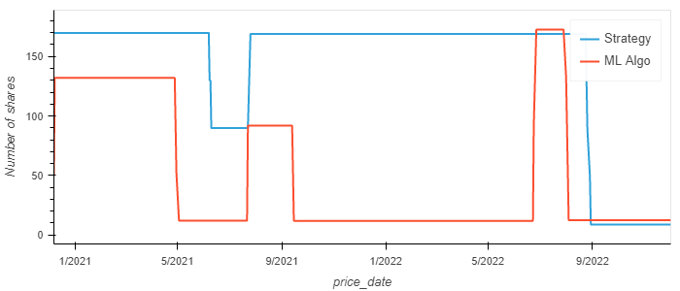
3.0 ML Algorithms
QDA

Slide 28
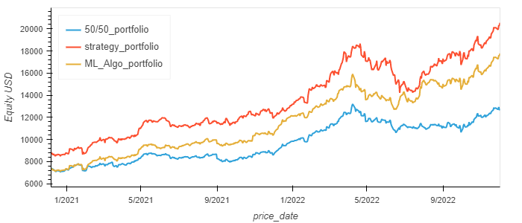
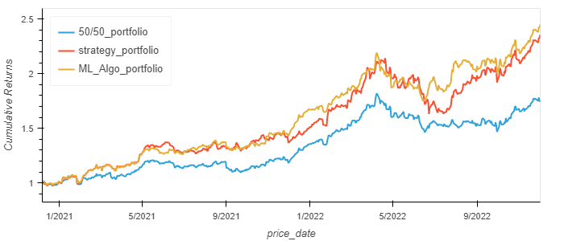
3.0 ML Algorithms
QDA

Slide 29
3.0 ML Algorithms
Cumulative returns comparison
SVC
RFC
QDA

Slide 30
4.0 Conclusions
As shown, the baseline strategy of pairs trading produces higher returns than the original pair portfolio (unchanged).
The three ML algorithms follow the cumulative returns profile of the baseline strategy.
However, RFC has a higher degree of accuracy (86%) in the triggering of trading signals than SVC and QDA (79% and 62% respectively)
The three trained ML models were saved in the repository as .sav files.

Slide 31
References
Wilmott P. (2001). Paul Wilmott introduces quantitative finance. John Wiley.
Mazzoni T. (2018). A first course in quantitative finance. Cambridge University Press.
Weiming J. M. (2019). Mastering python for finance : implement advanced state-of-the-art financial statistical applications using python (Second). Packt Publishing.

Slide 32
Thank you!

