Slide 1
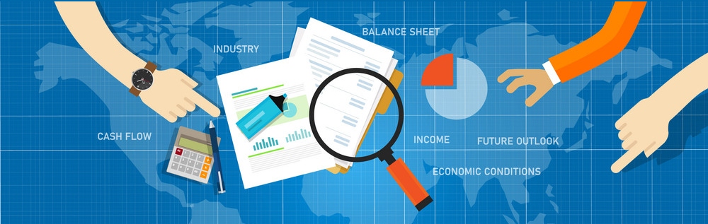
Fundamental Quantitative Analysis
of Explorer and Producer Mining Companies
https://cdn2.vectorstock.com/i/1000x1000/37/26/fundamental-analysis-stock-investment-analysis-vector-34553726.jpg

Slide 2
Motivation
The analysis notebooks included in the Repo were developed to perform a quantitative fundamental analysis of several mining company stocks at a microeconomic level by attempting to assess the effectiveness of a mining company's management from financial statements.
The objective is to determine a stock's true value that an investor can compare against the current market price to see whether the security is undervalued or overvalued by other investors.
The series of analyses performed provide a clearer picture of the companies' financial health and growth perspective for market investment.

Slide 3
Data Acquisition and Ratio Analysis
Historical balance sheets, and income and cash flow statements of 12 mining companies were retrieved via API from Financial Modeling Prep API – A separate jupyter notebook with defined functions was created.
The historical prices of gold and silver were collected as well, along with iShares Core Canadian Universe Bond Index, for data comparison analyses.
The financial data were stored in a PostgresSQL database and subseqquently used to carry out a ratio analysis for each company in order to compare performance. Ratios evaluated included:
  Q/Q Earnings
  Y/Y Earnings for Q1-Q4
  Q/Q Cash flows
  D/E Ratio (solvency)
  Quick Ratio (A/D)
  The price-to-cash flow (P/CF) ratio

Slide 4
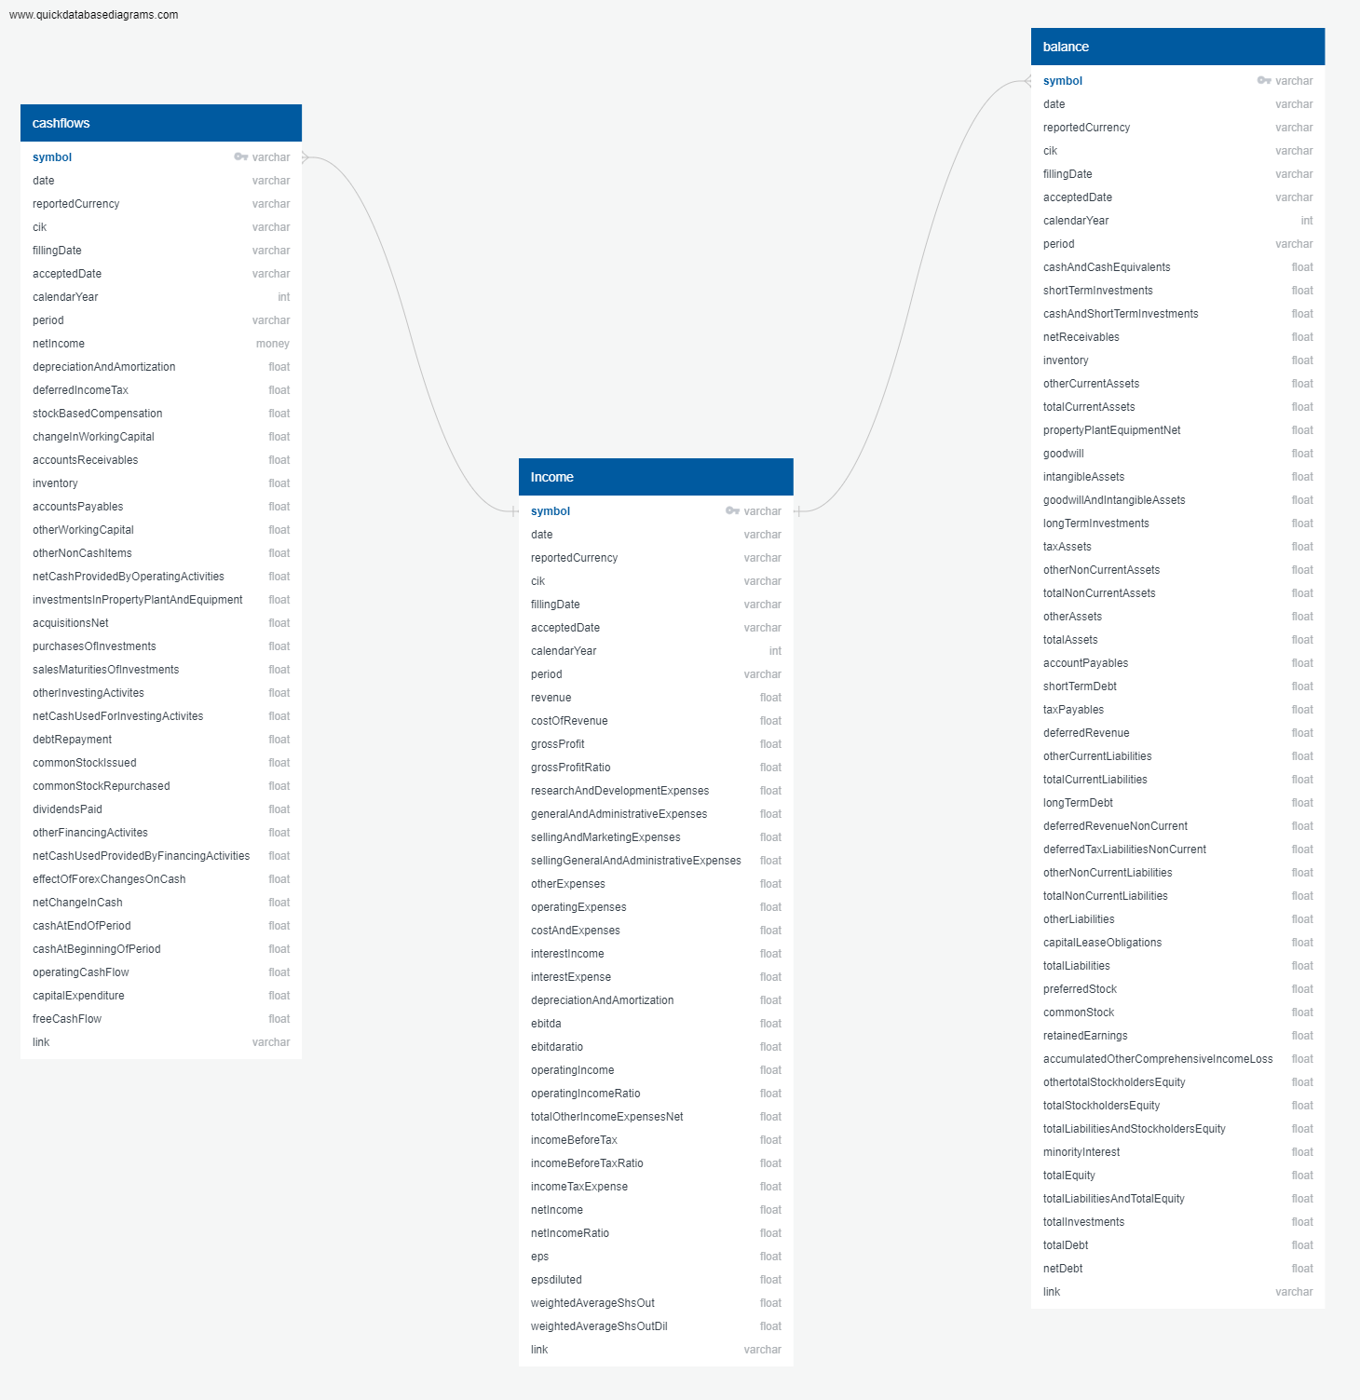
Data Cleanup & Exploration
The data were pulled from the API via the defined python functions and stored in CSV format.
A financial statement database schema was developed on https://www.quickdatabasediagrams.com/
The database was populated using the CSV files pulled from the API.
Query Views were created to more succinctly pull the data required for analysis.

Slide 5
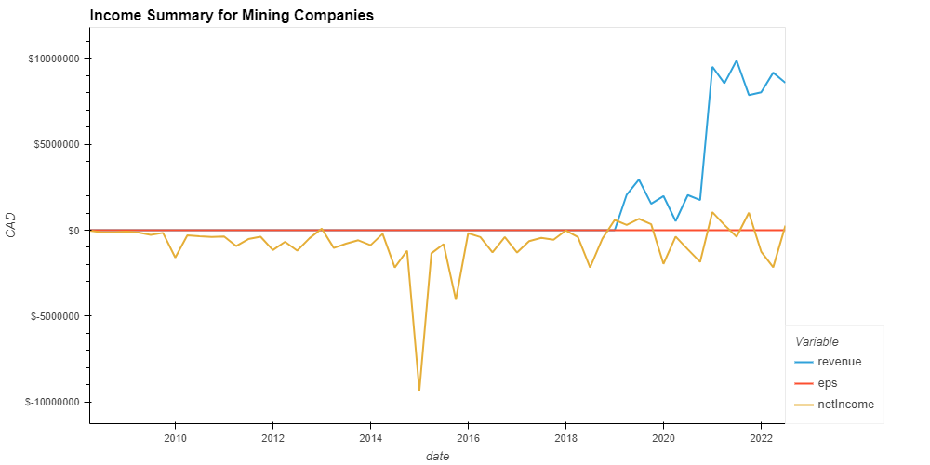
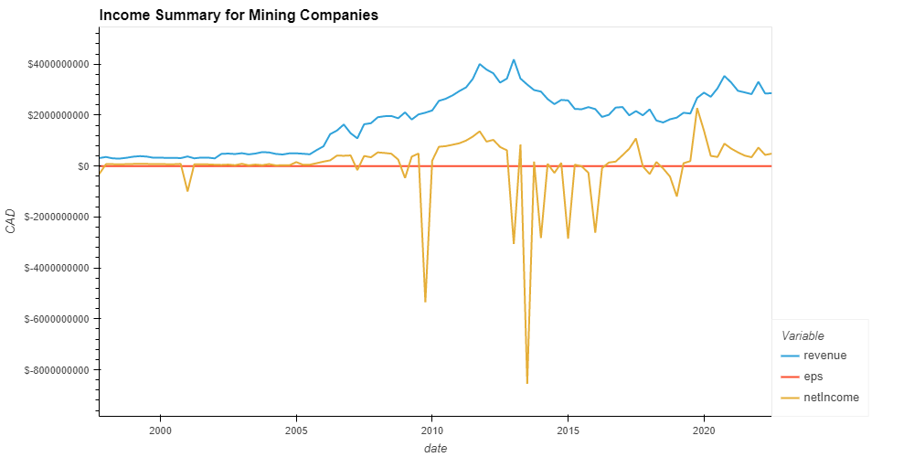
Data Cleanup & Exploration
Upon loading the data into the notebook for analysis, it was noted that net income (earnings) tend to oscillate around zero.
This was noted in junior companies such as Aya, as well as in major established companies like Barrick.
This makes assessment of market prospect ratio P/E difficult, as it would indicate the company is consistently losing money.
This is due to the nature of the business, which requires extensive capital expenditures, both for exploration and the initial establishment of mining operations.
However, once a mine is operational, its operating costs tend to be significantly lower and relatively stable.
Additionally, because mining revenues are subject to fluctuations in commodity prices, it is important for mine operators to wisely manage changes in production levels.
Aya Gold & Silver
Barrick Gold
https://www.investopedia.com/articles/active-trading/082615/key-financial-ratios-analyze-mining-industry.asp

Slide 6
Data Analysis
The analysis performed looks at a company's performance in three distinct areas:
  Growth: Q/Q earnings, Y/Y Earnings for Q1-Q4, and Q/Q Cash flows
  Liquidity and Solvency: D/E Ratio, Quick Ratio
  Market Prospect: The price-to-cash flow (P/CF) ratio
The quick ratio is important for evaluating mining companies because of the substantial capital expenditures and financing necessary for mining operations. Analysts and creditors prefer to see quick ratio values higher than 1, the minimum acceptable value.
The fundamental questions to be answered as therefore:
  Which companies exhibit the best growth tendencies?
  Which companies show acceptable levels of liquidity and solvency?
  Which companies have overvalued/undervalued stocks?
The answers to these questions are presented in a ranking system developed for the analysis.

Slide 7
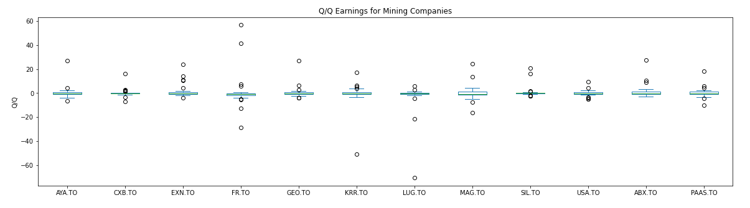
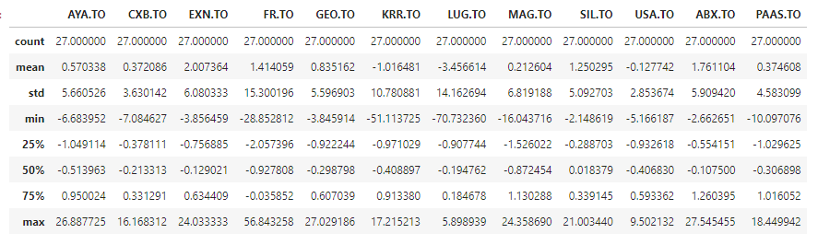
Discussion
Growth: Q/Q Earnings

Slide 8
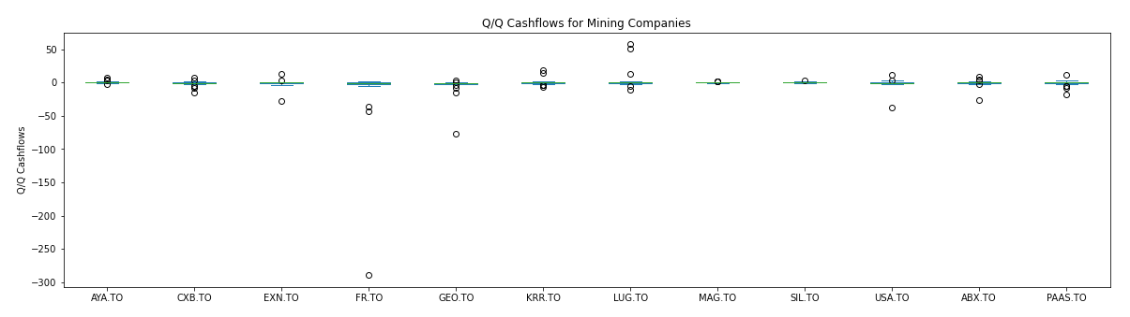
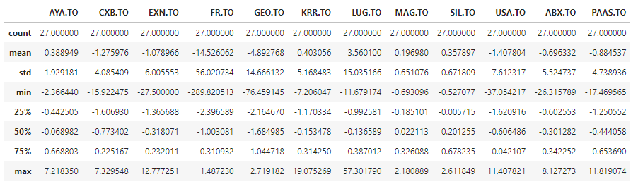
Discussion
Growth: Q/Q Cashflows

Slide 9
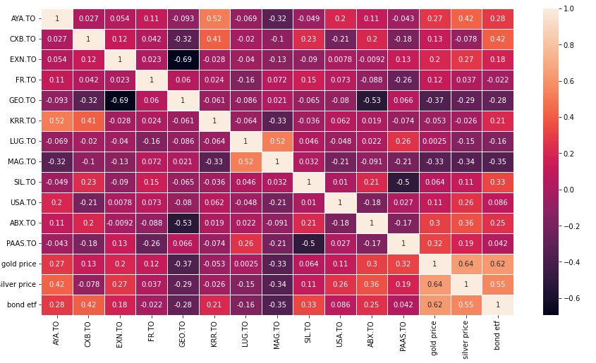
Discussion
Growth: Q/Q cash flows correlation with Commodity and Bond ETF

Slide 10
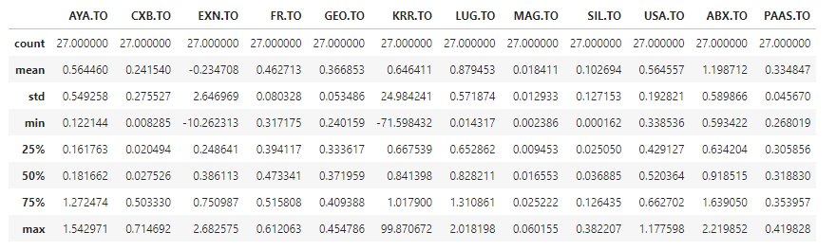
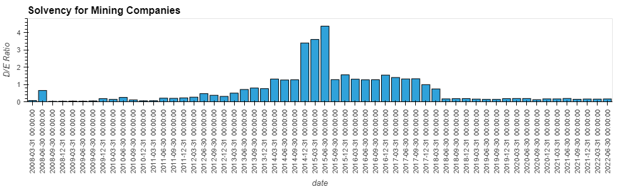
Discussion
Solvency: D/E
Aya Gold & Silver

Slide 11
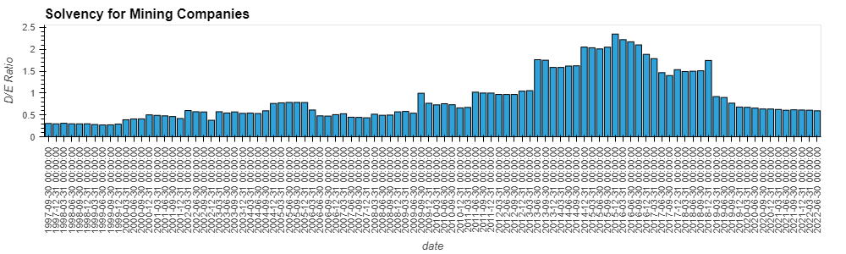
Discussion
Solvency: D/E
Barrick Gold

Slide 12
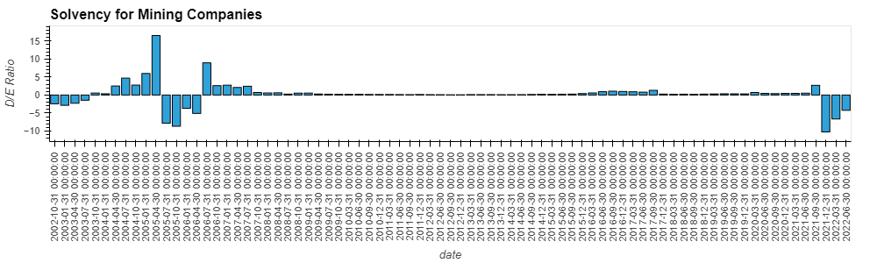
Discussion
Solvency: D/E
Excellon Gold

Slide 13
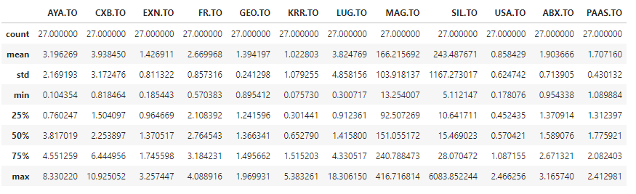
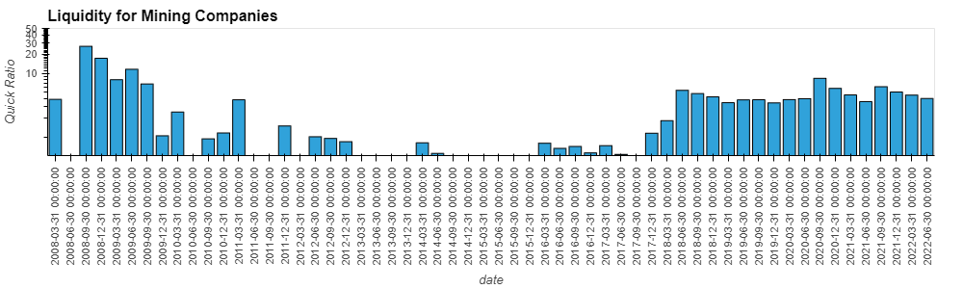
Discussion
Liquidity: Quick Ratio
Aya Gold & Silver

Slide 14
Discussion
Liquidity: Quick Ratio
Barrick Gold

Slide 15
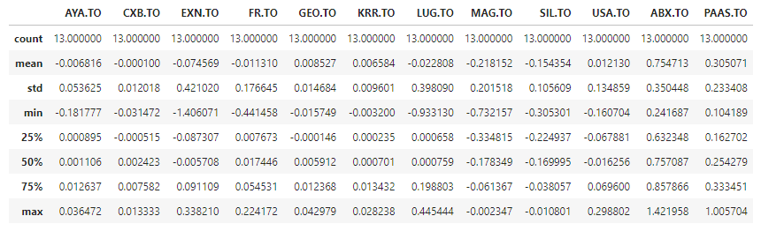
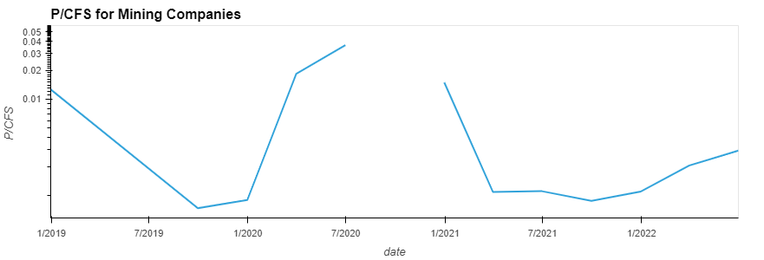
Discussion
Market Prospect: P/CFS
Aya Gold & Silver

Slide 16
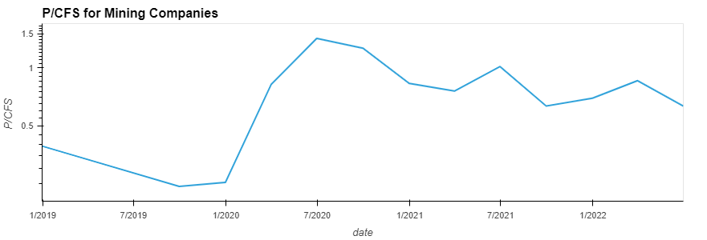
Discussion
Market Prospect: P/CFS
Barrick Gold

Slide 17
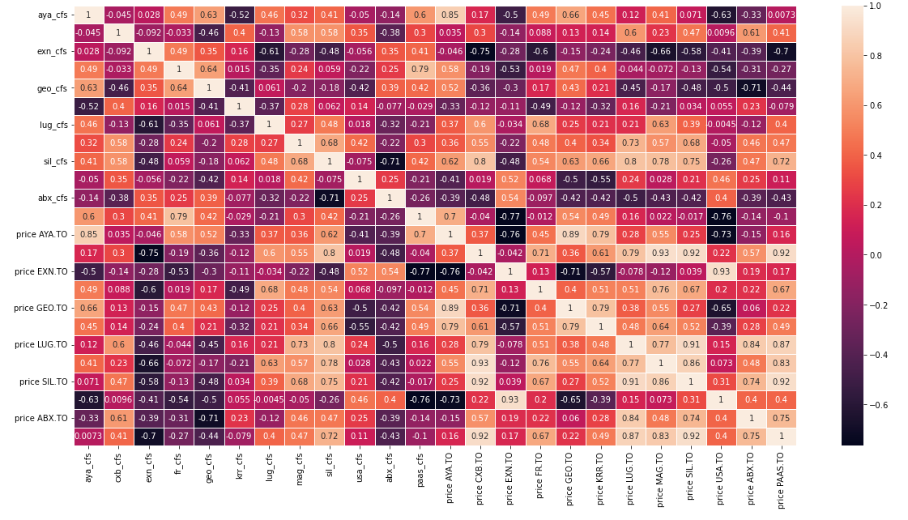
Discussion
Market Prospect: Corr between P and CFS

Slide 18
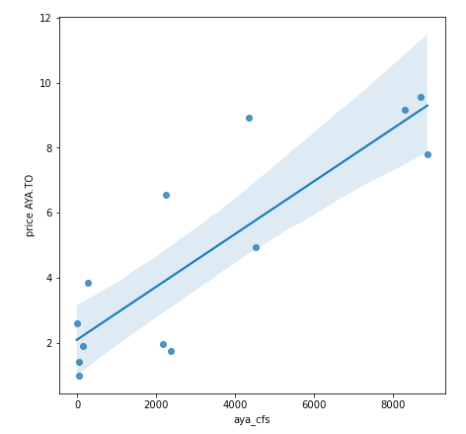
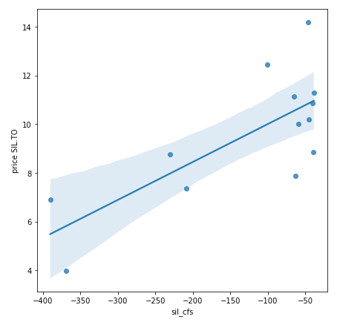
Discussion
Market Prospect: Corr between P and CFS

Slide 19
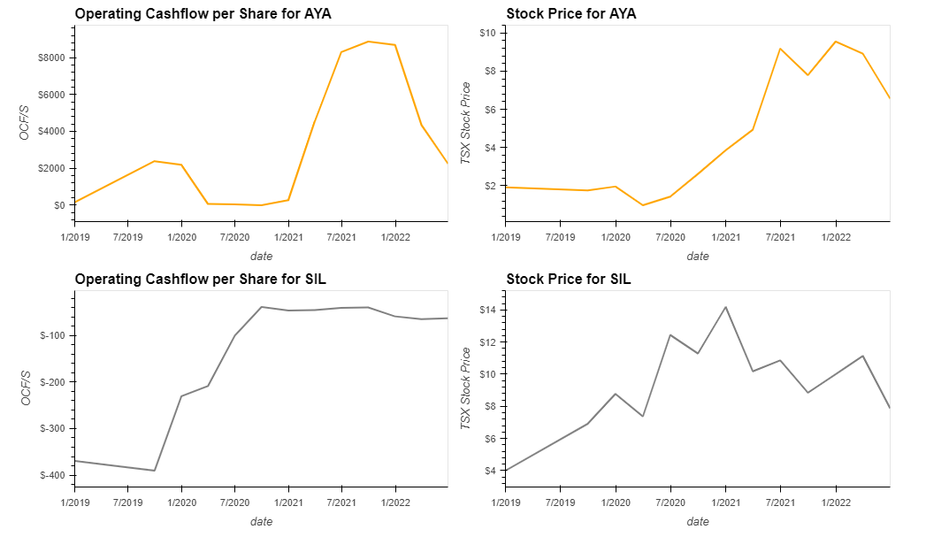
Discussion
Market Prospect: Corr between P and CFS

Slide 20
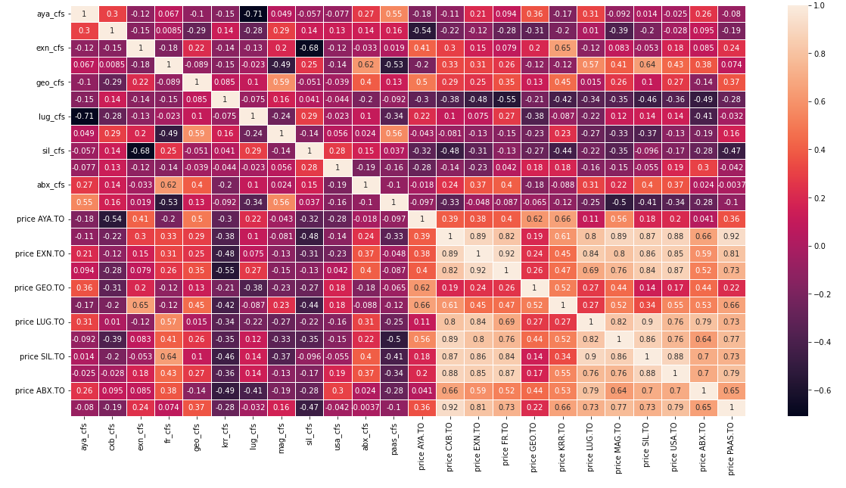
Discussion
Market Prospect: Corr between %change P and CFS

Slide 21
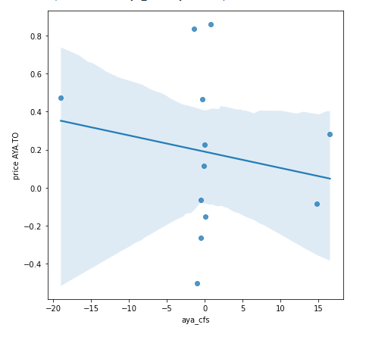
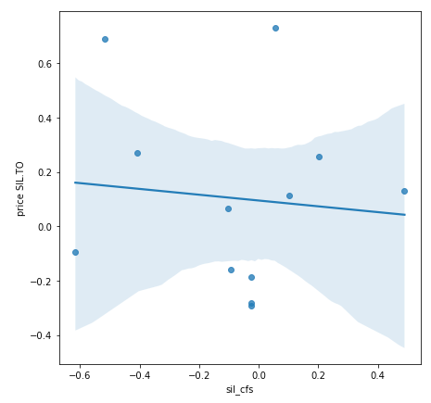
Discussion
Market Prospect: Corr between P and CFS

Slide 22
Discussion
Market Prospect: Corr between P and CFS

Slide 23
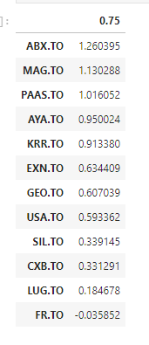
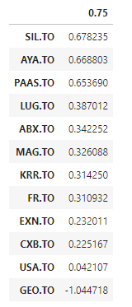
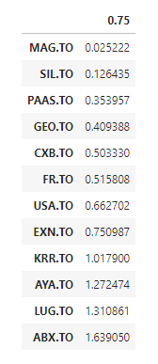
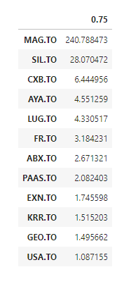
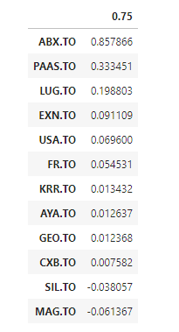
Conclusions
Q/Q Quick R
P/CFS
TTM
Q/Q Earnings
Q/Q Cashflows
Q/Q D/E
Best performers by ranking:
MAG(42), SIL (38),PAAS (35), AYA (32), ABX (27)

Slide 24
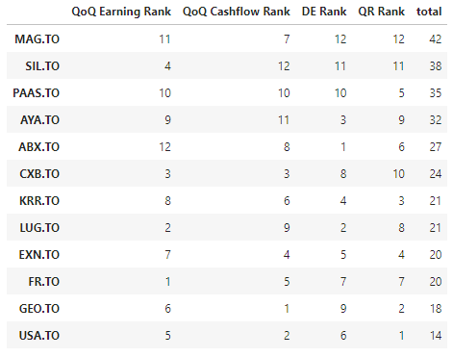
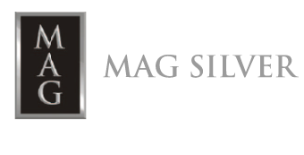




Conclusions
Best performers by ranking:
MAG(42), SIL (38),PAAS (35), AYA (32), ABX (27)

Slide 25
Postmortem
Further research:
Performing a discounted cash flow valuation for the selected performers
Performing a Monte Carlo simulation on the stocks
Comparing forecast data

Slide 26

Thank you!
https://jrossrecruiters.com/sites/default/files/styles/blog_promoted_image/public/field/image/any-questions.jpg?itok=6THzQGhb

