Slide 1

Emotional Verification on Social Media
Alexander Ramsayer
Christopher Long
Spencer Fuhriman

Slide 2

The Problem
2005: 5% 2011: 50% Today: 70%
Keep people connected
The Concept of the “Like”
Ingenuine engagement
Purchasing likes
Clickbait
Familiarity

Slide 3

The Solution
Legitimize the “like” and the “dislike”
BCI measures positive/negative emotion as user views social media post
Results of BCI measurement are represented in gauge
User presses space-bar when finished viewing post
Viewed posts are ranked by level of enjoyment
Create an environments where the top content is objectively the most enjoyed by the community

Slide 4
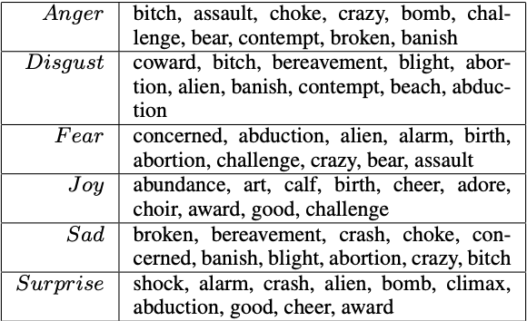
Detecting Emotions in Social Media
Classification of social media posts based on different emotions utilizing different constraints
Used an algorithmic approach to be able to group different emotions into overlapped broader ones
Authored by Yichen Wang and Aditya Pal
Published 2015

Slide 5

Emotion Classification Based on Gamma Band EEG
Mu Li ; Bao-Liang Lu, 2009
Classified happiness and sadness
Evoked emotions showing above images
Used machine-learning
Trials with lengths of 3s and 1s
Gamma band
93% accuracy
62-channel electrode cap

Slide 6
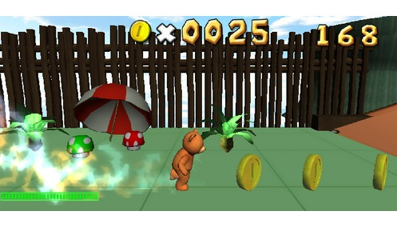
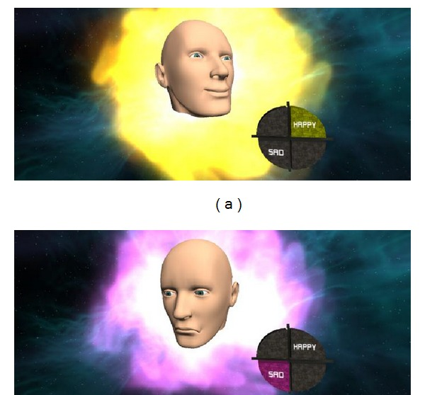
Real-time EEG-Based Happiness Detection
2013 study conducted by Chulalongkorn University
Noppadon Jatupaiboon
Setha Pan-ngum
Pasin Israsena
Their study focused on having volunteers play happiness based games.
Temporal pair (T7 and T8) of channels and high-frequency bands give the best result
~70% accuracy
Notes:
The study on happiness using games [2] provides readers with optimal locations of electrodes using as few as possible, however, the games were a self-elicited trigger for happiness that is suspected to be easier to detect than reading a social media post.

Slide 7
Our Approach
We collect information from the Frontal Cortex utilizing electrodes on the T7 and the T8
Users will see the results of their emotion via a sliding scale on screen
This visualization of intensity of emotion for given stimuli closes the feedback loop to the user
By measuring the actual emotions of the user, we can help verify the accuracy of individual’s perception within social media

Slide 8
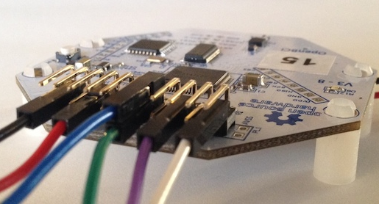
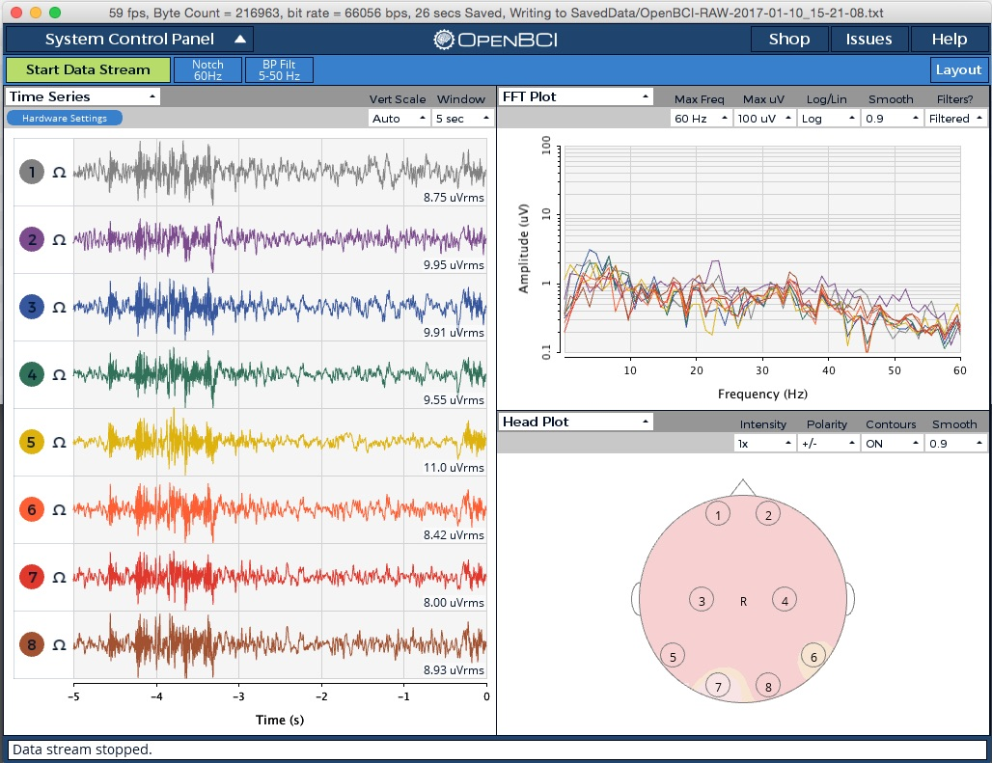
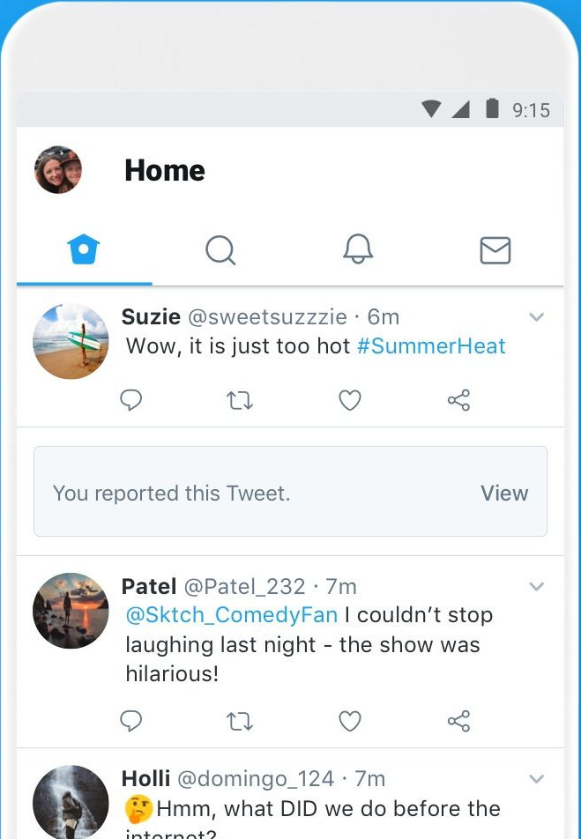

System Design
Signal Acquisition
Feature Extraction
Feature Translation
Social Media Platform
Proposed Device
OpenBCI Ganglion Board
OpenBCI GUI
Socket.IO
Socket.IO
Node.JS
BCI.JS
React / Express
Developed in JS in Atom and Visual Studio Code

Slide 9
Challenges
Most emotion based BCI applications utilizing machine learning to achieve greater accuracy
Determining which Javascript frameworks to use
Classifying brain wave activity into different designations
Getting the back end to communicate with the front end

Slide 10
Future Work
Improving emotional verification processes
Making it more accurate
Making it quicker
Integrating machine-learning
Adding more emotional responses
Better UI

Slide 11

Thank You
Alex Ramsayer
Christopher Long
Spencer Fuhriman
CS 491 - Dr. Chris Crawford

