Slide 1




Extracting Structured Information From Legal Documents
By Alexey Riepenhausen

Slide 2
- Introduction -
Collaboration between RoS and University of Edinburgh
RoS responsible for compiling & maintaining records relating to property
Registers of Scotland 400 Year Anniversary Scholarship

Slide 3
Problem Definition

Slide 4
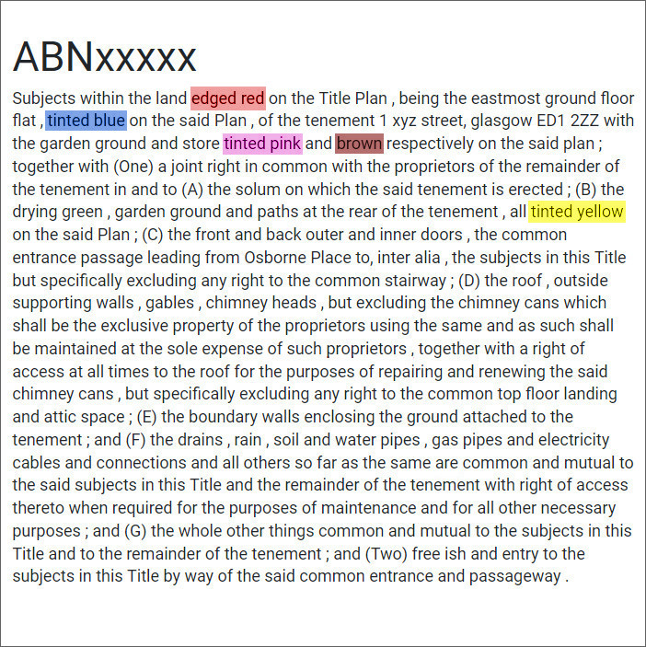
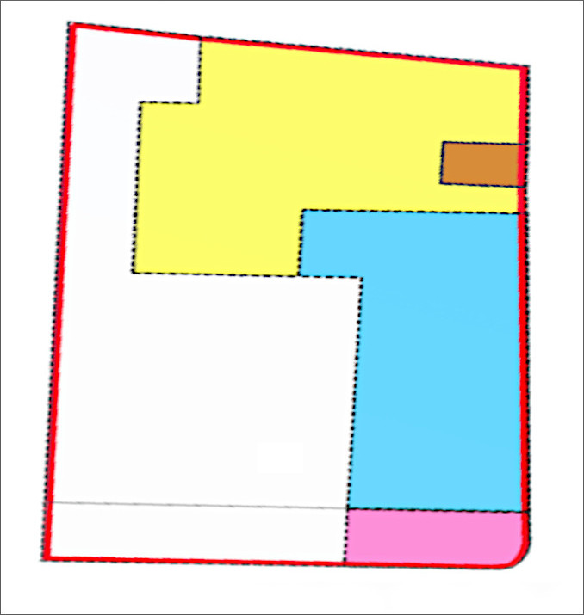

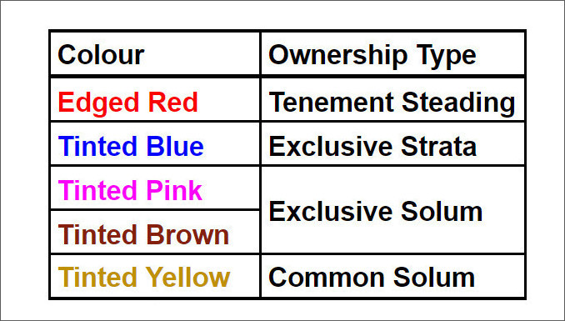

Slide 5
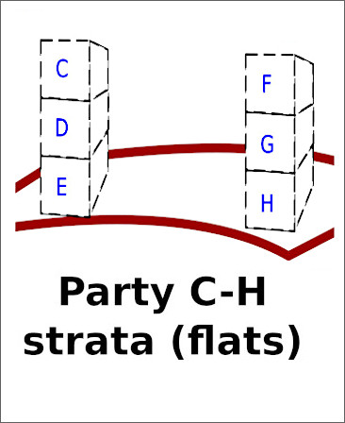
- Types of Ownership -
Exclusive Strata
2. Exclusive Solum
3. Common Strata
4. Common Solum

Slide 6
- Methodology -
Supervised learning using Word2vec and LSTM networks
Word2vec | Conversion of words into vector representations
LSTM | Long short-term memory neural classifier
Data set | 5,000 randomly selected A-sections on flats and houses
Annotated | 200 houses and 200 flats

Slide 7
- Methodology -
Three different classification stages
Stage 1 | Is this A-section a house of flat? | House | Flat
Stage 2 | Does [exclusive strata] exist in this A-section? | Yes | No
Stage 3 | Does this colour-pair represent [exclusive strata]? | Yes | No

Slide 8
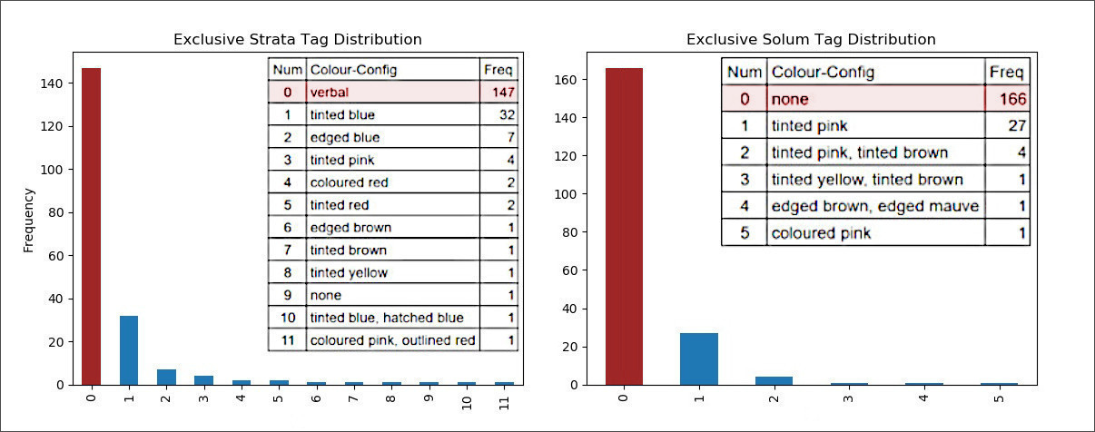

Slide 9
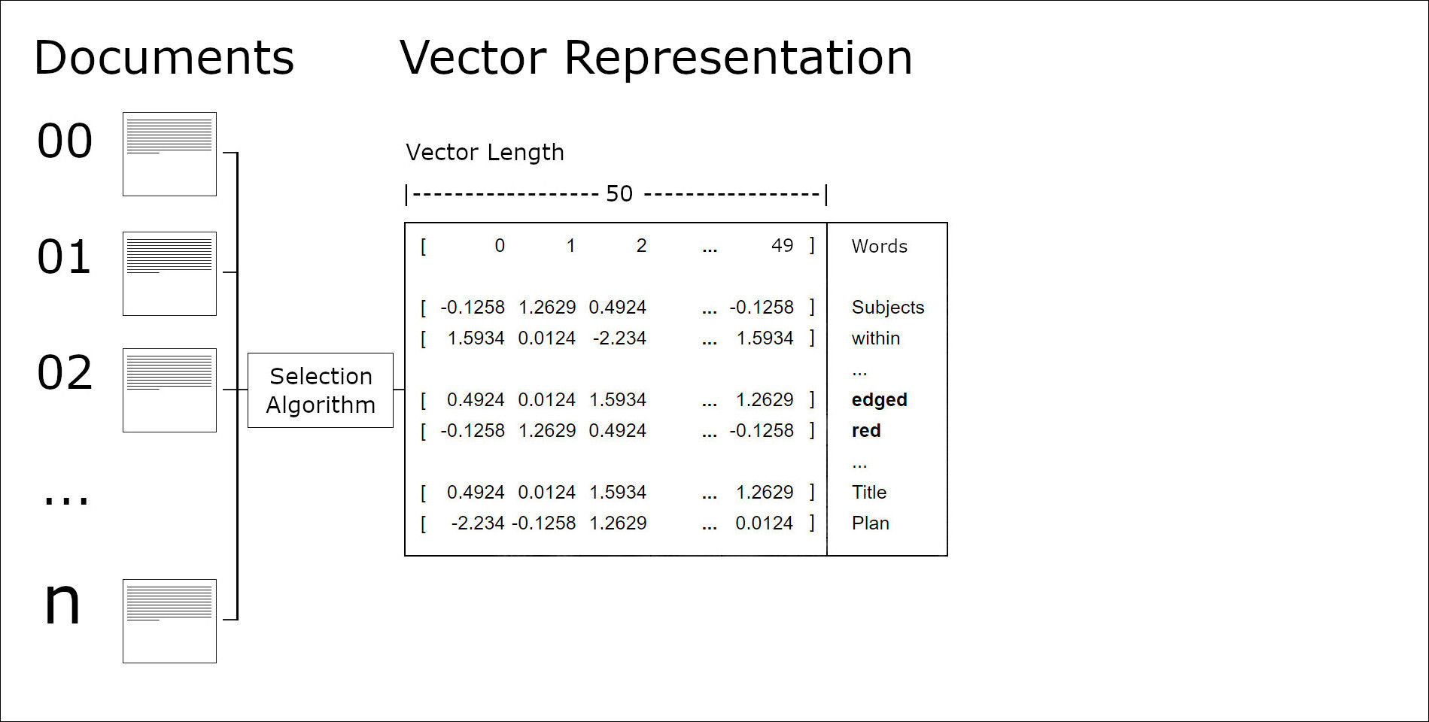

Slide 10
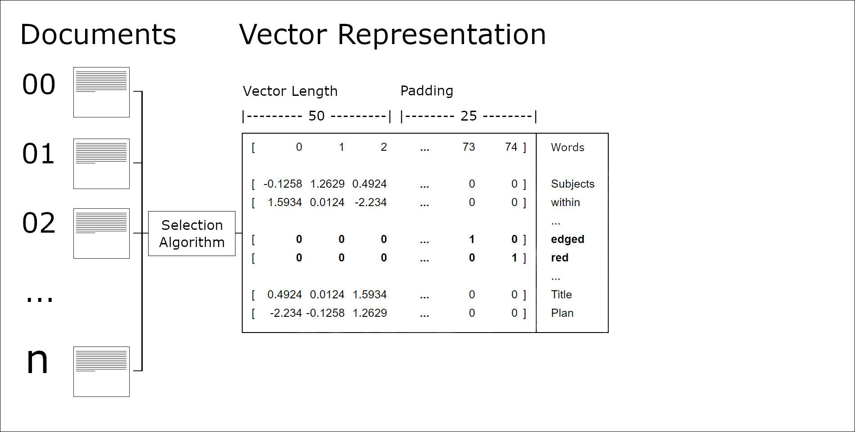

Slide 11
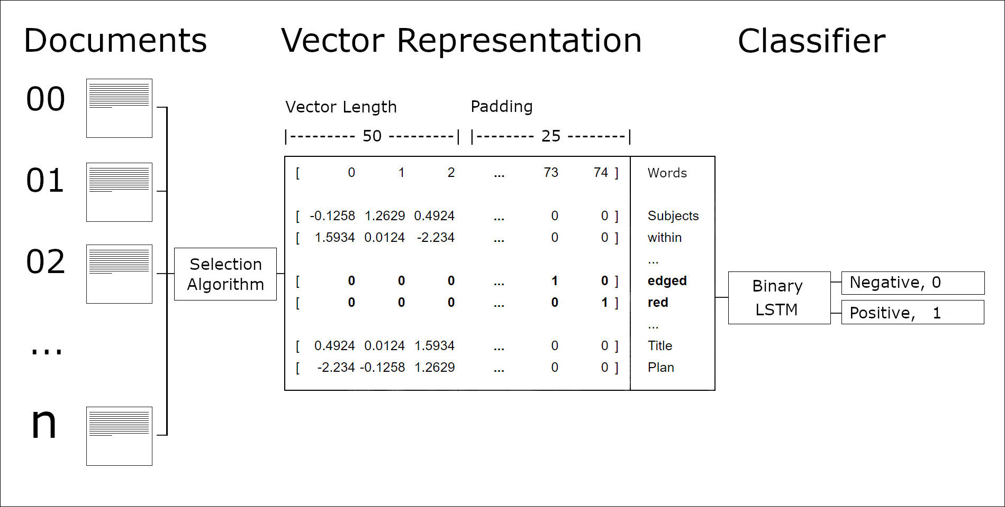

Slide 12
Is this A-section a house or a flat?

Slide 13
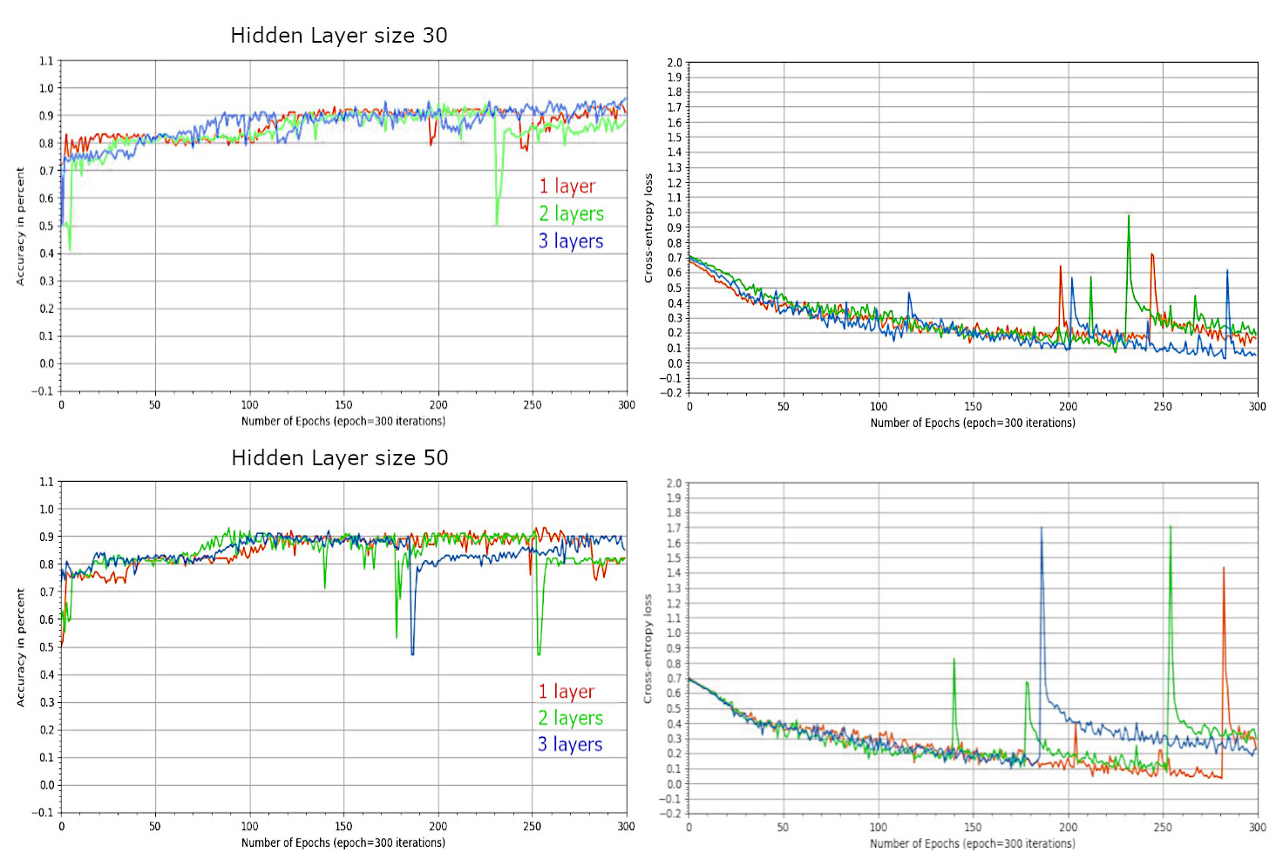

Slide 14
Is there one or more colour-pairs for exclusive strata in this A-section?

Slide 15
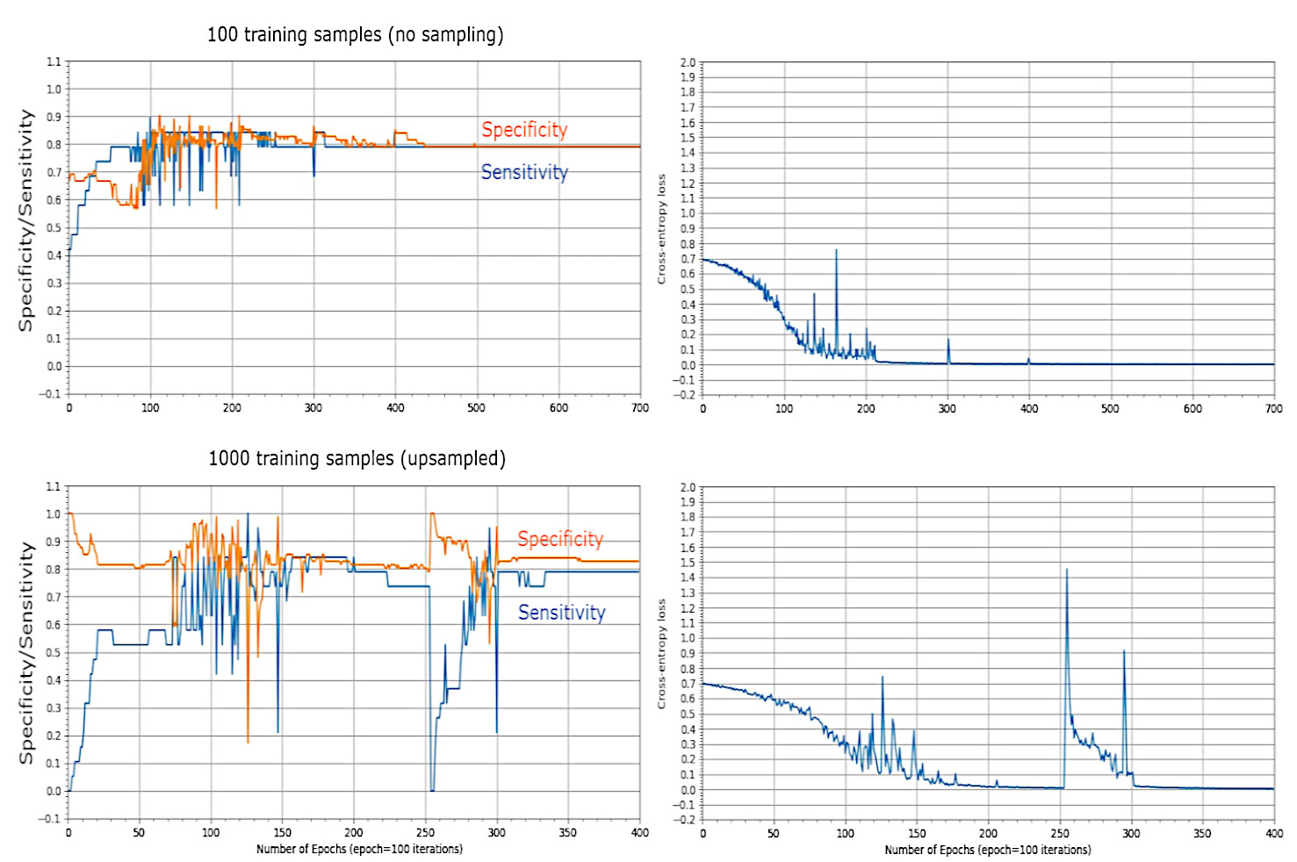

Slide 16
Does this colour-pair represent exclusive strata?

Slide 17
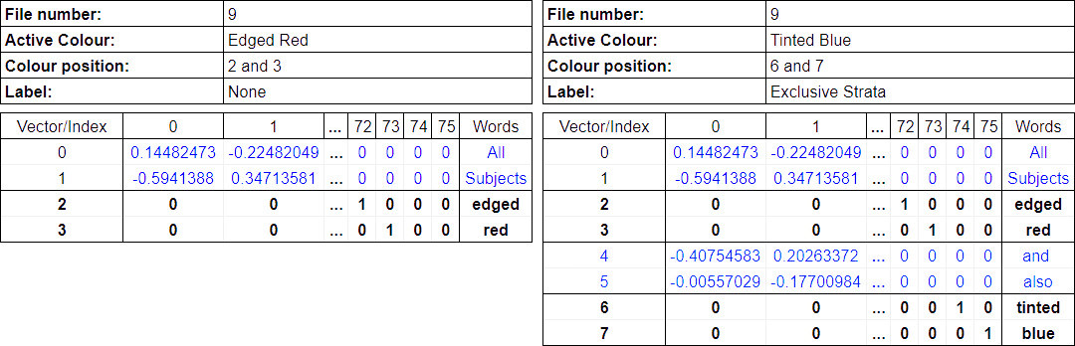

Slide 18
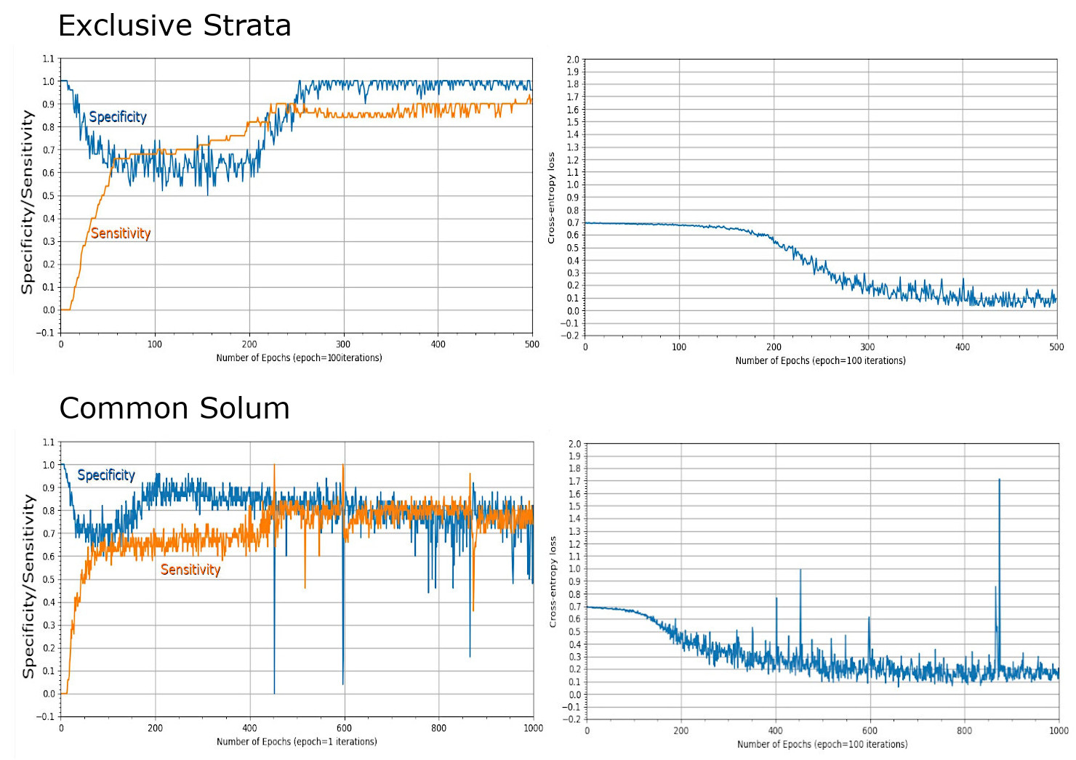

Slide 19
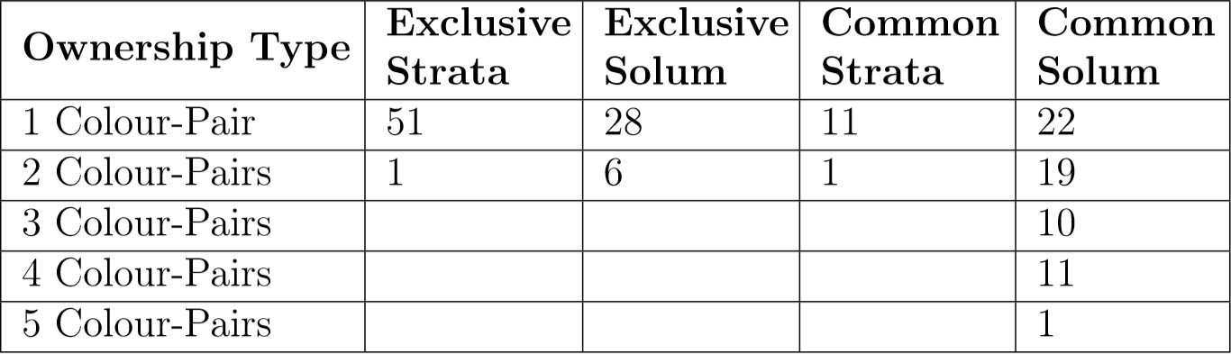

Slide 20
Q&A

