Slide 1
Commercial Framework
a r3 Delivery Framework view

Slide 2
Exec Summary

Slide 3
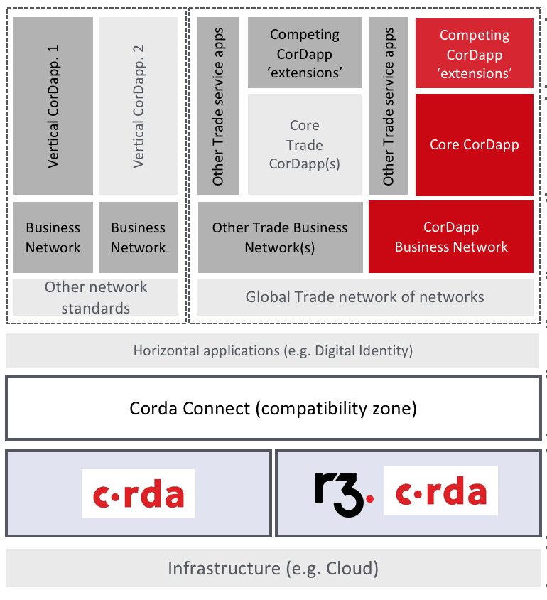
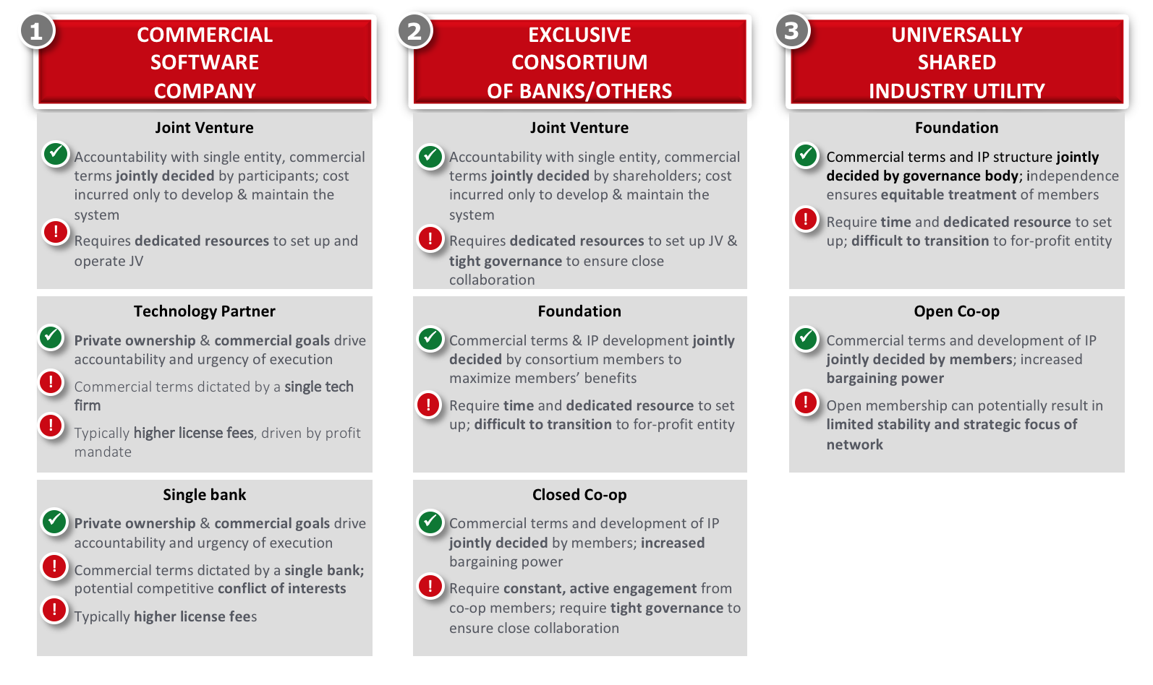
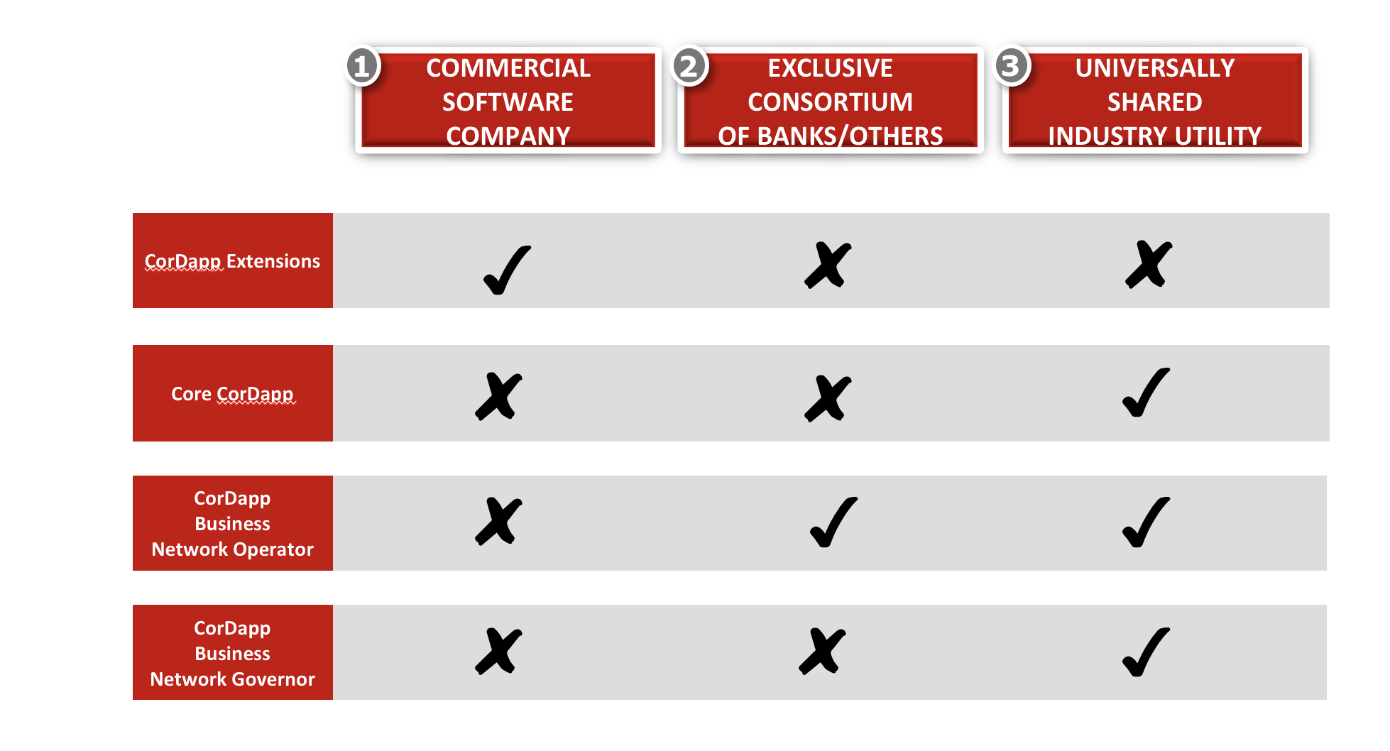
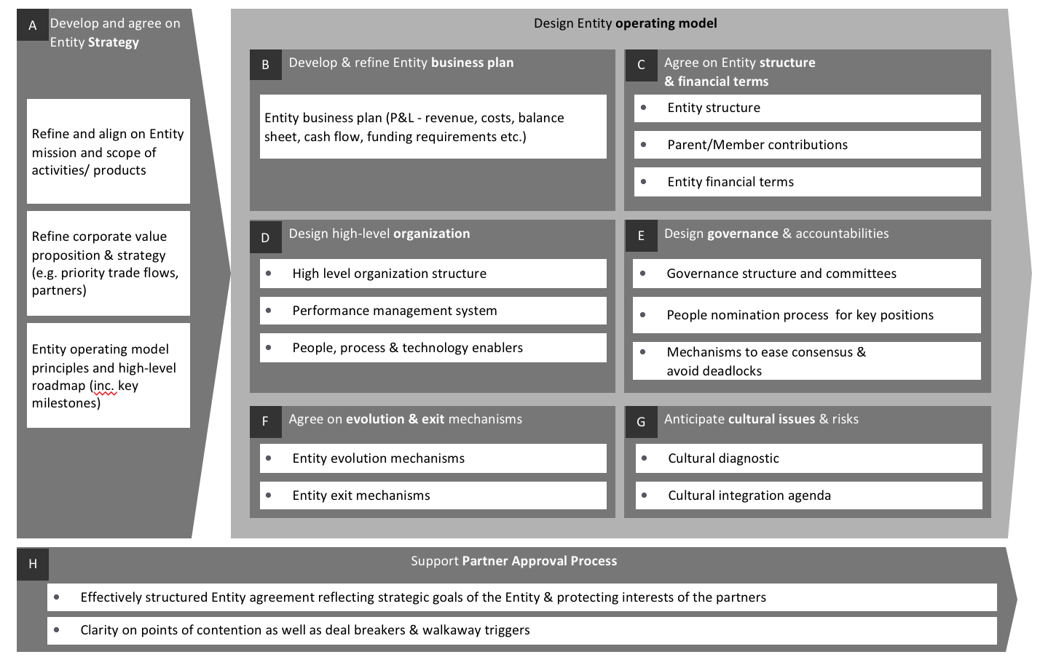
3 Steps to a commercial framework
1.Playfield
2.Ownership
3.Operating model
Pros-Cons
Consensus

Slide 4
Detailed Walk-through

Slide 5

Playfield - CorDapp and business network
Vertical CorDapp. 1
Vertical CorDapp. 2
Other Trade service apps
Competing CorDapp ‘extensions’
Other Trade service apps
Competing CorDapp ‘extensions’
Each network has Core app. designed by App. Designer, competing ‘extensions’ built by tech vendors and potentially, other services
Core
Trade CorDapp(s)
Core CorDapp
Vertical applications for specific objectives in each business network (e.g. Voltron, Marco Polo, etc. for Trade Finance)
Business Network
Business Network
Other Trade Business Network(s)
CorDapp
Business Network
Business networks for specific objectives comprising three roles/activities, (i) Governance, (ii) Operations (iii) Usage
Other network standards
Global Trade network of networks
Technical, legal & business standards to connect business networks with similar objectives
Horizontal applications that cut across business networks (e.g. Digital Identity)
SAMPLE playfield
Horizontal applications (e.g. Digital Identity)
Corda Connect (compatibility zone)
A global network of Corda nodes sharing standards, frameworks and governance
DLT platform
Corda: Industry-leading blockchain platform
R3 Corda: Corda with additional enterprise features
Infrastructure (e.g. Cloud)
Underlying infrastructure
Playfield in discussion = Vertical Cordapp + associated Business Network

Slide 6
3 Steps to a commercial framework:
Step 1
Ownership: Evaluate the pros and cons for each approach
Step 2
Ownership: Reach consensus among the stakeholders
Step 3
Operating model: Setup the entity

Slide 7
Step1 - Ownership: Evaluate the pros and cons for each approach
1
Commercial
software
company
2
3
Exclusive
Consortium
Of banks/others
Universally
shared
industry utility
Joint Venture
Accountability with single entity, commercial terms jointly decided by participants; cost incurred only to develop & maintain the system
Requires dedicated resources to set up and operate JV
Joint Venture
Accountability with single entity, commercial terms jointly decided by shareholders; cost incurred only to develop & maintain the system
Requires dedicated resources to set up JV & tight governance to ensure close collaboration
Foundation
Commercial terms and IP structure jointly decided by governance body; independence ensures equitable treatment of members
Require time and dedicated resource to set up; difficult to transition to for-profit entity
✓
✓
✓
!
!
!
Technology Partner
Private ownership & commercial goals drive accountability and urgency of execution
Commercial terms dictated by a single tech firm
Typically higher license fees, driven by profit mandate
Foundation
Commercial terms & IP development jointly decided by consortium members to maximize members’ benefits
Require time and dedicated resource to set up; difficult to transition to for-profit entity
Open Co-op
Commercial terms and development of IP jointly decided by members; increased bargaining power
Open membership can potentially result in limited stability and strategic focus of network
✓
✓
✓
SAMPLE Pros-Cons
!
!
!
!
Single bank
Private ownership & commercial goals drive accountability and urgency of execution
Commercial terms dictated by a single bank; potential competitive conflict of interests
Typically higher license fees
Closed Co-op
Commercial terms and development of IP jointly decided by members; increased bargaining power
Require constant, active engagement from co-op members; require tight governance to ensure close collaboration
✓
✓
!
!
!

Slide 8
Step2 – Ownership: Reach Consensus among different roles
1
2
3
Commercial
software
company
Exclusive
Consortium
Of banks/others
Universally
shared
industry utility
CorDapp Extensions
Core CorDapp
SAMPLE preferences
CorDapp
Business
Network Operator
CorDapp
Business
Network Governor

Slide 9
Step3 - Operating model: Setup the entity
A
Develop and agree on Entity Strategy
Design Entity operating model
B
Develop & refine Entity business plan
Agree on Entity structure
& financial terms
C
Refine and align on Entity mission and scope of activities/ products
Entity business plan (P&L - revenue, costs, balance sheet, cash flow, funding requirements etc.)
Entity structure
Parent/Member contributions
Entity financial terms
Refine corporate value proposition & strategy (e.g. priority trade flows, partners)
Design high-level organization
E
D
Design governance & accountabilities
High level organization structure
Governance structure and committees
Performance management system
People nomination process for key positions
INDICATIVE
Entity operating model principles and high-level roadmap (inc. key milestones)
People, process & technology enablers
Mechanisms to ease consensus & avoid deadlocks
Agree on evolution & exit mechanisms
F
Anticipate cultural issues & risks
G
Entity evolution mechanisms
Cultural diagnostic
Entity exit mechanisms
Cultural integration agenda
Support Partner Approval Process
H
Effectively structured Entity agreement reflecting strategic goals of the Entity & protecting interests of the partners
Clarity on points of contention as well as deal breakers & walkaway triggers

