Slide 1
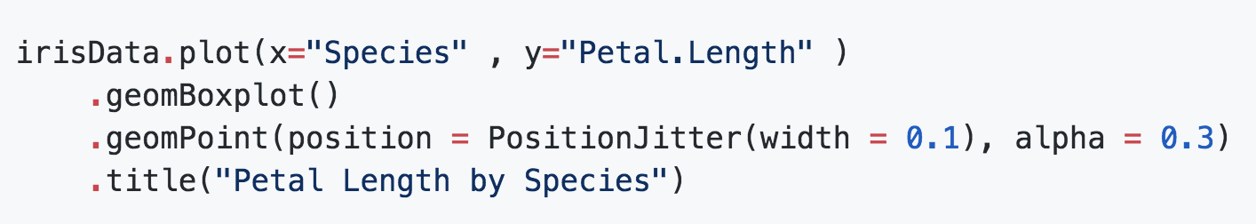
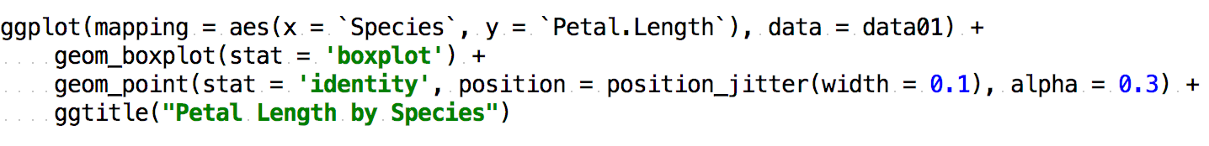
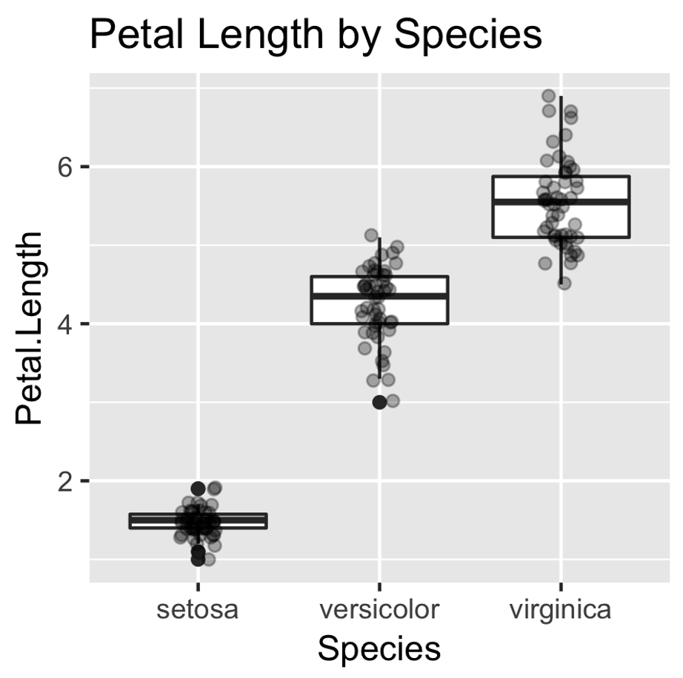
Dockerized R
Local R Installation
Remote R
(via Rserve)
SVG, PNG, JPG, PDF, EPS
Later: JRI
JavaFx Device
Jupyter
Swing Device
File IO

