Slide 1
k-Nearest neighbors and decision tree
Nonparametric Supervised Learning

Slide 2
Outline
Context of these algorithms
K-nearest neighbors (k-NN)
1-nearest neighbor (1-NN
Extension to k-nearest neighbors
Decision Tree
Summary

Slide 3
Outline
Context of these algorithms
K-nearest neighbors (k-NN)
1-nearest neighbor (1-NN
Extension to k-nearest neighbors
Decision Tree
Summary

Slide 4
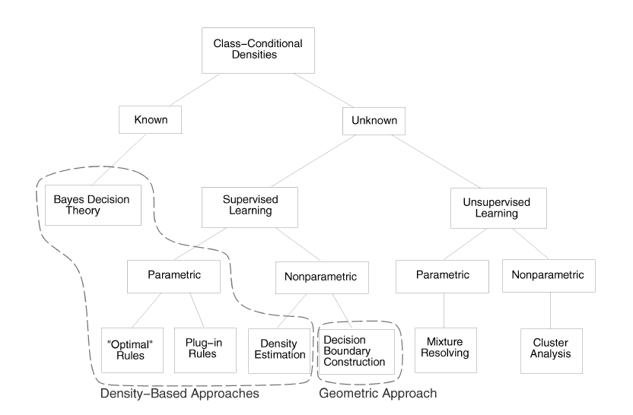
Context of these Algorithms
Supervised Learning: labeled training samples
Nonparametric: mathematical representation of the underlying probability distribution is hard to obtain
Figure: various approaches in statistical pattern recognition

Slide 5
K-Nearest Neighbors
Implicitly constructs decision boundaries
Used for both classification and regression
Figure: various approaches in statistical pattern recognition

Slide 6
Decision Tree
Explicitly constructs decision boundaries
Used for classification
Figure: various approaches in statistical pattern recognition

Slide 7
Outline
Context of these algorithms
K-nearest neighbors (k-NN)
1-nearest neighbor (1-NN
Extension to k-nearest neighbors
Decision Tree
Summary

Slide 8
K-Nearest Neighbors
Goal: Classify an unknown training sample into one of C classes (can also be used for regression)
Idea: To determine the label of an unknown sample (x), look at x’s k-nearest neighbors
Image from MIT Opencourseware

Slide 9
Notation
Training samples:
x is the feature vector with d features
y is a class label of {1,2,…C}
Goal: determine for

Slide 10
Decision Boundaries
Implicitly found
Shown using a Voronoi Diagram

Slide 11
1-Nearest Neighbor (1-NN)
Consider k = 1
1-NN algorithm
Step 1: Find the closest to with respect to Euclidean distance
Find that minimizes
Step 2: Choose to be

Slide 12
Extensions of 1-Nearest Neighbor
How many neighbors to consider?
1 for 1-NN vs. k for k-NN
What distance to use?
Euclidean, L₁-norm, etc.
How to combine neighbors’ labels?
Majority vote vs. weighted majority vote

Slide 13
How many neighbors to consider?
K Too Small
K Too Large
Noisy decision boundaries
Over-smoothed boundaries
k = 1
k = 7

Slide 14
What distance to use?
Euclidean distance – treats every feature as equally important
Distance needs to be meaningful (1 foot vs. 12 inches)
Features could be insignificant
Scaled Euclidean distance

Slide 15
Distance Metrics

Slide 16
How to combine neighbors’ labels?
Majority vote: each of k-neighbors’ votes are weighted equally
Weighted majority vote: closer neighbors’ votes get more weight
Ex. Weight w_{i}= 1/distance²
(if distance = 0, that sample gets 100% of vote)
Note: for regression,

Slide 17
Pros and Cons of k-NN
Pros
Cons
Simple
Good results
Easy to add new training examples
Computationally expensive
To determine nearest neighbor, visit each training samples
O(nd)
n = number of training samples
d = dimensions

Slide 18
Outline
Context of these algorithms
K-nearest neighbors (k-NN)
1-nearest neighbor (1-NN
Extension to k-nearest neighbors
Decision Tree
Summary

Slide 19
Decision Tree
Goal: Classify an unknown training sample into one of C classes
Idea: Set thresholds for a sequence of features to make a classification decision

Slide 20
Definitions
Decision node: if-then decision based on features of testing sample
Root node: the first decision node
Leaf node: has a class label
Figure: an example of a simple decision tree

Slide 21
Decision Boundaries
Explicitly defined

Slide 22
Creating Optimal Decision Trees
Classification and Regression Trees (CART) by Brieman et al. is one method to produce decision trees
Creates binary decision trees – trees where each decision node has exactly two branches
Recursively split the feature space into a set of non-overlapping regions

Slide 23
Creating Optimal Decision Trees
Need to choose decisions that best partition the feature space
Choose the split s at node t that maximizes
Terms:
= left child at node t
= # records at t_{L} / # records in training set
= # records of class j at t_{L} / # records at t

Slide 24
Creating Optimal Decision Trees
C4.5 by Quinlan is another algorithm for creating trees
Creates trees based on optimal splits
Trees are not required to be binary

Slide 25
Creating Optimal Decision Trees
Splits based on entropy
Suppose variable X has k possible values
p_{i} = n_{i}/n = estimated probability X has value i
Entropy:
Candidate split S partitions training set T into subsets T₁, T₂, …T_{k}
Entropy is the weighted sum entropies at each subset

Slide 26
Creating Optimal Decision Trees
Information gain:
C4.5 selects the candidate split S that creates which maximizes the information gain

Slide 27
Pros and Cons of Decision Trees
Pros
Cons
Simple to understand
Little data preparation required
Results are easy to follow
Robust
Handles large datasets well
Practical algorithms based on heuristics which may not give globally-optimal trees
Require pruning to avoid over-fitting data

Slide 28
Outline
Context of these algorithms
K-nearest neighbors (k-NN)
1-nearest neighbor (1-NN)
Extension to k-nearest neighbors
Decision Tree
Summary

Slide 29
Summary
K-Nearest Neighbor
Decision Tree
Compare a new data point to similar labeled data points
Implicitly define the decision boundaries
Easy, but computationally expensive
Use thresholds of feature values to determine classification
Explicitly define decision boundaries
Simple, but hard to find globally-optimal trees

Slide 30
Sources on k-NN
“A study on classification techniques in data mining”. Kesavaraj, G.; Sukumaran, S.. Published in ICCCNT.
MIT Opencourseware, 15.097 Spring 2012. Credit: Seyda Ertekin.
http://ocw.mit.edu/courses/sloan-school-of-management/15-097-prediction-machine-learning-and-statistics-spring-2012/lecture-notes/MIT15_097S12_lec06.pdf
Oregon State – Machine Learning Course by Xiaoli Fern
http://classes.engr.oregonstate.edu/eecs/spring2012/cs534/notes/knn.pdf
Machine Learning Course by Rita Osadchy
http://www.cs.haifa.ac.il/~rita/ml_course/lectures/KNN.pdf
University of Wisconsin - Machine Learning Course by Xiaojin Zhu
http://www.cs.sun.ac.za/~kroon/courses/machine_learning/lecture2/kNN-intro_to_ML.pdf
UC Irvine – Intro to Artificial Intelligence Course by Richard Lathrop
http://www.ics.uci.edu/~rickl/courses/cs-171/2014-wq-cs171/2014-wq-cs171-lecture-slides/2014wq171-19-LearnClassifiers.pdf

Slide 31
Sources on Decision Tree
University of Wisconsin- Machine Learning Course by Jerry Zhu
http://pages.cs.wisc.edu/~jerryzhu/cs540/handouts/dt.pdf
Discovering Knowledge in Data: An Introduction to Data Mining. Larose, Daniel, T. (2005)
“Statistical Pattern Recognition: A Review”
Jain, Anil. K; Duin, Robert. P.W.; Mao, Jianchang (2000). “Statistical pattern recognition: a review”. IEEE Transtactions on Pattern Analysis and Machine Intelligence 22 (1): 4-37

Slide 32
Thank you
Any questions?

