Slide 1
Chapter 14 Introduction to Linear Regression and Correlation Analysis
Business Statistics:
A Decision-Making Approach
8th Edition

Slide 2
Chapter Goals
After completing this chapter, you should be able to:
Calculate and interpret the correlation between two variables
Determine whether the correlation is significant
Calculate and interpret the simple linear regression equation for a set of data
Understand the assumptions behind regression analysis
Determine whether a regression model is significant

Slide 3
Chapter Goals
(continued)
After completing this chapter, you should be able to:
Calculate and interpret confidence intervals for the regression coefficients
Recognize regression analysis applications for purposes of prediction and description
Recognize some potential problems if regression analysis is used incorrectly

Slide 4
Scatter Plots and Correlation
A scatter plot (or scatter diagram) is used to show the relationship between two quantitative variables
The linear relationship can be:
Positive – as x increases, y increases
As advertising dollars increase, sales increase
Negative – as x increases, y decreases
As expenses increase, net income decreases

Slide 5
Scatter Plot Examples
Linear relationships
Curvilinear relationships
y
y
x
x
y
y
x
x

Slide 6
Scatter Plot Examples
(continued)
Strong relationships
Weak relationships
y
y
x
x
y
y
x
x

Slide 7
Scatter Plot Examples
(continued)
No relationship
y
x
y
x

Slide 8
Correlation Coefficient
(continued)
The sample correlation coefficient r is a measure of the strength of the linear relationship between two variables, based on sample observations
Only concerned with strength of the relationship
No causal effect is implied
Causal effect: if event A happens, event B is more likely happen.

Slide 9
Features of r
Range between -1 and 1
The closer to -1, the stronger the negative linear relationship
The closer to 1, the stronger the positive linear relationship
The closer to 0, the weaker the linear relationship
+1 or -1 are perfect correlations where all data points fall on a straight line

Slide 10
Examples of Approximate r Values
y
y
y
x
x
x
r = -1
r = -.6
r = 0
y
y
x
x
r = +.3
r = +1

Slide 11
Calculating the Correlation Coefficient
Sample correlation coefficient:
or the algebraic equivalent:
where:
r = Sample correlation coefficient
n = Sample size
x = Value of the independent variable
y = Value of the dependent variable

Slide 12
Quick Example
A national consumer magazine reported the following correlations.
The correlation between car weight and car reliability is -0.30.
The correlation between car weight and annual maintenance cost is 0.20.
Heavier cars tend to be less reliable.
Heavier cars tend to cost more to maintain.
Car weight is related more strongly to reliability than to maintenance cost.

Slide 13
Correlation Example
Tree Height | Trunk Diameter
y | x | xy | y² | x²
35 | 8 | 280 | 1225 | 64
49 | 9 | 441 | 2401 | 81
27 | 7 | 189 | 729 | 49
33 | 6 | 198 | 1089 | 36
60 | 13 | 780 | 3600 | 169
21 | 7 | 147 | 441 | 49
45 | 11 | 495 | 2025 | 121
51 | 12 | 612 | 2601 | 144
Σ=321 | Σ=73 | Σ=3142 | Σ=14111 | Σ=713

Slide 14
Calculation Example
(continued)
Tree
Height,
y
Scatter Plot
r = 0.886 → relatively strong positive
linear association between x and y
Trunk Diameter, x

Slide 15
Excel Output
Excel Correlation Output
Tools / data analysis / correlation…
Try this using Excel (copy and paste data): refer to the tutorial
Correlation between
Tree Height and Trunk Diameter

Slide 16
Significance Test for Correlation
Hypotheses
H₀: ρ = 0 (no correlation)
H_{A}: ρ ≠ 0 (correlation exists)
t Test statistic (two samples)
(with n – 2 degrees of freedom)
Assumptions:
Data are interval or ratio
x and y are normally distributed
The Greek letter ρ (rho) represents the population correlation coefficient
We lose one more degree of freedom for each sample mean (TWO samples)

Slide 17
Example: Produce Stores
Is there evidence of a linear relationship between tree height and trunk diameter at the 0.05 level of significance?
H₀: ρ (R) = 0 (No correlation)
H₁: ρ (R) ≠ 0 (correlation exists)
α =0.05 , df = 8 - 2 (two sample means) = 6

Slide 18
Produce Stores: Test Solution
TINV(6, .05) = 2.4469
P-value: TDIST(4.68, 6, .05) = 0.00396
Decision: Reject H₀
Conclusion: There is sufficient evidence of a linear relationship at the 0.05 significance level
d.f. = 8-2 = 6
α/2=0.025
α/2=0.025
Reject H₀
-t_{α/2}
Do not reject H₀
t_{α/2}
Reject H₀
0
-2.4469
2.4469
4.68

Slide 19
Regression Analysis (video clip on the website)
Regression analysis is used to:
Predict the value of a dependent variable, such as sales based on the value of at least one independent variable, such as years at company as a salesmen
Based on the Midwest Excel file
Dependent variable: the variable we wish to explain (cause)
Independent variable: the variable used to explain the dependent variable (effect)
Explain the impact of changes in an independent variable on the dependent variable

Slide 20
Simple Linear Regression Model
Only one independent variable
Relationship between iv and dv is described by a linear function
independent: iv, dependent: dv
Changes in dv are assumed to be caused by changes in iv

Slide 21
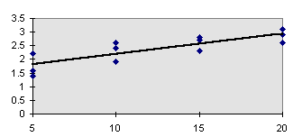
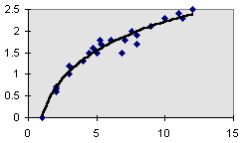
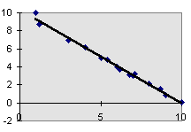
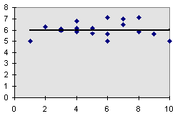
Types of Regression Models
Positive Linear Relationship
Relationship NOT Linear
Negative Linear Relationship
No Relationship

Slide 22
Population Linear Regression
The population regression model:
Population Slope Coefficient
Population y intercept
Independent Variable
residual
Dependent Variable
Linear component
Random Error
component

Slide 23
Residual
Because a linear regression model is not always appropriate for the data,
the appropriateness of the model can be assessed by defining and examining residuals and residual plots.

Slide 24
Population Linear Regression
(continued)
y
Observed Value of y for x_{i}
e_{i}
Slope = b₁
Predicted Value of y for x_{i}
Random Error for this x value
Intercept = b₀
x_{i}
x
Notes:
b₀ is the estimated average value of y when the value of x is zero
b₁ is the estimated change in the average value of y as a result of a one-unit change in x

Slide 25
Estimated Regression Model
The sample regression line provides an estimate of the population regression line
Estimated (or predicted) y value
Estimate of the regression intercept
Estimate of the regression slope
Independent variable
The individual random error terms e_{i} have a mean of zero

Slide 26

Simple Linear Regression Example
A real estate agent wishes to examine the relationship between the selling price of a home and its size (measured in square feet)
A random sample of 10 houses is selected
“x” variable affects (influences) “y” variable
Dependent variable (y) = house price in $1000s
Independent variable (x) = square feet

Slide 27
Sample Data for House Price Model
House Price in $1000s (y) | Square Feet (x)
245 | 1400
312 | 1600
279 | 1700
308 | 1875
199 | 1100
219 | 1550
405 | 2350
324 | 2450
319 | 1425
255 | 1700

Slide 28
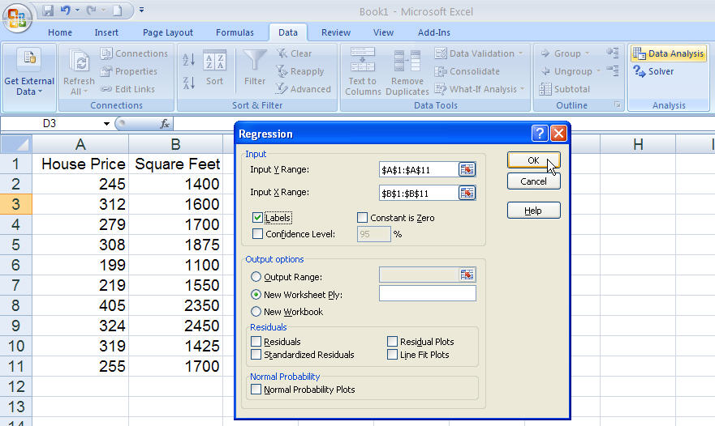
Regression Using Excel
Do this together, enter data and select Regression

Slide 29
Excel Output
Regression Statistics
Multiple R | 0.76211
R Square | 0.58082
Adjusted R Square | 0.52842
Standard Error | 41.33032
Observations | 10
ANOVA | df | SS | MS | F | Significance F
Regression | 1 | 18934.9348 | 18934.9348 | 11.0848 | 0.01039
Residual | 8 | 13665.5652 | 1708.1957
Total | 9 | 32600.5000
 | Coefficients | Standard Error | t Stat | P-value | Lower 95% | Upper 95%
Intercept | 98.24833 | 58.03348 | 1.69296 | 0.12892 | -35.57720 | 232.07386
Square Feet | 0.10977 | 0.03297 | 3.32938 | 0.01039 | 0.03374 | 0.18580
The regression equation is:

Slide 30
Regression Analysis for Prediction: House Prices
Estimated Regression Equation:
House Price in $1000s (y) | Square Feet (x)
245 | 1400
312 | 1600
279 | 1700
308 | 1875
199 | 1100
219 | 1550
405 | 2350
324 | 2450
319 | 1425
255 | 1700
Predict the price for a house with 2000 square feet

Slide 31
Example: House Prices
Predict the price for a house with 2000 square feet:
The predicted price for a house with 2000 square feet is 317.85($1,000s) = $317,850

Slide 32
Graphical Presentation
House price model: scatter plot and regression line
Slope
= 0.10977
Intercept
= 98.248

Slide 33
Interpretation of the Intercept, b₀
b₀ is the estimated average value of Y when the value of X is zero (if x = 0 is in the range of observed x values)
Here, no houses had 0 square feet, so b₀ = 98.24833 just indicates that, for houses within the range of sizes observed. $98,248.33 is the portion of the house price not explained by square feet. So, it has no meaning.

Slide 34
Interpretation of the Slope Coefficient, b₁
b₁ measures the estimated change in the average value of Y as a result of a one-unit change in X
Here, b₁ = 0.10977 tells us that the average value of a house increases by 0.10977($1000) = $109.77, on average, for each additional one square foot of size

Slide 35
Excel Output
Regression Statistics
Multiple R | 0.76211
R Square | 0.58082
Adjusted R Square | 0.52842
Standard Error | 41.33032
Observations | 10
ANOVA | df | SS | MS | F | Significance F
Regression | 1 | 18934.9348 | 18934.9348 | 11.0848 | 0.01039
Residual | 8 | 13665.5652 | 1708.1957
Total | 9 | 32600.5000
 | Coefficients | Standard Error | t Stat | P-value | Lower 95% | Upper 95%
Intercept | 98.24833 | 58.03348 | 1.69296 | 0.12892 | -35.57720 | 232.07386
Square Feet | 0.10977 | 0.03297 | 3.32938 | 0.01039 | 0.03374 | 0.18580
58.08% of the variation in house prices is explained by variation in square feet

Slide 36
Explained and Unexplained Variation (page 591-594)
Total variation is made up of two parts:
unexplained
explained
Total sum of Squares
Sum of Squares Error
Sum of Squares Regression
where:
= Average value of the dependent variable
y = Observed values of the dependent variable
= Estimated value of y for the given x value

Slide 37
Coefficient of Determination, R²
The coefficient of determination is the portion of the total variation in the dependent variable that is explained by variation in the independent variable
The coefficient of determination is also called R-squared and is denoted as R²
where

Slide 38
Coefficient of Determination, R²
(continued)
Coefficient of determination
Note: In the single independent variable case, the coefficient of determination is
where:
R² = Coefficient of determination
r = Simple correlation coefficient

Slide 39
Examples of Approximate R² Values
(continued)
y
R² = 1
Perfect linear relationship between x and y:
100% of the variation in y is explained by variation in x
x
y
x

Slide 40
Examples of Approximate R² Values
(continued)
y
0 < R² < 1
Weaker linear relationship between x and y:
Some but not all of the variation in y is explained by variation in x
x
y
x

Slide 41
Examples of Approximate R² Values
“Linear Regression” on the class website covers up to this slide (#38).
R² = 0
y
No linear relationship between x and y:
The value of Y does not depend on x. (None of the variation in y is explained by variation in x)
x
R² = 0

Slide 42
Significance Tests
For simple linear regression there are there equivalent statistical tests:
Test for significance of the correlation between x and y
Test for significance of the coefficient of determination (r²)
Test for significance of the regression slope coefficient (β₁)

Slide 43
Test for Significance of Coefficient of Determination
Hypotheses
H₀: ρ² = 0
H_{A}: ρ² ≠ 0
Test statistic
(with D₁ = 1 and D₂ = n - 2
degrees of freedom)
H₀: The independent variable does not explain a significant
portion of the variation in the dependent variable (in other word, the regression slope is zero)
H_{A}: The independent variable does explain a significant
portion of the variation in the dependent variable
α = 0.05

Slide 44
Excel Output
Regression Statistics
Multiple R | 0.76211
R Square | 0.58082
Adjusted R Square | 0.52842
Standard Error | 41.33032
Observations | 10
ANOVA | df | SS | MS | F | Significance F
Regression | 1 | 18934.9348 | 18934.9348 | 11.0848 | 0.01039
Residual | 8 | 13665.5652 | 1708.1957
Total | 9 | 32600.5000
 | Coefficients | Standard Error | t Stat | P-value | Lower 95% | Upper 95%
Intercept | 98.24833 | 58.03348 | 1.69296 | 0.12892 | -35.57720 | 232.07386
Square Feet | 0.10977 | 0.03297 | 3.32938 | 0.01039 | 0.03374 | 0.18580
The critical F value from Appendix H for
α = 0.05 and D₁ = 1 and D₂ = 8 d.f. is 5.318. Since 11.085 > 5.318 we reject H₀: ρ² = 0

Slide 45
Inference about the Slope: t Test
(continued)
Estimated Regression Equation:
House Price in $1000s (y) | Square Feet (x)
245 | 1400
312 | 1600
279 | 1700
308 | 1875
199 | 1100
219 | 1550
405 | 2350
324 | 2450
319 | 1425
255 | 1700
The slope of this model is 0.1098
Does square footage of the house affect its sales price?

Slide 46
Inferences about the Slope: t Test Example
Test Statistic: t = 3.329
b₁
t
H₀: β₁ = 0
H_{A}: β₁ ≠ 0
From Excel output:
 | Coefficients | Standard Error | t Stat | P-value
Intercept | 98.24833 | 58.03348 | 1.69296 | 0.12892
Square Feet | 0.10977 | 0.03297 | 3.32938 | 0.01039
d.f. = 10-2 = 8
Decision:
Conclusion:
Reject H₀
α/2=0.025
α/2=0.025
There is sufficient evidence that square footage affects house price
Reject H₀
Do not reject H₀
Reject H₀
-t_{α/2}
t_{α/2}
0
-2.3060
2.3060
3.329

Slide 47
Regression Analysis for Description
Confidence Interval Estimate of the Slope:
d.f. = n - 2
Excel Printout for House Prices:
 | Coefficients | Standard Error | t Stat | P-value | Lower 95% | Upper 95%
Intercept | 98.24833 | 58.03348 | 1.69296 | 0.12892 | -35.57720 | 232.07386
Square Feet | 0.10977 | 0.03297 | 3.32938 | 0.01039 | 0.03374 | 0.18580
At 95% level of confidence, the confidence interval for the slope is (0.0337, 0.1858)

Slide 48
Regression Analysis for Description
 | Coefficients | Standard Error | t Stat | P-value | Lower 95% | Upper 95%
Intercept | 98.24833 | 58.03348 | 1.69296 | 0.12892 | -35.57720 | 232.07386
Square Feet | 0.10977 | 0.03297 | 3.32938 | 0.01039 | 0.03374 | 0.18580
Since the units of the house price variable is $1000s, we are 95% confident that the average impact on sales price is between $33.70 and $185.80 per square foot of house size
This 95% confidence interval does not include 0.
Conclusion: There is a significant relationship between house price and square feet at the 0.05 level of significance

Slide 49
Estimation of Mean Values: Example
Confidence Interval Estimate for E(y)|x_{p}
Find the 95% confidence interval for the average price of 2,000 square-foot houses
∧
Predicted Price Y_{i} = 317.85 ($1,000s)
The confidence interval endpoints are 280.66 -- 354.90, or from $280,660 -- $354,900

Slide 50
Estimation of Individual Values: Example
Prediction Interval Estimate for y|x_{p}
Find the 95% confidence interval for an individual house with 2,000 square feet
∧
Predicted Price Y_{i} = 317.85 ($1,000s)
The prediction interval endpoints are 215.50 -- 420.07, or from $215,500 -- $420,070

Slide 51
Standard Error of Estimate
The standard deviation of the variation of observations around the simple regression line is estimated by
Where
SSE = Sum of squares error
n = Sample size

Slide 52
The Standard Deviation of the Regression Slope
The standard error of the regression slope coefficient (b₁) is estimated by
where:
= Estimate of the standard error of the least squares slope
= Sample standard error of the estimate

Slide 53
Excel Output
Regression Statistics
Multiple R | 0.76211
R Square | 0.58082
Adjusted R Square | 0.52842
Standard Error | 41.33032
Observations | 10
ANOVA | df | SS | MS | F | Significance F
Regression | 1 | 18934.9348 | 18934.9348 | 11.0848 | 0.01039
Residual | 8 | 13665.5652 | 1708.1957
Total | 9 | 32600.5000
 | Coefficients | Standard Error | t Stat | P-value | Lower 95% | Upper 95%
Intercept | 98.24833 | 58.03348 | 1.69296 | 0.12892 | -35.57720 | 232.07386
Square Feet | 0.10977 | 0.03297 | 3.32938 | 0.01039 | 0.03374 | 0.18580
Std. of regression slope

Slide 54
Comparing Standard Errors
Variation of observed y values from the regression line
Variation in the slope of regression lines from different possible samples
y
y
x
x
y
y
x
x

Slide 55
Inference about the Slope: t Test
t test for a population slope
Is there a linear relationship between x and y ?
Null and alternative hypotheses
H₀: β₁ = 0 (no linear relationship)
H_{A}: β₁ ≠ 0 (linear relationship does exist)
Test statistic
where:
b₁ = Sample regression slope
coefficient
β₁ = Hypothesized slope
s_{b1} = Estimator of the standard
error of the slope

Slide 56
Simple Linear Regression: Summary
Define the independent an dependent variables
Develop a scatter plot
Compute the correlation coefficient
Calculate the regression line
Calculate the coefficient of determination
Conduct one (1) of the three (3) significance tests
Reach a decision
Draw a conclusion

Slide 57
Confidence Interval for the Average y, Given x
Confidence interval estimate for the
mean of y given a particular x_{p}
Size of interval varies according to distance away from mean, x

Slide 58
Confidence Interval for an Individual y, Given x
Confidence interval estimate for an
Individual value of y given a particular x_{p}
This extra term adds to the interval width to reflect the added uncertainty for an individual case

Slide 59
Interval Estimates for Different Values of x
Prediction Interval for an individual y, given x_{p}
y
Confidence Interval for the mean of y, given x_{p}
∧
y = b₀ + b₁x
x
x
x_{p}

Slide 60
Finding Confidence and Prediction Intervals PHStat
In Excel, use
PHStat | regression | simple linear regression …
Check the
“confidence and prediction interval for X=”
box and enter the x-value and confidence level desired

Slide 61
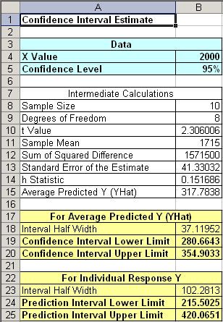
Finding Confidence and Prediction Intervals PHStat
(continued)
Input values
Confidence Interval Estimate for E(y)|x_{p}
Prediction Interval Estimate for y|x_{p}

Slide 62
Problems with Regression
Applying regression analysis for predictive purposes
Larger prediction errors can occur
Don’t assume correlation implies causation
A high coefficient of determination, R², does not guarantee the model is a good predictor
R² is simply the fit of the regression line to the sample data
A large R² with a large standard error
Confidence and prediction errors may be too wide for the model to be of value

Slide 63
Chapter Summary
Introduced correlation analysis
Discussed correlation to measure the strength of a linear association
Introduced simple linear regression analysis
Calculated the coefficients for the simple linear regression equation
Described measures of variation (R² and s_{ε})
Addressed assumptions of regression and correlation

Slide 64
Chapter Summary
(continued)
Described inference about the slope
Addressed estimation of mean values and prediction of individual values

