Slide 1
Learning Bayesian Network Models from Data
Emad Alsuwat

Slide 2
Bayesian Networks
A Bayesian network specifies a joint distribution in a structured form
Represent dependence/independence via a directed graph
Nodes = random variables
Edges = direct dependence
Structure of the graph ⬄ Conditional independence relations
Requires that graph is acyclic (no directed cycles)
2 components to a Bayesian network
The graph structure (conditional independence assumptions)
The numerical probabilities (for each variable given its parents)
In general,
p(X₁, X₂,....X_{N}) = Π p(X_{i} | parents(X_{i} ) )
The full joint distribution
The graph-structured approximation

Slide 3
Example of a simple Bayesian network
A
B
p(A,B,C) = p(C|A,B)p(A)p(B)
C
Probability model has simple factored form
Directed edges => direct dependence
Absence of an edge => conditional independence
Also known as belief networks, graphical models, causal networks
Other formulations, e.g., undirected graphical models

Slide 4
Examples of 3-way Bayesian Networks
A
B
C
Marginal Independence:
p(A,B,C) = p(A) p(B) p(C)

Slide 5
Examples of 3-way Bayesian Networks
Conditionally independent effects:
p(A,B,C) = p(B|A)p(C|A)p(A)
B and C are conditionally independent
Given A
e.g., A is a disease, and we model
B and C as conditionally independent
symptoms given A
A
B
C

Slide 6
Examples of 3-way Bayesian Networks
A
B
Independent Causes:
p(A,B,C) = p(C|A,B)p(A)p(B)
“Explaining away” effect:
Given C, observing A makes B less likely
e.g., earthquake/burglary/alarm example
A and B are (marginally) independent
but become dependent once C is known
C

Slide 7
Examples of 3-way Bayesian Networks
A
B
C
Markov dependence:
p(A,B,C) = p(C|B) p(B|A)p(A)

Slide 8
Example
Consider the following 5 binary variables:
B = a burglary occurs at your house
E = an earthquake occurs at your house
A = the alarm goes off
J = John calls to report the alarm
M = Mary calls to report the alarm
What is P(B | M, J) ? (for example)
We can use the full joint distribution to answer this question
Requires 2⁵ = 32 probabilities
Can we use prior domain knowledge to come up with a Bayesian network that requires fewer probabilities?

Slide 9
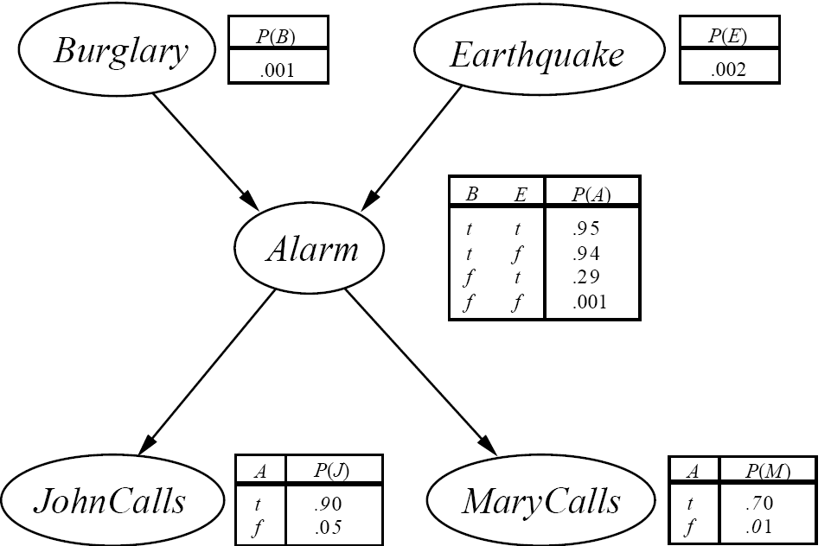
The Resulting Bayesian Network

Slide 10
Constructing this Bayesian Network
P(J, M, A, E, B) =
P(J | A) P(M | A) P(A | E, B) P(E) P(B)
There are 3 conditional probability tables (CPDs) to be determined: P(J | A), P(M | A), P(A | E, B)
Requiring 2 + 2 + 4 = 8 probabilities
And 2 marginal probabilities P(E), P(B) -> 2 more probabilities
Where do these probabilities come from?
Expert knowledge
From data (relative frequency estimates)
Or a combination of both

Slide 11
The Bayesian network

Slide 12

Inference (Reasoning) in Bayesian Networks
Consider answering a query in a Bayesian Network
Q = set of query variables
e = evidence (set of instantiated variable-value pairs)
Inference = computation of conditional distribution P(Q | e)
Examples
P(burglary | alarm)
P(earthquake | JCalls, MCalls)
P(JCalls, MCalls | burglary, earthquake)
Can we use the structure of the Bayesian Network to answer such queries efficiently? Answer = yes
Generally speaking, complexity is inversely proportional to sparsity of graph

Slide 13
Learning Bayesian Networks from Data

Slide 14
Why learning?
Knowledge acquisition bottleneck
Knowledge acquisition is an expensive process
Often we don’t have an expert
Data is cheap
Amount of available information growing rapidly
Learning allows us to construct models from raw data

Slide 15
Learning Bayesian networks
Data
+
Prior Information
E
B
Learner
R
A
C
E
B
P(A | E,B)
e
b
.9
.1
e
b
.7
.3
e
b
.8
.2
e
b
.99
.01

Slide 16
Known Structure, Complete Data
E, B, A
<Y,N,N>
<Y,N,Y>
<N,N,Y>
<N,Y,Y>
.
.
<N,Y,Y>
E
B
Learner
A
E
B
P(A | E,B)
E
B
e
b
.9
.1
E
B
P(A | E,B)
e
b
?
?
e
b
.7
.3
A
e
b
.8
.2
e
b
?
?
e
b
.99
.01
e
b
?
?
e
b
?
?
Network structure is specified
Inducer needs to estimate parameters
Data does not contain missing values

Slide 17
Unknown Structure, Complete Data
E, B, A
<Y,N,N>
<Y,N,Y>
<N,N,Y>
<N,Y,Y>
.
.
<N,Y,Y>
E
B
Learner
A
E
B
P(A | E,B)
E
B
e
b
.9
.1
E
B
P(A | E,B)
e
b
?
?
e
b
.7
.3
A
e
b
.8
.2
e
b
?
?
e
b
.99
.01
e
b
?
?
e
b
?
?
Network structure is not specified
Inducer needs to select arcs & estimate parameters
Data does not contain missing values

Slide 18
Known Structure, Incomplete Data
E, B, A
<Y,N,N>
<Y,?,Y>
<N,N,Y>
<N,Y,?>
.
.
<?,Y,Y>
E
B
Learner
A
E
B
P(A | E,B)
E
B
e
b
.9
.1
E
B
P(A | E,B)
e
b
?
?
e
b
.7
.3
A
e
b
.8
.2
e
b
?
?
e
b
.99
.01
e
b
?
?
e
b
?
?
Network structure is specified
Data contains missing values
Need to consider assignments to missing values

Slide 19
Unknown Structure, Incomplete Data
E, B, A
<Y,N,N>
<Y,?,Y>
<N,N,Y>
<N,Y,?>
.
.
<?,Y,Y>
E
B
Learner
A
E
B
P(A | E,B)
E
B
e
b
.9
.1
E
B
P(A | E,B)
e
b
?
?
e
b
.7
.3
A
e
b
.8
.2
e
b
?
?
e
b
.99
.01
e
b
?
?
e
b
?
?
Network structure is not specified
Data contains missing values
Need to consider assignments to missing values

Slide 20

What Software do we use for BN structure learning?

Slide 21
Idea
We use Known Structure, Incomplete Data
First, we use Hugin to generate 10,000 cases
Then we use this data to learning the original BN model

Slide 22
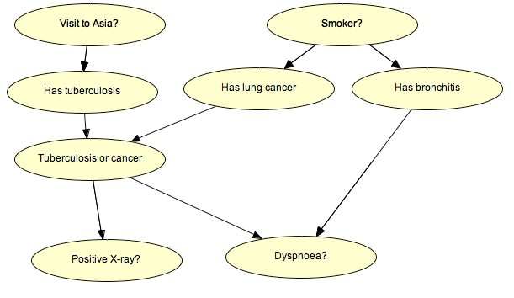
Example: Chest Clinic Model

Slide 23
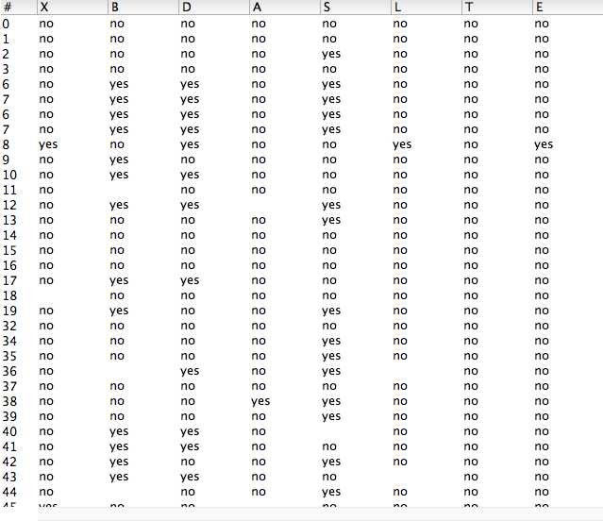
Generate 10,000 cases

Slide 24
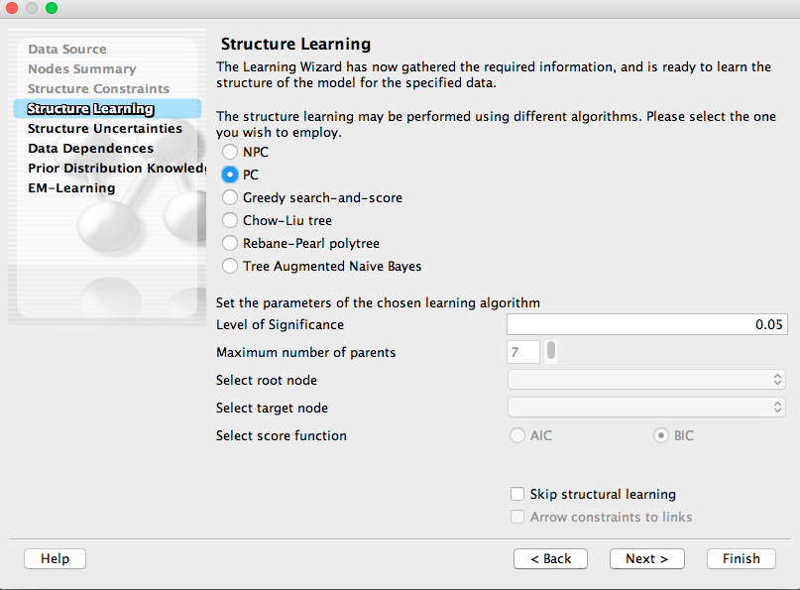
Now we use Learning Wizard in Hugin and try to learn the model

Slide 25
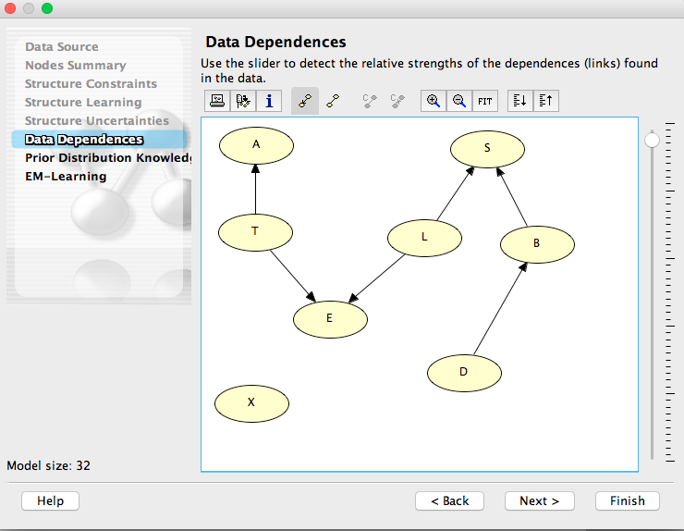

Slide 26
Using BN learning algorithms for detecting offense (data corrupting) and defense (data quality) information operations

Slide 27
Offensive Information Operation (Corrupting Data)
In offensive information operation, the dataset is corrupted and then is used to learn the BN model by using the PC algorithm.
What is the minimal data that needs to be modified to change the model? The difficulty on this process can range from easier (such as masking that smoking causes cancer) to hard (such as changing to a desired model).

Slide 28
Defensive Information Operation (Data Quality)
In defensive information operation, the new data in dataset is introduced and then the PC algorithm uses this dataset to learn the BN model.
How much incorrect data can be introduced in the database without changing the model?
How can we use Bayesian networks to be able to detect unauthorized data manipulation or incorrect data entries? Can we use Bayesian networks to ensure data quality assessment for integrity aspect?

Slide 29
Questions?

Slide 30
References
Bayesian Networks for Padhraic Smyth
Learning Bayesian Networks from Data for Nir Friedman (ebrew U.) and Daphne Koller(Stanford)

