Slide 1
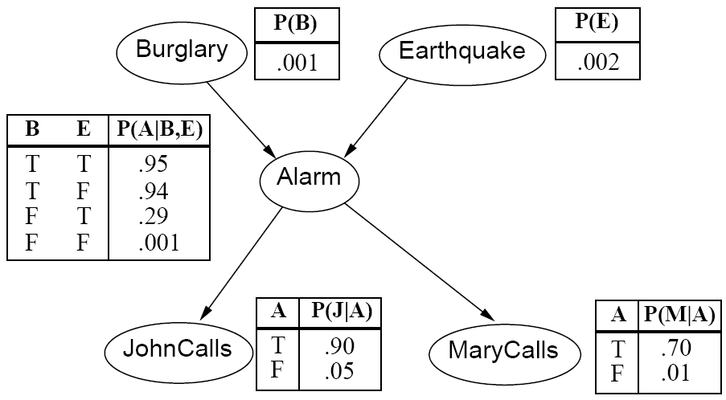
CS440/ECE448 Lecture 18: Bayesian Networks
Slides by Svetlana Lazebnik, 10/2016
Modified by Mark Hasegawa-Johnson, 3/2019

Slide 2
Review: Bayesian inference
A general scenario:
Query variables: X
Evidence (observed) variables and their values: E = e
Inference problem: answer questions about the query variables given the evidence variables
This can be done using the posterior distribution P(X | E = e)
Example of a useful question: Which X is true?
More formally: what value of X has the least probability of being wrong?
Answer: MPE = MAP (argmin P(error) = argmax P(X=x|E=e))
Notes:
2

Slide 3
Today: What if P(X,E) is complicated?
Very, very common problem: P(X,E) is complicated because both X and E depend on some hidden variable Y
SOLUTION:
Draw a bunch of circles and arrows that represent the dependence
When your algorithm performs inference, make sure it does so in the order of the graph
FORMALISM: Bayesian Network

Slide 4
Hidden Variables
A general scenario:
Query variables: X
Evidence (observed) variables and their values: E = e
Unobserved variables: Y
Inference problem: answer questions about the query variables given the evidence variables
This can be done using the posterior distribution P(X | E = e)
In turn, the posterior needs to be derived from the full joint P(X, E, Y)
Bayesian networks are a tool for representing joint probability distributions efficiently
Notes:
4

Slide 5


Bayesian networks
More commonly called graphical models
A way to depict conditional independence relationships between random variables
A compact specification of full joint distributions

Slide 6
Outline
Review: Bayesian inference
Bayesian network: graph semantics
The Los Angeles burglar alarm example
Conditional independence ≠ Independence
Constructing a Bayesian network: Structure learning
Constructing a Bayesian network: Hire an expert

Slide 7
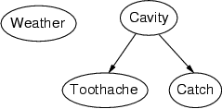
Bayesian networks: Structure
Nodes: random variables
Arcs: interactions
An arrow from one variable to another indicates direct influence
Must form a directed, acyclic graph

Slide 8
Example: N independent coin flips
Complete independence: no interactions
…
X₁
X₂
X_{n}

Slide 9
Example: Naïve Bayes document model
Random variables:
X: document class
W₁, …, W_{n}: words in the document
X
…
W₁
W₂
W_{n}

Slide 10
Outline
Review: Bayesian inference
Bayesian network: graph semantics
The Los Angeles burglar alarm example
Conditional independence ≠ Independence
Constructing a Bayesian network: Structure learning
Constructing a Bayesian network: Hire an expert

Slide 11

Example: Los Angeles Burglar Alarm
I have a burglar alarm that is sometimes set off by minor earthquakes. My two neighbors, John and Mary, promised to call me at work if they hear the alarm
Example inference task: suppose Mary calls and John doesn’t call. What is the probability of a burglary?
What are the random variables?
Burglary, Earthquake, Alarm, JohnCalls, MaryCalls
What are the direct influence relationships?
A burglar can set the alarm off
An earthquake can set the alarm off
The alarm can cause Mary to call
The alarm can cause John to call

Slide 12
Example: Burglar Alarm

Slide 13
Conditional independence and the joint distribution
Key property: each node is conditionally independent of its non-descendants given its parents
Suppose the nodes X₁, …, X_{n} are sorted in topological order
To get the joint distribution P(X₁, …, X_{n}), use chain rule:

Slide 14
Conditional probability distributions
To specify the full joint distribution, we need to specify a conditional distribution for each node given its parents: P (X | Parents(X))
…
Z₁
Z₂
Z_{n}
X
P (X | Z₁, …, Z_{n})

Slide 15





Example: Burglar Alarm
$$P(E)$$
$$P(B)$$
$$P(A|B,E)$$
$$P(M|A)$$
$$P(J|A)$$

Slide 16



Example: Burglar Alarm
$$P(B)$$
$$P(E)$$
A “model” is a complete specification of the dependencies.
The conditional probability tables are the model parameters.
$$P(A|B,E)$$
$$P(J|A)$$
$$P(M|A)$$

Slide 17
Outline
Review: Bayesian inference
Bayesian network: graph semantics
The Los Angeles burglar alarm example
Conditional independence ≠ Independence
Constructing a Bayesian network: Structure learning
Constructing a Bayesian network: Hire an expert

Slide 18
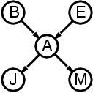
The joint probability distribution
For example,
$$\text{P}\text{(}\text{j}\text{, }\text{m}\text{, }\text{a}\text{, }¬\text{b}\text{,}¬\text{e}\text{) = }\text{P}\text{(}¬\text{b}\text{) }\text{P}\text{(}¬\text{e}\text{) }\text{P}\text{(}\text{a}\text{|}¬\text{b}\text{,}¬\text{e}\text{) }\text{P}\text{(}\text{j}\text{|}\text{a}\text{) }\text{P}\text{(}\text{m}\text{|}\text{a}\text{)}$$

Slide 19
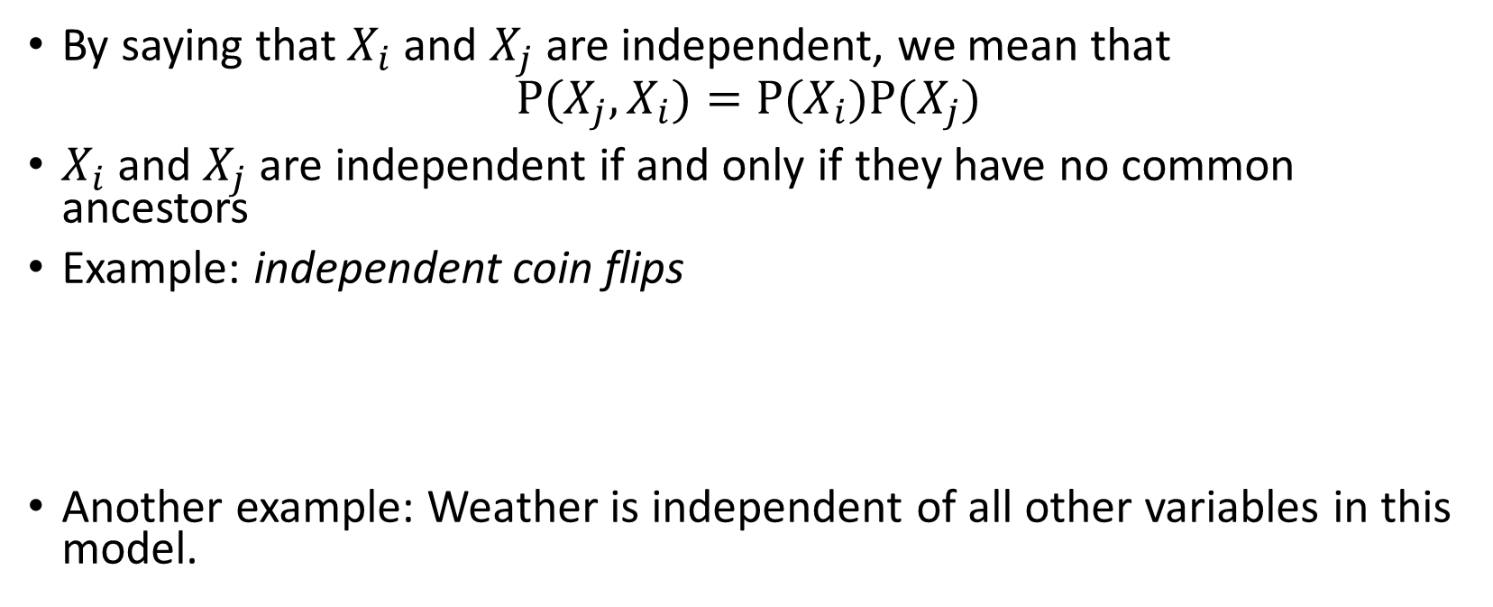
Independence
By saying that $X_{i}$and $X_{j}$are independent, we mean that
$$P(X_{j},X_{i})=P(X_{i})P(X_{j})$$
$X_{i}$and $X_{j}$ are independent if and only if they have no common ancestors
Example: independent coin flips
Another example: Weather is independent of all other variables in this model.
…
X₁
X₂
X_{n}

Slide 20
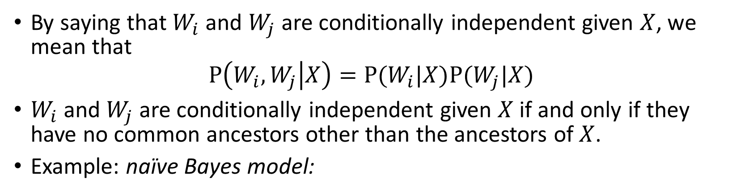
Conditional independence
By saying that $W_{i}$and $W_{j}$are conditionally independent given $X$, we mean that
$$P\left(W_{i},W_{j} | X\right)=P(W_{i}|X)P(W_{j}|X)$$
$W_{i}$and $W_{j}$are conditionally independent given $X$ if and only if they have no common ancestors other than the ancestors of $X$.
Example: naïve Bayes model:
X
…
W₁
W₂
W_{n}

Slide 21
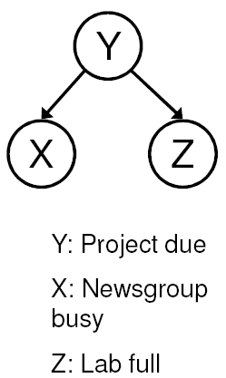
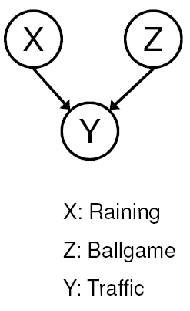
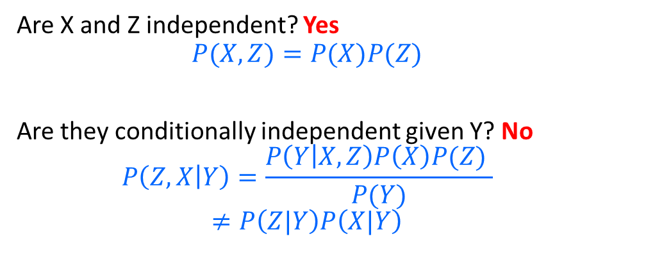

Conditional independence ≠ Independence
Common cause: Conditionally Independent
Common effect: Independent
Are X and Z independent? No
$$P\left(Z,X\right)=\sum_{Y}{P\left(Z | Y\right)P\left(X | Y\right)P(Y)}$$
$$P\left(Z\right)P\left(X\right)=\left(\sum_{Y}{P\left(Z | Y\right)P(Y)}\right)\left(\sum_{Y}{P\left(X | Y\right)P(Y)}\right)$$
Are they conditionally independent given Y? Yes
$$P\left(Z,X | Y\right)=P(Z|Y)P(X|Y)$$
Are X and Z independent? Yes
$$P(X,Z)=P(X)P(Z)$$
Are they conditionally independent given Y? No
$$P\left(Z,X | Y\right)=\frac{P\left(Y | X,Z\right)P\left(X\right)P(Z) }{P(Y)}$$
$$≠P\left(Z|Y\right)P\left(X|Y\right)$$
Notes:
Is P(Raining | Traffic) the same as P(Raining | Traffic, Ballgame)?

Slide 22
Conditional independence ≠ Independence
Common cause: Conditionally Independent
Common effect: Independent
Are X and Z independent? No
Knowing X tells you about Y, which tells you about Z.
Are they conditionally independent given Y? Yes
If you already know Y, then X gives you no useful information about Z.
Are X and Z independent? Yes
Knowing X tells you nothing about Z.
Are they conditionally independent given Y? No
If Y is true, then either X or Z must be true.
Knowing that X is false means Z must be true.
We say that X “explains away” Z.
Notes:
Is P(Raining | Traffic) the same as P(Raining | Traffic, Ballgame)?

Slide 23
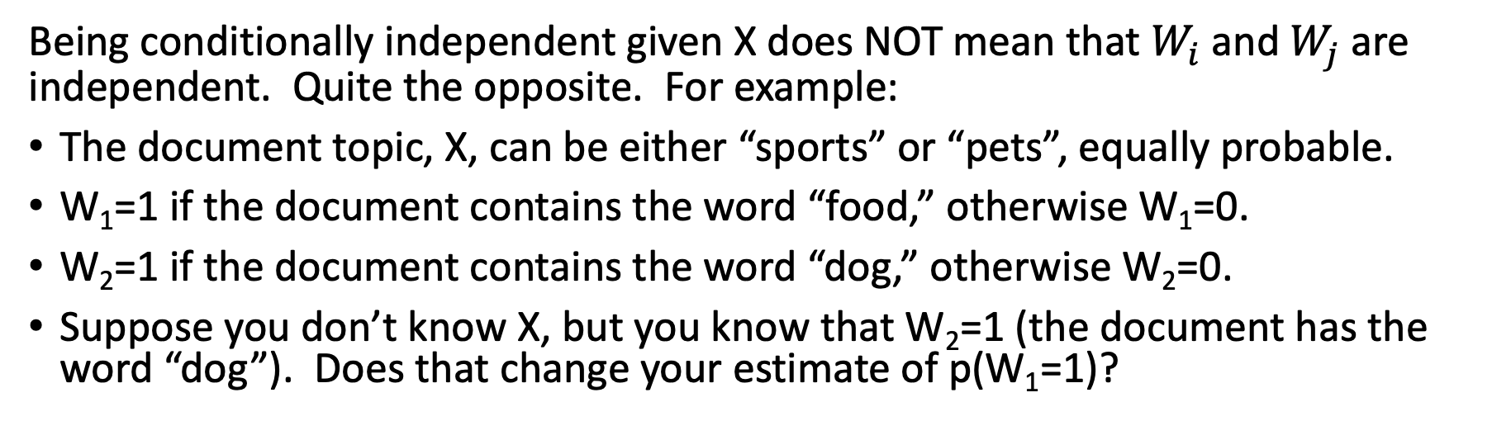
Conditional independence ≠ Independence
X
…
W₁
W₂
W_{n}
Being conditionally independent given X does NOT mean that $W_{i}$and $W_{j}$are independent. Quite the opposite. For example:
The document topic, X, can be either “sports” or “pets”, equally probable.
W₁=1 if the document contains the word “food,” otherwise W₁=0.
W₂=1 if the document contains the word “dog,” otherwise W₂=0.
Suppose you don’t know X, but you know that W₂=1 (the document has the word “dog”). Does that change your estimate of p(W₁=1)?

Slide 24
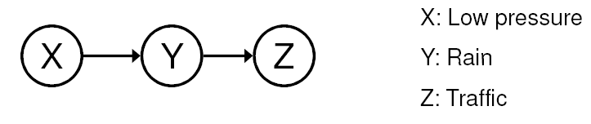
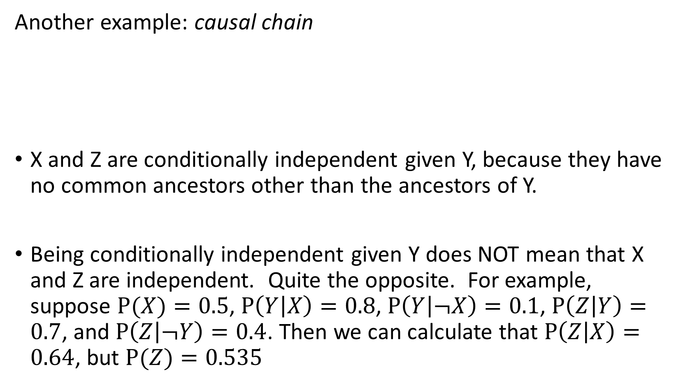
Conditional independence
Another example: causal chain
X and Z are conditionally independent given Y, because they have no common ancestors other than the ancestors of Y.
Being conditionally independent given Y does NOT mean that X and Z are independent. Quite the opposite. For example, suppose $P(X)=0.5$, $P\left(Y | X\right)=0.8$, $P\left(Y | ¬X\right)=0.1$, $P\left(Z | Y\right)=0.7$, and $P\left(Z | ¬Y\right)=0.4$. Then we can calculate that $P\left(Z | X\right)=0.64$, but $P(Z)=0.535$

Slide 25
Outline
Review: Bayesian inference
Bayesian network: graph semantics
The Los Angeles burglar alarm example
Conditional independence ≠ Independence
Constructing a Bayesian network: Structure learning
Constructing a Bayesian network: Hire an expert

Slide 26
Constructing a Bayes Network: Two Methods
“Structure Learning” a.k.a. “Analysis of Causality:”
Suppose you know the variables, but you don’t know which variables depend on which others. You can learn this from data.
This is an exciting new area of research in statistics, where it goes by the name of “analysis of causality.”
… but it’s almost always harder than method #2. You should know how to do this in very simple examples (like the Los Angeles burglar alarm), but you don’t need to know how to do this in the general case.
“Hire an Expert:”
Find somebody who knows how to solve the problem.
Get her to tell you what are the important variables, and which variables depend on which others.
THIS IS ALMOST ALWAYS THE BEST WAY.

Slide 27
Constructing Bayesian networks: Structure Learning
Choose an ordering of variables X₁, … , X_{n}
For i = 1 to n
add X_{i} to the network
Check your training data. If there is any variable X₁, … ,X_{i-1} that CHANGES the probability of X_{i}=1, then add that variable to the set Parents(X_{i}) such that P(X_{i} | Parents(X_{i})) = P(X_{i} | X₁, ... X_{i-1})
Repeat the above steps for every possible ordering (complexity: n!).
Choose the graph that has the smallest number of edges.

Slide 28
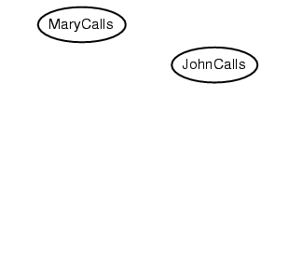
Example
Suppose we choose the ordering M, J, A, B, E

Slide 29
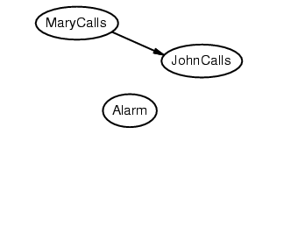
Example
Suppose we choose the ordering M, J, A, B, E

Slide 30
Example
Suppose we choose the ordering M, J, A, B, E

Slide 31
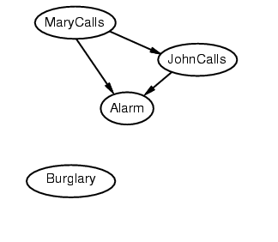
Example
Suppose we choose the ordering M, J, A, B, E

Slide 32
Example
Suppose we choose the ordering M, J, A, B, E

Slide 33
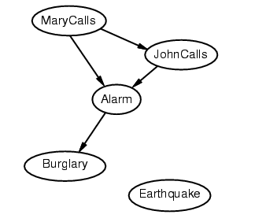
Example
Suppose we choose the ordering M, J, A, B, E

Slide 34
Example
Suppose we choose the ordering M, J, A, B, E

Slide 35
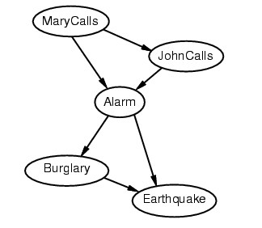
Example
Suppose we choose the ordering M, J, A, B, E

Slide 36
Example contd.
Deciding conditional independence is hard in noncausal directions
The causal direction seems much more natural
Network is less compact: 1 + 2 + 4 + 2 + 4 = 13 numbers needed (vs. 1+1+4+2+2=10 for the causal ordering)
versus

Slide 37
Why store it in causal order? A: Saves memory
Suppose we have a Boolean variable X_{i} with k Boolean parents. How many rows does its conditional probability table have?
2^{k} rows for all the combinations of parent values
Each row requires one number for P(X_{i} = true | parent values)
If each variable has no more than k parents, how many numbers does the complete network require?
O(n · 2^{k}) numbers – vs. O(2^{n}) for the full joint distribution
How many nodes for the burglary network?
1 + 1 + 4 + 2 + 2 = 10 numbers (vs. 2⁵-1 = 31)

Slide 38
Outline
Review: Bayesian inference
Bayesian network: graph semantics
The Los Angeles burglar alarm example
Conditional independence ≠ Independence
Constructing a Bayesian network: Structure learning
Constructing a Bayesian network: Hire an expert

Slide 39
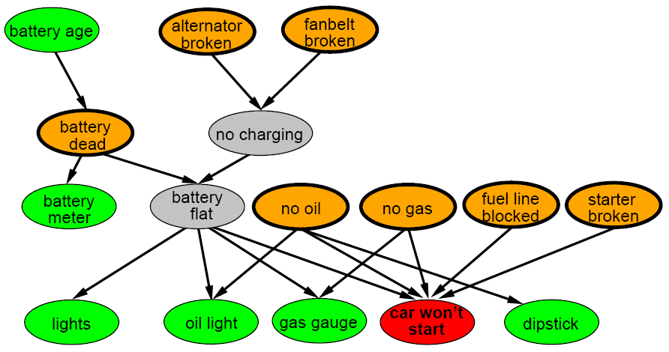
A more realistic Bayes Network: Car diagnosis
Initial observation: car won’t start
Orange: “broken, so fix it” nodes
Green: testable evidence
Gray: “hidden variables” to ensure sparse structure, reduce parameters

Slide 40
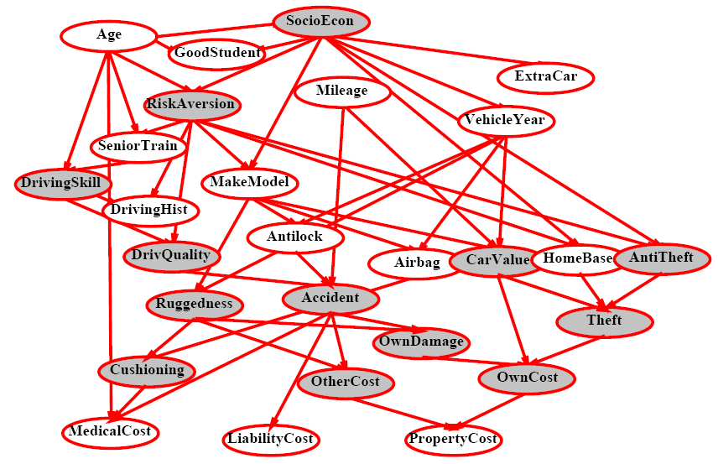
Car insurance

Slide 41
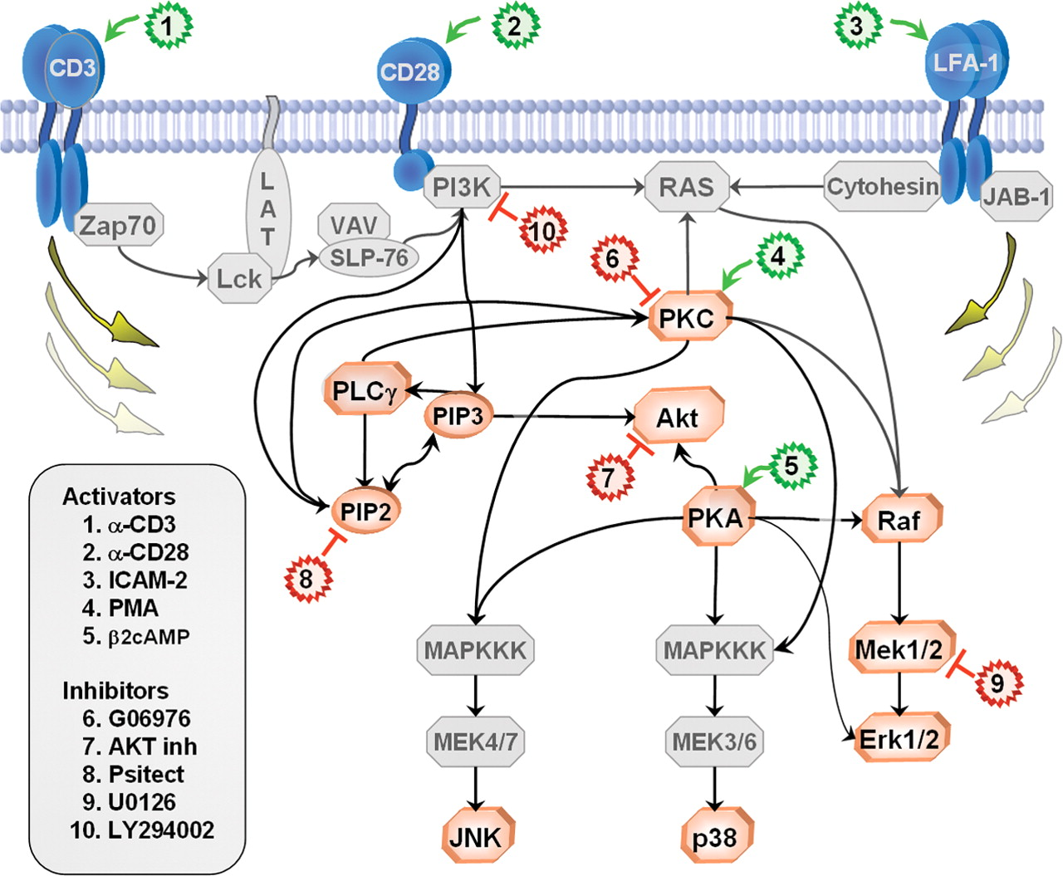
In research literature…
Causal Protein-Signaling Networks Derived from Multiparameter Single-Cell Data
Karen Sachs, Omar Perez, Dana Pe'er, Douglas A. Lauffenburger, and Garry P. Nolan
(22 April 2005) Science 308 (5721), 523.

Slide 42
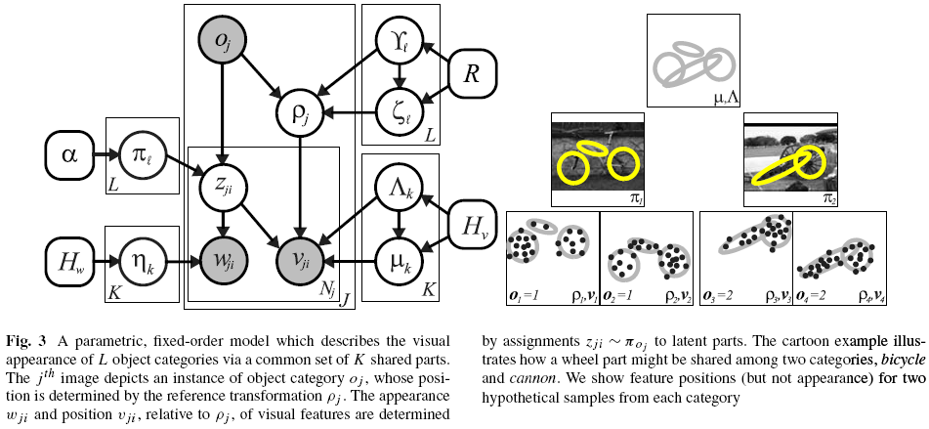
In research literature…
Describing Visual Scenes Using Transformed Objects and Parts
E. Sudderth, A. Torralba, W. T. Freeman, and A. Willsky.
International Journal of Computer Vision, No. 1-3, May 2008, pp. 291-330.

Slide 43
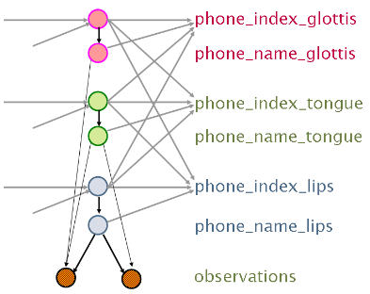
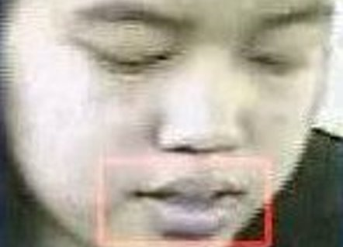
In research literature…
Audiovisual Speech Recognition with Articulator Positions as Hidden Variables
Mark Hasegawa-Johnson, Karen Livescu, Partha Lal and Kate Saenko
International Congress on Phonetic Sciences 1719:299-302, 2007

Slide 44
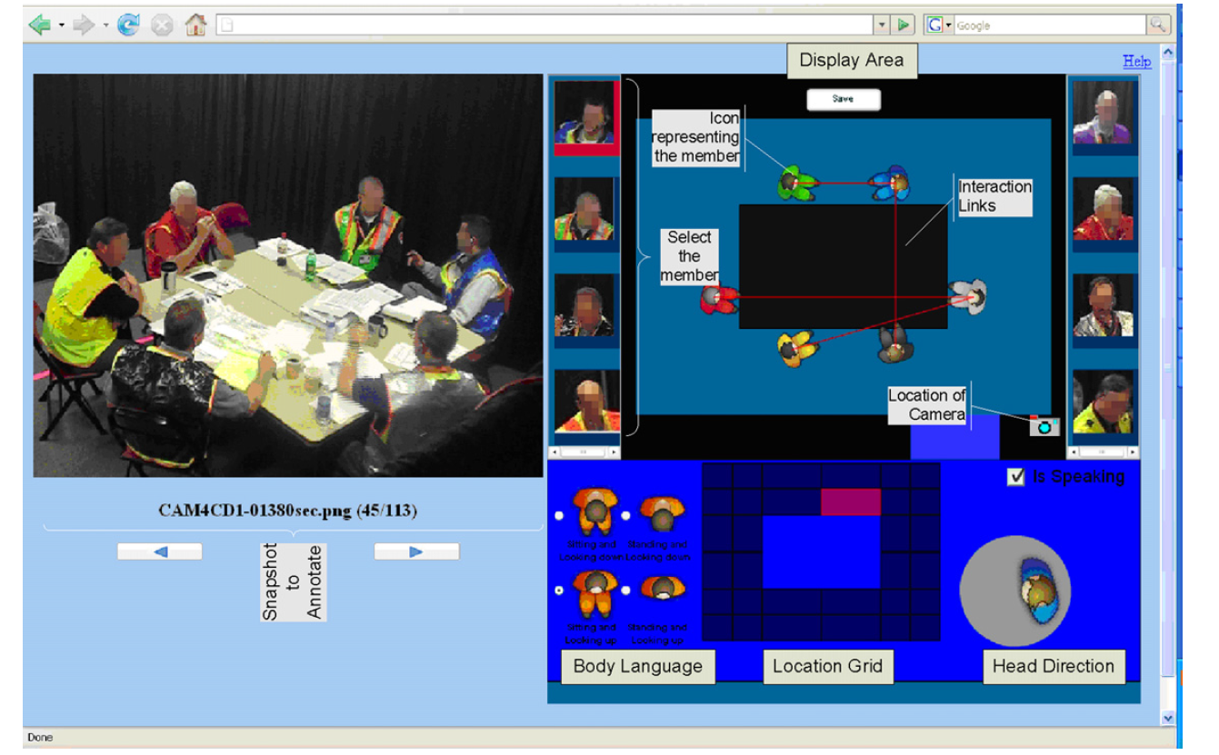
In research literature…
Detecting interaction links in a collaborating group using manually annotated data
S. Mathur, M.S. Poole, F. Pena-Mora, M. Hasegawa-Johnson, N. Contractor
Social Networks 10.1016/j.socnet.2012.04.002

Slide 45
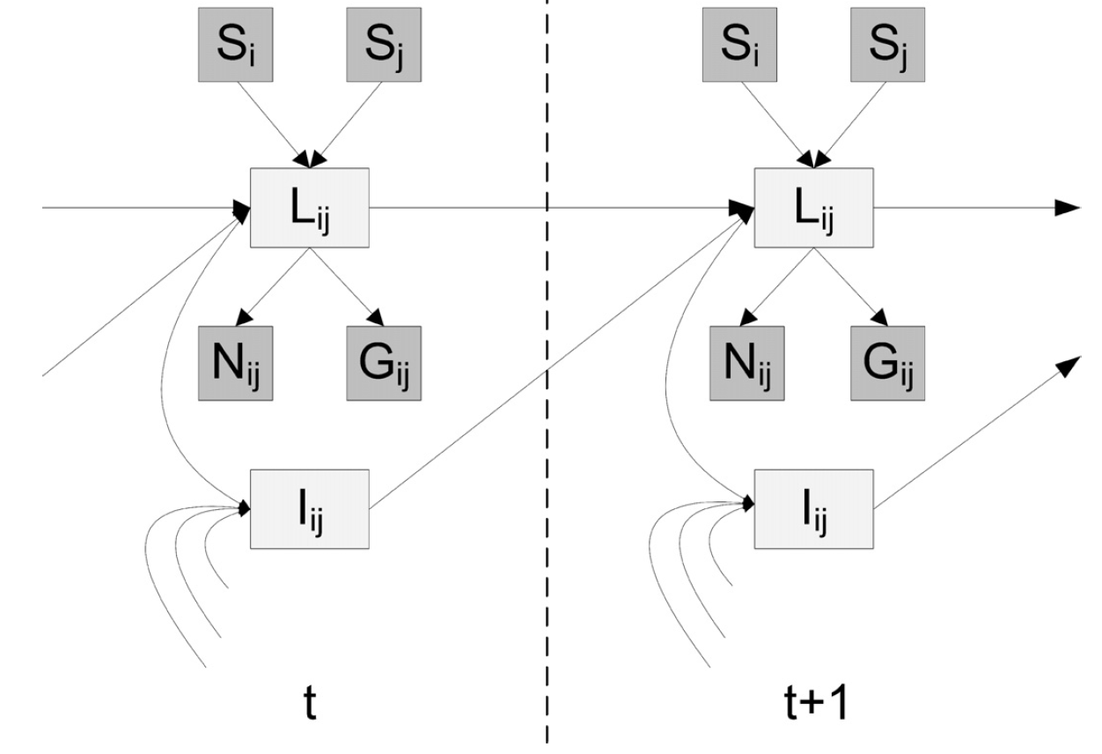
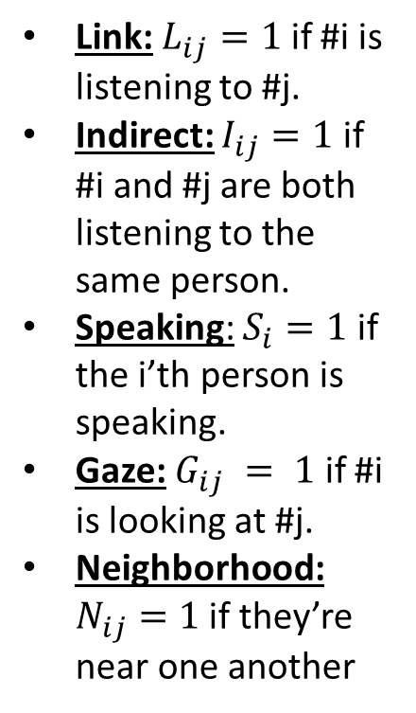
In research literature…
Link: $L_{ij}=1$ if #i is listening to #j.
Indirect: $I_{ij}=1$ if #i and #j are both listening to the same person.
Speaking: $S_{i}=1$ if the i’th person is speaking.
Gaze: $G_{ij} = 1$ if #i is looking at #j.
Neighborhood: $N_{ij}=1$ if they’re near one another
Detecting interaction links in a collaborating group using manually annotated data
S. Mathur, M.S. Poole, F. Pena-Mora, M. Hasegawa-Johnson, N. Contractor
Social Networks 10.1016/j.socnet.2012.04.002

Slide 46
Summary
Bayesian networks provide a natural representation for (causally induced) conditional independence
Topology + conditional probability tables
Generally easy for domain experts to construct

