Slide 1
K-means Clustering
2011 Machine Learning
J.-S. Roger Jang (張智星)
CS Dept., Tsing Hua Univ., Taiwan
http://mirlab.org/jang
jang@mirlab.org
Notes:
...
In this talk, we are going to apply two neural network controller design techniques to fuzzy controllers, and construct the so-called on-line adaptive neuro-fuzzy controllers for nonlinear control systems. We are going to use MATLAB, SIMULINK and Handle Graphics to demonstrate the concept. So you can also get a preview of some of the features of the Fuzzy Logic Toolbox, or FLT, version 2.

Slide 2
Problem Definition
Input:
: A data set in d-dim. space
m: Number of clusters (we don’t use k here to avoid confusion with summation index…)
Output:
Cluster centers:
Assignment of each xi to one of the m clusters:
Requirement:
The output should minimize the objective function…

Slide 3
Objective Function
Objective function (distortion)
d*m (for matrix C) plus n*m (for matrix A) tunable parameters with certain constraints on matrix A
Np-hard problem if exact solution is required

Slide 4
Task 1: How to Find Assignment in A?
Goal
Find A to minimize J(X; C, A) with fixed C
Facts
Close-form solution exists:

Slide 5
Task 2: How to Find Centers in C?
Goal
Find C to minimize J(X; C, A) with fixed A
Facts
Close-form solution exists:

Slide 6
Algorithm
Initialize
Select initial m cluster centers
Find clusters
For each xi, assign the cluster with nearest center
➔ Find A to minimize J(X; C, A) with fixed C
Find centers
Recompute each cluster center as the mean of data in the cluster
➔ Find C to minimize J(X; C, A) with fixed A
Stopping criterion
Stop if clusters stay the same. Otherwise go to step 2.

Slide 7
Stopping Criteria
Two stopping criteria
Repeating until no more change in cluster assignment
Repeat until distortion improvement is less than a threshold
Facts
Convergence is assured since J is reduced repeatedly.

Slide 8
Properties of K-means Clustering
K-means can find the approximate solution efficiently.
The distortion (squared error) is a monotonically non-increasing function of iterations.
The goal is to minimize the square error, but it could end up in a local minimum.
To increase the probability of finding the global maximum, try to start k-means with different initial conditions.
“Cluster validation” refers to a set of methods which try to determine the best value of k.
Other distance measures can be used in place of the Euclidean distance, with corresponding change in center identification.

Slide 9
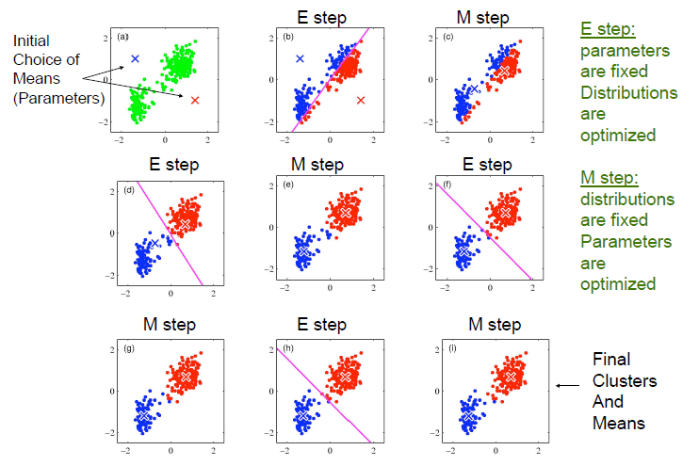
K-means Snapshots

Slide 10
Demo of K-means Clustering
Toolbox download
Utility Toolbox
Machine Learning Toolbox
Demos
kMeansClustering.m
vecQuzntize.m

Slide 11
Demos of K-means Clustering
kMeansClustering.m

Slide 12
Application: Image Compression
Goal
Convert a image from true colors to indexed colors with minimum distortion.
Steps
Collect data from a true-color image
Perform k-means clustering to obtain cluster centers as the indexed colors
Compute the compression rate

Slide 13
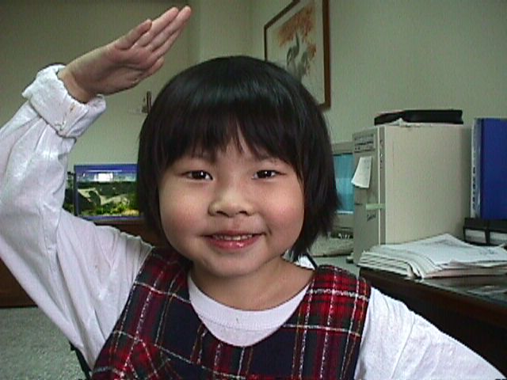
Example: Image Compression
Original image
Dimension: 480x640
Data size: 480*640*3*8 bits = 0.92 MB

Slide 14
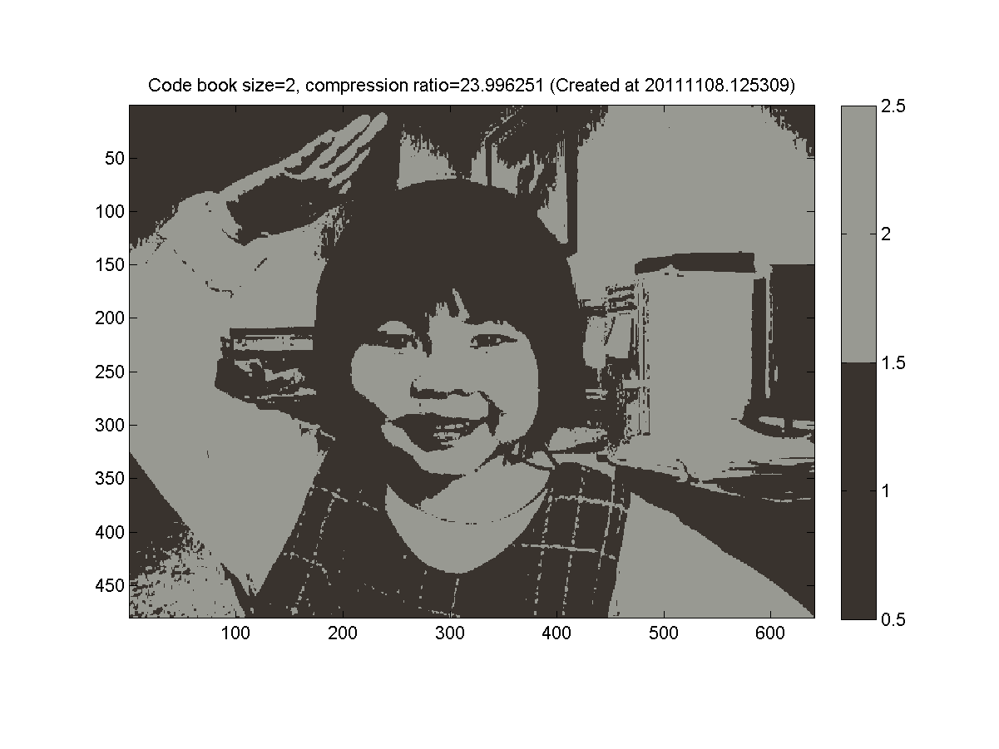
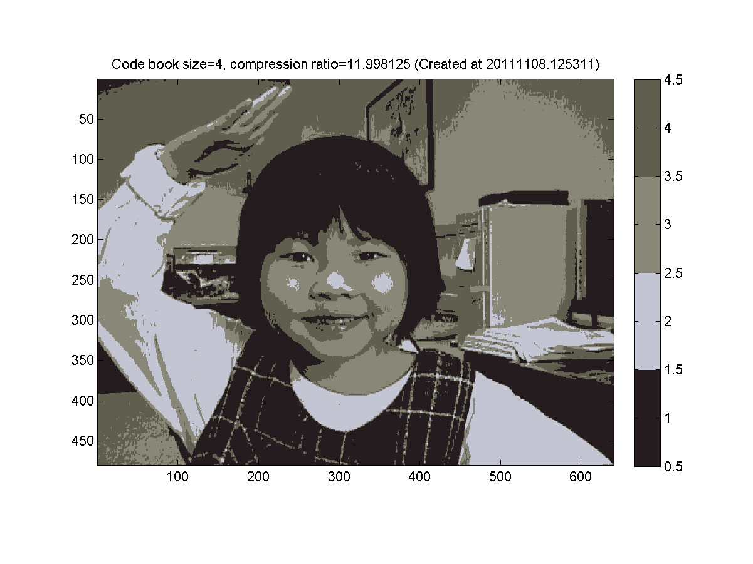
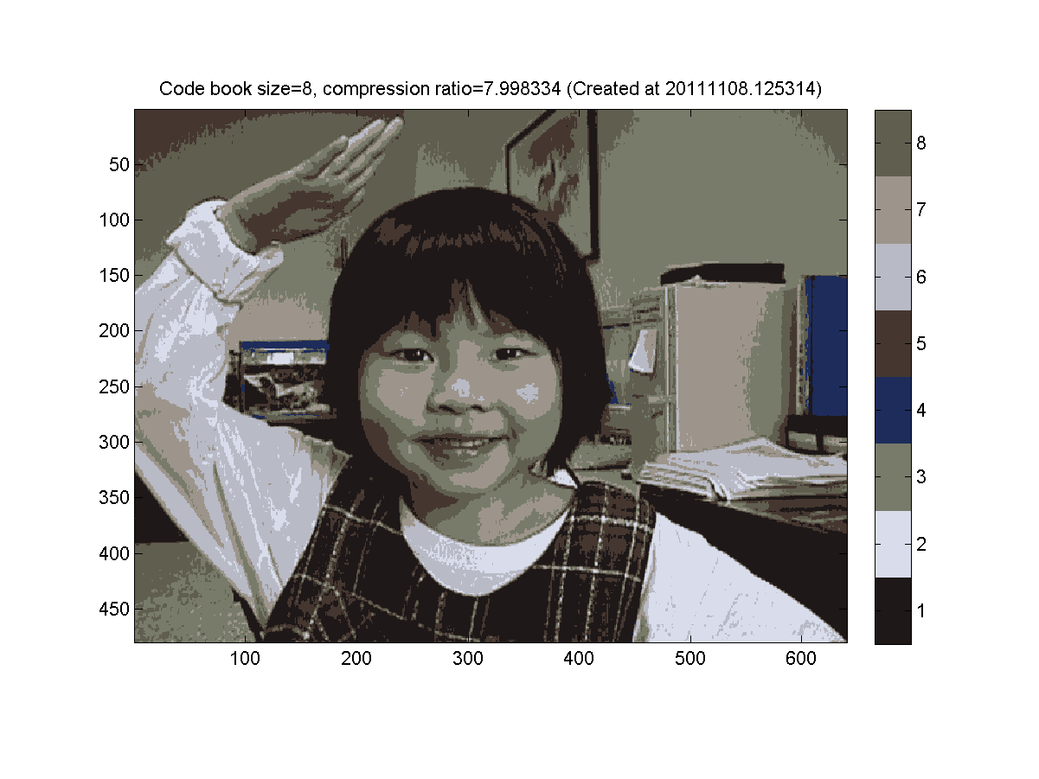
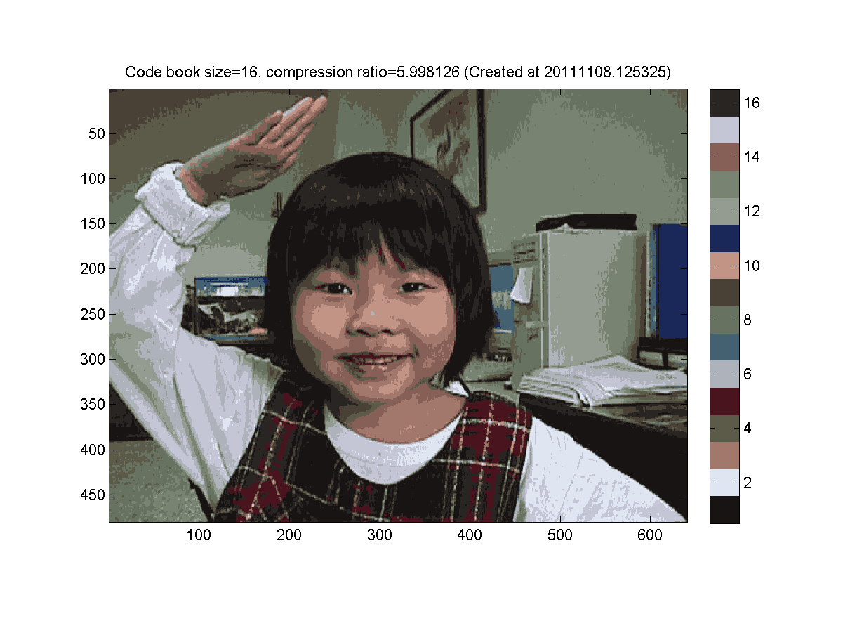
Example: Image Compression

Slide 15
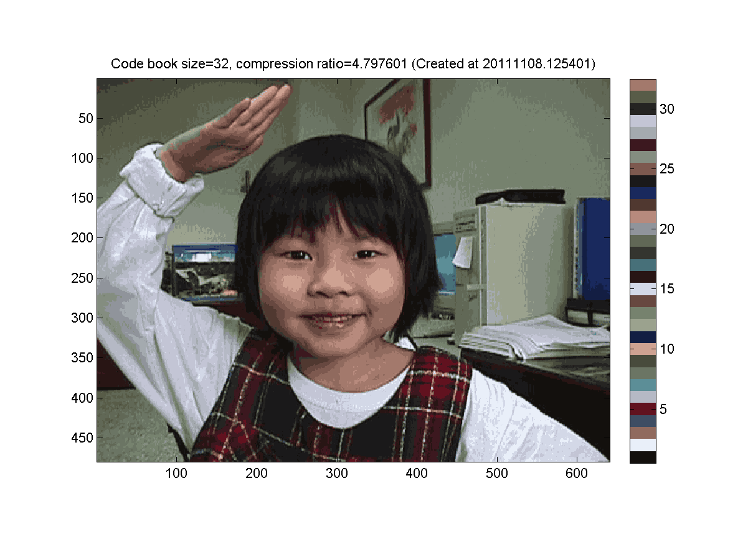
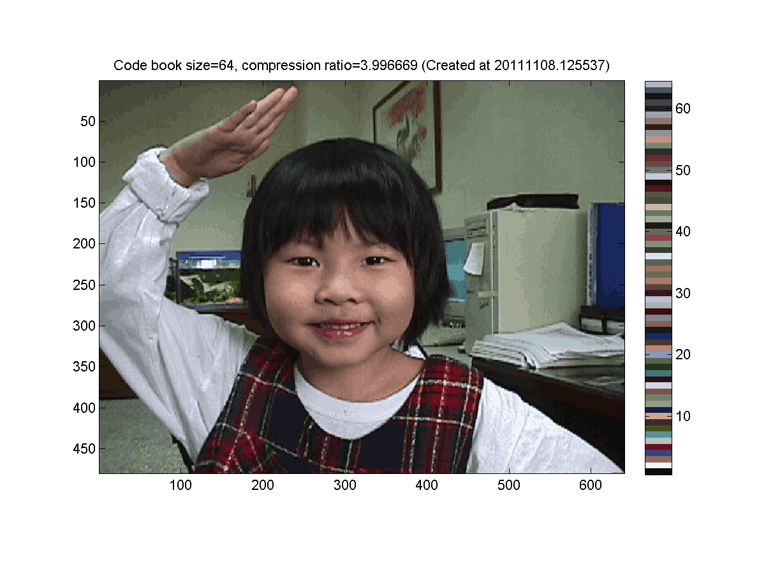
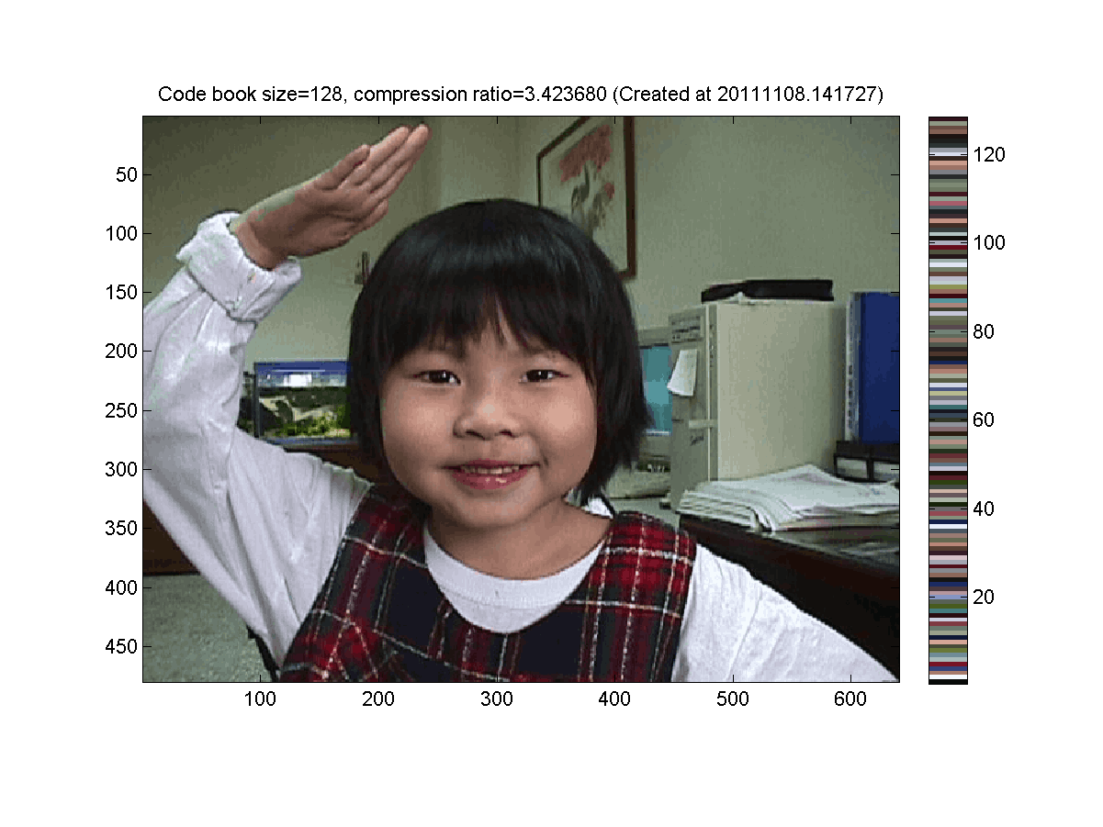
Example: Image Compression

Slide 16
Code
X = imread('annie19980405.jpg');
image(X)
[m, n, p]=size(X);
index=(1:m*n:m*n*p)'*ones(1, m*n)+ones(p,1)*(0:m*n-1);
data=double(X(index));
maxI=6;
for i=1:maxI
centerNum=2^i;
fprintf('i=%d/%d: no. of centers=%d\n', i, maxI, centerNum);
center=kMeansClustering(data, centerNum);
distMat=distPairwise(center, data);
[minValue, minIndex]=min(distMat);
X2=reshape(minIndex, m, n);
map=center'/255;
figure; image(X2); colormap(map); colorbar; axis image;
end

