Slide 1
Unsupervised learning
David Kauchak CS 158 – Fall 2019

Slide 2
Administrative
Final project
Project proposal due tomorrow (Wednesday)
Progress report due next Wednesday
Grading
Assignment 8 back soon
Assignment 9 next week

Slide 3
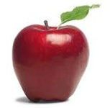
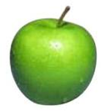
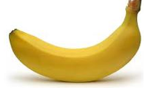
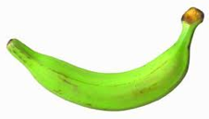
Supervised learning
label
label₁
model/
predictor
label₃
label₄
label₅
Supervised learning: given labeled examples

Slide 4
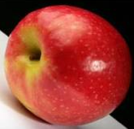
Unsupervised learning
Unsupervised learning: given data, i.e. examples, but no labels

Slide 5
Unsupervised learning
Given some example without labels, do something!

Slide 6
Unsupervised applications areas
learn clusters/groups without any label
customer segmentation (i.e. grouping)
image compression
bioinformatics: learn motifs
find important features
…

Slide 7
Unsupervised learning: clustering
Raw data
features
f₁, f₂, f₃, …, f_{n}
f₁, f₂, f₃, …, f_{n}
Clusters
f₁, f₂, f₃, …, f_{n}
f₁, f₂, f₃, …, f_{n}
group into classes/clusters
extract
features
f₁, f₂, f₃, …, f_{n}
No “supervision”, we’re only given data and want to find natural groupings

Slide 8
Unsupervised learning: modeling
Most frequently, when people think of unsupervised learning they think clustering
Another category: learning probabilities/parameters for models without supervision
Learn a translation dictionary
Learn a grammar for a language
Learn the social graph

Slide 9
Clustering
Clustering: the process of grouping a set of objects into classes of similar objects
Applications?

Slide 10
Gene expression data
Data from Garber et al.
PNAS (98), 2001.

Slide 11
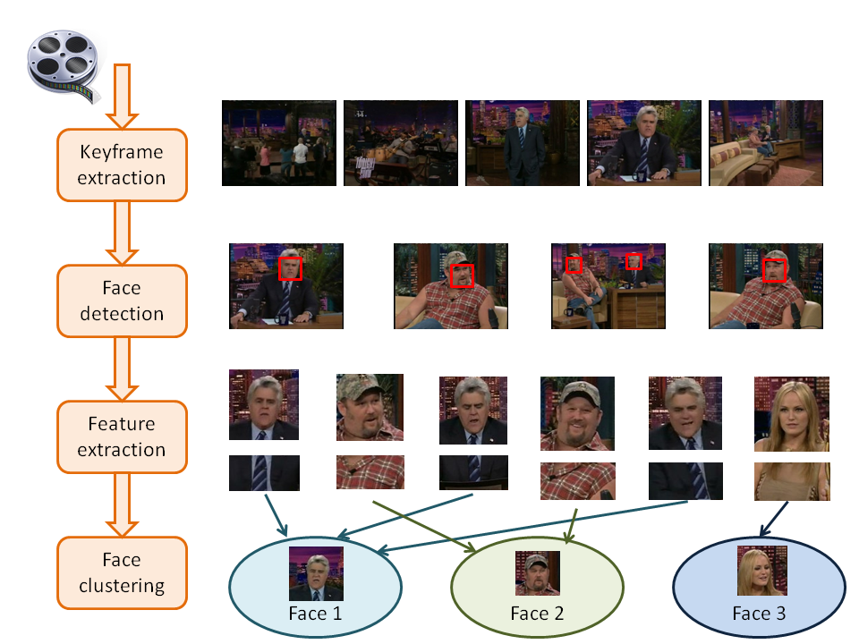
Face Clustering

Slide 12
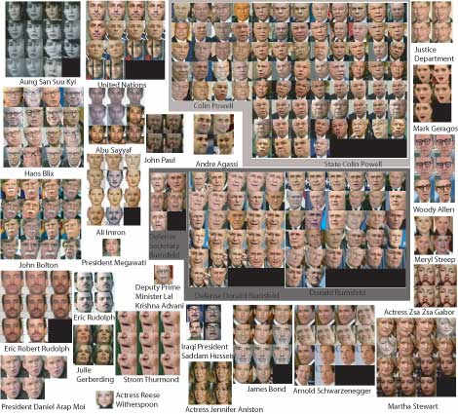
Face clustering

Slide 13
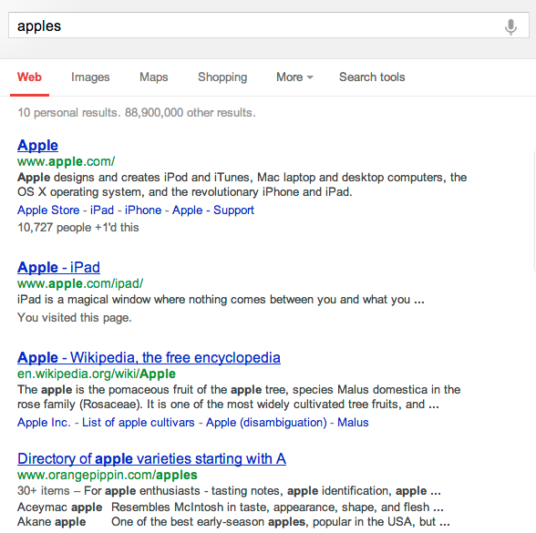
Search result clustering

Slide 14
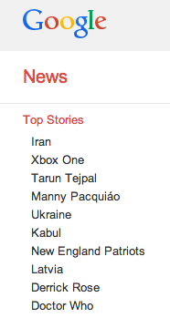
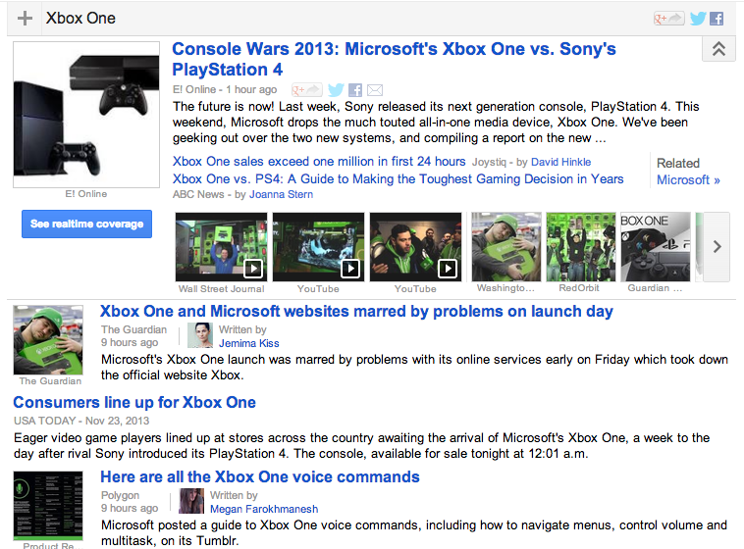
Google News

Slide 15
Clustering in search advertising
Find clusters of advertisers and keywords
Keyword suggestion
Performance estimation
bids
Advertiser
Bidded Keyword
~10M nodes

Slide 16
Clustering applications
Find clusters of users
Targeted advertising
Exploratory analysis
Clusters of the Web Graph
Distributed pagerank computation
Who-messages-who IM/text/twitter graph
~100M nodes

Slide 17
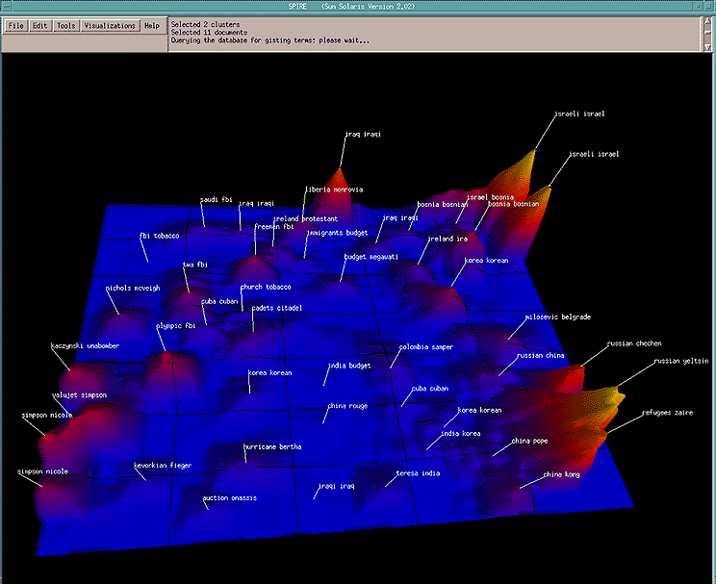
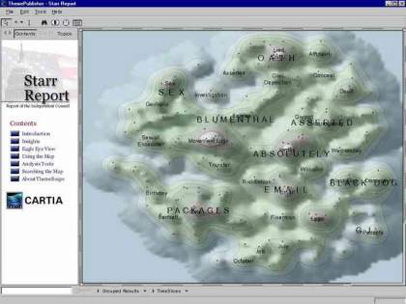
Data visualization
Wise et al, “Visualizing the non-visual” PNNL
ThemeScapes, Cartia
[Mountain height = cluster size]

Slide 18
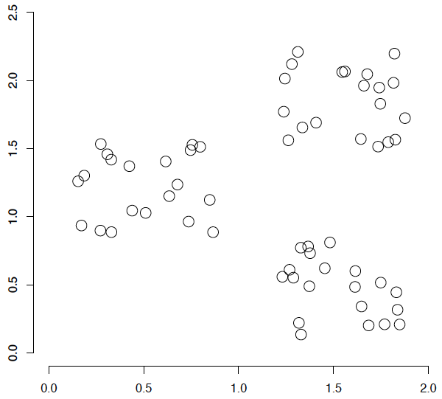
A data set with clear cluster structure
What are some of the issues for clustering?
What clustering algorithms have you seen/used?

Slide 19
Issues for clustering
Representation for clustering
How do we represent an example
features, etc.
Similarity/distance between examples
Flat clustering or hierarchical
Number of clusters
Fixed a priori
Data driven?

Slide 20
Clustering Algorithms
Flat algorithms
Usually start with a random (partial) partitioning
Refine it iteratively
K means clustering
Model based clustering
Spectral clustering
Hierarchical algorithms
Bottom-up, agglomerative
Top-down, divisive

Slide 21
Hard vs. soft clustering
Hard clustering: Each example belongs to exactly one cluster
Soft clustering: An example can belong to more than one cluster (probabilistic)
Makes more sense for applications like creating browsable hierarchies
You may want to put a pair of sneakers in two clusters: (i) sports apparel and (ii) shoes

Slide 22
K-means
Most well-known and popular clustering algorithm:
Start with some initial cluster centers
Iterate:
Assign/cluster each example to closest center
Recalculate centers as the mean of the points in a cluster

Slide 23
K-means: an example

Slide 24
K-means: Initialize centers randomly

Slide 25
K-means: Initialize centers randomly
What points are closest?

Slide 26
K-means: assign points to nearest center

Slide 27
K-means: assign points to nearest center
Where are the new centers?

Slide 28
K-means: readjust centers

Slide 29
K-means: readjust centers
What points are closest?

Slide 30
K-means: assign points to nearest center

Slide 31
K-means: assign points to nearest center
Where are the new centers?

Slide 32
K-means: readjust centers

Slide 33
K-means: assign points to nearest center

Slide 34
K-means: readjust centers

Slide 35
K-means: readjust centers
When do we stop?

Slide 36
K-means: assign points to nearest center
No changes: Done

Slide 37
K-means
Iterate:
Assign/cluster each example to closest center
Recalculate centers as the mean of the points in a cluster
How do we do this?

Slide 38
K-means
Iterate:
Assign/cluster each example to closest center
Recalculate centers as the mean of the points in a cluster
iterate over each point:
- get distance to each cluster center
- assign to closest center (hard cluster)

Slide 39
K-means
Iterate:
Assign/cluster each example to closest center
Recalculate centers as the mean of the points in a cluster
iterate over each point:
- get distance to each cluster center
- assign to closest center (hard cluster)
What distance measure should we use?

Slide 40
Distance measures
Euclidean:
good for spatial data

Slide 41
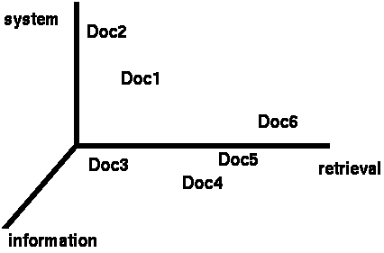
Clustering documents (e.g. wine data)
One feature for each word. The value is the number of times that word occurs.
Documents are points or vectors in this space

Slide 42
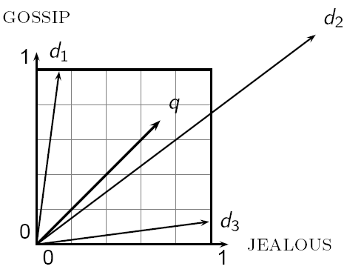
When Euclidean distance doesn’t work
Which document is closest to q using Euclidian distance?
Which do you think should be closer?

Slide 43
Issues with Euclidian distance
the Euclidean distance between q and d₂ is large
but, the distribution of terms in q and d₂ are very similar
This is not what we want!

Slide 44
cosine similarity
correlated with the angle between two vectors

Slide 45
cosine distance
cosine similarity ranges from 0 and 1, with things that are similar 1 and dissimilar 0
cosine distance:
good for text data and many other “real world” data sets
computationally friendly since we only need to consider features that have non-zero values for both examples

Slide 46
K-means
Iterate:
Assign/cluster each example to closest center
Recalculate centers as the mean of the points in a cluster
Where are the cluster centers?

Slide 47
K-means
Iterate:
Assign/cluster each example to closest center
Recalculate centers as the mean of the points in a cluster
How do we calculate these?

Slide 48
K-means
Iterate:
Assign/cluster each example to closest center
Recalculate centers as the mean of the points in a cluster
Mean of the points in the cluster:
where:

Slide 49
K-means loss function
K-means tries to minimize what is called the “k-means” loss function:
the sum of the squared distances from each point to the associated cluster center

Slide 50
Minimizing k-means loss
Iterate:
1. Assign/cluster each example to closest center
2. Recalculate centers as the mean of the points in a cluster
Does each step of k-means move towards reducing this loss function (or at least not increasing it)?

Slide 51
Minimizing k-means loss
Iterate:
1. Assign/cluster each example to closest center
2. Recalculate centers as the mean of the points in a cluster
This isn’t quite a complete proof/argument, but:
Any other assignment would end up in a larger loss
The mean of a set of values minimizes the squared error

Slide 52
Minimizing k-means loss
Iterate:
1. Assign/cluster each example to closest center
2. Recalculate centers as the mean of the points in a cluster
Does this mean that k-means will always find the minimum loss/clustering?

Slide 53
Minimizing k-means loss
Iterate:
1. Assign/cluster each example to closest center
2. Recalculate centers as the mean of the points in a cluster
NO! It will find a minimum.
Unfortunately, the k-means loss function is generally not convex and for most problems has many, many minima
We’re only guaranteed to find one of them

Slide 54
K-means variations/parameters
Start with some initial cluster centers
Iterate:
Assign/cluster each example to closest center
Recalculate centers as the mean of the points in a cluster
What are some other variations/parameters we haven’t specified?

Slide 55
K-means variations/parameters
Initial (seed) cluster centers
Convergence
A fixed number of iterations
partitions unchanged
Cluster centers don’t change
K!

Slide 56
K-means: Initialize centers randomly
What would happen here?
Seed selection ideas?

Slide 57
Seed choice
Results can vary drastically based on random seed selection
Some seeds can result in poor convergence rate, or convergence to sub-optimal clusterings
Common heuristics
Random points (not examples) in the space
Randomly pick examples
Points least similar to any existing center (furthest centers heuristic)
Try out multiple starting points
Initialize with the results of another clustering method

Slide 58
Furthest centers heuristic
μ₁ = pick random point
for i = 2 to K:
μ_{i} = point that is furthest from any previous centers
point with the largest distance to any previous center
smallest distance from x to any previous center

Slide 59
K-means: Initialize furthest from centers
Pick a random point for the first center

Slide 60
K-means: Initialize furthest from centers
What point will be chosen next?

Slide 61
K-means: Initialize furthest from centers
Furthest point from center
What point will be chosen next?

Slide 62
K-means: Initialize furthest from centers
Furthest point from center
What point will be chosen next?

Slide 63
K-means: Initialize furthest from centers
Furthest point from center
Any issues/concerns with this approach?

Slide 64
Furthest points concerns
If k = 4, which points will get chosen?

Slide 65
Furthest points concerns
If we do a number of trials, will we get different centers?
Notes:
yes and no
we will get different centers, but the three outliers will always get chosen!

Slide 66
Furthest points concerns
Doesn’t deal well with outliers

Slide 67
K-means++
μ₁ = pick random point
for k = 2 to K:
for i = 1 to N:
s_{i} = min d(x_{i}, μ_{1…k-1}) // smallest distance to any center
μ_{k} = randomly pick point proportionate to s
How does this help?

Slide 68
K-means++
μ₁ = pick random point
for k = 2 to K:
for i = 1 to N:
s_{i} = min d(x_{i}, μ_{1…k-1}) // smallest distance to any center
μ_{k} = randomly pick point proportionate to s
Makes it possible to select other points
if #points >> #outliers, we will pick good points
Makes it non-deterministic, which will help with random runs
Nice theoretical guarantees!

Slide 69
K-means variations/parameters
Initial (seed) cluster centers
Convergence
A fixed number of iterations
partitions unchanged
Cluster centers don’t change
K!

Slide 70
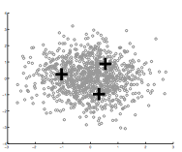
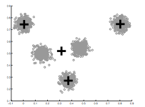
How Many Clusters?
Number of clusters K must be provided
How should we determine the number of clusters?
How did we deal with models becoming too complicated previously?
too many
too few

Slide 71
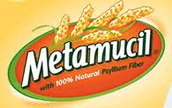
Many approaches
Regularization!!!
Statistical test

Slide 72
k-means loss revisited
K-means is trying to minimize:
What happens when k increases?

Slide 73
k-means loss revisited
K-means is trying to minimize:
Loss goes down!
Making the model more complicated allows us more flexibility, but can “overfit” to the data

Slide 74
k-means loss revisited
K-means is trying to minimize:
(where N = number of points)
2 regularization options
What effect will this have? Which will tend to produce smaller k?

Slide 75
k-means loss revisited
(where N = number of points)
2 regularization options
AIC penalizes increases in K more harshly
Both require a change to the K-means algorithm
Tend to work reasonably well in practice if you don’t know K

Slide 76
Midterm
Mean: 84%
Q1: 79%
Median: 85%
Q3: 90%

Slide 77
Statistical approach
Assume data is Gaussian (i.e. spherical)
Test for this
Testing in high dimensions doesn’t work well
Testing in lower dimensions does work well
ideas?

Slide 78
Project to one dimension and check
For each cluster, project down to one dimension
Use a statistical test to see if the data is Gaussian

Slide 79
Project to one dimension and check
For each cluster, project down to one dimension
Use a statistical test to see if the data is Gaussian
What will this look like projected to 1-D?

Slide 80
Project to one dimension and check
For each cluster, project down to one dimension
Use a statistical test to see if the data is Gaussian

Slide 81
Project to one dimension and check
For each cluster, project down to one dimension
Use a statistical test to see if the data is Gaussian
What will this look like projected to 1-D?

Slide 82
Project to one dimension and check
For each cluster, project down to one dimension
Use a statistical test to see if the data is Gaussian

Slide 83
Project to one dimension and check
For each cluster, project down to one dimension
Use a statistical test to see if the data is Gaussian
What will this look like projected to 1-D?

Slide 84
Project to one dimension and check
For each cluster, project down to one dimension
Use a statistical test to see if the data is Gaussian
Solution?

Slide 85
Project to one dimension and check
For each cluster, project down to one dimension
Use a statistical test to see if the data is Gaussian
Chose the dimension of the projection as the dimension with highest variance

Slide 86
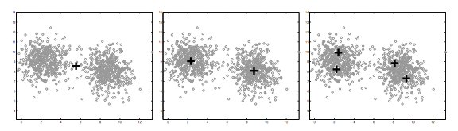
On synthetic data
Split too far

Slide 87
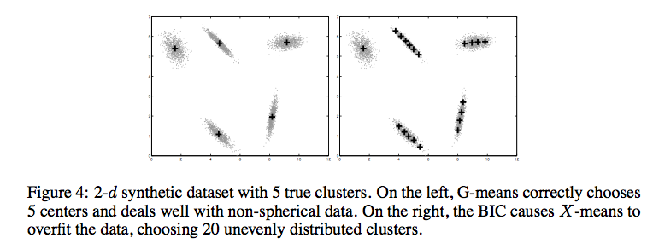
Compared to other approaches
http://cs.baylor.edu/~hamerly/papers/nips_03.pdf

Slide 88
K-Means time complexity
Variables: K clusters, n data points, m features/dimensions, I iterations
What is the runtime complexity?
Computing distance between two points (e.g. euclidean)
Reassigning clusters
Computing new centers
Iterate…

Slide 89
K-Means time complexity
Variables: K clusters, n data points, m features/dimensions, I iterations
What is the runtime complexity?
Computing distance between two points is O(m) where m is the dimensionality of the vectors/number of features.
Reassigning clusters: O(Kn) distance computations, or O(Knm)
Computing centroids: Each points gets added once to some centroid: O(nm)
Assume these two steps are each done once for I iterations: O(Iknm)
In practice, K-means converges quickly and is fairly fast

