Slide 1
Last lecture summary

Slide 2
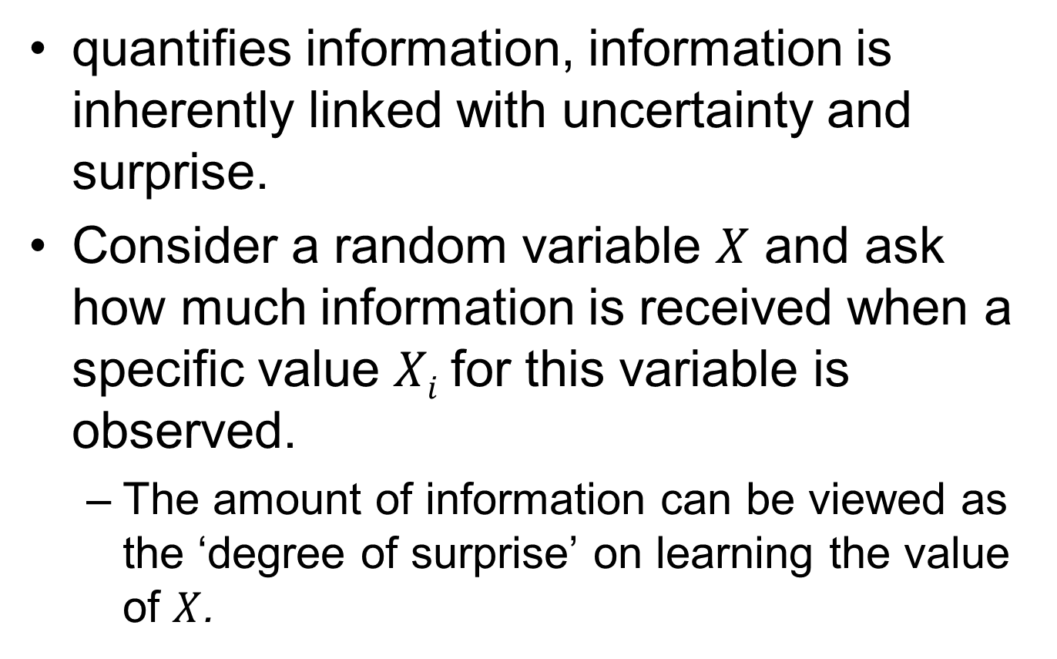
Information theory
quantifies information, information is inherently linked with uncertainty and surprise.
Consider a random variable $X$ and ask how much information is received when a specific value $Xi$for this variable is observed.
The amount of information can be viewed as the ‘degree of surprise’ on learning the value of $X$.

Slide 3
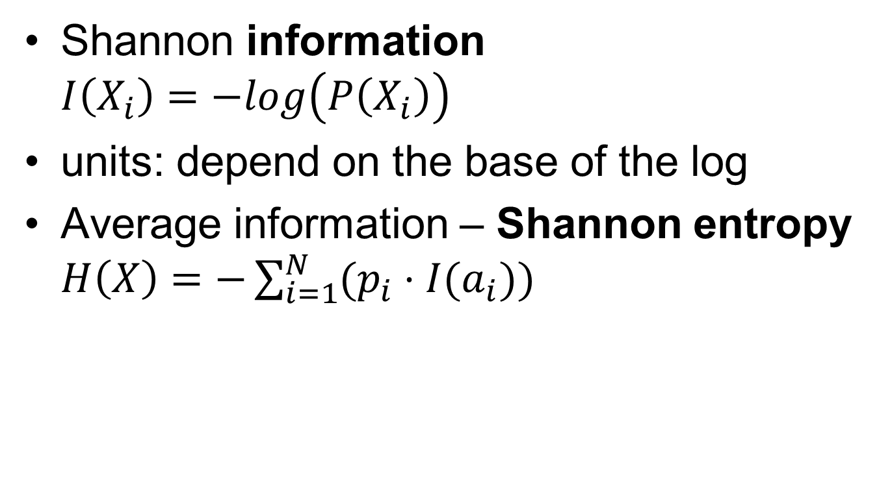
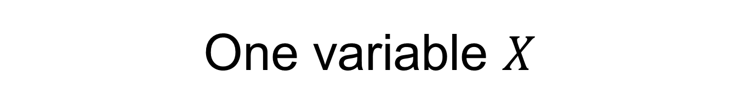
One variable $X$
Shannon information $I\left(X_{i}\right)=−log\left(P\left(X_{i}\right)\right)$
units: depend on the base of the log
Average information – Shannon entropy $H\left(X\right)=−\sum_{i=1}^{N}{(p_{i}⋅I(a_{i}))}$

Slide 4
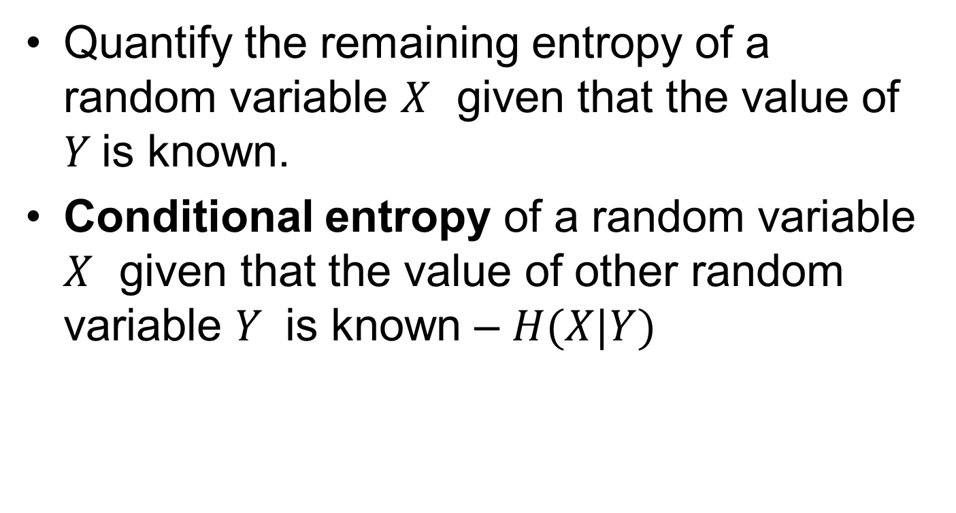
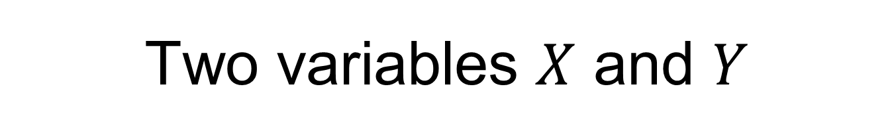
Two variables $X$ and $Y$
Quantify the remaining entropy of a random variable $X$ given that the value of $Y$is known.
Conditional entropy of a random variable $X$ given that the value of other random variable $Y$ is known – $H(X|Y)$

Slide 5
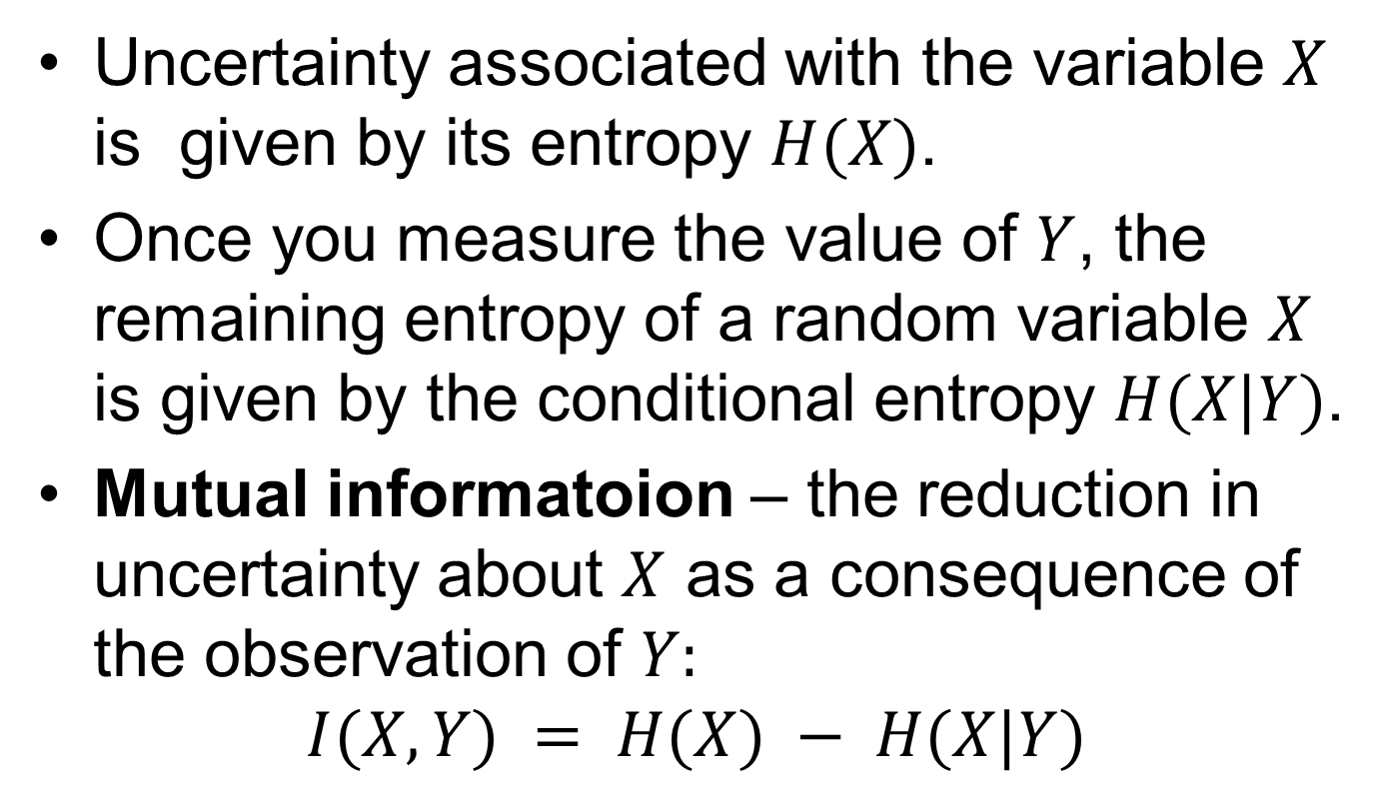
Two variables $X$ and $Y$
Uncertainty associated with the variable $X$ is given by its entropy $H(X)$.
Once you measure the value of $Y$, the remaining entropy of a random variable $X$ is given by the conditional entropy $H(X|Y)$.
Mutual informatoion – the reduction in uncertainty about $X$ as a consequence of the observation of $Y:$
$$I(X,Y) = H(X) − H(X|Y)$$

Slide 6
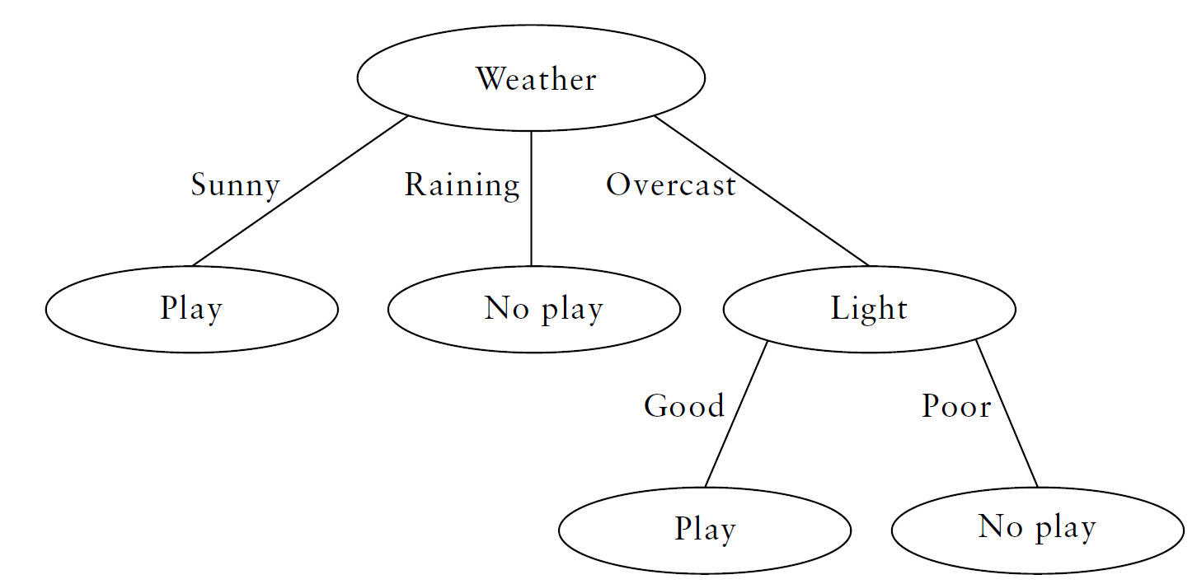
Decision trees
branch
leaf
Intelligent bioinformatics The application of artificial intelligence techniques to bioinformatics problems, Keedwell

Slide 7
Supervised
Used both for
classification – classification tree
regression – regression tree
Advantages
computationally undemanding
clear, explicit reasoning, sets of rules
accurate, robust in the face of noise

Slide 8
How to split the data so that each subset in the data uniquely identifies a class in the data?
Perform different tests
i.e. split the data in subsets according to the value of different attributes
Measure the effectiveness of the tests to choose the best one.
Information based criteria are commonly used.

Slide 9
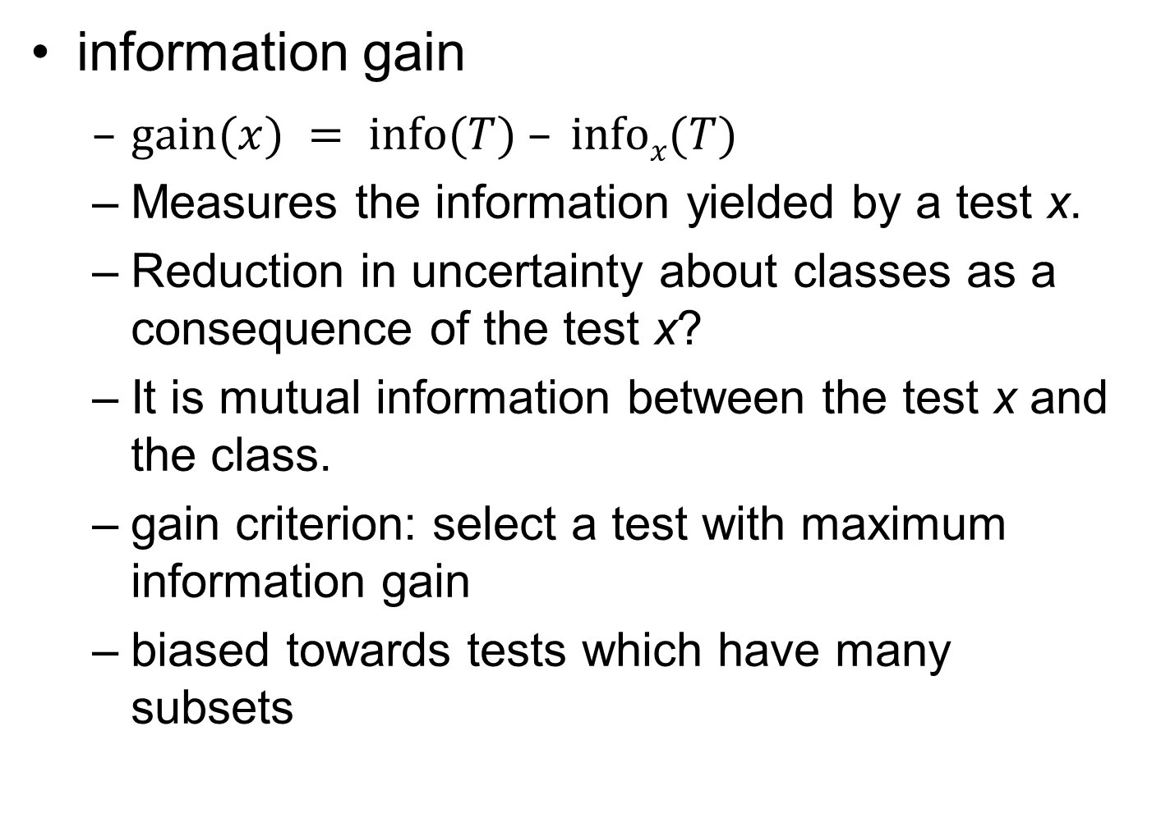
information gain
$gain(x) = info(T) – infox(T)$
Measures the information yielded by a test x.
Reduction in uncertainty about classes as a consequence of the test x?
It is mutual information between the test x and the class.
gain criterion: select a test with maximum information gain
biased towards tests which have many subsets

Slide 10
New stuff

Slide 11
Gain ratio
Gain criterion is biased towards tests which have many subsets.
Revised gain measure taking into account the size of the subsets created by test is called a gain ratio.

Slide 12
J. Ross Quinlan, C4.5: Programs for machine learning (book)
“In my experience, the gain ratio criterion is robust and typically gives a consistently better choice of test than the gain criterion”.
However, Mingers J.¹ finds that though gain ratio leads to smaller trees (which is good), it has tendency to favor unbalanced splits in which one subset is much smaller than the others.
¹ Mingers J., ”An empirical comparison of selection measures for decision-tree induction.”, Machine Learning 3(4), 319-342, 1989

Slide 13
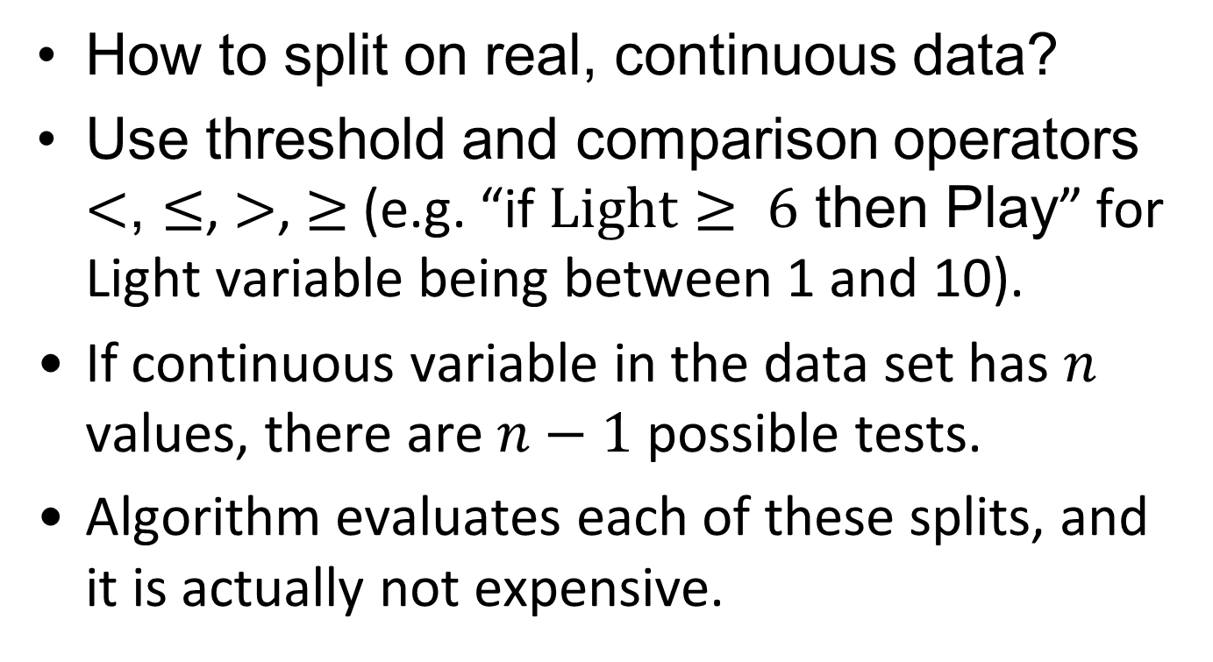
Continuous data
How to split on real, continuous data?
Use threshold and comparison operators $<$, $≤$, $>$, $≥$ (e.g. “if $Light≥ 6$ then Play” for Light variable being between 1 and 10).
If continuous variable in the data set has $n$ values, there are $n−1$ possible tests.
Algorithm evaluates each of these splits, and it is actually not expensive.

Slide 14
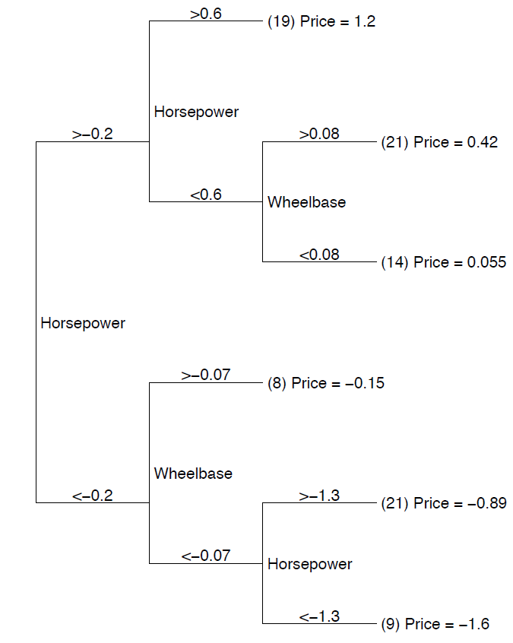
Regression tree
Regression tree for predicting price of 1993-model cars.
All features have been standardized to have zero mean and unit variance.
The R² of the tree is 0.85, which is significantly higher than that
of a multiple linear regression fit to the same data (R² = 0.8)

Slide 15
Pruning
Decision tree overfits, i.e. it learns to reproduce training data exactly.
Strategy to prevent overfitting – pruning:
Build the whole tree.
Prune the tree back, so that complex branches are consolidated into smaller (less accurate on the training data) sub-branches.
Pruning method uses some estimate of the expected error.
Notes:
- prune - prorezavat

Slide 16
Algorithms, programs
ID3, C4.5, C5.0(Linux)/See5(Win) (Ross Quinlan)
Only classification
ID3
uses information gain
C4.5
extension of ID3
Improvements from ID3
Handling both continuous and discrete attributes (threshold)
Handling training data with missing attribute values
Pruning trees after creation
C5.0/See5
Improvements from C4.5 (for comparison see http://www.rulequest.com/see5-comparison.html)
Speed
Memory usage
Smaller decision trees

Slide 17
CART (Leo Breiman)
Classification and Regression Trees
only binary splits
splitting criterion – Gini impurity (index)
not based on information theory
Both C4.5 and CART are robust tools
No method is always superior – experiment!
Not binary

Slide 18
Support Vector Machine (SVM)

Slide 19
supervised binary classifier (SVM)
also works for regression (SVMR)
two main ingrediences:
maximum margin
kernel functions

Slide 20
Linear classification methods
Decision boundaries are linear.
Two class problem
The decision boundary between the two classes is a hyperplane (line, plane) in the feature vector space.

Slide 21

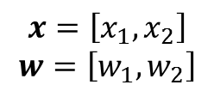

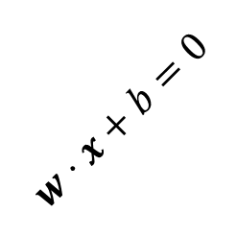

Linear classifiers
$$y_{i}=sign(w⋅x+b)$$
denotes +1
denotes -1
$$w⋅x+b>0$$
x₂
$$w⋅x+b=0$$
How would you classify this data?
$$x=\left[x_{1},x_{2}\right]$$
$$w=\left[w_{1},w_{2}\right]$$
$$w⋅x+b<0$$
x₁

Slide 22
Linear classifiers
denotes +1
denotes -1
Any of these would be fine..
..but which is best?

Slide 23
Linear classifiers
denotes +1
denotes -1
How would you classify this data?
Misclassified
to +1 class

Slide 24
Linear classifiers
denotes +1
denotes -1
Define the margin of a linear classifier as the width that the boundary could be increased by before hitting a datapoint.

Slide 25
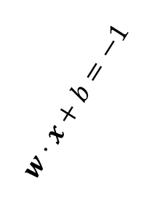
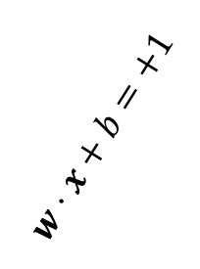
Linear classifiers
$$w⋅x+b=+1$$
denotes +1
denotes -1
$$w⋅x+b=−1$$
Support Vectors are the datapoints that the margin pushes up against
The maximum margin linear classifier is the linear classifier with the, um, maximum margin.
This is the simplest kind of SVM (called an LSVM)
Linear SVM

Slide 26
Why maximum margin?
Intuitively this feels safest.
Small error in the location of boundary – least chance of misclassification.
LOOCV is easy, the model is immune to removal of any non-support-vector data point.
Only support vectors are important !
Also theoretically well justified (statistical learning theory).
Empirically it works very, very well.

Slide 27
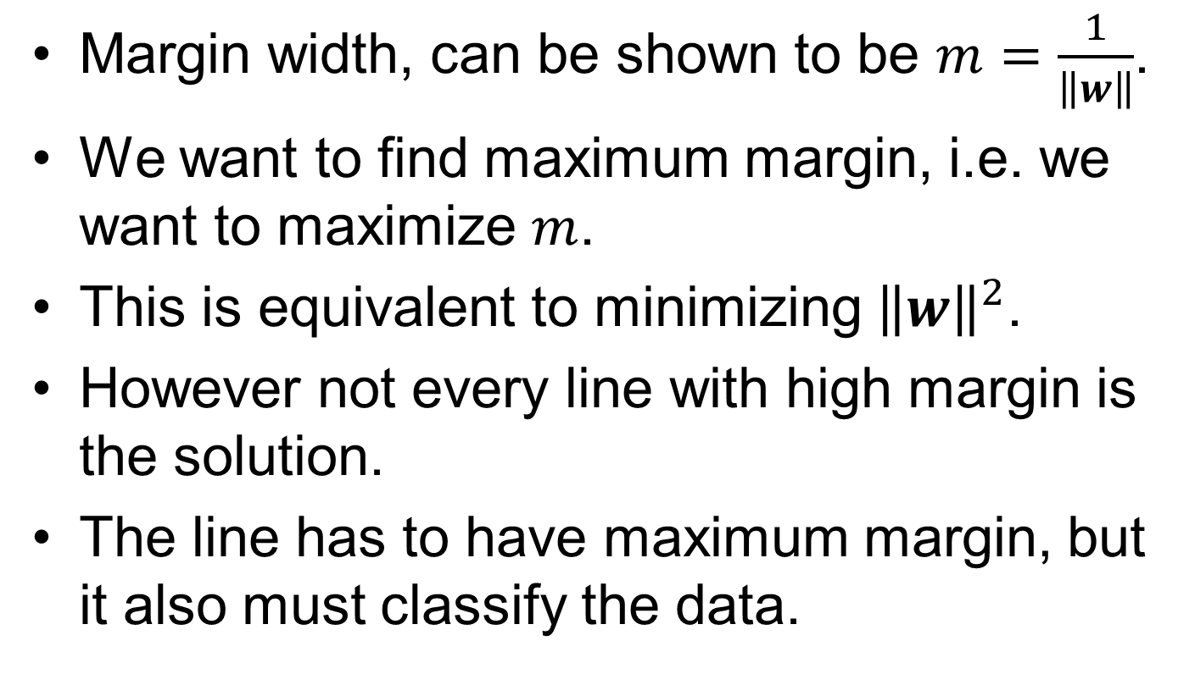
How to find a margin?
Margin width, can be shown to be $m=\frac{1}{\left\|w\right\|}$.
We want to find maximum margin, i.e. we want to maximize $m$.
This is equivalent to minimizing ${\left\|w\right\|}^{2}$.
However not every line with high margin is the solution.
The line has to have maximum margin, but it also must classify the data.

Slide 28
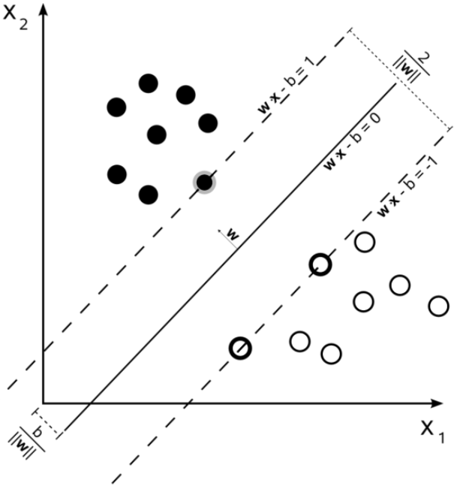

Slide 29
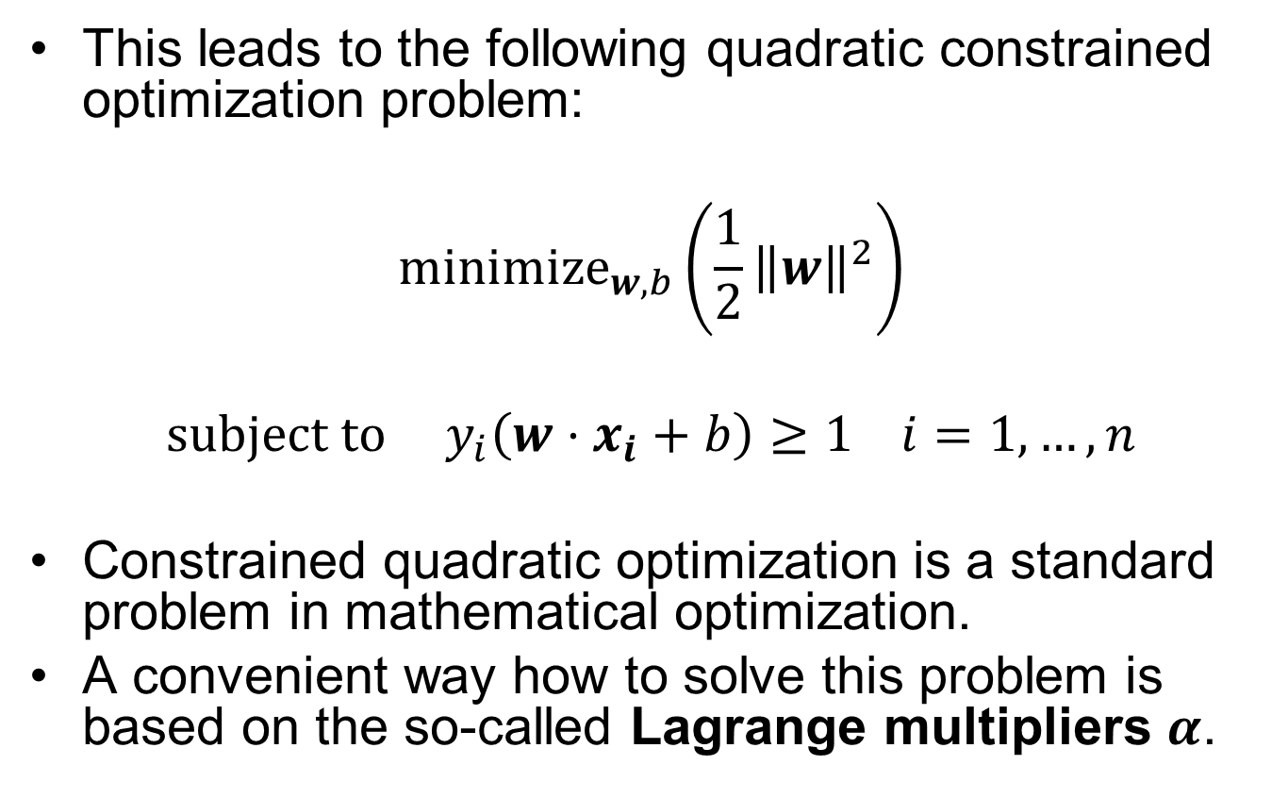
Quadratic constrained optimization
This leads to the following quadratic constrained optimization problem:
$$minimize_{w, b}\left(\frac{1}{2}{\left\|w\right\|}^{2}\right)$$
$$subject to y_{i}\left(w⋅x_{i}+b\right)≥1 i=1,…,n$$
Constrained quadratic optimization is a standard problem in mathematical optimization.
A convenient way how to solve this problem is based on the so-called Lagrange multipliers $α$.
Notes:
- $y_{i}\left(w⋅x_{i}+b\right)≥1$ because we want to prevent data points from falling into the margin

Slide 30
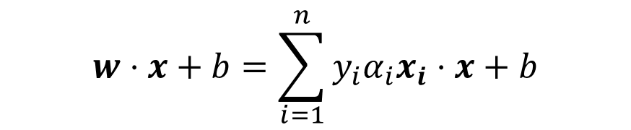
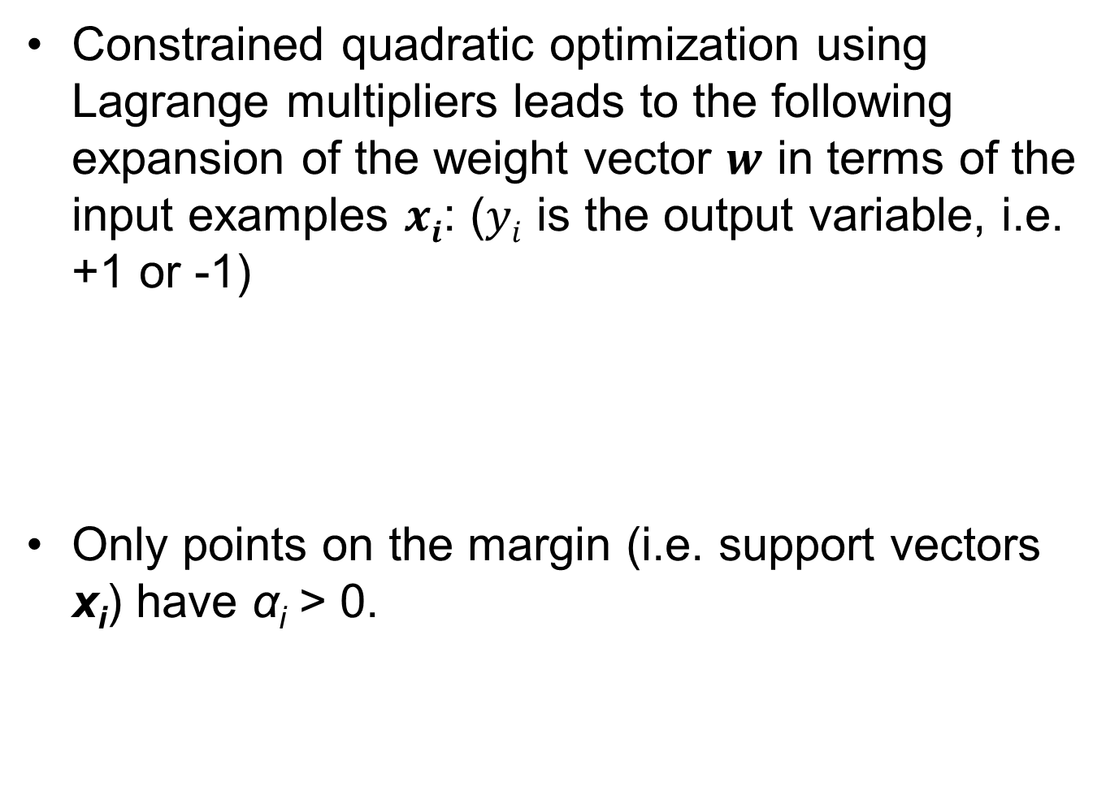


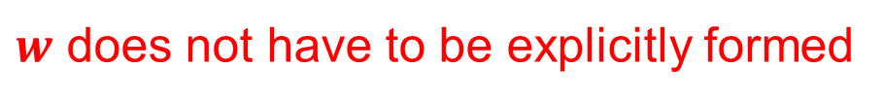
$$y_{i}=sign(w⋅x+b)$$
Constrained quadratic optimization using Lagrange multipliers leads to the following expansion of the weight vector $w$ in terms of the input examples $xi$: ($yi$ is the output variable, i.e. +1 or -1)
Only points on the margin (i.e. support vectors x_{i}) have α_{i} > 0.
$$w=\sum_{i=1}^{n}{y_{i}α_{i}x_{i}}$$
$$w⋅x+b=\sum_{i=1}^{n}{y_{i}α_{i}x_{i}⋅x+b}$$
$w$ does not have to be explicitly formed
dot product

Slide 31
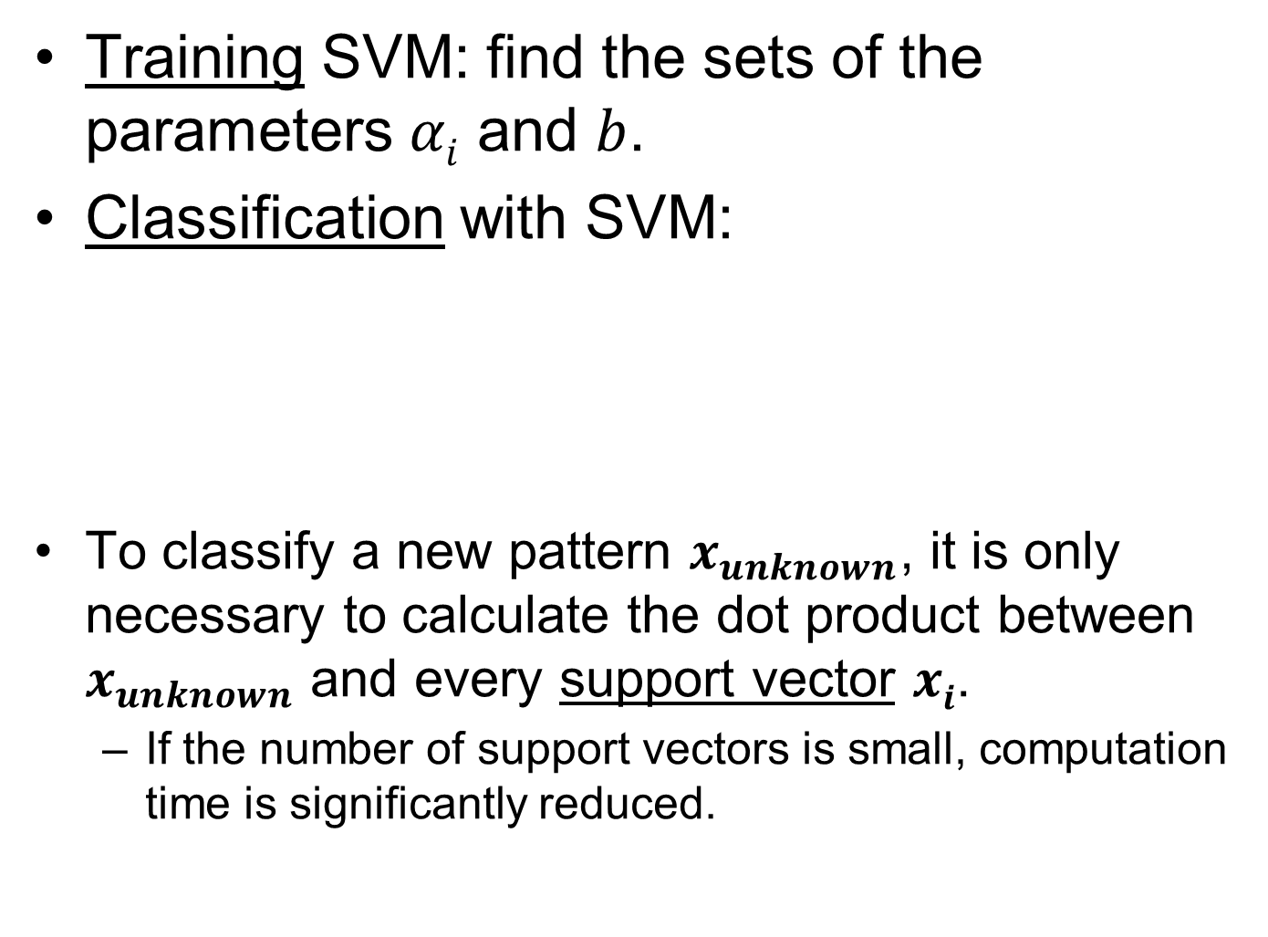
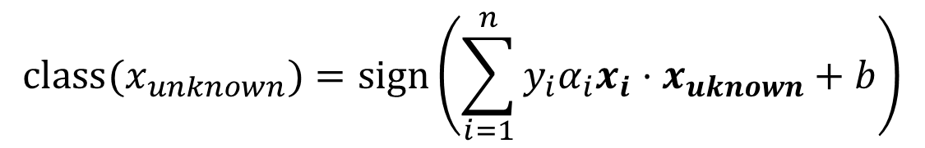
Training SVM: find the sets of the parameters $αi$ and $b$.
Classification with SVM:
To classify a new pattern $x_{unknown}$, it is only necessary to calculate the dot product between $x_{unknown}$ and every support vector $xi$.
If the number of support vectors is small, computation time is significantly reduced.
$$class(x_{unknown})=sign\left(\sum_{i=1}^{n}{y_{i}α_{i}x_{i}⋅x_{uknown}+b}\right)$$
Notes:
- As the separation hyperplane is determined only by support vectors, the elimination of patterns that are supposed not to be support vectors accelerates the training phase.

Slide 32
Soft margin
The above described margin is usually refered to as hard margin.
What if the data are not 100% linearly separable?
We allow error ξ_{i} in the classification.

Slide 33

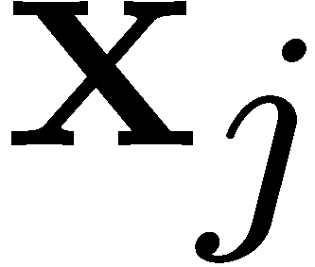
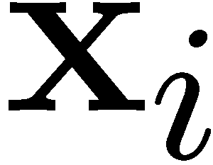

Soft margin

Slide 34
Soft margin
And we introduced capacity parameter C - trade-off between error and margin.
C is adjusted by the user
large C – a high penalty to classification errors, the number of misclassified patterns is minimized (i.e. hard margin).
Decrease in C: points move inside margin.
Data dependent, good value to start with is 100

Slide 35
Kernel Functions

Slide 36
Linear classifiers have advantages, one of them being that they often have simple training algorithms that scale linearly with the number of examples.
What to do if the classification boundary is non-linear?
Can we propose an approach generating non-linear classification boundary just by extending the linear classifier machinery?
Of course we can. Otherwise I wouldn’t ask.

Slide 37


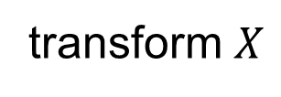
$$X$$
transform $X$
$$X$$

Slide 38
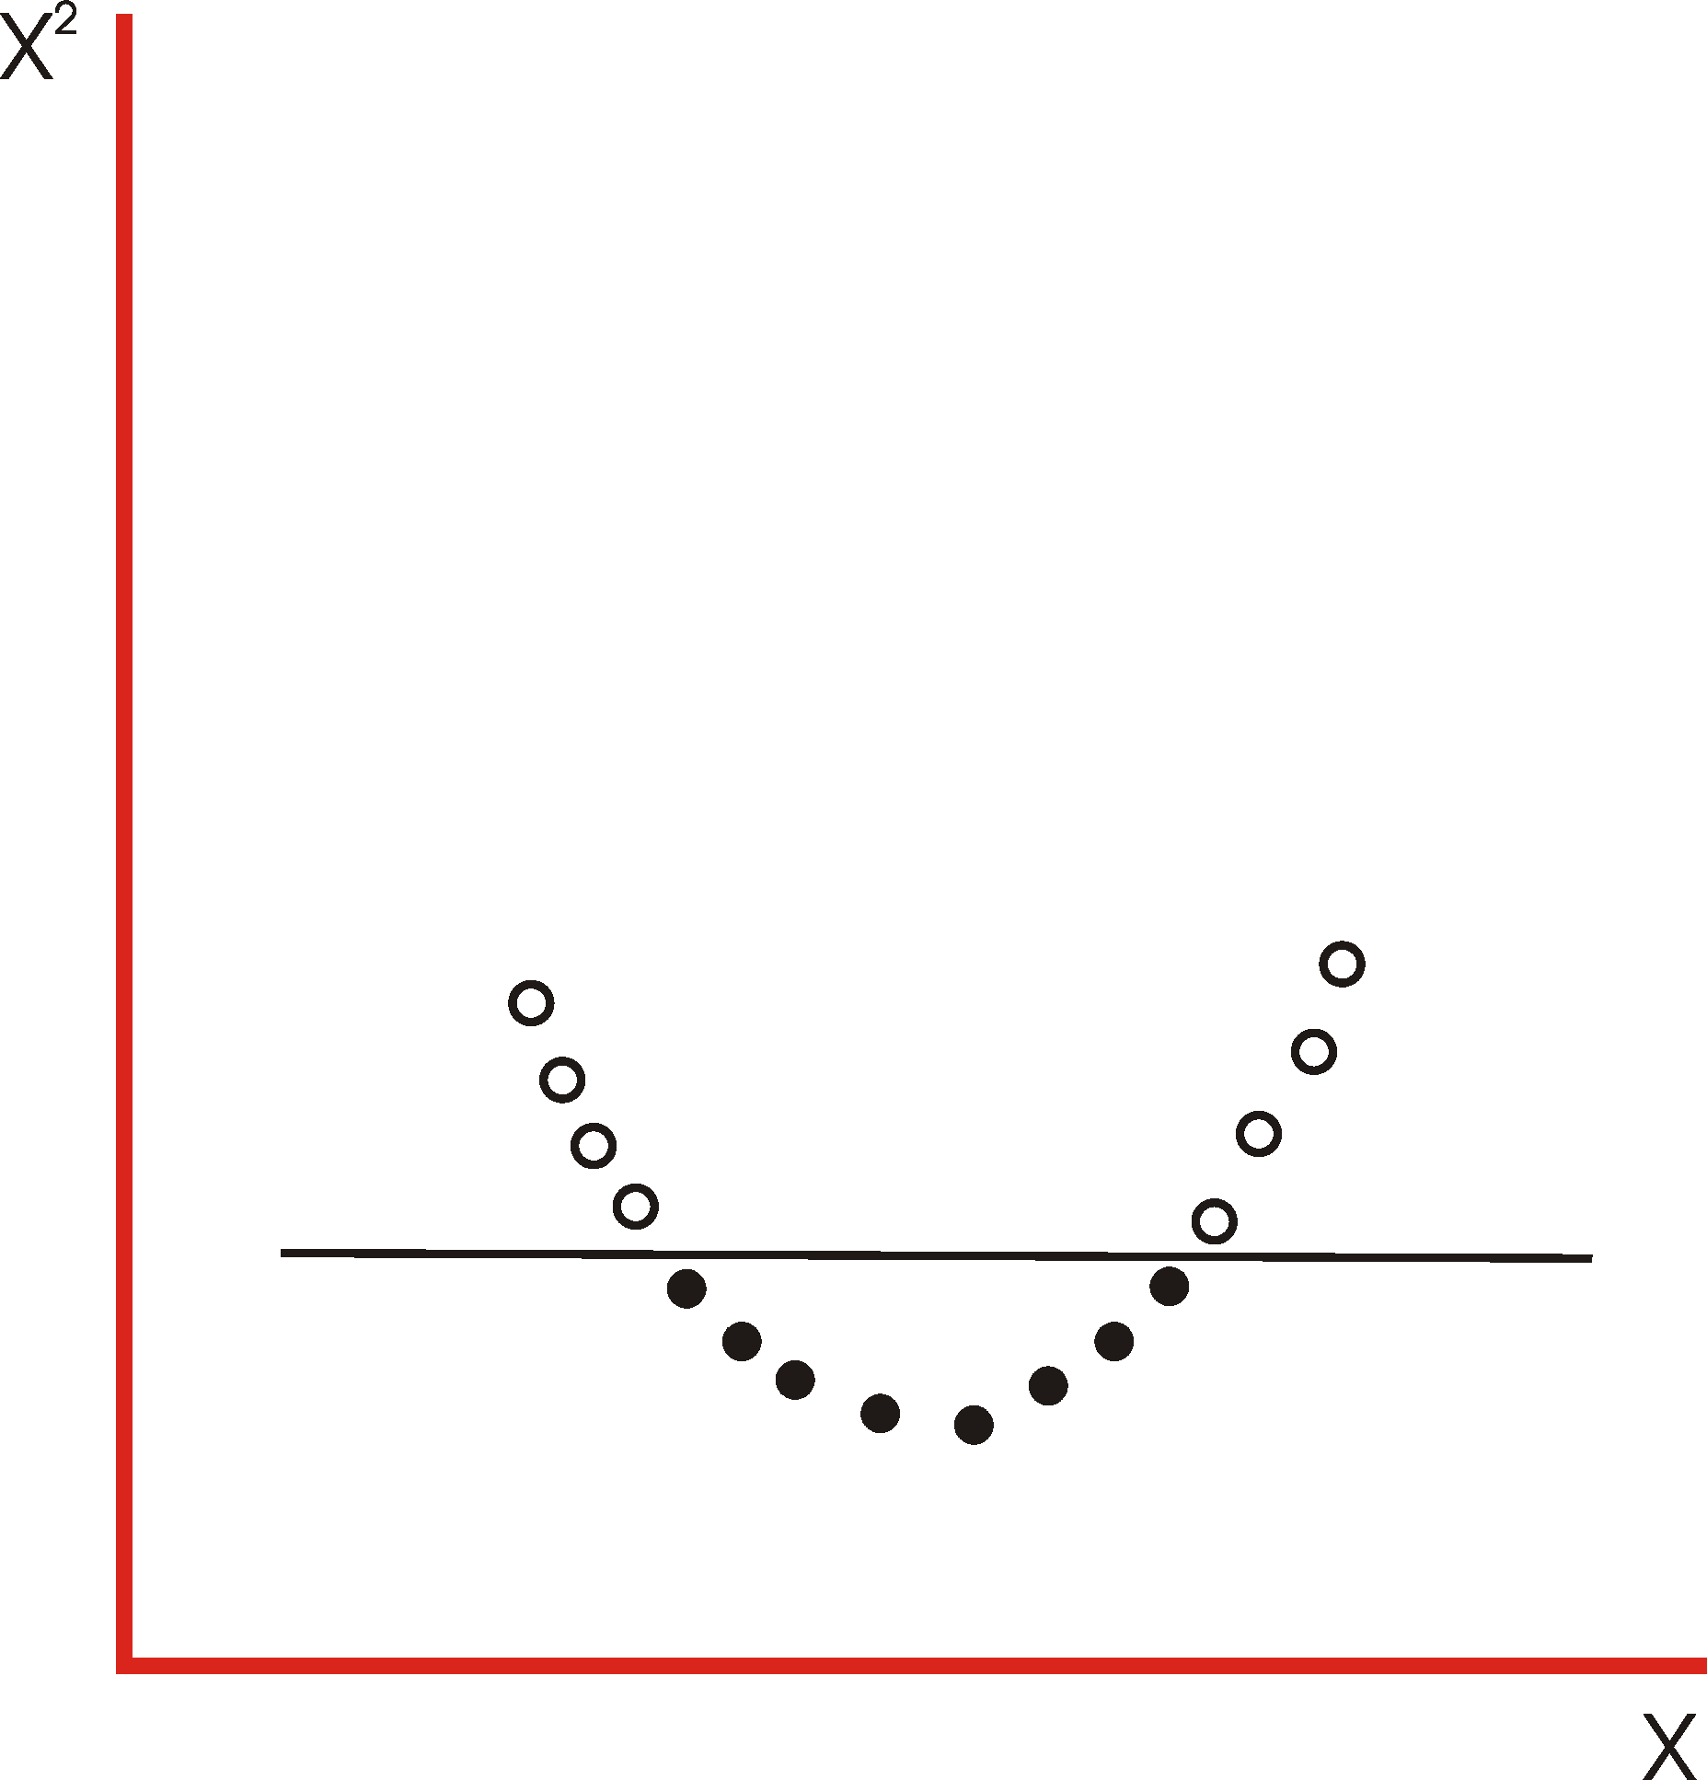

Slide 39
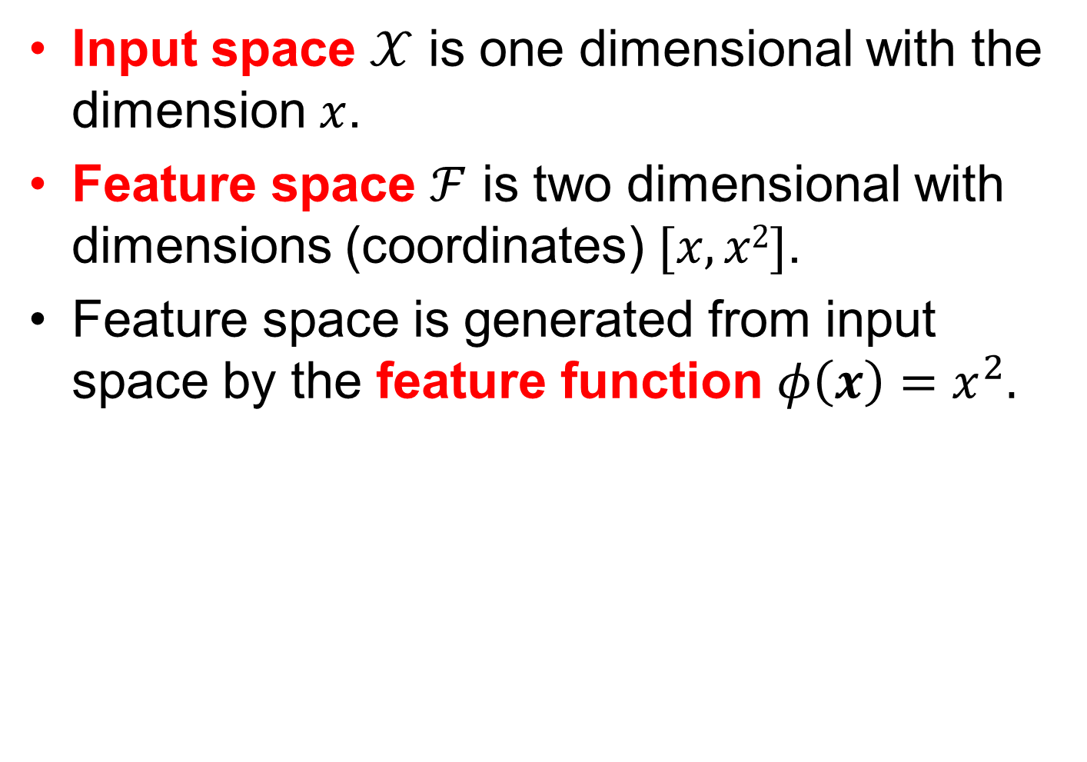
Input space $𝒳$ is one dimensional with the dimension $x$.
Feature space $ℱ$ is two dimensional with dimensions (coordinates) $[x, x2]$.
Feature space is generated from input space by the feature function $φ\left(x\right)=x^{2}.$
X²

Slide 40
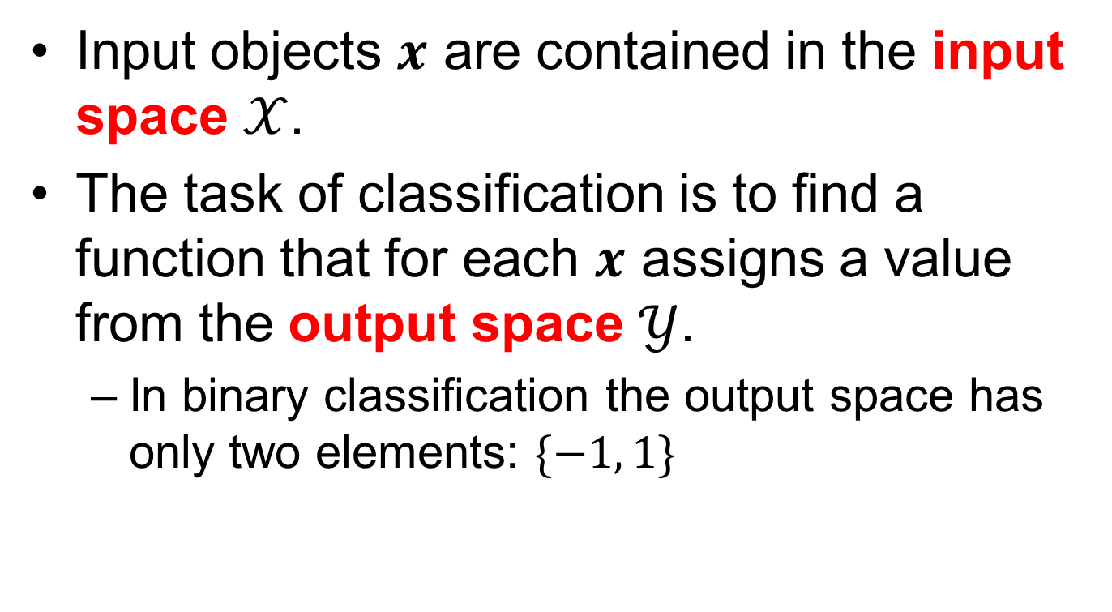
Nomenclature
Input objects $x$ are contained in the input space $𝒳$.
The task of classification is to find a function that for each $x$ assigns a value from the output space $𝒴$.
In binary classification the output space has only two elements: $\{−1, 1\}$

Slide 41
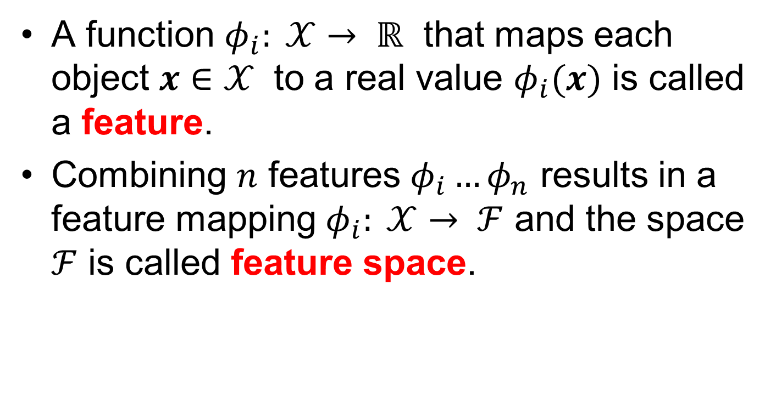
Nomenclature contd.
A function $φ_{i}: 𝒳→ ℝ$ that maps each object $x∈𝒳$ to a real value $φ_{i}(x)$ is called a feature.
Combining $n$ features $φ_{i}…φ_{n}$ results in a feature mapping $φ_{i}: 𝒳→ ℱ$ and the space $ℱ$ is called feature space.

Slide 42
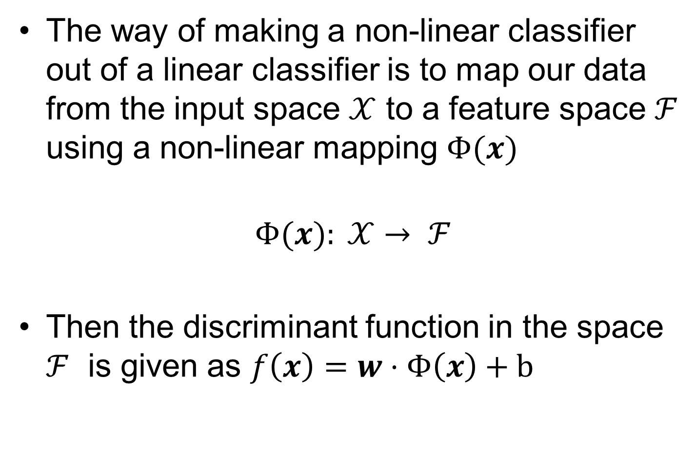
The way of making a non-linear classifier out of a linear classifier is to map our data from the input space $𝒳$ to a feature space $ℱ$ using a non-linear mapping $Φ(x)$
$$Φ(x): 𝒳→ ℱ$$
Then the discriminant function in the space $ℱ$ is given as $f\left(x\right)=w⋅Φ\left(x\right)+b$

Slide 43
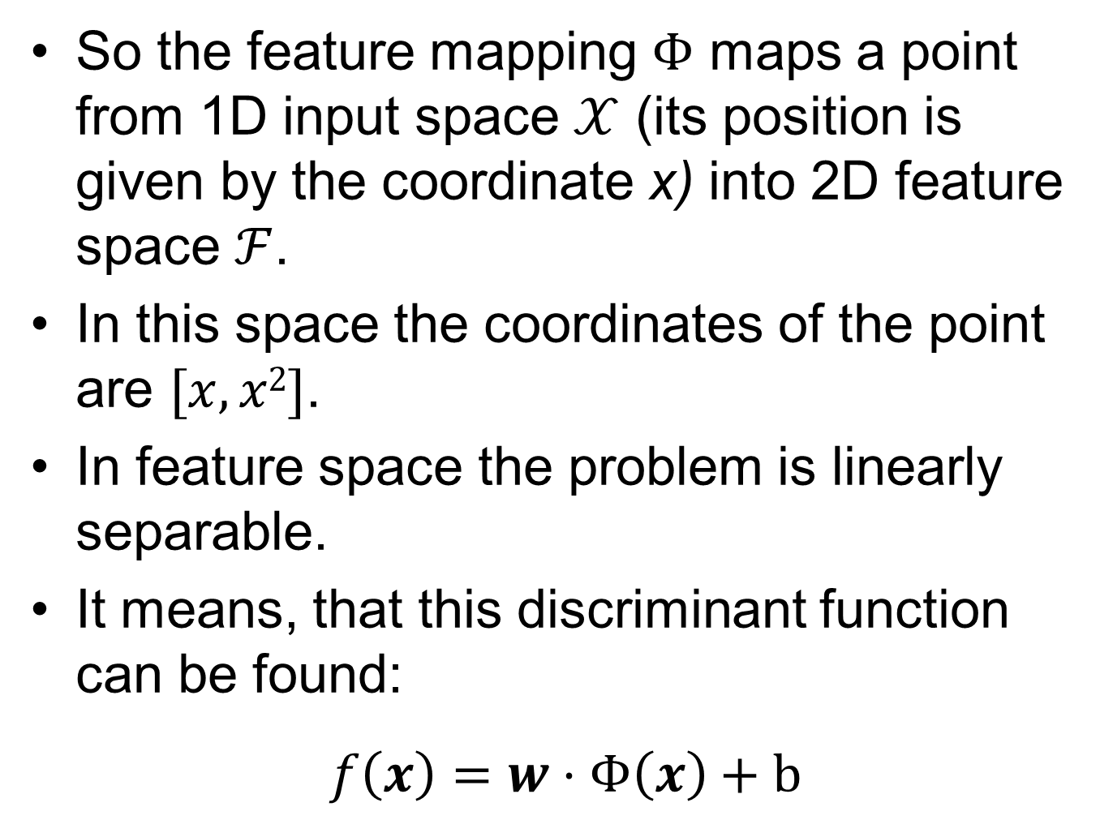
So the feature mapping $Φ$ maps a point from 1D input space $𝒳$ (its position is given by the coordinate x) into 2D feature space $ℱ$.
In this space the coordinates of the point are $[x, x2]$.
In feature space the problem is linearly separable.
It means, that this discriminant function can be found:
$$f\left(x\right)=w⋅Φ\left(x\right)+b$$

Slide 44
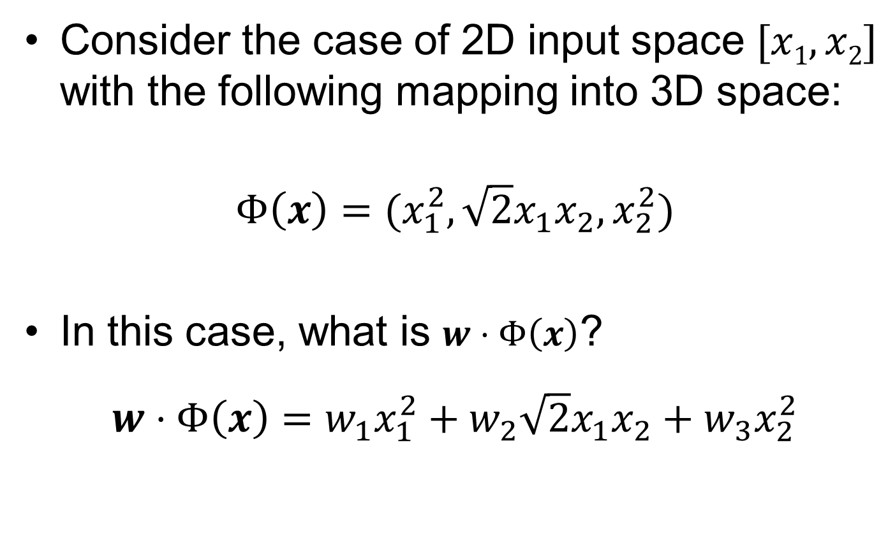


Example
Consider the case of 2D input space $[x1, x2]$ with the following mapping into 3D space:
$$Φ\left(x\right)={(x}_{1}^{2},\sqrt{2}x_{1}x_{2}, x_{2}^{2})$$
In this case, what is $w⋅Φ\left(x\right)$?
$$w⋅Φ\left(x\right)=w_{1}x_{1}^{2}+w_{2}\sqrt{2}x_{1}x_{2}+w_{3}x_{2}^{2}$$
features $φ_{i}$
$$f\left(x\right)=w⋅Φ\left(x\right)+b$$

Slide 45
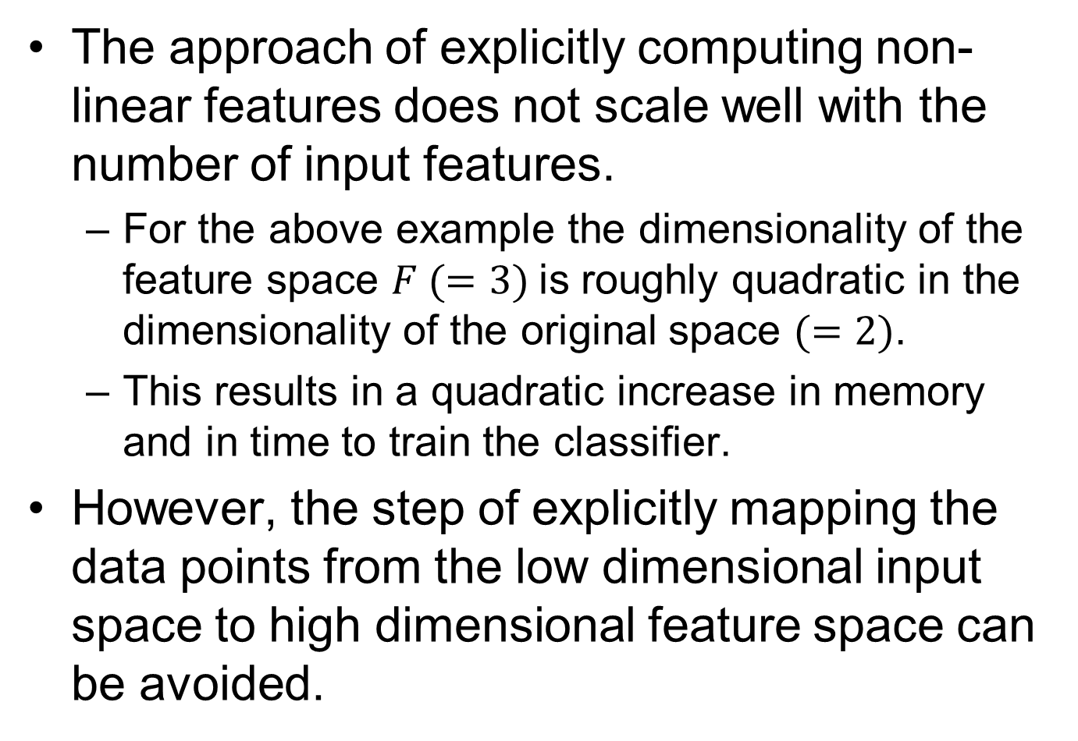
The approach of explicitly computing non-linear features does not scale well with the number of input features.
For the above example the dimensionality of the feature space $F (=3)$is roughly quadratic in the dimensionality of the original space $(=2)$.
This results in a quadratic increase in memory and in time to train the classifier.
However, the step of explicitly mapping the data points from the low dimensional input space to high dimensional feature space can be avoided.

Slide 46
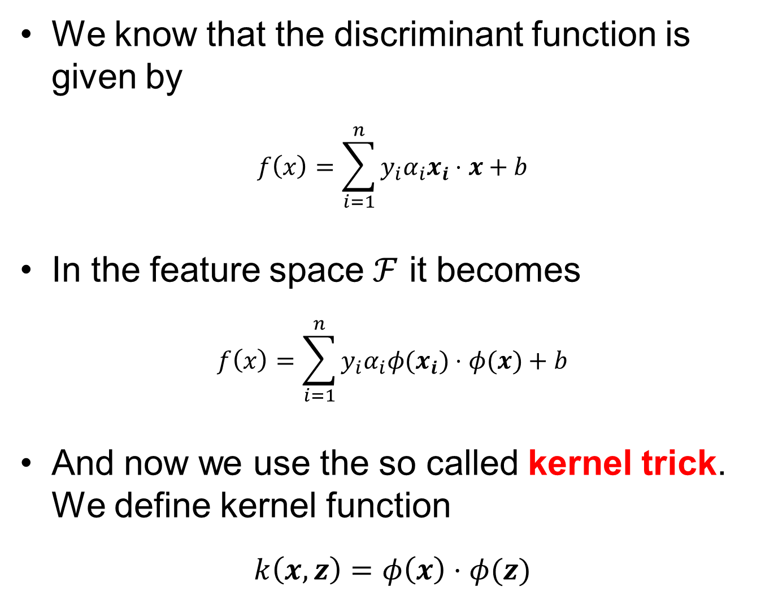
We know that the discriminant function is given by
$$f\left(x\right)=\sum_{i=1}^{n}{y_{i}α_{i}x_{i}⋅x+b}$$
In the feature space $ℱ$ it becomes
$$f\left(x\right)=\sum_{i=1}^{n}{y_{i}α_{i}{φ(x}_{i})⋅φ(x)+b}$$
And now we use the so called kernel trick. We define kernel function
$$k\left(x,z\right)=φ\left(x\right)⋅φ(z)$$

Slide 47

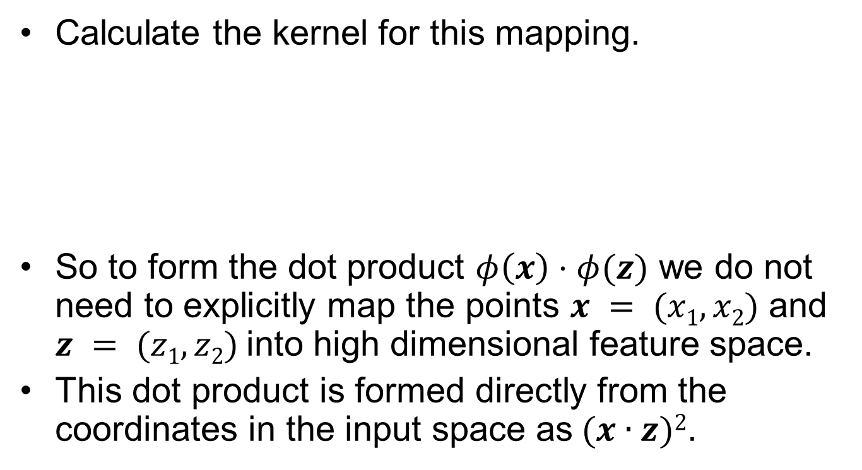

Example
$$φ\left(x\right)=(x_{1}^{2},\sqrt{2}x_{1}x_{2},x_{2}^{2})$$
$$k\left(x,z\right)=φ\left(x\right)⋅φ(z)$$
Calculate the kernel for this mapping.
So to form the dot product $φ\left(x\right)⋅φ(z)$ we do not need to explicitly map the points $x = (x1, x2)$ and $z = (z1, z2)$into high dimensional feature space.
This dot product is formed directly from the coordinates in the input space as$(x∙z)2$.
$$k\left(x,z\right)=φ\left(x\right)⋅φ\left(z\right)=\left[x_{1}^{2},\sqrt{2}x_{1}x_{2},x_{2}^{2}\right]⋅\left[z_{1}^{2},\sqrt{2}z_{1}z_{2},z_{2}^{2}\right]=$$
$${ x}_{1}^{2}z_{1}^{2}+2x_{1}x_{2}z_{1}z_{2}+x_{2}^{2}z_{2}^{2}={\left(x_{1}z_{1}+x_{2}z_{2}\right)}^{2}={\left(x⋅z\right)}^{2}$$

Slide 48
Kernels
Linear (dot) kernel
This is linear classifier, use it as a test of non-linearity.
Or as a reference for the classification improvement with non-linear kernels.
Polynomial
simple, efficient for non-linear relationships
d – degree, high d leads to overfitting

Slide 49
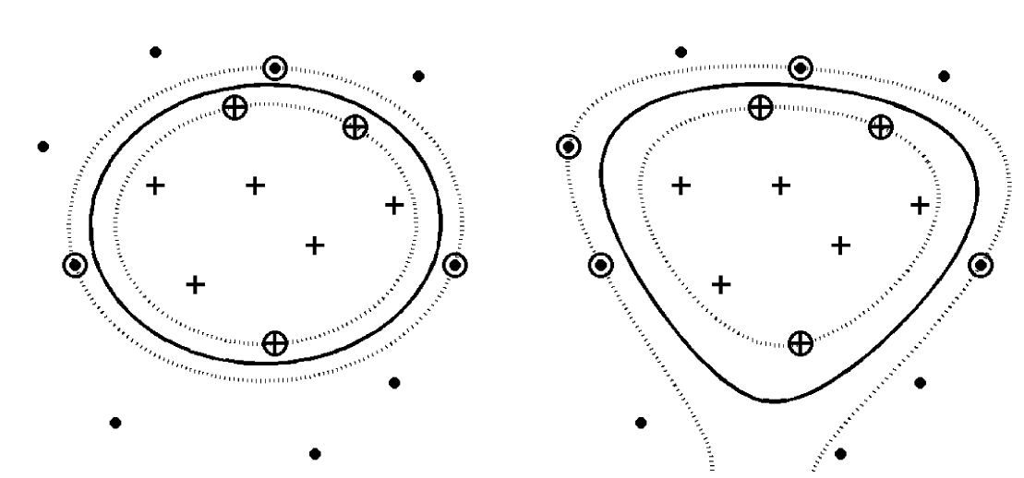
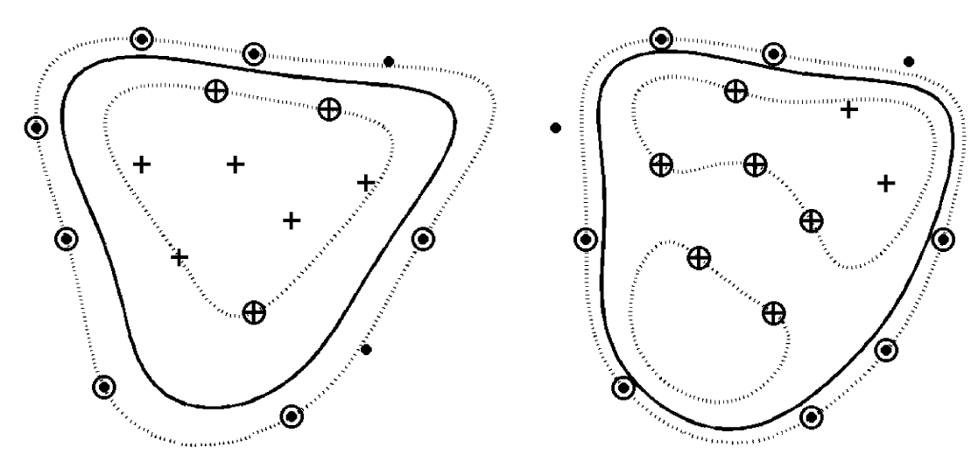
Polynomial kernel
O. Ivanciuc, Applications of SVM in Chemistry, In: Reviews in Comp. Chem. Vol 23
d = 2
d = 5
d = 3
d = 10
Notes:
- The downside of using polynomial kernels is the overfitting that might appear when the degree increases. As the degree of the polynomial increases, the classification surface becomes more complex. For the degree 10 polynomial, one can see that the border hypersurface defines two regions for the cluster of +1 patterns.

Slide 50
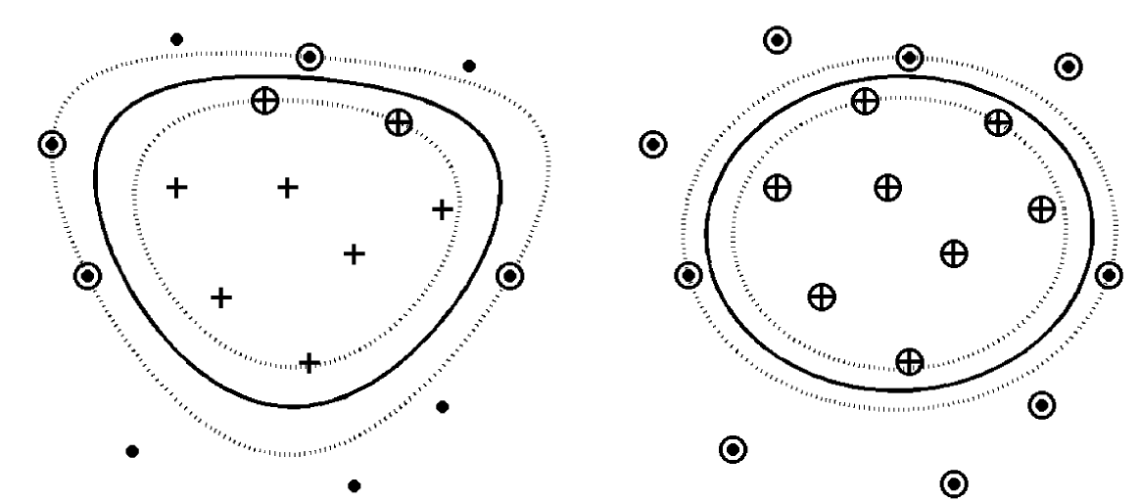
Gaussian RBF Kernel
σ = 1
σ = 10
O. Ivanciuc, Applications of SVM in Chemistry, In: Reviews in Comp. Chem. Vol 23
Notes:
- The number of support vectors increases from 6 to 17, showing that the second setting does not generalize well.

Slide 51
Kernel functions exist also for inputs that are not vectors:
sequential data (characters from the given alphabet)
data in the form of graphs
It is possible to prove that for any given data set there exists a kernel function imposing linear separability !
So why not always project data to higher dimension (avoiding soft margin)?
Because of the curse of dimensionality.

Slide 52
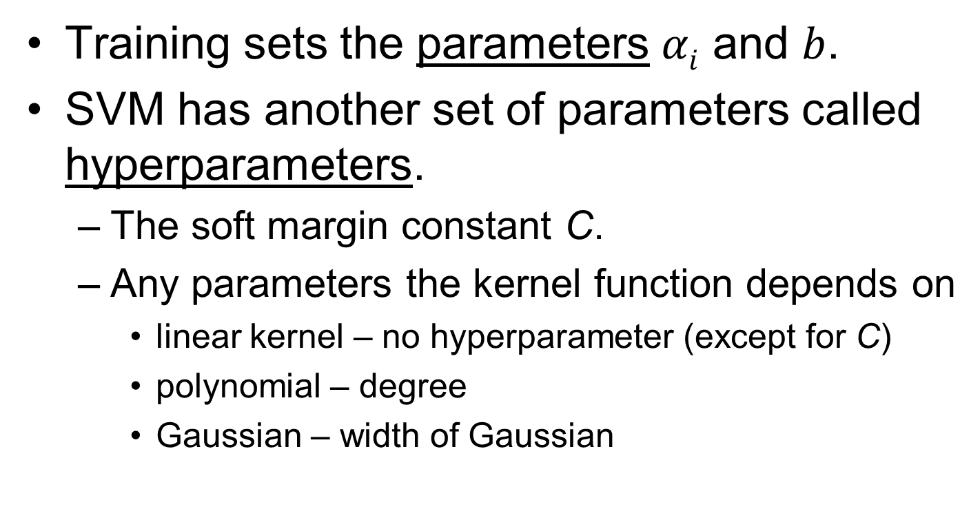
SVM parameters
Training sets the parameters $αi$ and $b$.
SVM has another set of parameters called hyperparameters.
The soft margin constant C.
Any parameters the kernel function depends on
linear kernel – no hyperparameter (except for C)
polynomial – degree
Gaussian – width of Gaussian

Slide 53
So which kernel and which parameters should I use?
The answer is data-dependent.
Several kernels should be tried.
Try linear kernel first and then see, if the classification can be improved with nonlinear kernels (tradeoff between quality of the kernel and the number of dimensions).
Select kernel + parameters + C by crossvalidation.

Slide 54
Computational aspects
Classification of new samples is very quick, training is longer (reasonably fast for thousands of samples).
Linear kernel – scales linearly.
Nonlinear kernels – scale quadratically.

Slide 55
Multiclass SVM
SVM is defined for binary classification.
How to predict more than two classes (multiclass)?
Simplest approach: decompose the multiclass problem into several binary problems and train several binary SVM’s.

Slide 56
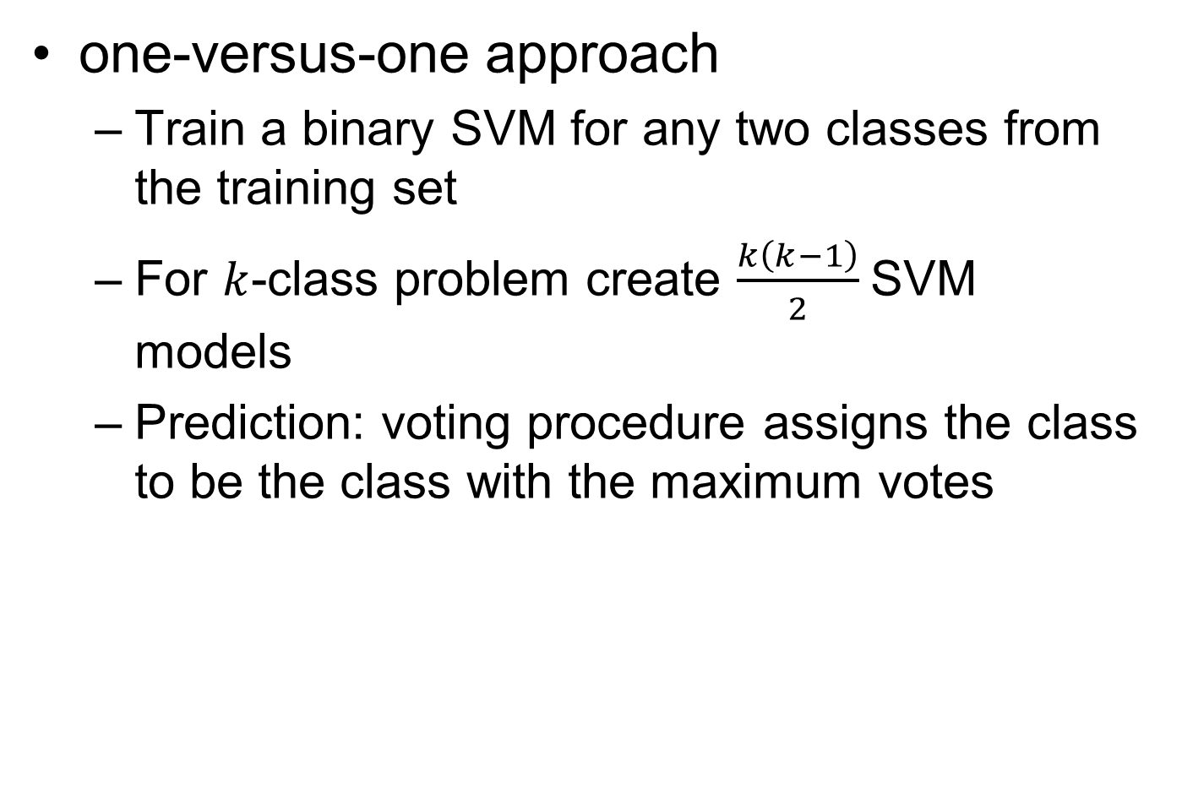
one-versus-one approach
Train a binary SVM for any two classes from the training set
For $k$-class problem create $\frac{k\left(k−1\right)}{2}$SVM models
Prediction: voting procedure assigns the class to be the class with the maximum votes
1/2
1/3
1/4
2/3
2/4
3/4
1
3
1
4
1
4
1

Slide 57
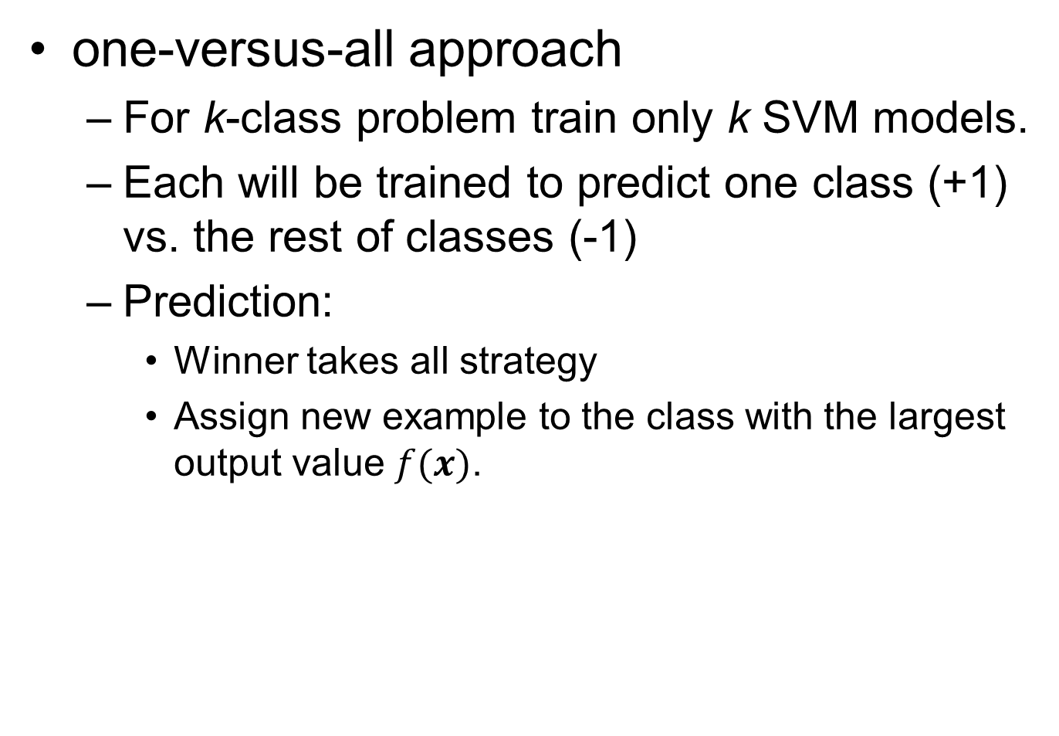
one-versus-all approach
For k-class problem train only k SVM models.
Each will be trained to predict one class (+1) vs. the rest of classes (-1)
Prediction:
Winner takes all strategy
Assign new example to the class with the largest output value $f(x)$.
1/rest
2/rest
3/rest
4/rest

Slide 58
Resources
SVM and Kernels for Comput. Biol., Ratsch et al., PLOS Comput. Biol., 4 (10), 1-10, 2008
What is a support vector machine, W. S. Noble, Nature Biotechnology, 24 (12), 1565-1567, 2006
A tutorial on SVM for pattern recognition, C. J. C. Burges, Data Mining and Knowledge Discovery, 2, 121-167, 1998
A User’s Guide to Support Vector Machines, Asa Ben-Hur, Jason Weston

Slide 59
http://support-vector-machines.org/
http://www.kernel-machines.org/
http://www.support-vector.net/
companion to the book An Introduction to Support Vector Machines by Cristianini and Shawe-Taylor
http://www.kernel-methods.net/
companion to the book Kernel Methods for Pattern Analysis by Shawe-Taylor and Cristianini
http://www.learning-with-kernels.org/
Several chapters on SVM from the book Learning with Kernels by Scholkopf and Smola are available from this site

Slide 60
Software
SVM^{light} – one of the most widely used SVM package. fast optimization, can handle very large datasets, very efficient implementation of the leave–one–out cross-validation, C++ code
SVM^{struct} - can model complex data, such as trees, sequences, or sets
LIBSVM – multiclass, weighted SVM for unbalanced data, cross-validation, automatic model selection, C++, Java

Slide 62
Examples of Kernel Functions
Linear: K(x_{i},x_{j})= x_{i}^{T}x_{j}
Mapping Φ: x → φ(x), where φ(x) is x itself
Polynomial of power p: K(x_{i},x_{j})= (1+ x_{i}^{T}x_{j})^{p}
Mapping Φ: x → φ(x), where φ(x) has dimensions
Gaussian (radial-basis function): K(x_{i},x_{j}) =
Mapping Φ: x → φ(x), where φ(x) is infinite-dimensional: every point is mapped to a function (a Gaussian); combination of functions for support vectors is the separator.
Higher-dimensional space still has intrinsic dimensionality d (the mapping is not onto), but linear separators in it correspond to non-linear separators in original space.

Slide 63
Training a linear SVM
To find the maximum margin separator, we have to solve the following optimization problem:
This is tricky but it’s a convex problem. There is only one optimum and we can find it without fiddling with learning rates or weight decay or early stopping.
Don’t worry about the optimization problem. It has been solved. Its called quadratic programming.
It takes time proportional to N^2 which is really bad for very big datasets
so for big datasets we end up doing approximate optimization!

Slide 64
Introducing slack variables
Slack variables are constrained to be non-negative. When they are greater than zero they allow us to cheat by putting the plane closer to the datapoint than the margin. So we need to minimize the amount of cheating. This means we have to pick a value for lamba (this sounds familiar!)

Slide 65
Performance
Support Vector Machines work very well in practice.
The user must choose the kernel function and its parameters, but the rest is automatic.
The test performance is very good.
They can be expensive in time and space for big datasets
The computation of the maximum-margin hyper-plane depends on the square of the number of training cases.
We need to store all the support vectors.
SVM’s are very good if you have no idea about what structure to impose on the task.
The kernel trick can also be used to do PCA in a much higher-dimensional space, thus giving a non-linear version of PCA in the original space.

Slide 66
Support Vector Machines are Perceptrons!
SVM’s use each training case, x, to define a feature K(x, .) where K is chosen by the user.
So the user designs the features.
Then they do “feature selection” by picking the support vectors, and they learn how to weight the features by solving a big optimization problem.
So an SVM is just a very clever way to train a standard perceptron.
All of the things that a perceptron cannot do cannot be done by SVM’s (but it’s a long time since 1969 so people have forgotten this).

