Slide 1
Openshift VMR Integration – PoC
Presenter Francois Dickey

Slide 2
Goals
Demonstrate a typical application deployment in Openshift.
Inspired from (https://github.com/openshift/nodejs-ex), which demonstrated the use of templates to deploy micro services from source code and configure them to connect together.
Based on OpenShift templates.
Sample cloud application was created by Mark S. to demonstrate the VMR in PCF. It can be applied in the context of other platform such as Openshift, so it was used for this demonstration. It is made of 2 micro services:
Aggregator - publish work to a Queue
Worker – Receive work from the Queue and process the work before consuming next message
The sample application’s template will deploy a VMR in Openshift as the sample application will depend on a VMR to function.

Slide 3
Technical Overview

Slide 4
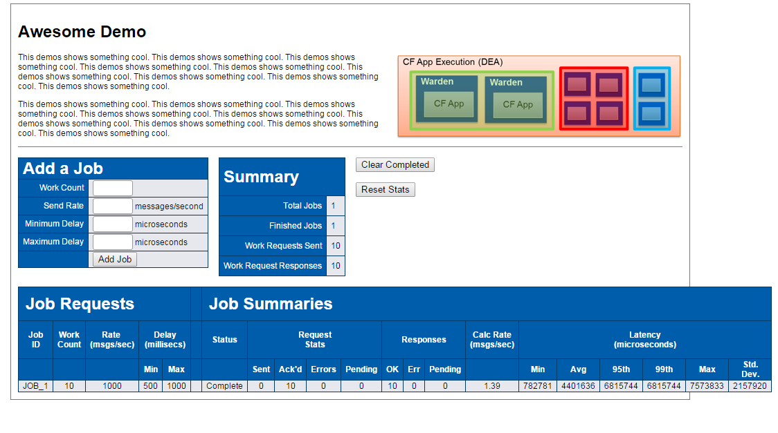







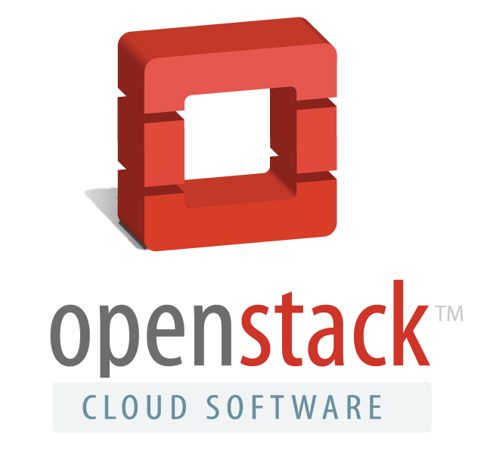

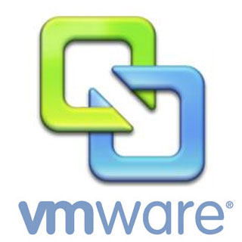
The big picture
Demo UI
OC Command Line
Tools
Master Nodes
Routing Layer
API Server
Openshift Node
Openshift Node
Build Controller
Pod
Pod
Pod
Pod
1
Application
Source
Code
Deployment
Controller
Aggregator
2
Authentication
3
Spring Cloud
3
Data Store
Scheduler
4
Management /
Replication
IaaS,
VMs, Baremetal

Slide 5
SCM (Git) and Continuous Integration
Aggregator and Worker source code is compiled into Docker images by Openshift.
Every time new images are built they get deployed, replacing older pods.
Concept of pipelines allows integration with external tools such as Jenkins.
S2I Image enforces a consistent build environment for everyone.
Great for DevOps
Watches
for change
BuildConfig
S2I Image
Pod (Short Lived)
Source Code
Snapshot
Build output
ImageStream
Git repo
Images
Maven
Gradle
Watches for
newer image
Git
Client
Open
JDK
DeploymentConfig
Pod
Deploys image
to a pod.
Pod Settings
Container Setting

Slide 6
Continous Integration with remote docker repository
VMR is pre-built, thus it doesn’t need a BuildConfig.
Instead VMR would be available on a Docker Repository, external to the Openshift deployment.
The ImageStream for the VMR would be setup to use the VMR images in the External Repository as image source.
Whenever a newer version of the VMR becomes available on the external repository, a VMR upgrade will be triggered.
External Repository
Watches for
newer image
ImageStream
Image
Images
Watches for
newer image
DeploymentConfig
Deploys image
to a pod.
Pod Settings
Container Setting
Pod

Slide 7
Services
Pods uses dynamic IP addresses.
Pods can be replaced at any time by an equivalent Pod, which changes the IP addresses.
Thus it is not recommended to connect to a Pod’s IP directly as tracking the IP would be hard.
Instead, connections are made to a service, which then redirect traffic to pods providing the service.
Services enables anything that depends on it to refer to a consistent internal address
VMR could use a service per VMR for HA setup, and a messaging service for client applications.
Services also serves as a load balancer, as well as a fail-over proxy.
VMR-P
Service
VMR-B
Service
VMR-M
Service
eth0
Pod
eth0
eth0
Pod
Pod
Primary
Backup
Monitor
solace-messaging
Service
SMF client Hostlist = solace-messaging

Slide 8
Routes
Aggregator
Routes are used to expose HTTP services as a FQDN hostname.
The route is identified by the FQDN, and an HAProxy pod will reverse proxy connection made to the FQDN to the desired service.
Used for web application, REST endpoints and other HTTP based protocol (SEMPv1)
Spring Cloud
aggregator
Service
https://aggregator.<domain>
Route
Internal and External HTTP clients

Slide 9

Components View
veth
veth
veth
veth
veth
eth0
eth0
eth0
eth0
Pod
Pod
Pod
Pod
Pod
eth0
HAProxy
Aggregator
aggregator
route
Spring Cloud
User’s
Browser
Router
Service
Aggregator
Service
SMF
Service
Public IP
https://<route-fqdn>

Slide 10
Step by Step Instructions here : https://github.com/SolaceDev/openshift-messaging-demo
Demonstration Steps

Slide 11
Prerequisites
Must have access to an Openshift environment
Have a cluster admin privileges
Alternatively, ask someone to add those SCCs to your project’s service account: anyuid and privileged

Slide 12
Setup a new project
Create a new project (vmr-openshift-demo)
The project’s service account needs to be granted access to the privileged Security Context Constraints (SCC) and to the any anyuid SCC.
The VMR runs its processes as root, so the service account needs anyuid SCC to install the VMR pod.
The VMR requires privileged mode to use an external tmpfs mounted on /dev/shm.
The external /dev/shm is required because it’s the only way to give the VMR its 2 gigs of /dev/shm.

Slide 13
Upload the Docker image
The VMR Docker images needs to be made available to the Openshift project.
We can create an ImageStream that uses an external Docker repository as image source.
We can also load the tar.gz Docker container collateral from a local docker engine, and then push it to Openshift.
The latter is the fastest to achieve method today as we don’t have our Docker images hosted on a Docker repository yet.
For Openshift and many other similar platforms, it would be nice to have our Docker collateral hosted on our private Docker repository. That would be the prefered way.

Slide 14
Create the S2I (Source to Image) image stream
This demo requires the definition of BuildConfigs which will retrieve the source code for two Java Spring Boot applications, and output two docker images.
A BuildConfig uses a S2I image to compile the code, and package it into a Docker images which entrypoints start the compiled application.
The S2I image contains the tools required to compile the code, and the runtime dependencies required to run it. There exists many S2I images to support many languages and frameworks.
Unfortunately Openshift only comes with S2I images for Wildfly and Jboss (Redhat’s curated J2EE).
A Github user “jorgemoralespou” did contribute a S2I image to compile generic single fatjar java application. It supports both Maven and Graddle, and auto detects which one the project is using. Since SprintBoot applications compile into a standalone fat jar, they works with this S2I image.

Slide 15
Upload the Demo’s Openshift template
“A template describes a set of objects that can be parameterized and processed to produce a list of objects for creation by OpenShift Origin. A template can be processed to create anything you have permission to create within a project, for example services, build configurations, and deployment configurations. A template may also define a set of labels to apply to every object defined in the template”¹
This demo uses a template to automate the creation of objects required by the project. It uses parameters to allow the user to specify certains values when he instantiates the template.
This demonstrates a typical use case of how applications are deployed in Openshift along with their dependencies (The VMR in this demo).
1 - https://docs.openshift.org/latest/dev_guide/templates.html

