Slide 1
Generating Fake Reviews
A Case Study on eMAG Fake Review Generation
Students:
Jitea Gabriel-Octavian
Rus Alexandru

Slide 2
Project Overview & Goals
Goal:
Generate realistic fake product reviews using AI
How can this be done?
using LLMs like ChatGPT to simulate human-like fake reviews based on our existing real ones
From a fine-tuned RoGPT2 model

Slide 3

Real Reviews Dataset
Source: eMAG.ro
Volume: 970k real reviews extracted from eMag
Format: .CSV (text, label, category, source)

Slide 4
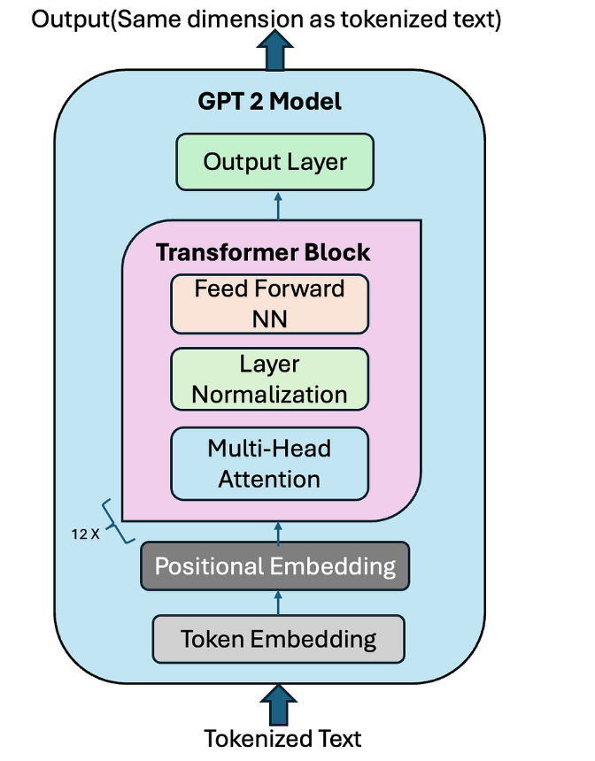
Fine-Tuning RoGPT2
Base model: readerbench/RoGPT2-medium
The most accurate model trained on the largest corpus available for the Romanian language

Slide 5
Generating Reviews with Fine-Tuned Model
Used 30 Romanian prompts
167 samples per prompt (~5000 reviews)
Generation method:
Sampling with top_k=50, top_p=0.95, temp=0.9
Max length: 80 tokens
Output saved as CSV

Slide 6
Results & Insights
RoGPT2 generated coherent and contextually relevant reviews
Quality depends heavily on prompt design
Some reviews are indistinguishable from real ones

Slide 7
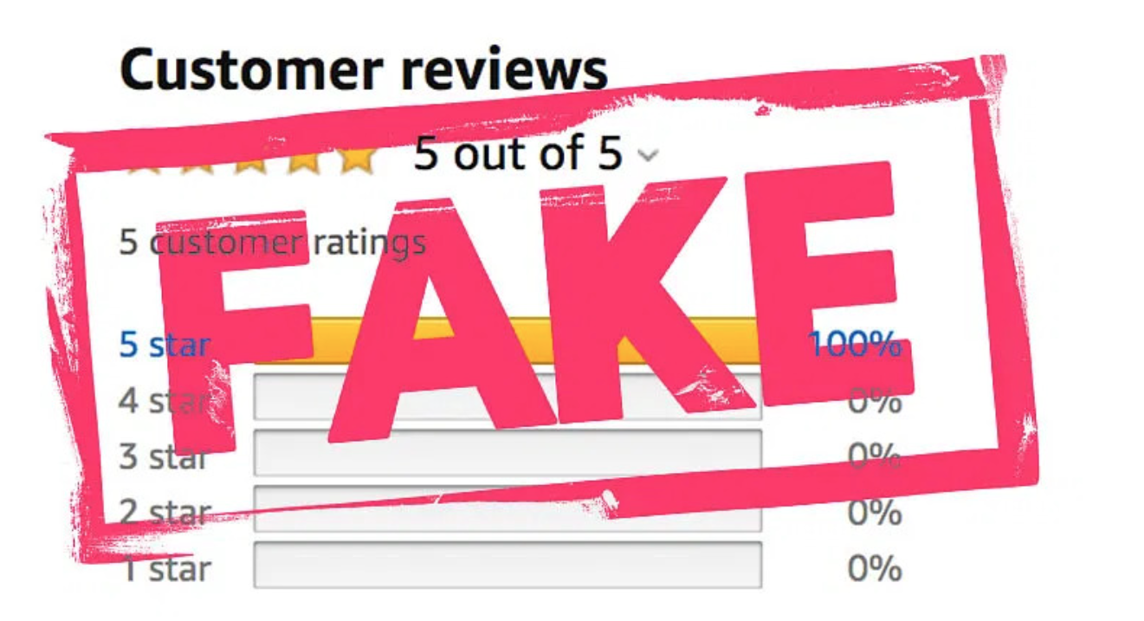
Final Thoughts
LLMs can convincingly mimic user-generated content, making businesses and customers very exposed to different types of scams leading to loss of trust and transparency.

