Slide 1

A Brief Introduction to Python
Alejandro Rodriguez Natal
Twitter: @AlejandroRNatal

Slide 2
What is Python?
High Level Interpreted Language
Interpreted- No need to link or compile code
High Level- « In computer science, it means strong abstraction from the details of the computer...»(Wikipedia 2019)
Non-statically typed- No need to specify type at time of declaration
Everything in Python is an Object –This means anything can be assigned to a variable or passed as a function argument.

Slide 3




Who uses Python?

Slide 4





Layers of Abstraction
User
Applications
Operating system
Kernel
Assembler
Firmware
Hardware

Slide 5
How many programmers does it take to screw in a light bulb?
None. It's a hardware problem.

Slide 6
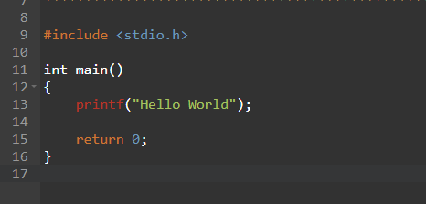
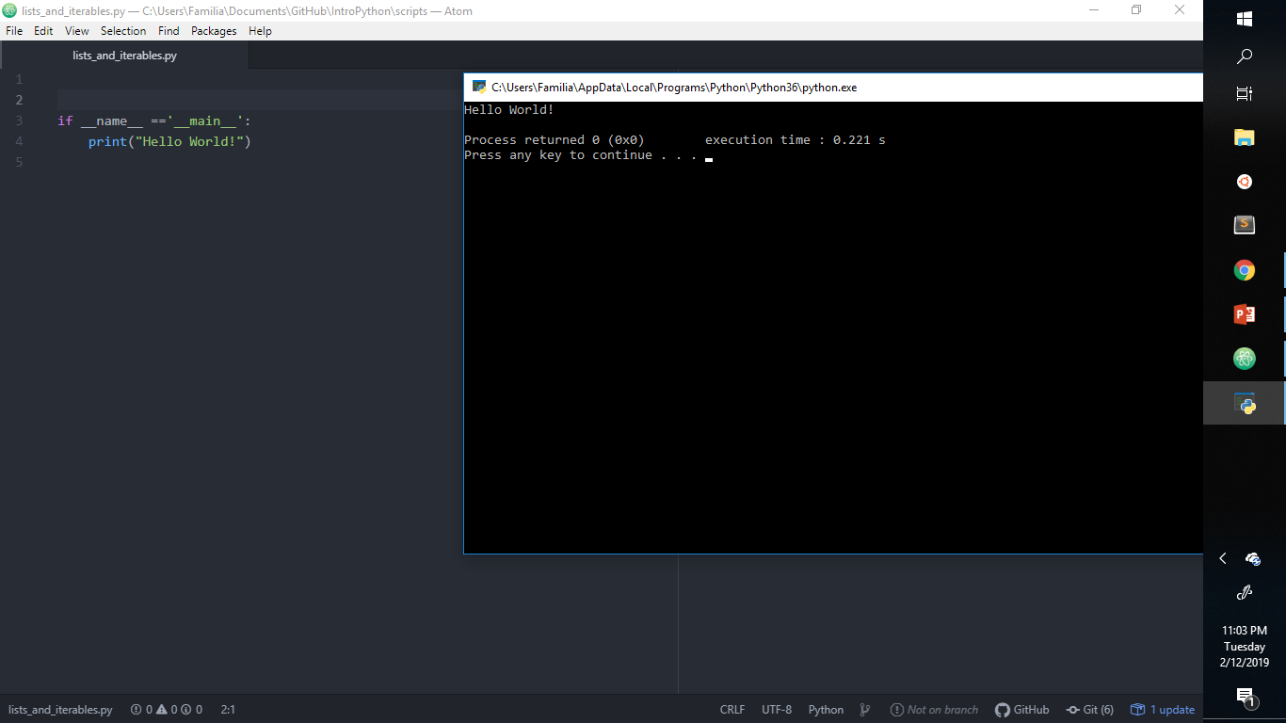
Python vs C (or look-alike languages)

Slide 7
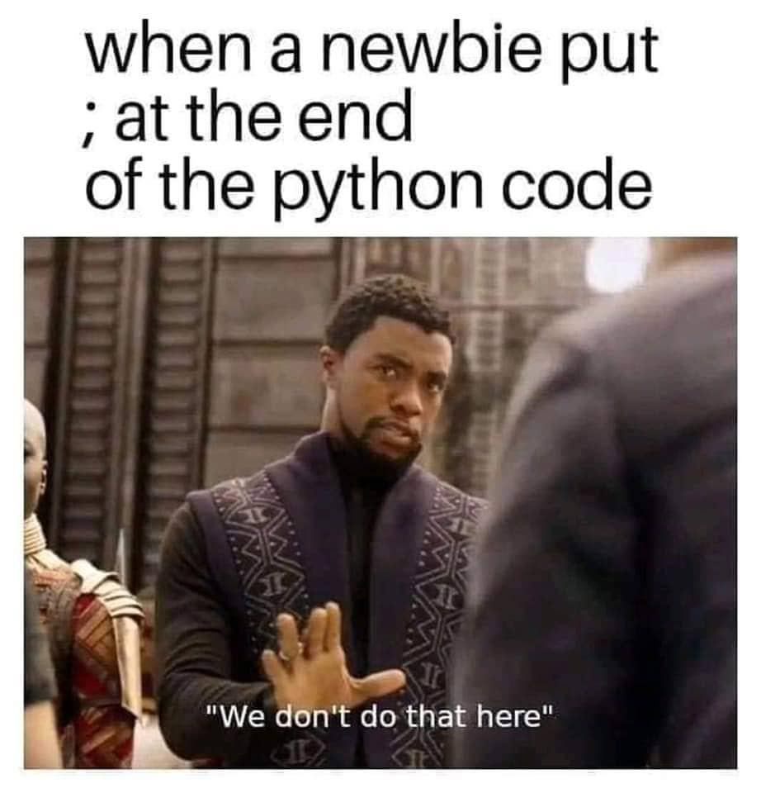

Slide 8
(Some)Keywords
and | del | from | not | while | as | elif
global | or | with | assert | else | if | pass
yield | break | except | import | print | class | exec
in | raise | continue | finally | is | return | def
for | lambda | try
Note: Python provides a built-in function that will provide all keywords in the Interpreter

Slide 9
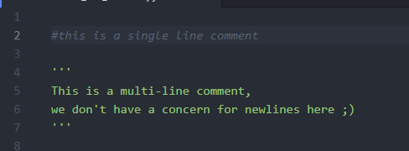
Comments
Non-executable pieces of characters
There exist 2 common ways to comment code in Python.

Slide 10
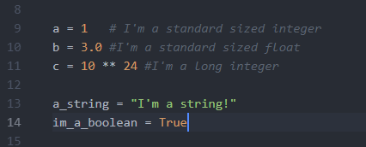
Variables and types
Variables
Types
Integers, floats, booleans, characters and strings

Slide 11
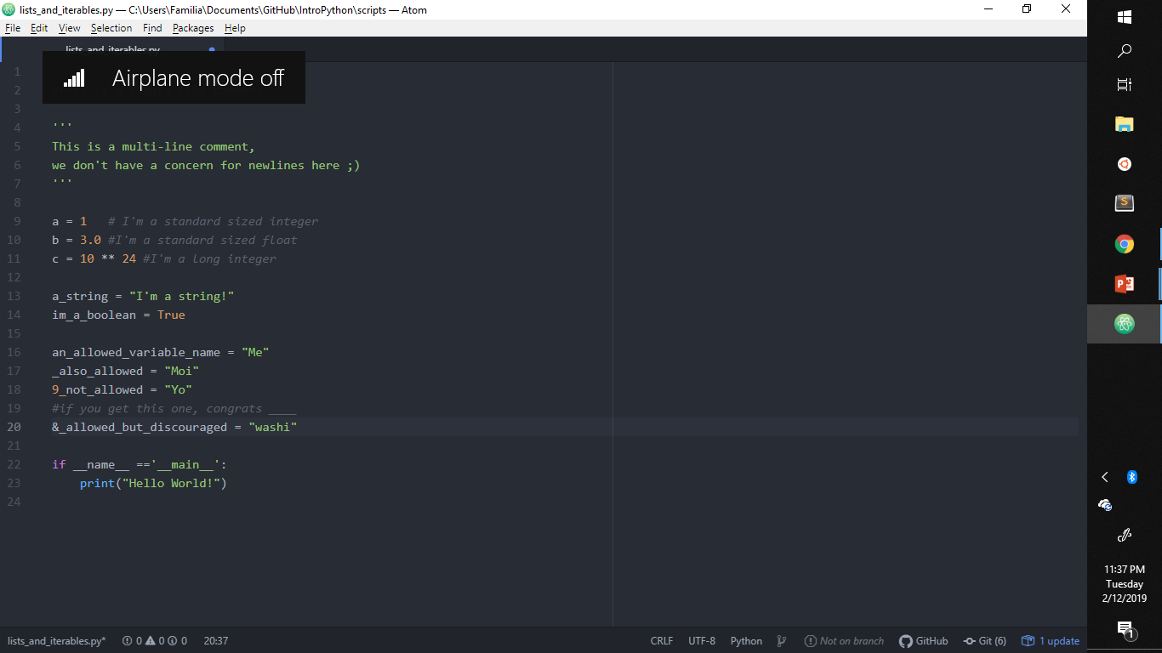
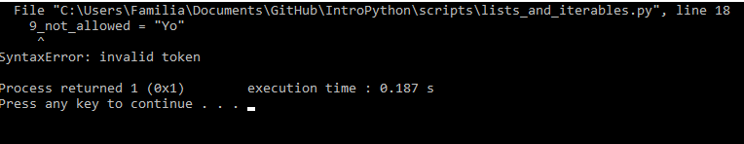
Variable Naming Guidelines
Can have characters from [Aa-Zz][0-9] and underscores(_)
Cannot start with a digit or special character or be a keyword

Slide 12
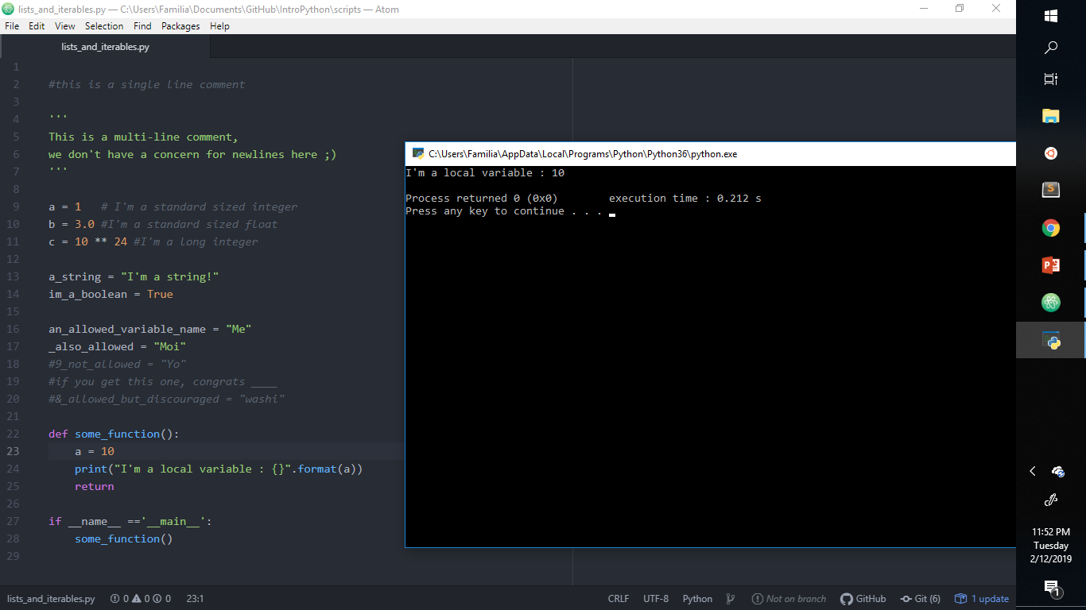
Functions & Scope

Slide 13
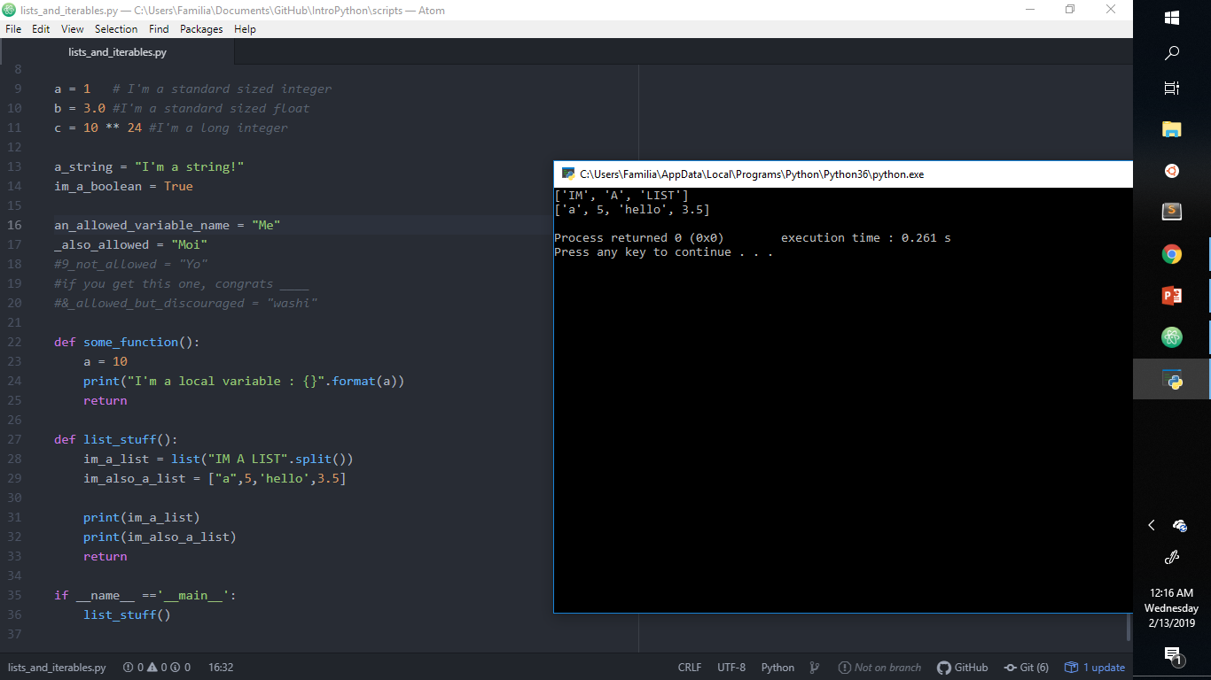
Lists
Iterable collections of variables of single or multiple types.

Slide 14
A Carton of Milk and Eggs
My wife said: "Please go to the store and buy a carton of milk and if they have eggs, get six."
I came back with 6 cartons of milk.
She said, "why in the hell did you buy six cartons of milk?!"
I replied: "They had eggs!"

Slide 15
Flow Control
if (condition)
Then: do something relevant to the condition
elif(else if) (other condition)
Then: do this other thing relevant to this condition
else
Do something preset ifthe previous conditions are not met.

Slide 16
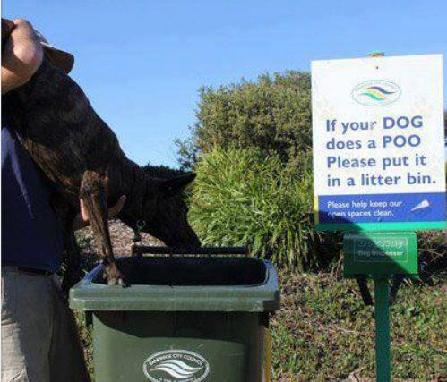

Slide 17
Logical Operands
A and B
If tomorrow it is sunny and my bike is available then I shall ride it to school.
A or B
If tomorrow it is rainy or I wake up late, I will not go to school.
A xor B
You can have wedges or french fries with your combo
You either sleep or eat at any given time

Slide 18
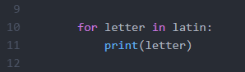
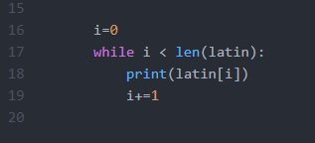
Loops
for(each) item in (iterable collection)
While(condition is true)
Do something

Slide 19
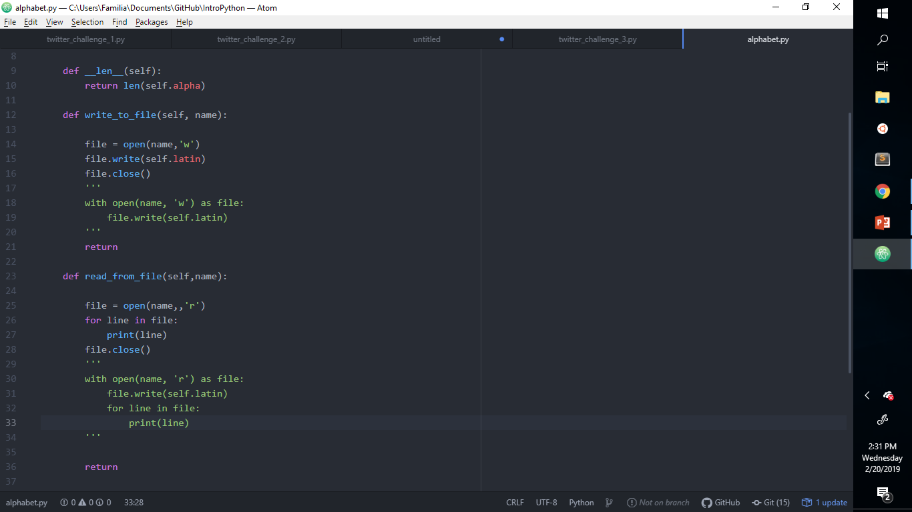
File Input & Output and « with »

Slide 20
File Input & Output and « with »

Slide 21
What next?

