Slide 1
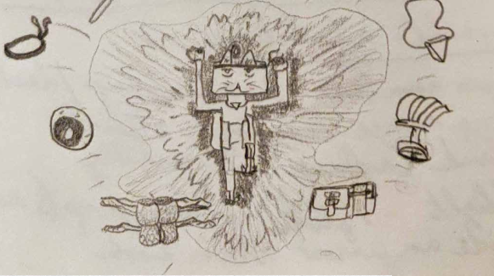
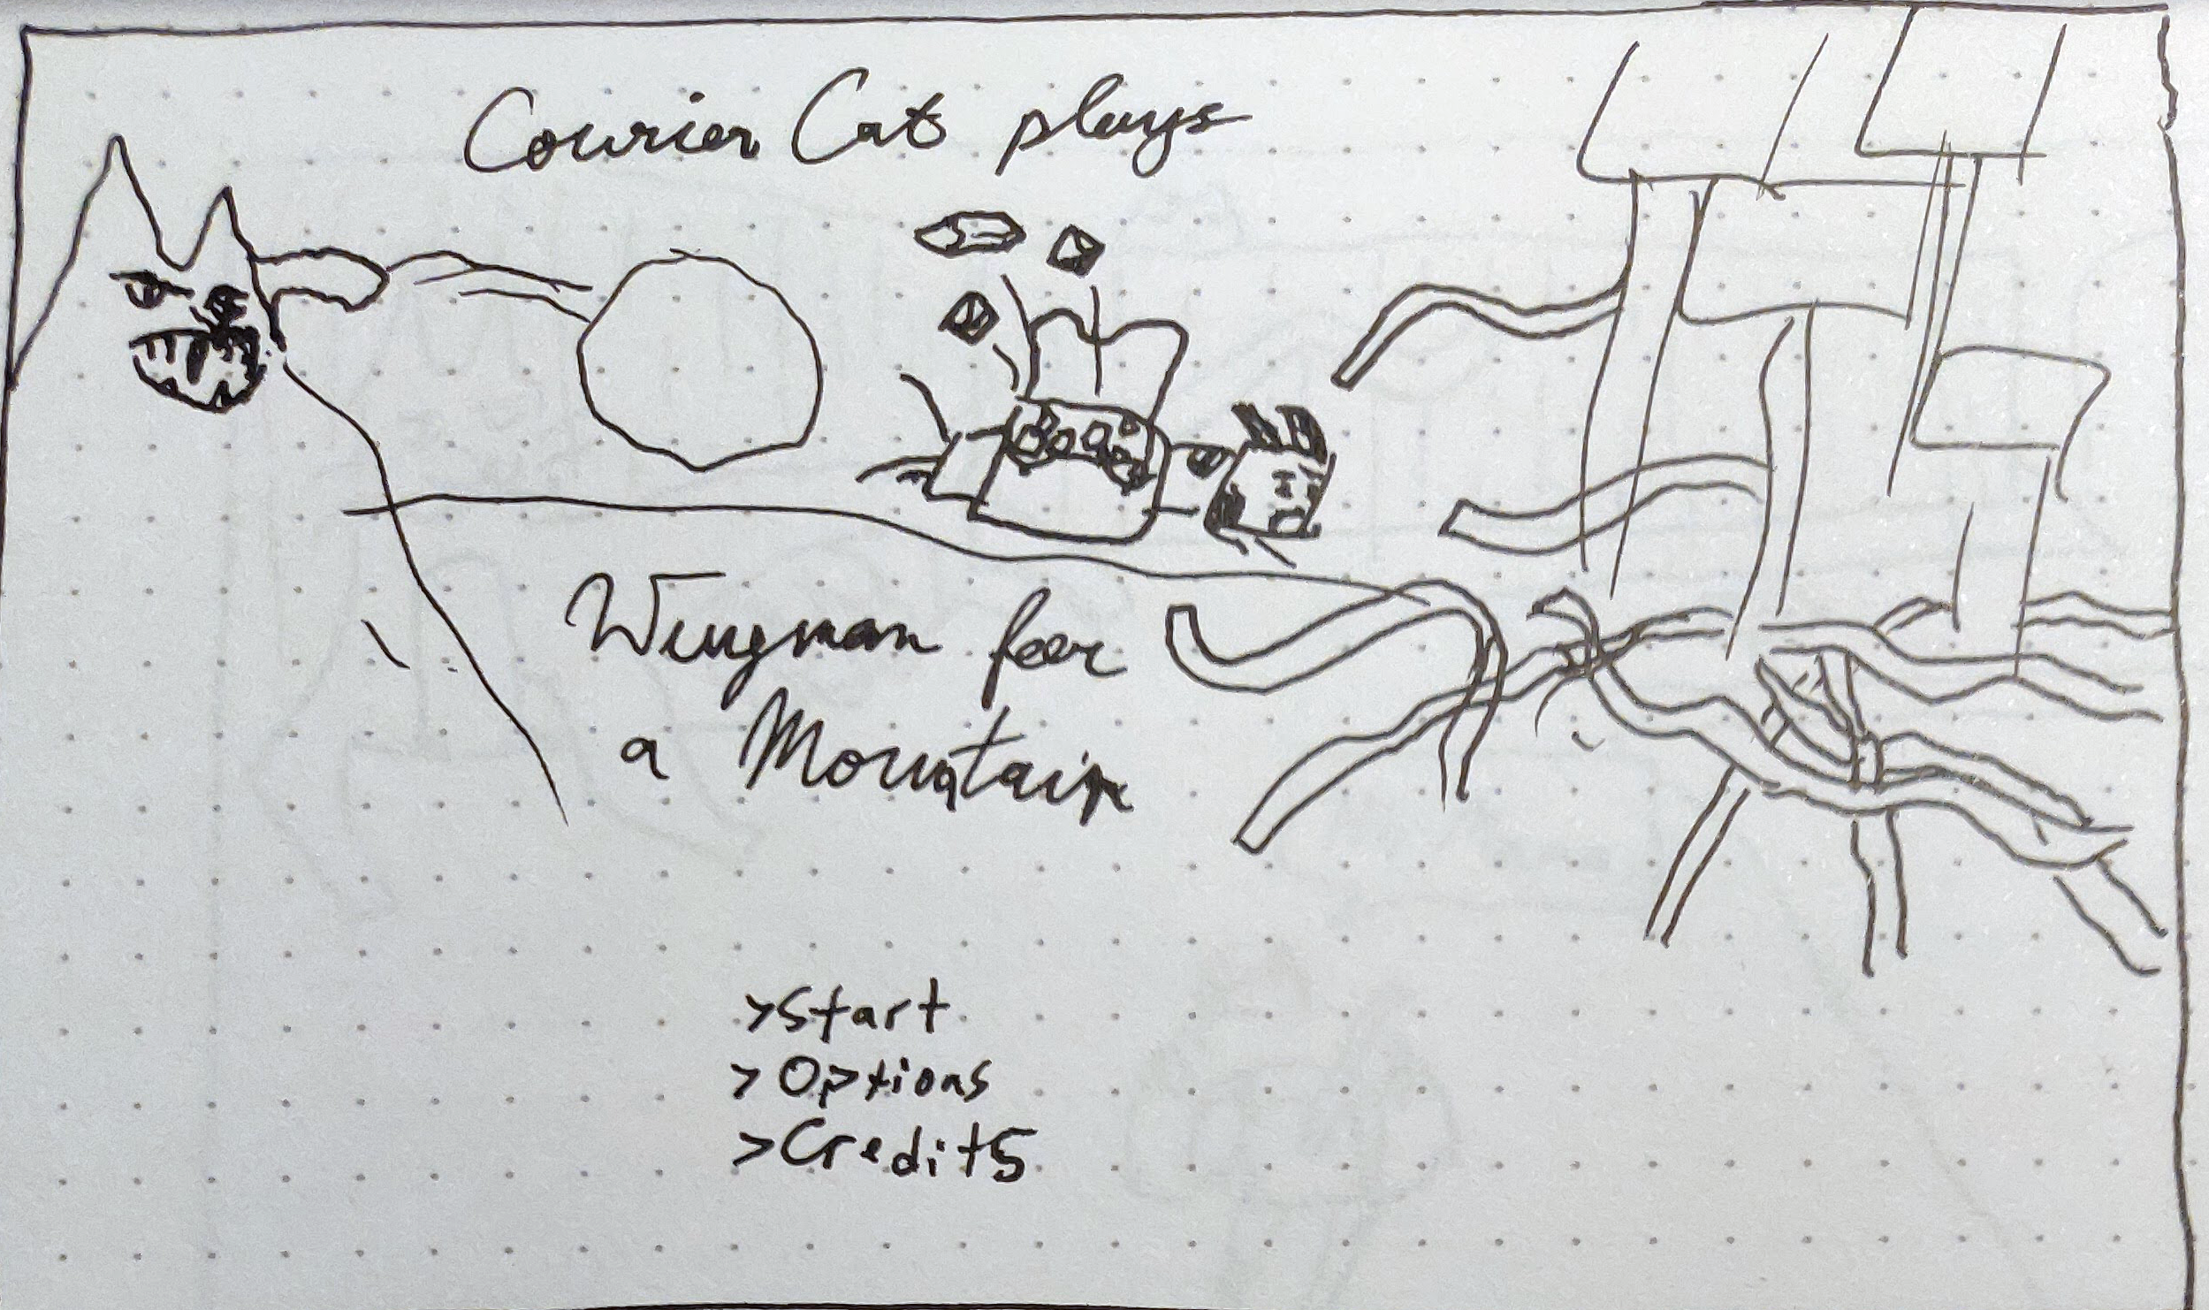
Introducing...
Courier Cat!
The Messenger of the Cat Gods

Slide 2
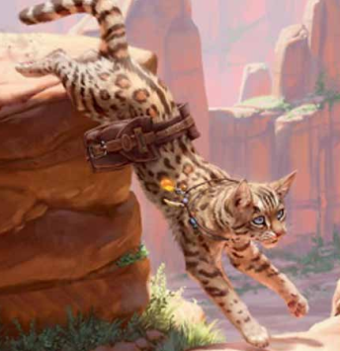
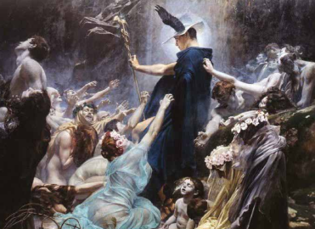
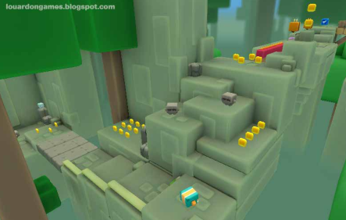
Elevator Pitch
Modern, playable creation myths featuring the cat messenger god
Short-Form Mythical Action-Adventure Precision / Stealth Platformer... with Cats
Sly Cooper meets Okami, with a Content Release Schedule (and Cats)
Paperboy + God of War + Animal Crossing

Slide 3
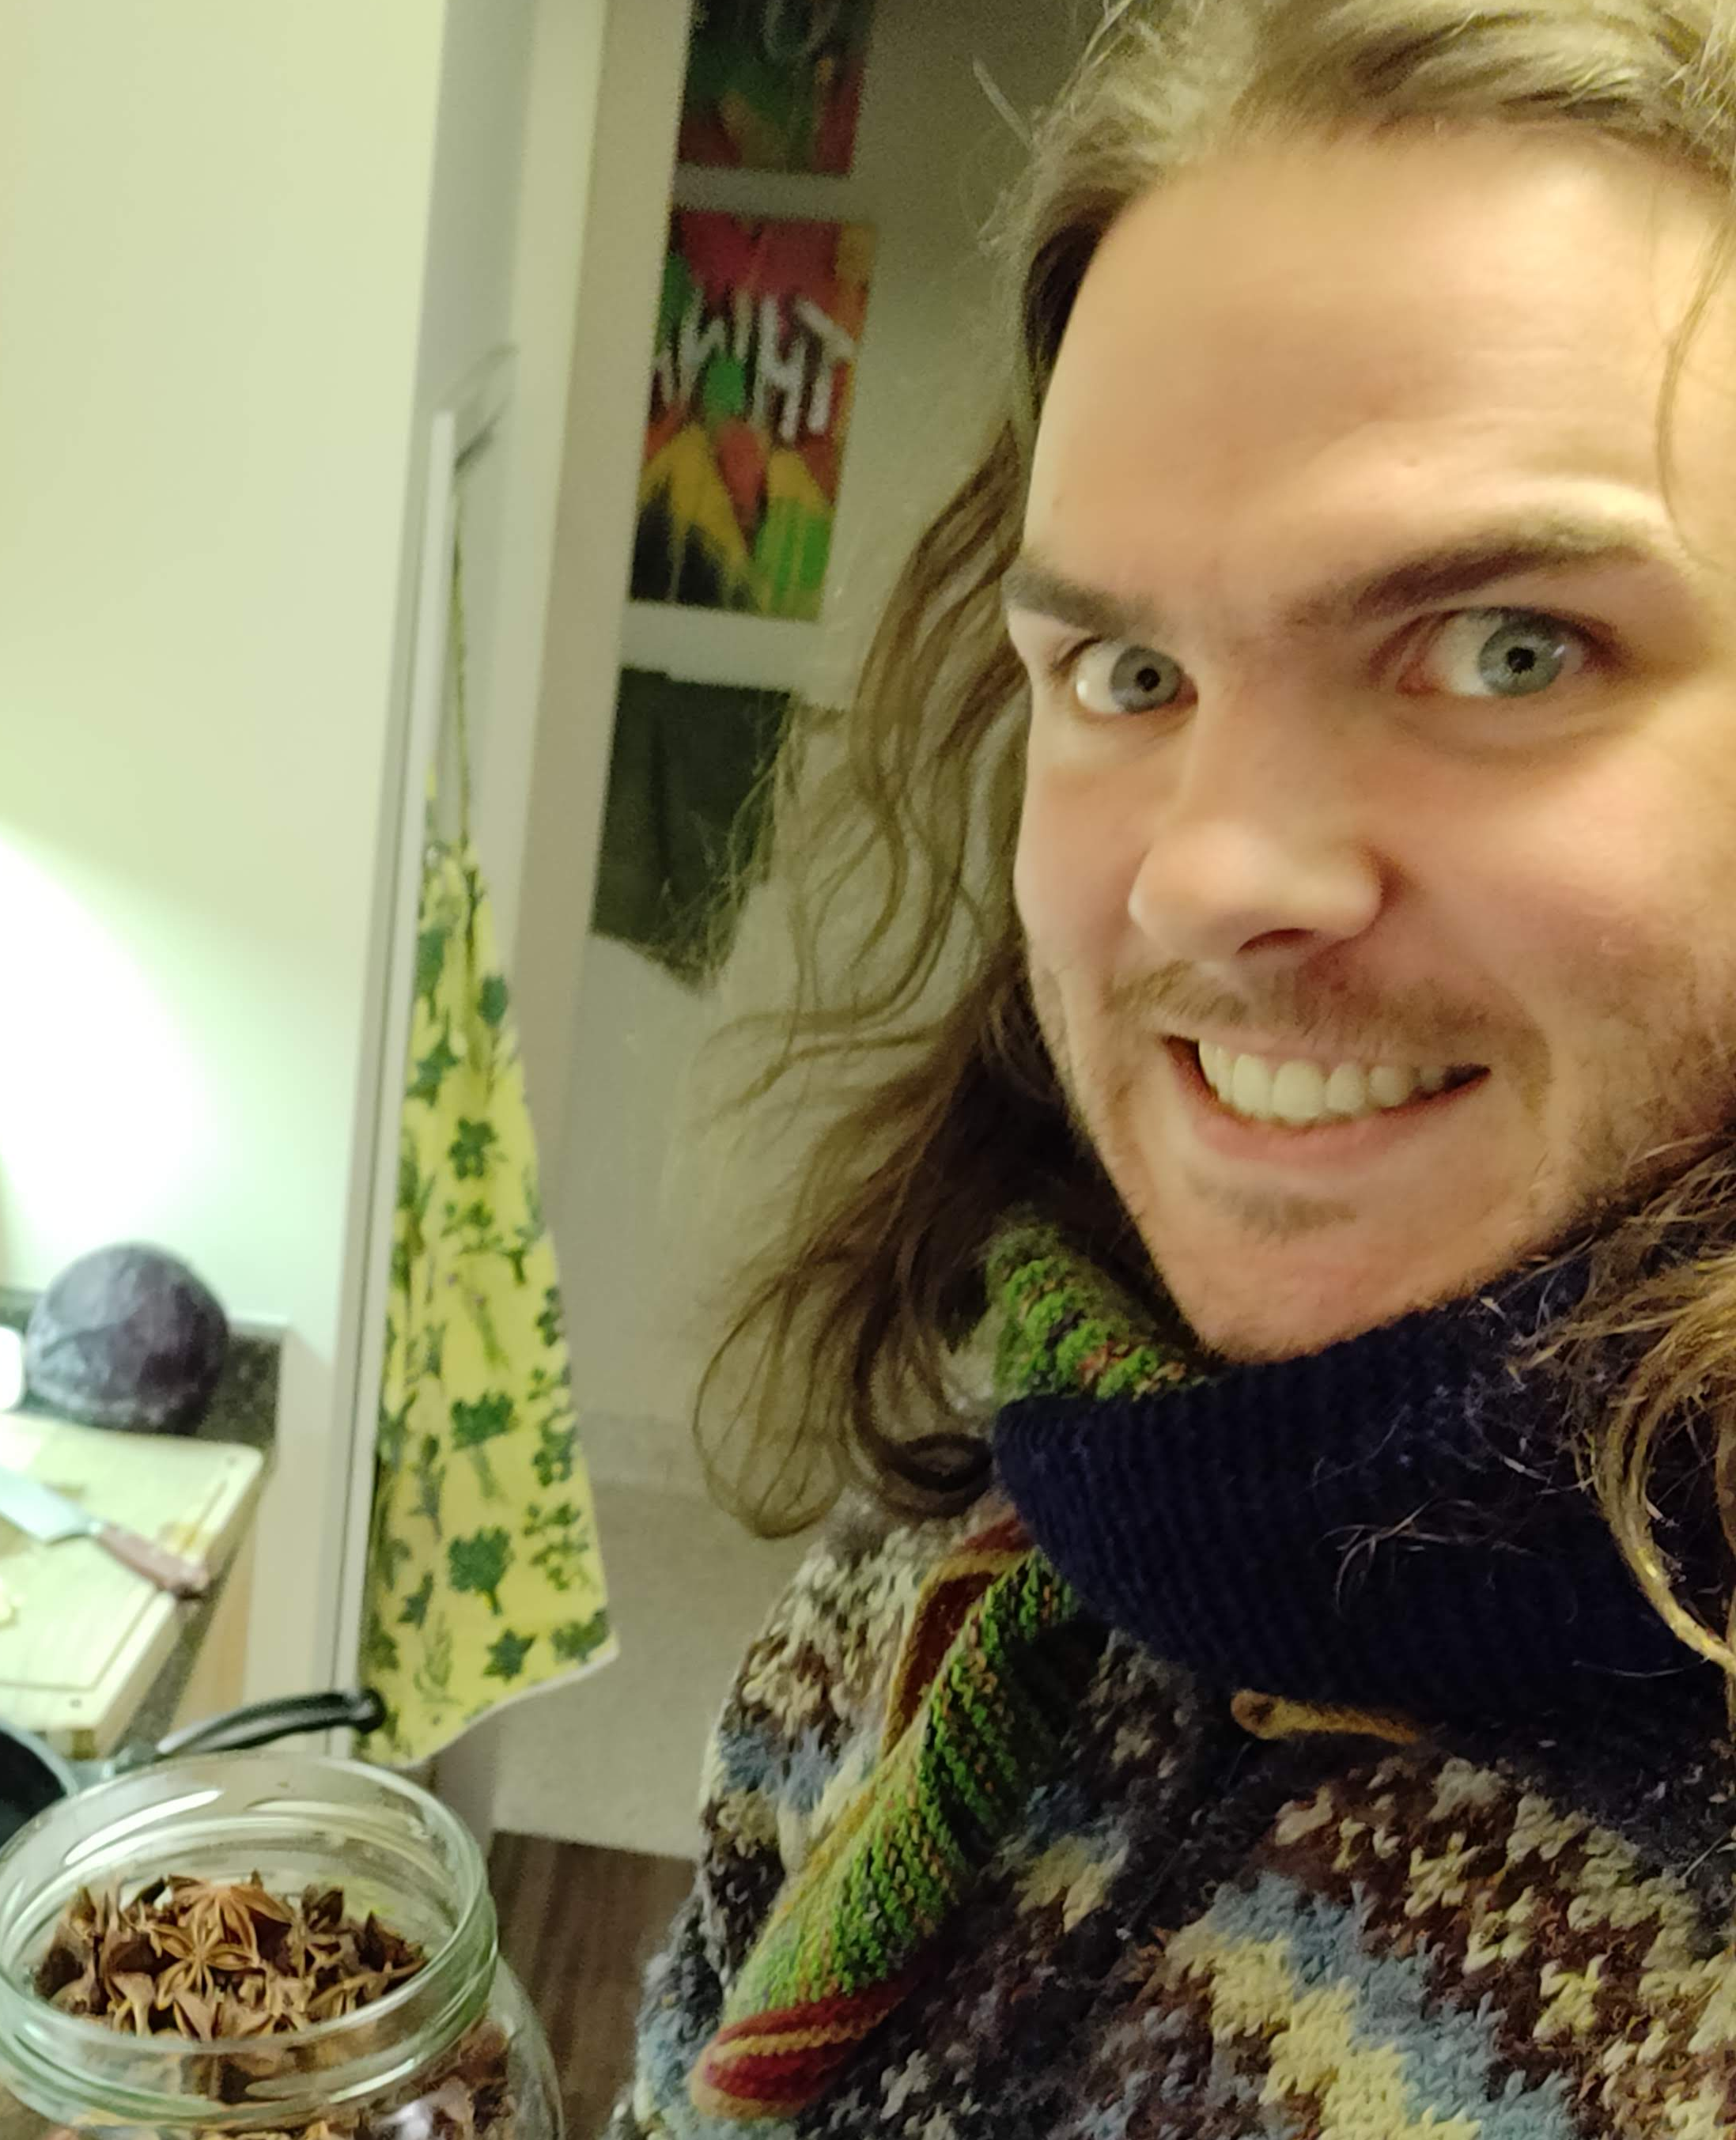
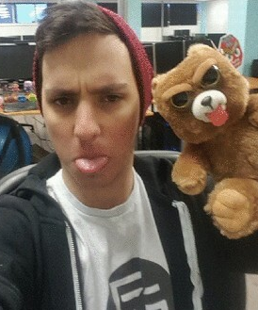
Who Are We?
Travis Martin
  Game Designer
  Level Designer
  Story Designer
  Writer, Poet, Actor
  ...gameplay programmer? >_<
Alex Sabourin
  Tech wizard
  Architect
  Tools dev

Slide 4
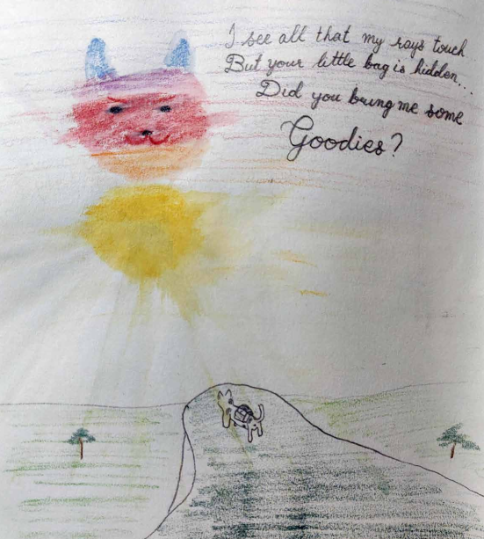
How Did We Get Here?
Travis Dreams Up “Cat Game”
Travis, Alex, and Billy make a small and bad 2D Cat Game prototype
Alex Dreams Up “Icebox Engine”
Travis reimagines Cat Game for 3D
Travis and Alex Team up to make Cat Game w/ Ice Box
Ice Box is many years from completion, so let’s start making Cat Game in Unity

Slide 5
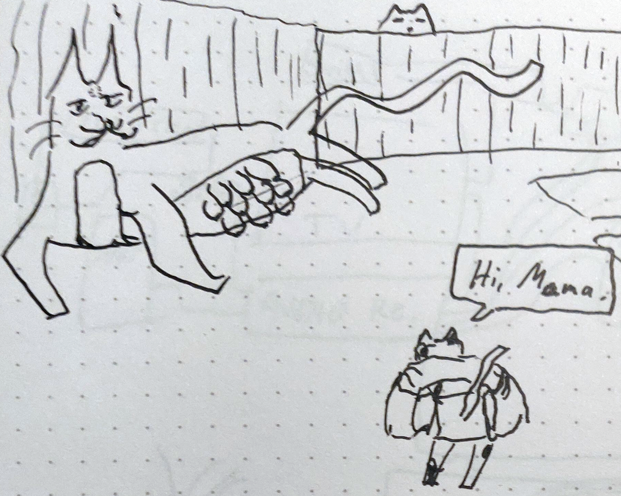
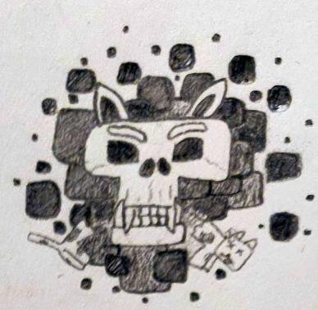
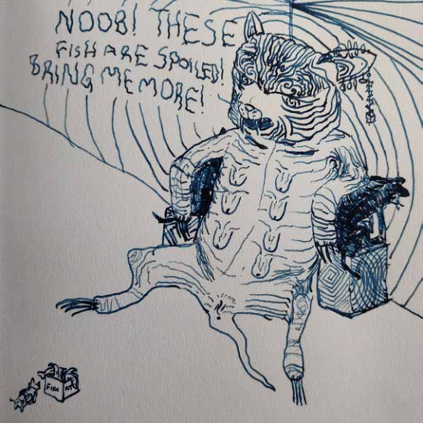
Creative Overview
Mythical World of Cat Gods
  Asgard, for Cats
God names in format: [thing]Cat
  E.g. MamaCat, MountainCat, CatnipCat, WrinkleCat
PaperCat: Messenger of the Gods
  Hermes, but a Cat
Taoist (I Ching) Influence
  Trigrams & Hexagrams
Suzy Cube aesthetic

Slide 6
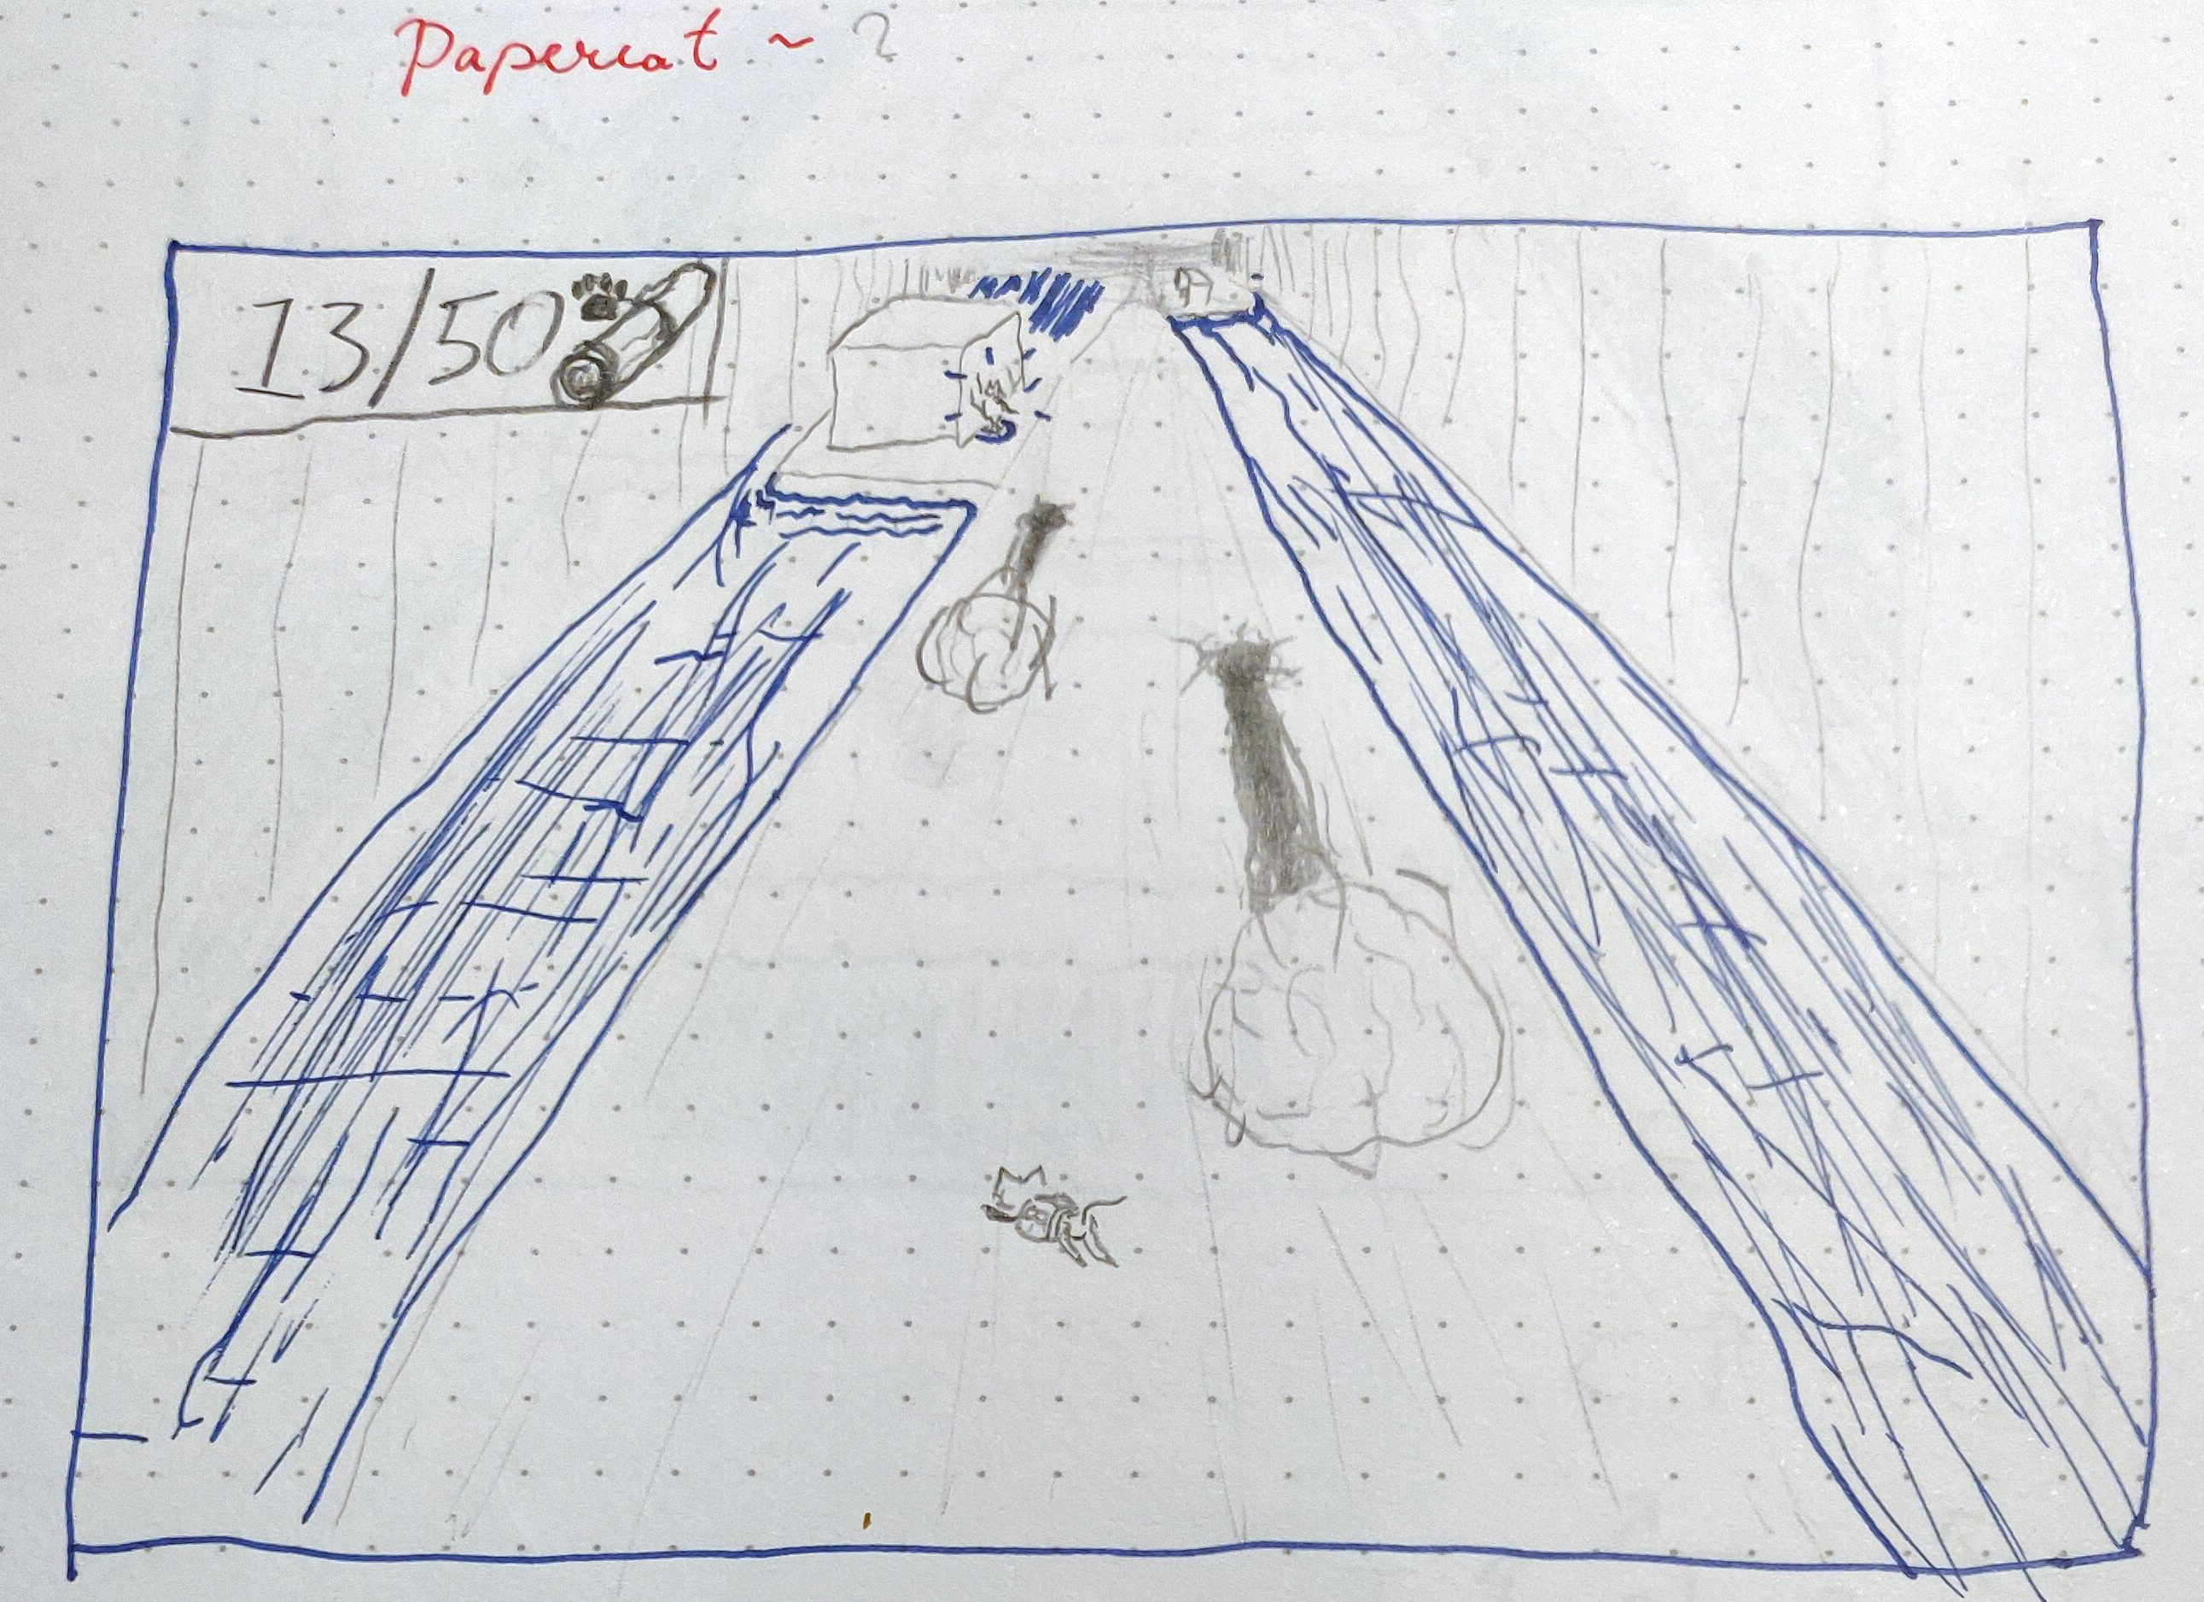
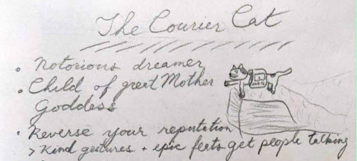
wait...
“PaperCat?” what about “CourierCat”?
(cannot for the life of me decide which to use)

Slide 7
Design Pillars
You Are a Cat
More Is Not Better
Messenger God
Fast and Agile
Stealthy
Climby
Haughty
Fewest elements
Short, simple tales about excess
Simple systems where possible
One environment per story (additive!)
Epic scale
Cosmology
Super-kitty feats
Highly impactful choices (1 or 2 per story)

Slide 8
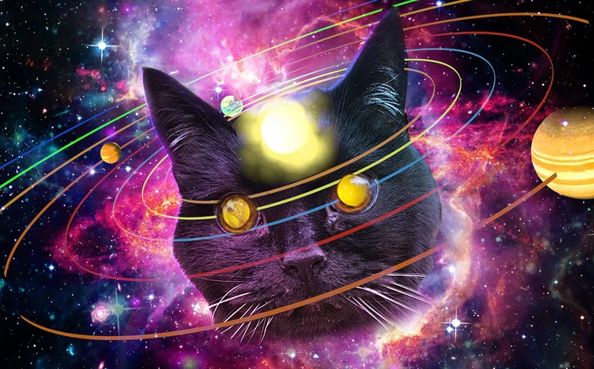
Hook ‘em
People love cats
Myths and gods have a visceral appeal
Cute & non-violent to attract Nintendo crowd
Humour w/ shareable moments

Slide 9
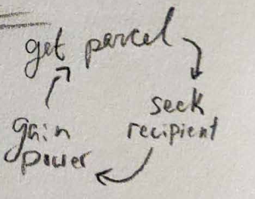
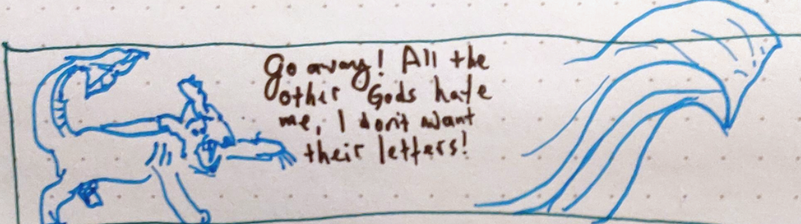
Reel ‘em
Epic, emotional storytelling
Tight, multi-modal action gameplay
Easy to play, hard to master
Sweet game loop
Expanding world

Slide 10


Technology Overview
Custom Engine in development (IceBox)
Unity (for now)
Design Tools
Fabgrid
  Grid editing plugin from Unity store
  Customizing it

Slide 11
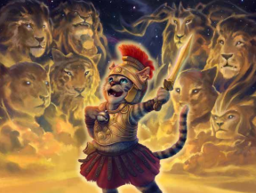
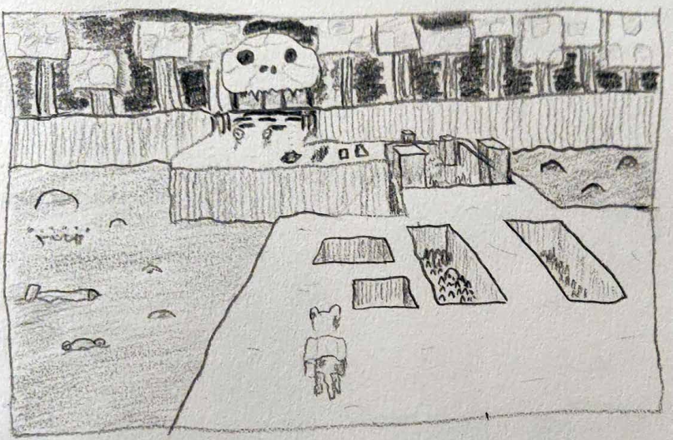
What We’re Aiming For
Target: 2030!
Long Term: The Series
  Release for free while it makes sense
  Monetize when we have enough content
  Maybe eventually make a “feature length” game?

Slide 12
What We’re Aiming For
Medium-Term: The One-Off
  Fun, Light-Hearted, Myth-like story
    See: Hermes Steals Apollo’s Cattle
  One hour or so of gameplay
  Some amount of replay value
  “Leave them wanting more!”
  Release on Steam for free
    See: Super Crate Box
Target: 2025

Slide 13
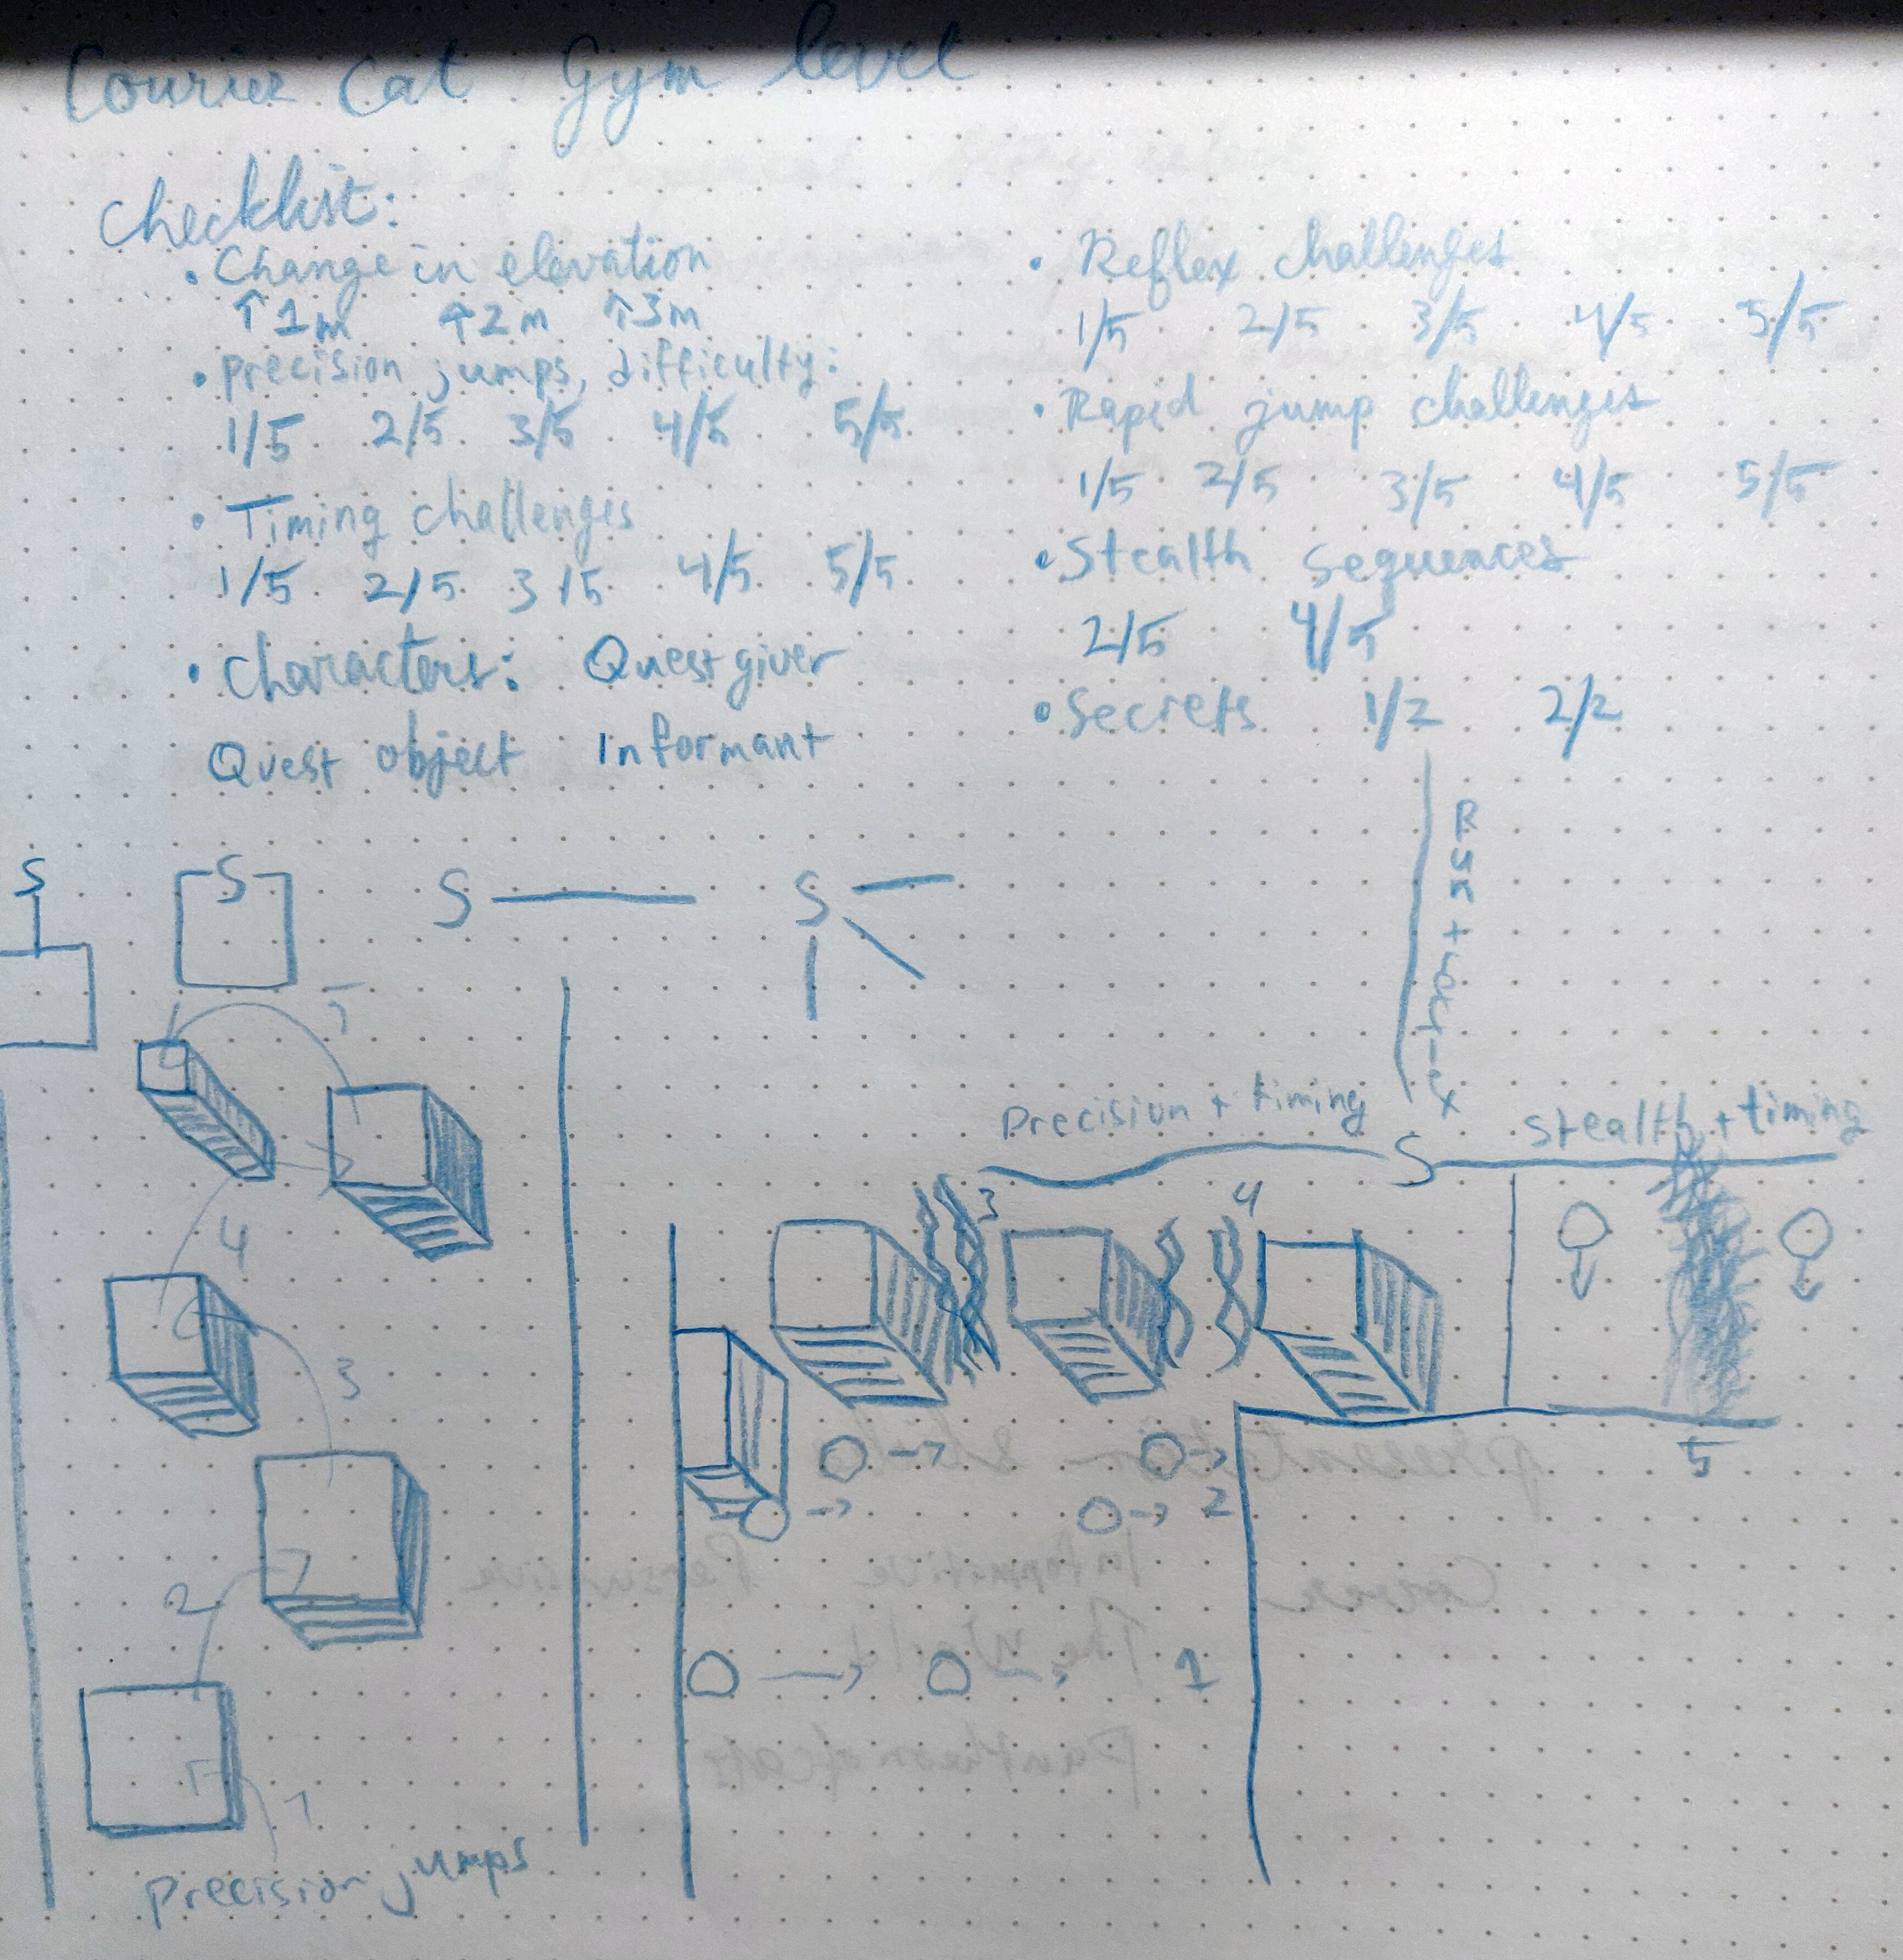
What We’re Aiming For
Short-Term: The Prototype
  Establish main gameplay tropes
  Establish metrics and challenge intensity
  Story: PaperCat and the Great Exam
    Earn your position as Messenger of the Gods!
    Use dev textures for level geometry, easy
    Pithy dialogue
    Mutable scope
Target: 2022!!!

Slide 14
How Do We Get There?
Step 0: Find some folks to help
Hi 👀

Slide 15
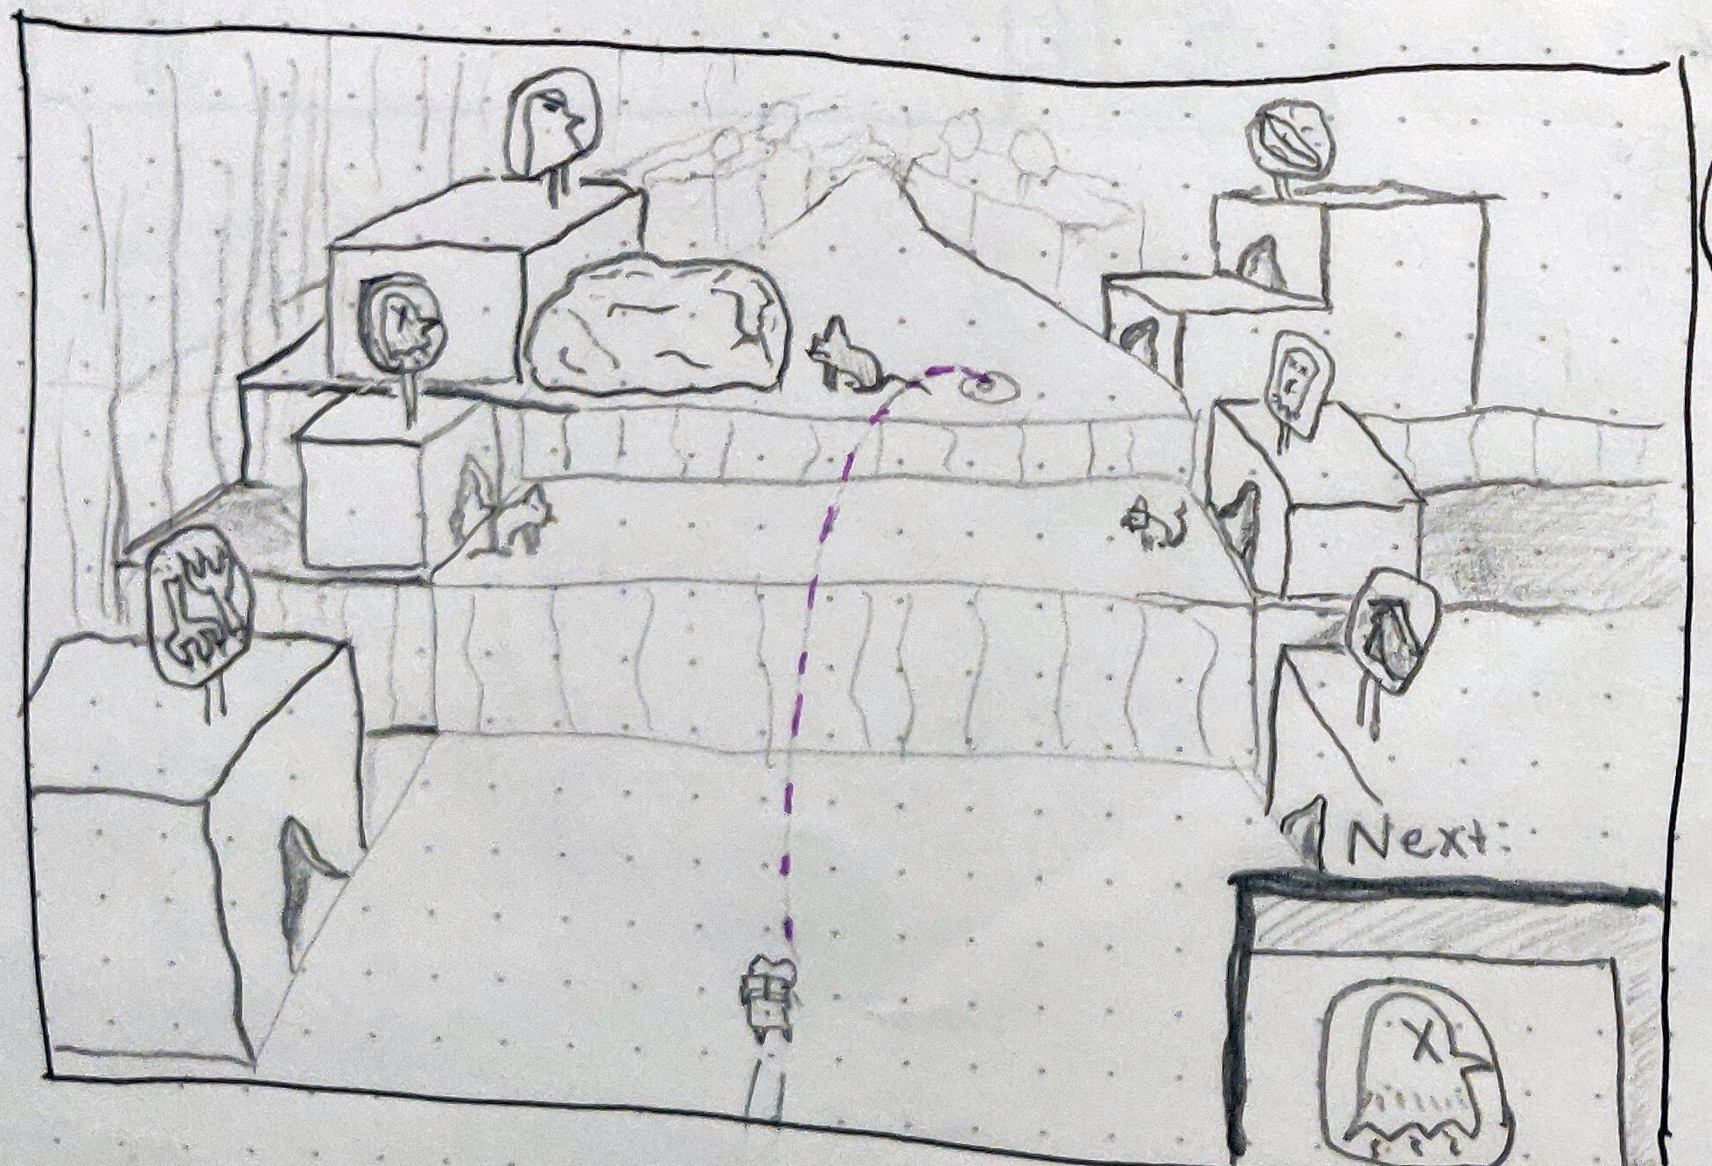
How Do We Get There?
Step 1: Test gameplay hypotheses
Camera and Controls
Movement & jumping
“Gym” level
Design tools
If successful...

Slide 16
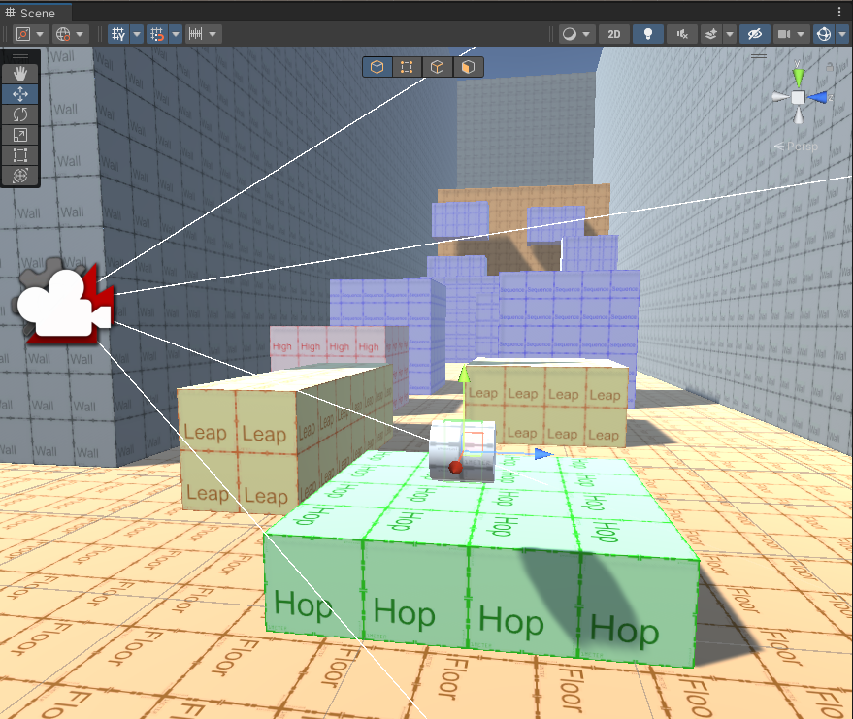
How Do We Get There?
Step 2: Build demo
  Create PaperCat and the Great Exam
  Test with users in target demographics
  Iterate
If successful...

Slide 17

How Do We Get There?
Step 3: More collaborators
  Need music
  Need art
  etc.

Slide 18
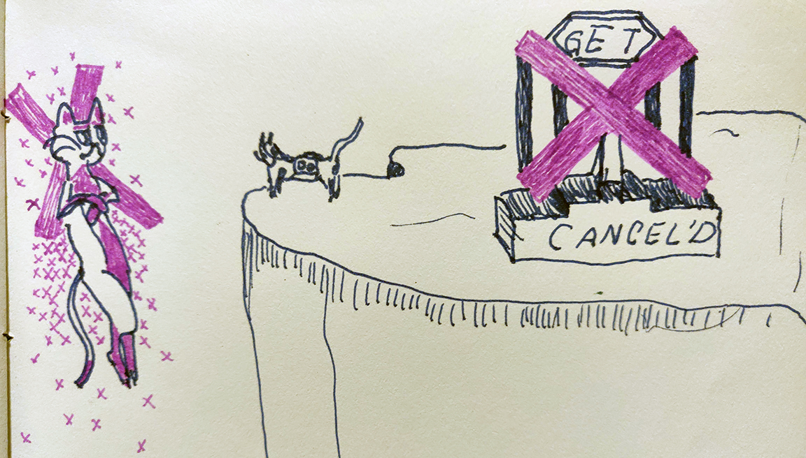
Process Overview
Goal: make a playable myth
How...? Let’s find out together!

Slide 19
Process Overview
Scientific-ish Method
Hypothesis
Prototype
Ideation
Questions

Slide 20
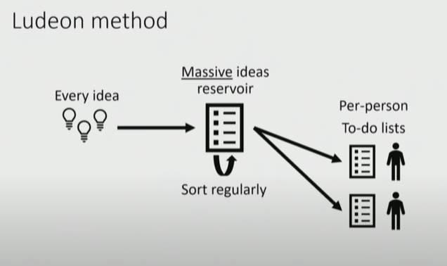
Ludeon (Rimworld) Method
Tynan Sylvester’s talk: https://youtu.be/VdqhHKjepiE

Slide 21
Ludeon (Rimworld) Method
Everyone puts their ideas in repository (Trello?)
Vision holder sorts ideas
  Highest impact vs. cost go to the top
Top ideas are the task list
Regular (monthly?) meetings

Slide 22




Production Tools Overview
Trello
  Documentation
  Task management
  Ideation
Meetings
  Progress, roadblocks, discussion
  Task assignment
Discord
  Ongoing communication
  Meetings
  Cat memes
GitHub
  Version control
  Testing
  File-sharing

Slide 23
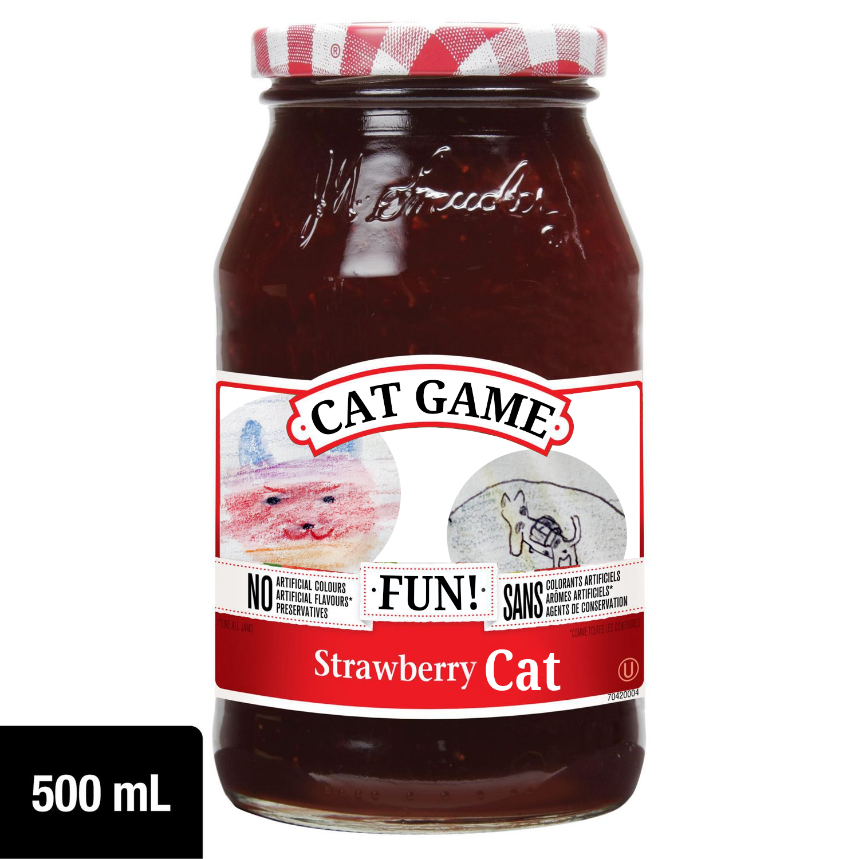
What’s Next?
Cat Motor Jam.
  Let’s make the cat feel really good!
  Short, intensive, collaborative
We end up with:
  Basic player motor
  Levers to help fine tune
  Prototype level
  2-3 basic gameplay ingredients

Slide 24
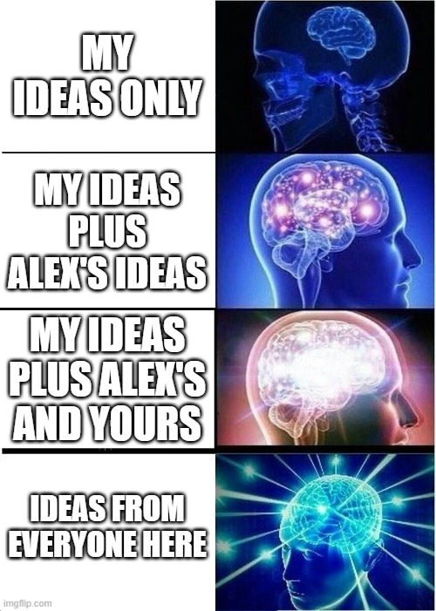
How Can I Help?
Programming support vs. collaboration
Do the jam with me!
Build the series
  Ideation and testing
  Building prototypes
  Talking about it
Build the engine
  Help Alex with IceBox!

Slide 25
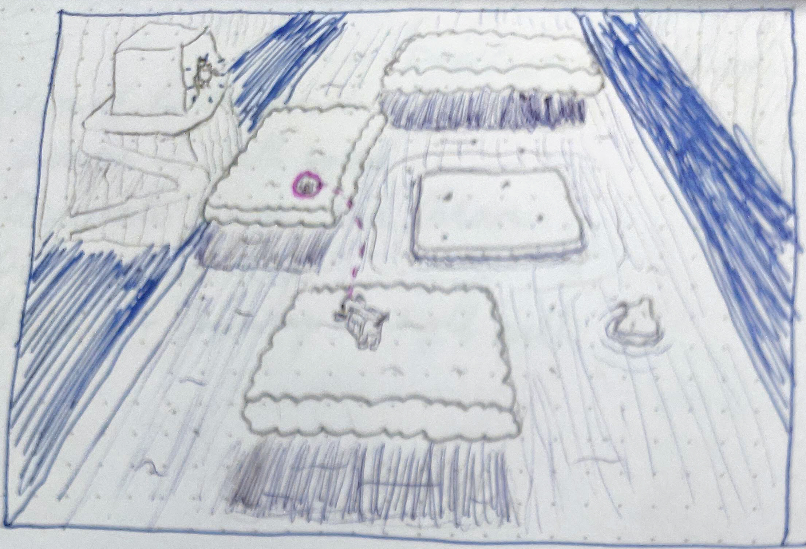
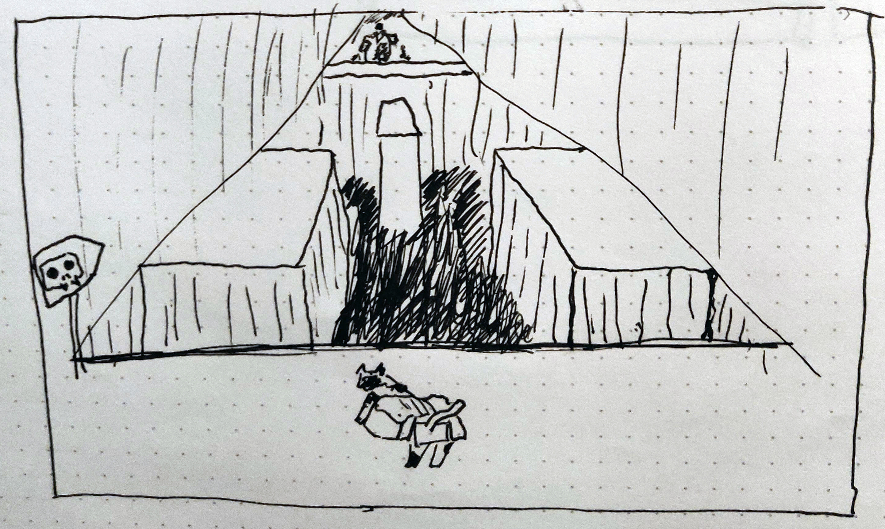
Motor Jam: what’s to do?
Cat motor
  Walking/running
  Jump system
  Climbing
Avatar tweaking tools
2-3 game ingredients (enemies / obstacles)
Grid system

Slide 26
Motor Jam: what’s to do?
Nice to Have:
Level Design tools
Dialogue system
Camera controls / cinematics
Game loop
Music & SFX
Art

Slide 27
Learning Squad!
Primary goal: building skills!
Get your hands dirty with gameplay code!
  Otherwise, do anything from the previous slides
We assign Lead(s)
  Experienced mentors; and/or
  Inexperienced leaders in training
Rapid prototyping! Let’s get it playable!

Slide 28
Question Period

Slide 29
Time commitments
Game jam
  1 or 2 week-ends in February and/or March
Long-term work
  3 hours per week (me)
  1 hour per week / 4 hours per month
  ... or whatever
Subsequent Jam Sessions...?

Slide 30
Jam Structure
Friday: Ideation and planning (3-4 hours)
Saturday: First playable...?! (8 hours)
Sunday: Tools and tweaking (8 hours)

Slide 31
Jam personnel
How many people are participating?
1-3: One team, one system
4-6: Three teams, three different systems
7+: Multiple teams, who can do the best cat??

Slide 32
