Slide 1
COVID Lung Analysis
Harrison Terry

Slide 2
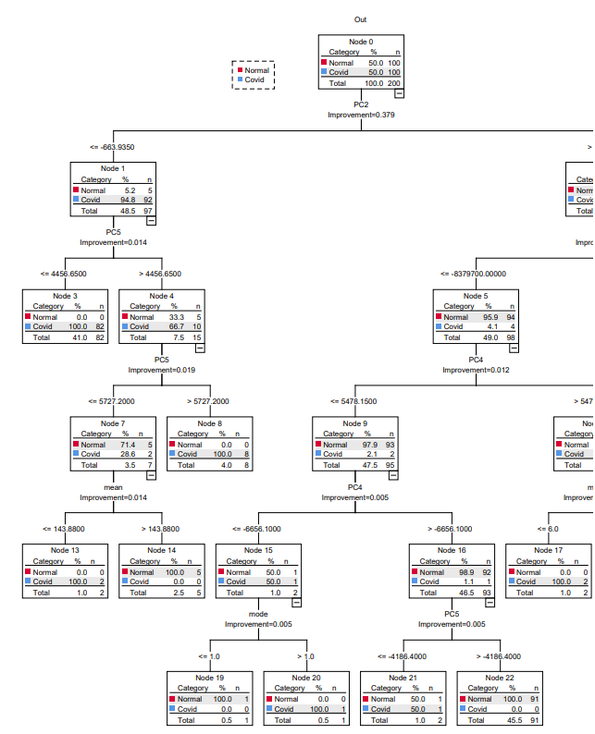
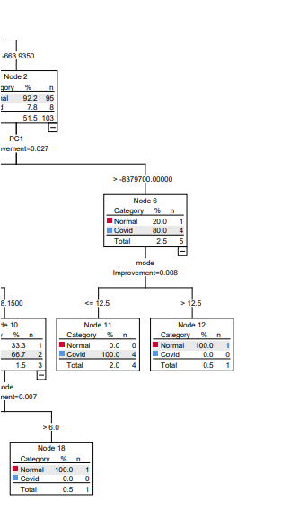
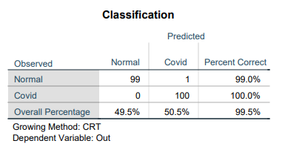
Tree Nodal Map
5 nodes deep

Slide 3
What does it mean?
From node tree map, most variables we took don’t matter in terms of diagnosis.
Taking every pixel to be a greyscale value from 0-255 and doing SVD analysis upon them, we find both normal and covid diagnoses pictures most principle component (called PC1) together is less important than PC2. This means PC1 measures something more general like human physiology structure than disease profile.
Besides PC2, standard statistical tools like the mean and median of the greyscale value is more important than other principle component (PC) values.

Slide 4
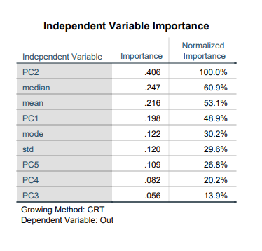
Independent Variables
As talked about before PC2 is most important, followed by median and mean.
PC1 is also somewhat important.
From node map, all other components at most pull out 2 cases and have little statistical importance in comparison.

Slide 5
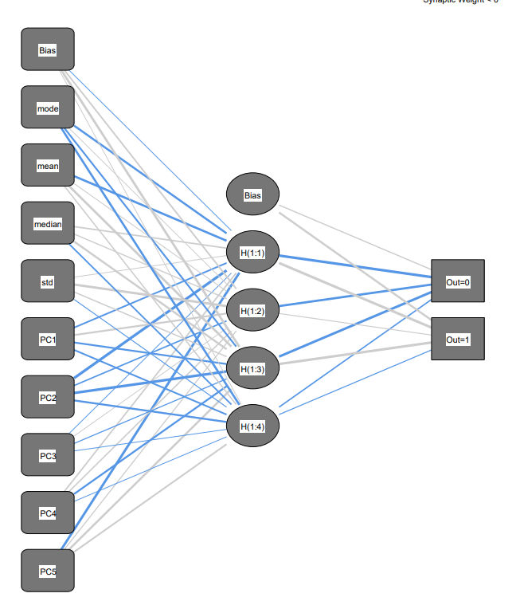
Neural Network (Shape)

Slide 6
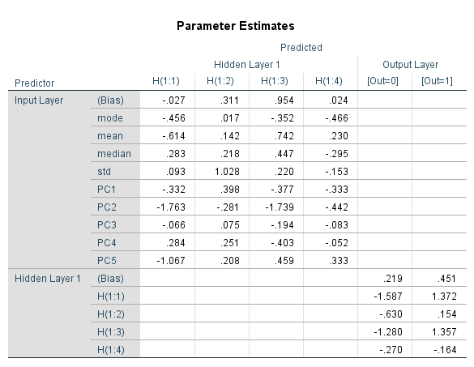
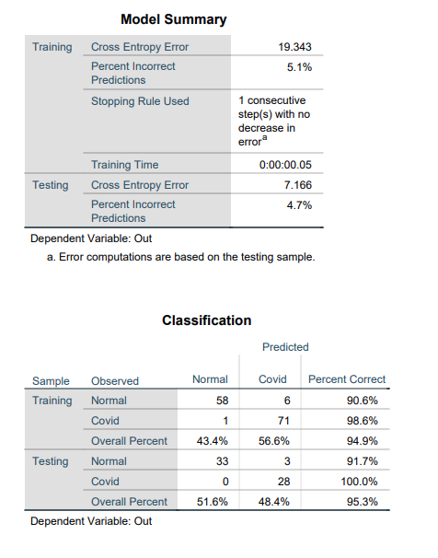
Neural Network (Parameters & Accuracy)

Slide 7
What does it mean?
Principle Component 2 (PC2) is again most important with high correlation values to the neural network.
Model finds PC5 to be much more significant than in node.
There is a high bias factor especially in the hidden layer 3. This means the data does not tell super-well what the diagnosis is, and so needs a large bias factor to nudge the network in the right way. This means we need either more data or better variables to get that last bit of accuracy.

