Slide 1
Exploratory Data Analysis of COVID vs Normal Lung X-Rays
Through a publicly available set of chest X-Rays, we have access to numerous images depicting the x-ray of diagnosed COVID infected lungs and Normal (or non-infected lungs) lungs.
These x-rays are Black and white images which can be encoded into a vector of grayscale values (0-255) for each image. Along with running basic analytics on the data itself, the matrix composed of the vectors from each x-ray is a prime candidate for principal component analysis. These principal components and descriptive statistics can be used to produce a predictive model whose goal is to predict whether a person’s lungs are COVID infected or not based only on the x-ray.
Braeden Vaughn

Slide 2
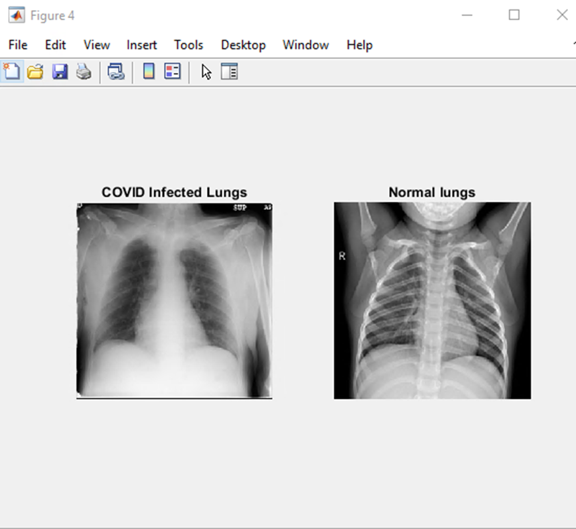
Analysis
The following analysis is based off the x-ray samples 601 – 620 for both COVID and Normal.
Two samples of the x-rays being used. One with a COVID diagnoses and the other Norma. At first look, the COVID x-ray appears blurrier compared to the Normal lungs. In terms of gray scale values, it looks like there are more lighter values in the COVID x-ray. Now we want to examine the whole subset of our data.

Slide 3
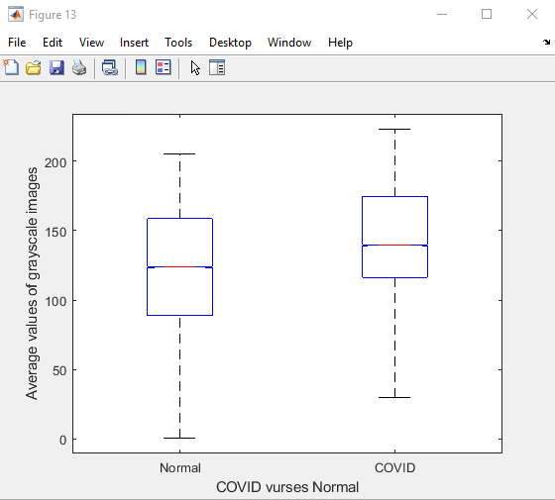
The Box and Whisker plot of our data shows that all the represented statistics (Max, Quartile 3, Median, Min) are all lower for the Normal samples compared to the COVID ones. Keeping in mind that these are grayscale values, so lower scores equate to darker pictures. Although the Normal values are lower, there is still overlap between the values. A natural progression would be to run statistical testing to test for instance, if the average values are statistically different.

Slide 4
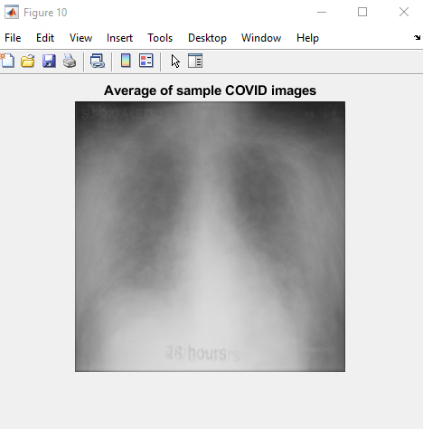
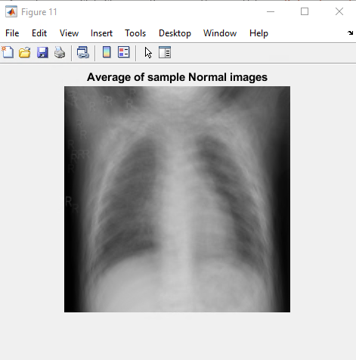
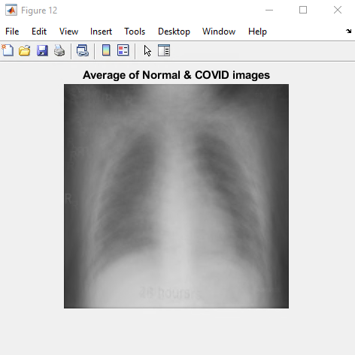
Above are images composed of the average grayscale values for the sets of COVID, Normal and both COVID and Normal. What we see is the same trend as earlier, in that the average of Normal images is clearer than the COVID images. In fact, one can make out the individual ribs on both the Normal and (Normal and COVID) images. Without trying to analyze the images too far without any radiology accreditation, it seems like the COVID samples are blurrier and hence have higher grayscale values. Conversely, the Normal samples are clearer hence having lower grayscale values.

Slide 5
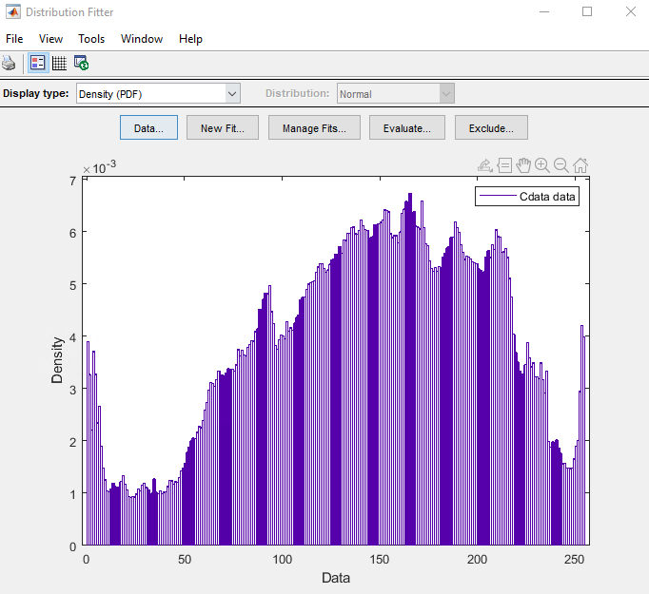
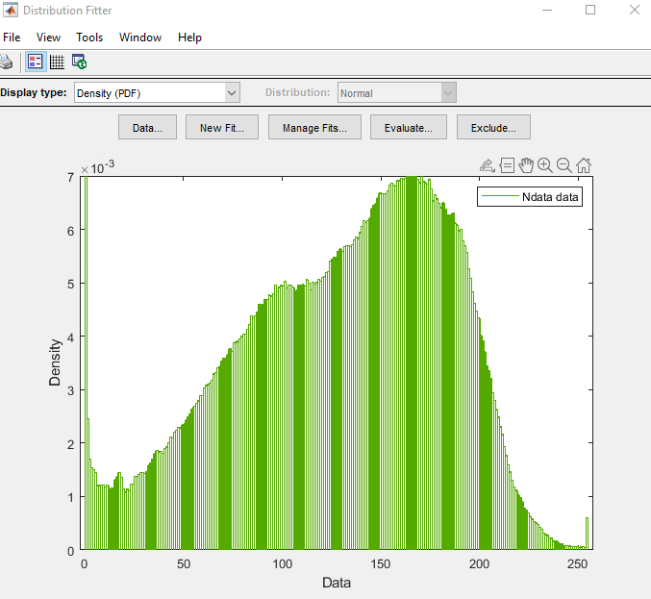
Graphs of the probability distributions of the data sets of COVID images (left) and Normal images (right)

Slide 6
Approximating the distribution of the data COVID Normal
Distribution: Normal
Log likelihood: -9.85054e+06
Domain: -Inf < y < Inf
Mean: 143.603
Variance: 3570.65
Parameter Estimate Std. Err.
mu 143.603 0.0446877
sigma 59.7549 0.031599
Estimated covariance of parameter estimates:
mu sigma
mu 0.00199699 -2.95798e-18
sigma -2.95798e-18 0.000998495
Distribution: Normal
Log likelihood: -9.9014e+06
Domain: -Inf < y < Inf
Mean: 118.985
Variance: 3779.65
Parameter Estimate Std. Err.
mu 118.985 0.0459769
sigma 61.4789 0.0325106
Estimated covariance of parameter estimates:
mu sigma
mu 0.00211388 2.07178e-17
sigma 2.07178e-17 0.00105694
The estimated normal distributions for the COVID and Normal data are described above. According to these distributions, the Normal data has a lower mean value than the COVID data. Remembering that the data refers to the grayscale values of the X-Rays, on average the Normal x-rays have a lower value than the COVID x-rays. This again reflects what we saw with Normal lung images appearing to have lower grayscale values on average.

Slide 7

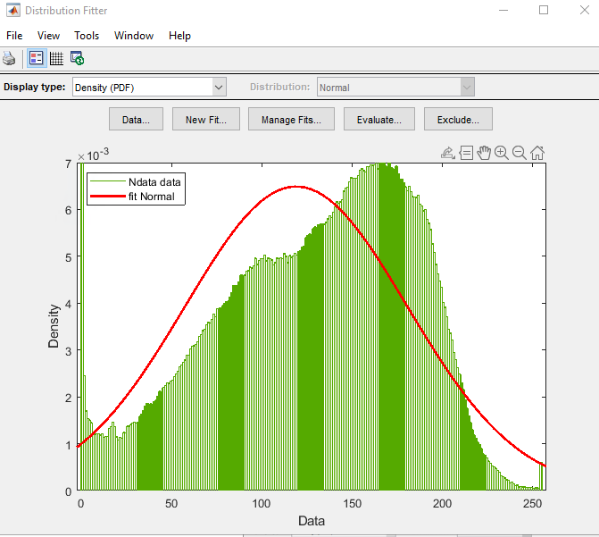
Fitted distributions

Slide 8
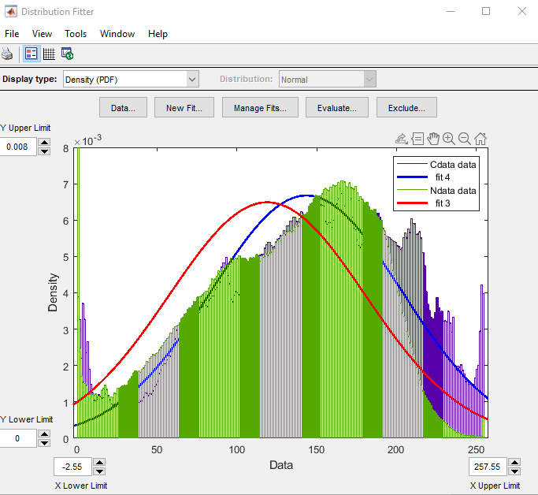
Our data and fitted distributions overlaid. Clearly shows the mean of the Normal data pdf is lower than the COVID data.

Slide 9
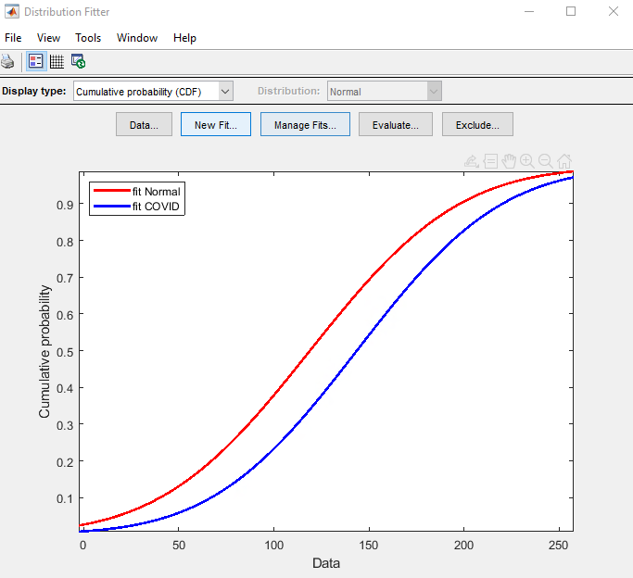
Cumulative Distribution
The Cumulative distributions of the approximate normal distributions for the data is shown to the right. The Normal cdf appears to always be higher than the COVID data. Which again corroborates what we have seen, that the Normal data has lower values on average. So, the Normal set has a higher proportion of its data in the lower grayscale values.

Slide 10
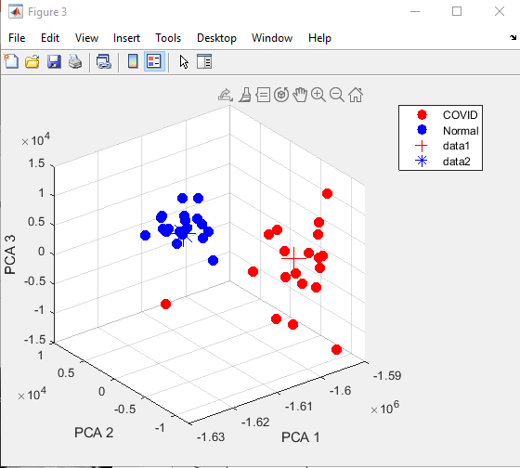
PCA
601-620 Normal and COVID samples
We see that we have very good clustering between the Normal and COVID cases over the PCA’s.
Especially PCA2 has a clear divide between Normal (greater than 0) and COVID positive (less than 0) lungs. So Normal x-rays are positively correlated with PC2 while COVID images are negatively correlated with PC2.
The test images(621) were grouped with the correct clusters. Based on this accurate placement we can try to generate a predictive model for this data.

Slide 11
Predictive Model: Classification and Regression Tree
Using samples (601 – 700) for both COVID and Normal we attempted to construct a predictive model that would predict if an x-ray of a pair of lungs was COVID positive or not based on the variables mean, median, mode, std, PC (1 -5).
PC(1-5) correspond the first five principal components.

Slide 12
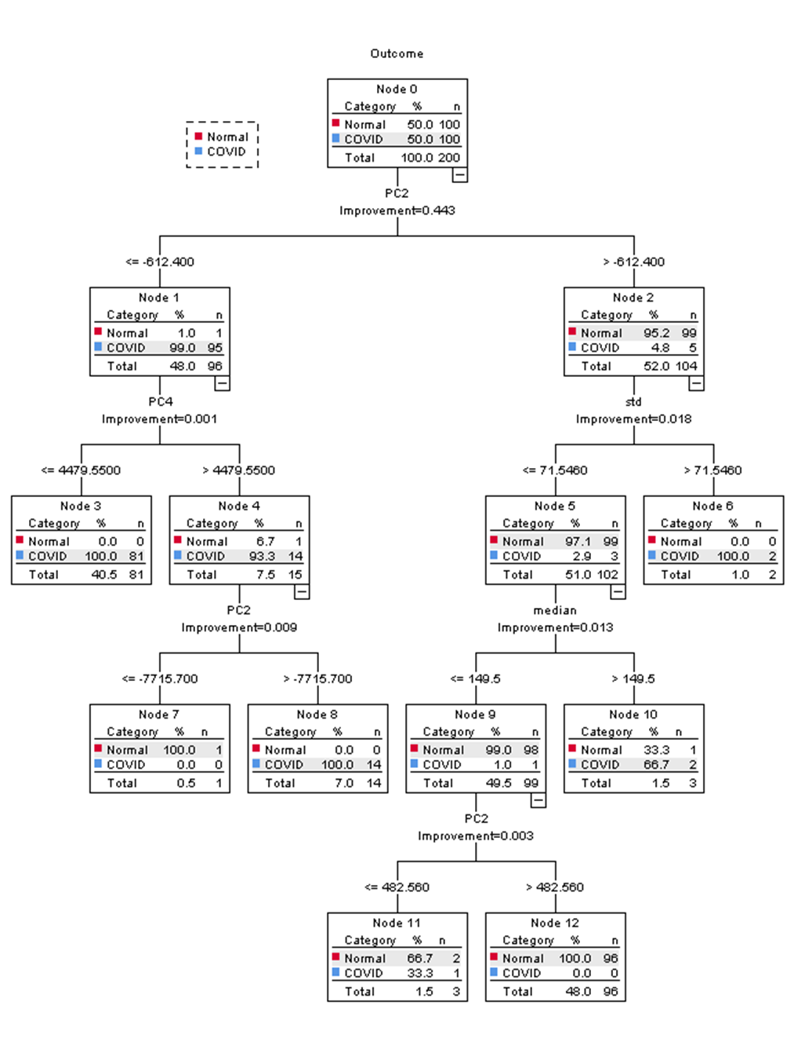
100 Normal images and 100 COVID images.
First Branch:
The first most important variable that we see is PC2.
If PC2 is less than or equal to -612.4, then 99% of the set of data was COVID positive and if PC2 was greater than -612.4 there was a 95.2% chance of the image being an x-ray of Normal lungs.
Second Branch:
On the left-hand side, we see that PC4 was the most significant variable with 100% of the data in this branching with PC4 less than or equal to 4479.55 were COVID positive and of the data with PC4 greater than 4479.55, only 6% were Normal. This branching only had 1 Normal case in its data.
On the RHS, std is the most important variable. Data with std less than or equal to 71.546 was 97% likely to be Normal and the data with std below 71.546 was all COVID (though this was only 2 cases.)
Third Branch:
LHS: PC2 again is the most important variable used for dividing the data. Images with PC2 less than or equal t -7715.7 were all Normal cases (again with only 1 case) while those with PC2 greater than -7715.7 were all COVID positive.
RHS: Median was the most important variable here with images having a median less than or equal to 149.5 were 99% Normal x-rays and those greater than 149.5 were about 67% likely to be COVID positive cases.

Slide 13
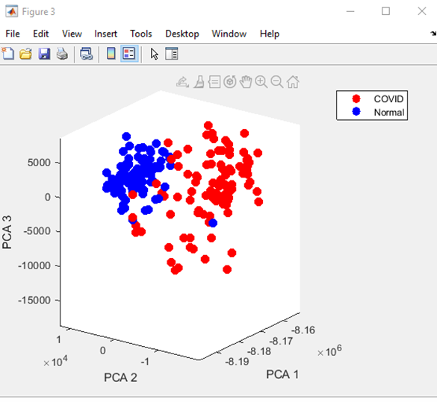
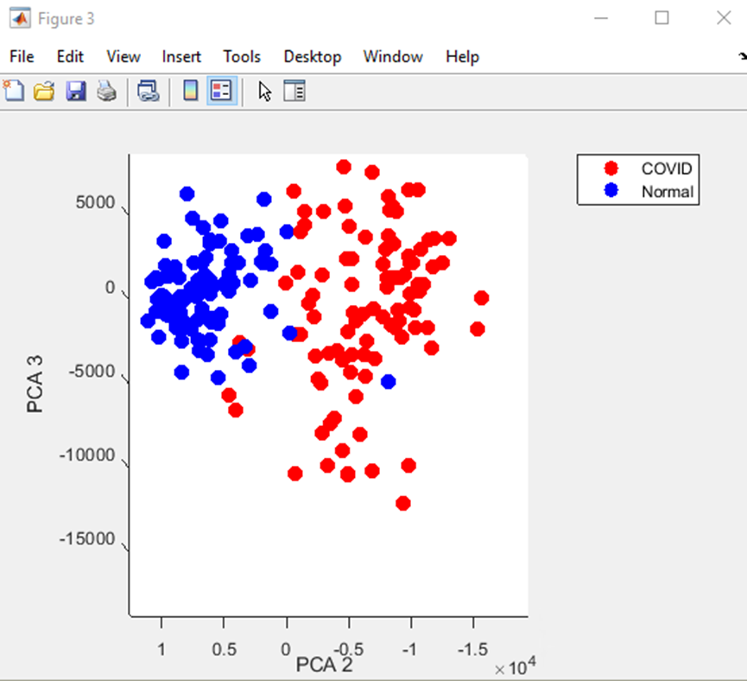
PC2 is shown again to be the most important variable as we saw in the previous slides there was a clear separation between the COVID and Normal images. We saw this in the previous analysis with the 20 sample images, there was a stark separation between the PC2 values of COVID and Normal images.
PC2 in this case with 100 of each Normal and COVID images isn’t quite as clear as before but still a strong predictor for COVID and Normal images.

Slide 14
The std error for this model is quite low which is a good sign and the overall percentage correct for the predictions is 99%. This model was very effective at predicting COVID and Normal lungs for out data set.

Slide 15
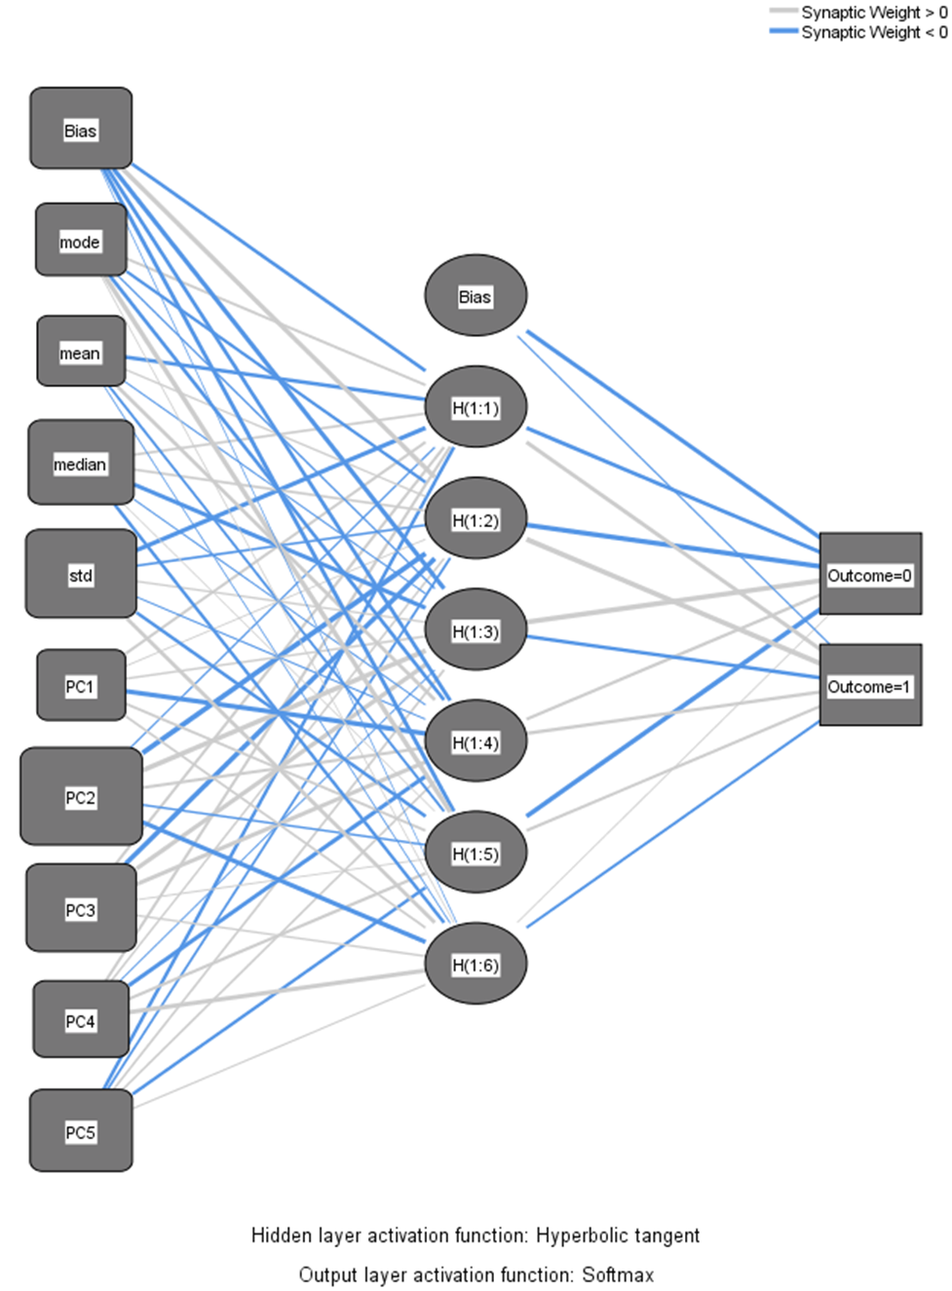
Multilayer Perceptron
The classification and regression tree had an accurate prediction rate for the test data. Now we want to examine if a neural network would produce as good as or better of a model.

Slide 16
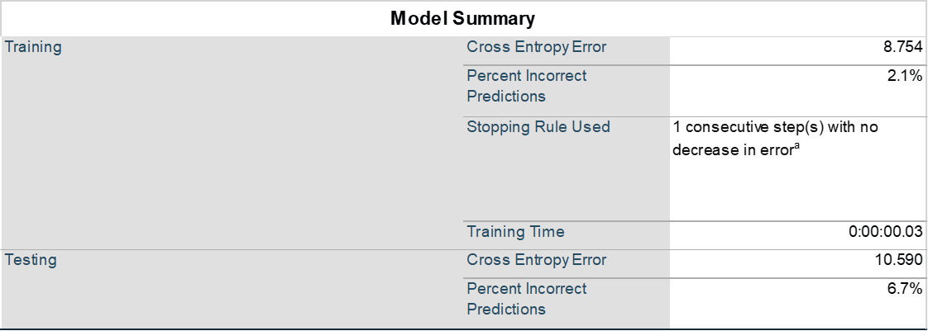
Multilayer Perceptron
In the testing of this neural network, our model predicted 6.7% of the testing data incorrectly. Not terrible by any means but this is slightly more error prone than the decision tree model.
Looking at what was predicted incorrectly, we see that our model falsely predicted COVID x-rays as Normal approximately 13% of the time in the testing data. One could argue that this is more severe of an error and should bed discounted more. In this model errors for both COVID and Normal were weighted equally.
Classification
Sample |  | Predicted
 |  | Normal | COVID | Percent Correct
Training | Normal | 66 | 3 | 95.7%
 | COVID | 0 | 71 | 100.0%
 | Overall Percent | 47.1% | 52.9% | 97.9%
Testing | Normal | 31 | 0 | 100.0%
 | COVID | 4 | 25 | 86.2%
 | Overall Percent | 58.3% | 41.7% | 93.3%

Slide 17
Multilayer Perceptron
Independent Variable Importance
 | Importance | Normalized Importance
mode | 0.051 | 22.5%
mean | 0.036 | 15.9%
median | 0.134 | 59.5%
std | 0.162 | 72.0%
PC1 | 0.039 | 17.4%
PC2 | 0.225 | 100.0%
PC3 | 0.158 | 70.3%
PC4 | 0.078 | 34.6%
PC5 | 0.117 | 52.0%
In this model PC2 was also the most important variable. The next most important variables were std, PC3 and median. One difference from the Classification tree is that the mode is relatively low in importance.

Slide 18
Radial Basis Function
Another kind of neural network we want to use to construct a predictive model and compare it to the classification and regression tree model is the Radial Basis Function.

Slide 19
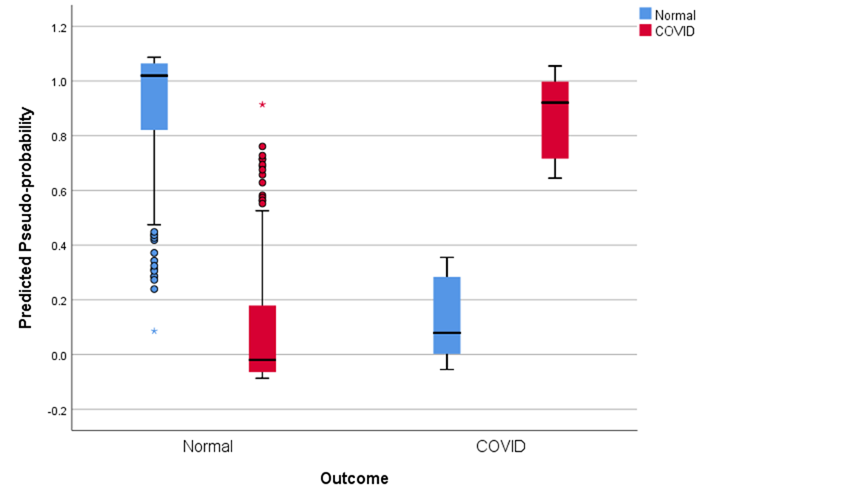
Radial Basis Function
The overall percent correct was slightly better in this model but still not as good as the classification tree.
From the table above we see that most of the error comes from incorrectly predicting the Normal data. For this model it may not be as severe to falsely predict someone has COVID as opposed to falsely predicting a COVID positive image as Normal as we saw in the previous model. We see for the predicted pseudo probability; the Normal plots have some overlap between the predicted probability of Normal and COVID.

Slide 20
Conclusion
Overall the classification and regression tree model provided the best predictive model of the ones examined here.
The pros of the classification tree is that it is easier to understand visually
RBF provided for a more accurate model than the MLP for our data.
If we wanted to implement this method using AI then a database could be setup that contains the data we used in this mode. So that when a patient’s lungs are examined the x-ray could be examined by the model and have a prediction made for COVID positive or not. When an official diagnoses is finally made, the data could be updated as to whether or not the initial prediction was correct or not.

Slide 21
Limits and Errors
Going forward we would want to include more data to have a better predictive model.
It was brought to our attention that the majority of the x-rays for Normal lungs were taken from babies. This is important to note since our model had good predictive behavior but it could be from the model separating by the qualities of infant lungs vs adult lungs as opposed to COVID and non-COVID lungs. More research would be needed to test our presented model’s effectiveness.
We saw good prediction for COVID vs Normal, but if we wanted to predict other illnesses such as pneumonia, bronchitis, cancer then it would be interesting to see how the results would change or if COVID is especially predictable.

