Slide 1
Chest Xray Analysis between Healthy and COVID Lung Capacities
Harrison Terry
Alex Schaeffer
Braeden Vaughn
Caston Stack

Slide 2
Introduction
First identified in 2003, the acute respiratory coronavirus SARS-CoV-1 was a precursor to 2019’s novel Coronavirus. Caused by the similar SARS-Cov-2, COVID-19 spreads through aerosolized droplets, causing respiratory distress. Although the long-term effects of COVID are yet unknown, reduced lung capacity and scar tissue from dry cough and pneumonia are known. Being able to quickly diagnose, isolate, and treat patients before becoming vectors or the disease can progress further is critical. Chest X-rays are one tool we have at our disposal.

Slide 3
Procedure
From an open-source dataset of thousands of grayscale chest X-rays, each group member was assigned 200 of these scans, including
a. 100 X-Rays from Covid Patients;
b. And 100 X-Rays from Healthy Lung Patients
2. Each of these 299 x 299 chest X-rays could be interpreted as matrices, with each pixel or cell value falling in the 0-255 range, with larger values representing darker pixels. With these, we used the MATLAB files COVID_PCA_project.m and COVID_CRT_NNW_project.m to extract information in the MLData excel file. This included
a. 5 Principal components (PCs), utilizing the Singular Value Decomposition (SVD) of a matrix with columns reshaped from individual images
b. Supporting statistics, such as mean, median, and mode pixel values.
3. With data now in a tabular form suitable for analysis, the goal was simple: to predict, with reasonable accuracy, whether a person was infected COVID based on their chest X-rays. To do this, we utilized two different forms of models
a. Classification and Regression Trees (CART), evaluated in-sample with 10-fold cross validation;
b. Multilayer Perceptron (MLP), with 1 hidden layer.

Slide 4
Goals
This is NOT a play-by-play of each group member’s individual findings.
This IS meant to help communicate common findings that could plausibly be applied to the dataset at large, not just a small sample of it.

Slide 5
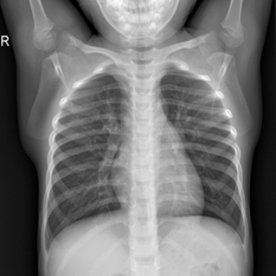
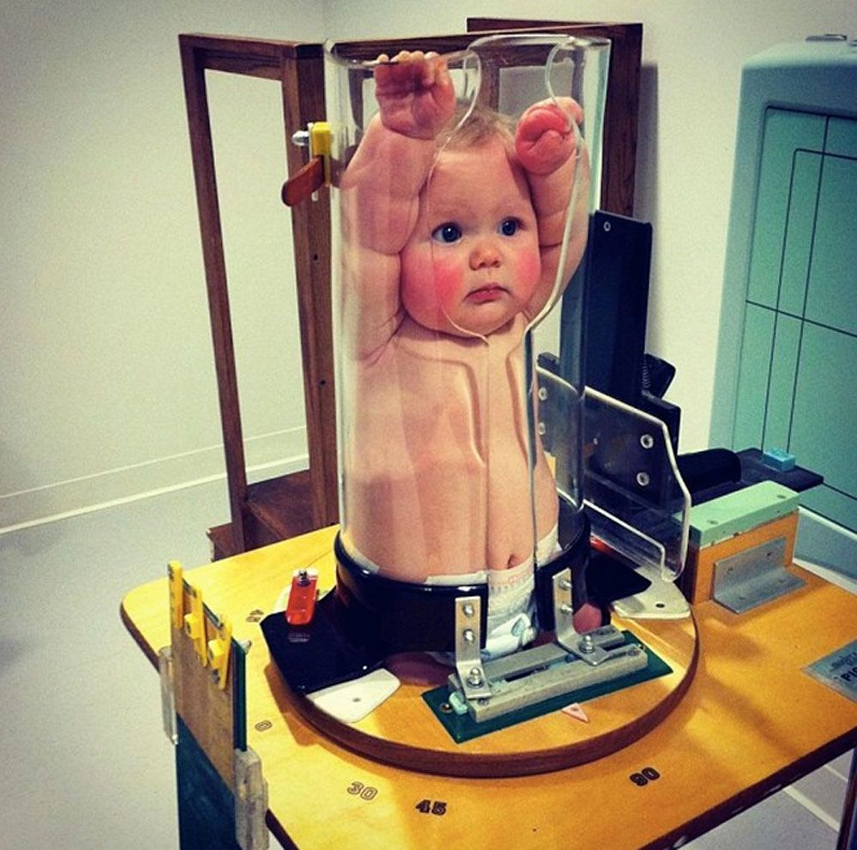
One group member noticed that ~95% of X-rays labeled 1-1400 are of babies.
Disclaimer: A Methodological Pitfall
Infant bone density could very well be significantly lower than that of an adult.
Additionally, reduced lung opacity could be an issue.
The position the patient (infant) is in while being X-rayed is substantially different from that of adult patients.

Slide 6
EDA and Early Analysis

Slide 7
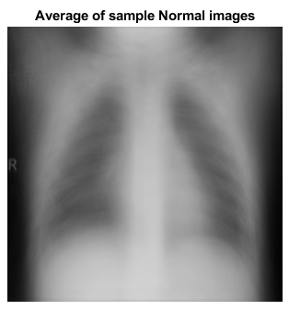
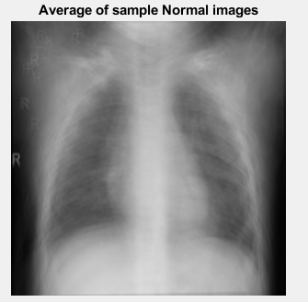
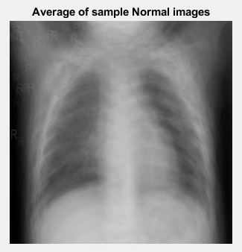
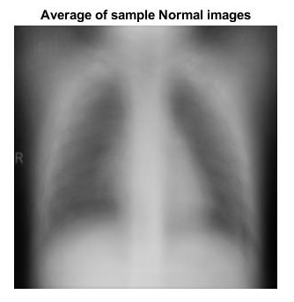
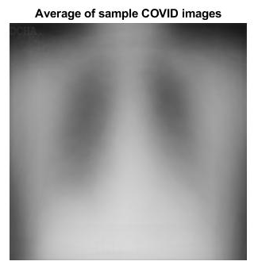
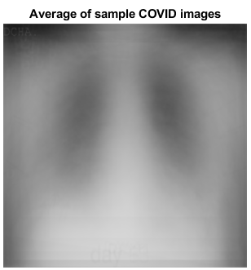
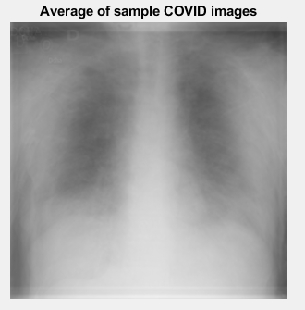
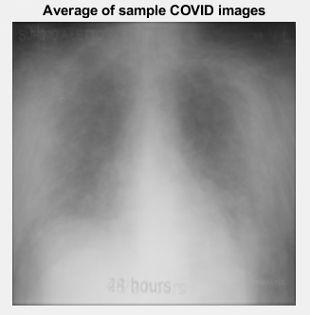

Slide 8
Average Healthy vs. COVID CXRs
Normal / Healthy Lungs
COVID-scarred Lungs
More defined structures – greater variance
Higher median pixel values
Less differentiated structures
Cloudier, more opaque images

Slide 9
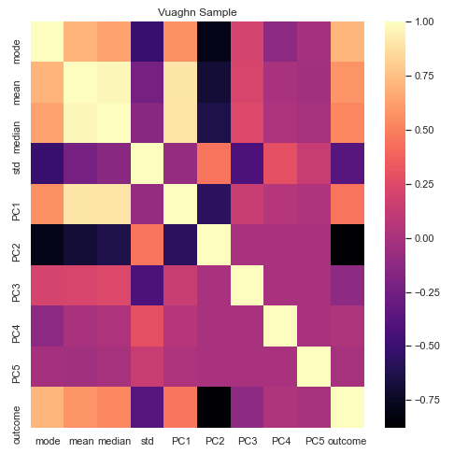
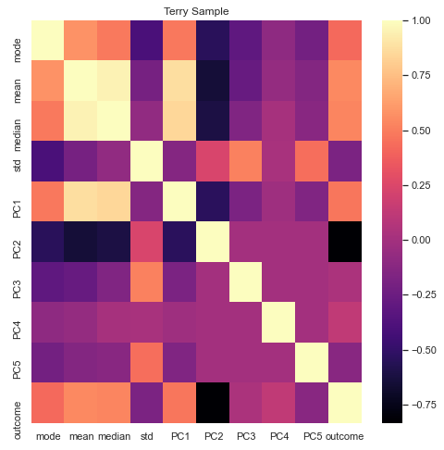
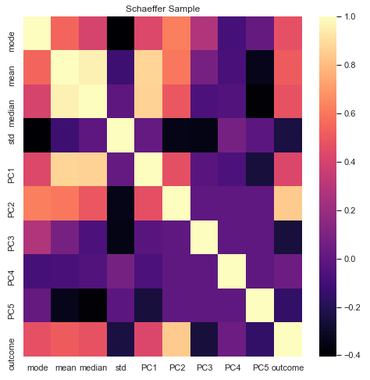
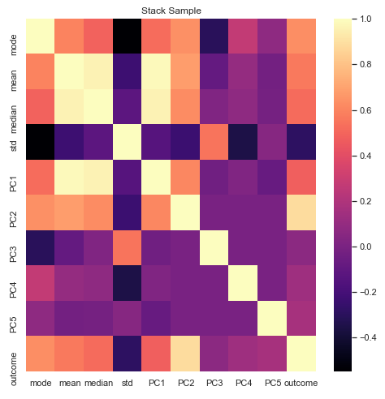
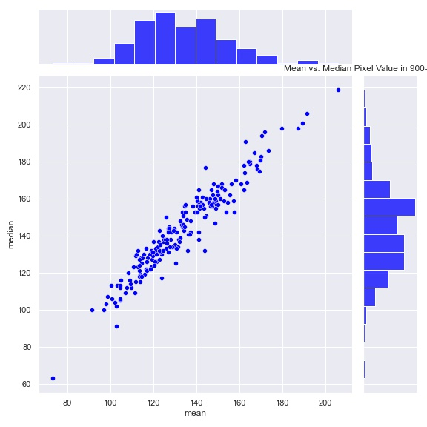
From the above by-sample correlational matrices, a few observations:
In each member’s sub-samples, the second principal component (PC2) shares a high correlational strength outcome.
Mean, median, and mode are moderately correlated with outcome
The mean and median values have high inter-correlational strength

Slide 10
Cluster Analysis with CART and MLP

Slide 11
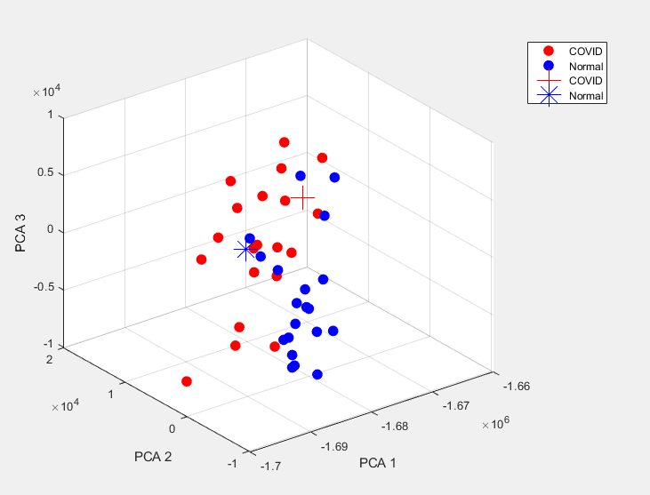
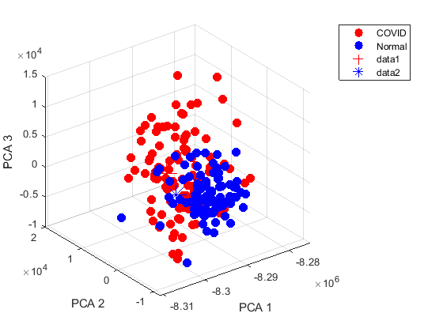
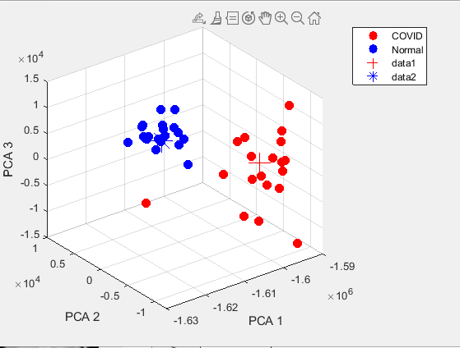
With the above 3-dim PCA clusters, we notice
There is a certain amount of discernable clustering between Normal (Blue) and COVID (Red) data points
PC2 seems to be the strongest axis for differentiating between the two clusters
It may be possible for a diagonal axis between PCA2 and PCA3 to be extruded into a Decision Surface

Slide 12
Individual CART Ranking
Stack
Top 4 IVs: PC2, mean, median, mode
99.5% correct in-sample
Explicitly penalizes Type I Error (False Negatives)
Terry
Top 4 IVs: PC2, median, mean, PC1
Also 99.5% correct in-sample
Vaughn
Top 4 Ivs: PC2, mode, mean, median
99% correct in-sample
Schaeffer
Top 4 IVs: PC2, mean, median, standard deviation
97.5% correct in-sample

Slide 13
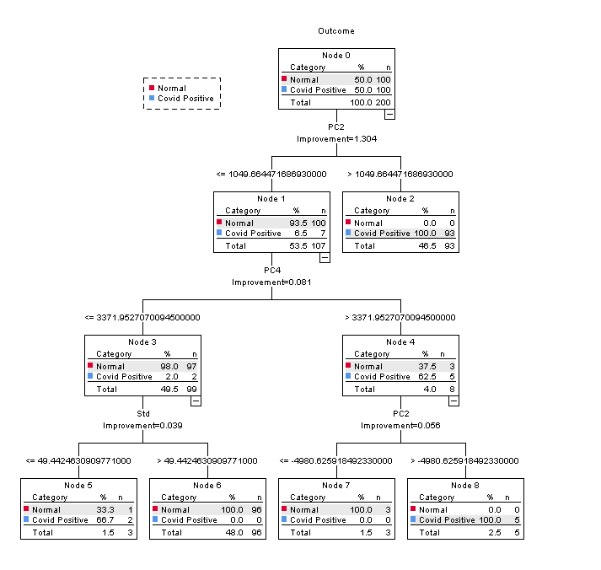
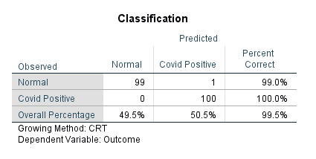
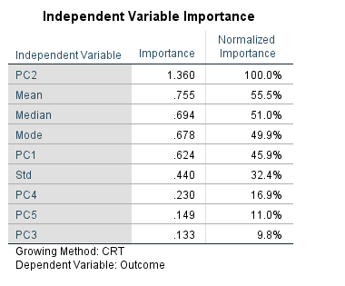
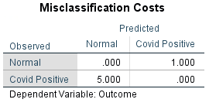
The BEST CART Model

Slide 14
MLP Structure
Simple input layers
A single hidden layer, activating Hyperbolic Tangent
Output layer: 0, 1
Trained with individual sub-samples

Slide 15
Individual MLP Ranking:
Stack
CEE: 3.006 (T), 4.976 (V)
PIP: 1% (T), 2.9% (V)
97.1-99% correct classification
High potential for overfitting, though.
Schaeffer
CEE: 3.967 (T), 9.543 (V)
PIP: 1.4% (T), 3.4% (V)
Vaughn
CEE: 8.754 (T), 10.59 (V)
PIP: 2.1% (T), 6.7% (V)
93.3-97.9% correct classification
13% False Positive rate
Terry
CEE: 19.343 (T), 7.166 (V)
PIP: 5.1% (T), 4.7% (V)
94.9-95.3% correct classification

Slide 16

Conclusions
Splitting data in such small sub-samples is problematic.
Given a higher level of interpretability and similar performances, CART is more appropriate
Efficient implementation would likely use PC2 for the parent node
Results should be alert-based, not deterministic.

