Slide 1
Chest Xray Comparative Analysis
Alex Schaeffer

Slide 2
Procedure:
Use COVID_PCA_project.m to generate 3-dimensional PCA clusters from 400 299 x 299 grayscale images, including
200 chest X-rays of Normal, healthy lungs
200 chest X-rays from COVID patients
Use COVID_CRT_NNW_project.m to generate 2 additional Principal Components, as statistics for each image, exporting tabular data to MLdata
Utilize CRTs and MLPs in SPSS to develop predictive modeling based on Mldata.

Slide 3
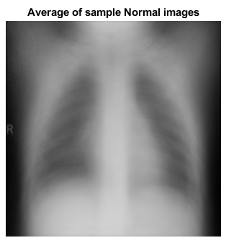
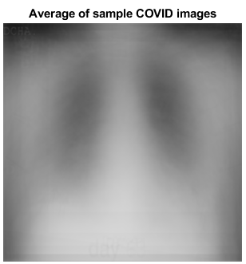
Dispersion Among Average Samples
The two graphics to the were inferred by our first MATLAB file
We notice that on average, chest X-rays from COVID patients were much cloudier, with a greater amount of dispersion
Normal lungs, by comparison, are well-defined in radiography

Slide 4
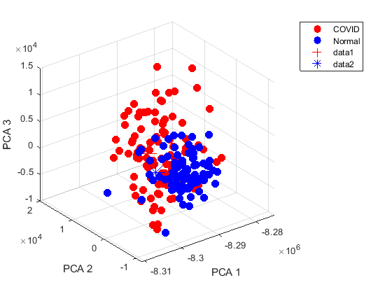
PC Clustering
To the right, we plot our first three principal components
Close inspection seems to suggest a decision plane extruded from a diagonal axis between PC2 and PC3 may be plausible

Slide 5
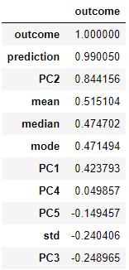
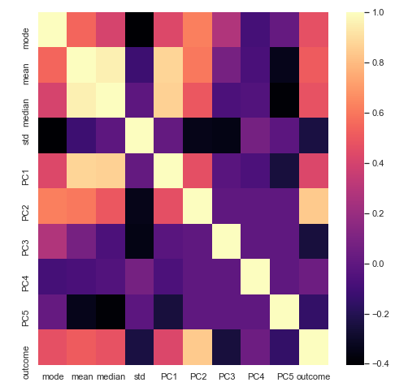
Correlational Observations
From the right correlation heatmap, a few things stand out:
The mean and median of samples are an incredibly strong correlation in the processed images
Among our independent variables, Principal Component 2 has the highest correlation with Outcome [of belonging to either the Normal (0) or COVID (1) label]
Mean, Median, Mode, and PC1 share roughly the same correlational strength with Outcome

Slide 6
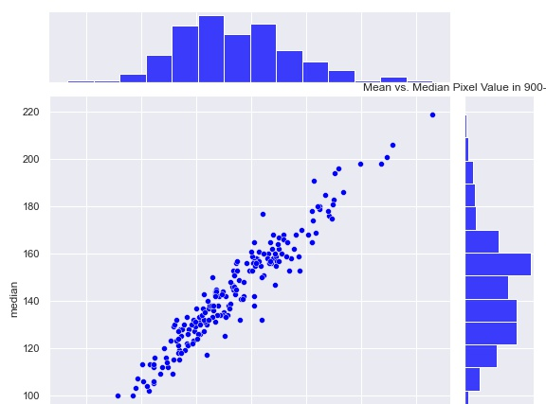
Another Observation
With a Pearson correlation coefficient of .96, the mean and median pixel values are almost perfectly linear.
This is mildly interesting, since the two’s correlation relative to outcome varies by a few percent.

Slide 7
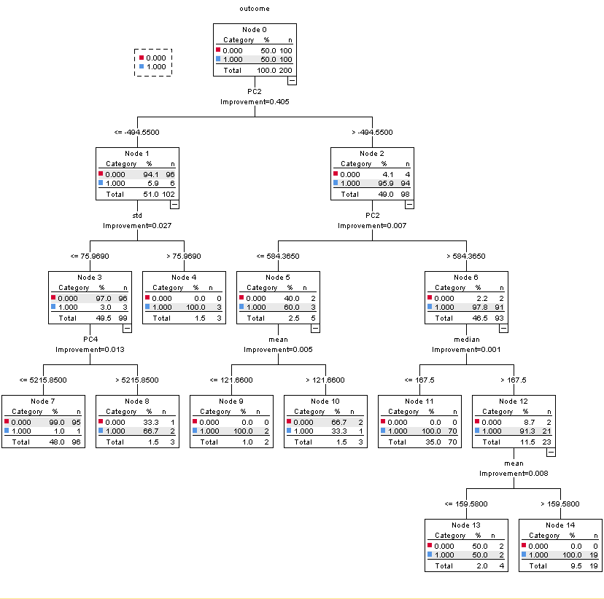
CART Structure
Using SPSS, I was able to generate the following Classification Tree
Unsurprisingly, PC2 was chosen as the primary node, and implement again as a first-tier child node.
Following this, mean and median were given equal precedence
An interesting result, though, was the mode, which shared roughly the same correlational strength to outcome as mean or median, was not implement until last.

Slide 8
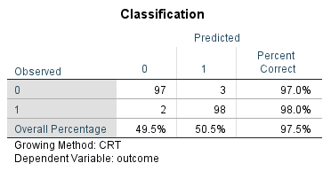
CART Performance

Slide 9

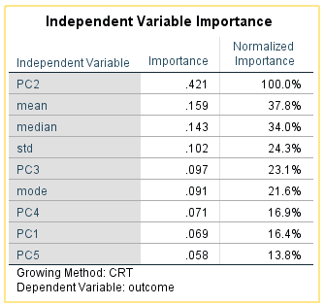

Slide 10
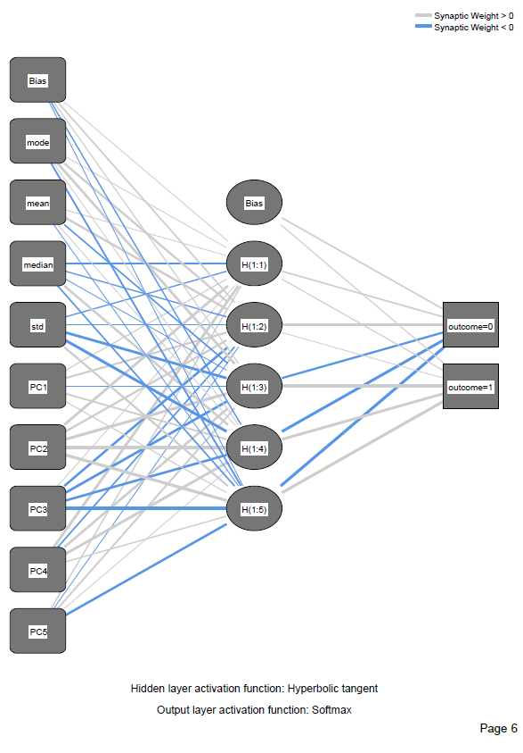
Another Modeling Approach: MLP

Slide 11
MLP Insights
One alternative to the CART approach involves a simple multi-layer perceptron (MLP) with a single hidden layer, which applys the hyperbolic tangent activation function.
Between the input and hidden layers, a densely connected network of weights, optimized through 10-fold cross-validation with a 70-30 training-test ratio.
We notice that between the input and hidden layers, negative synaptic weights for standard deviation, PC1, and PC3 are likely to go through the activation function and link to Outcome 0 [the lung belonging to a healthy patient].

Slide 12
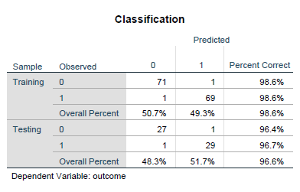
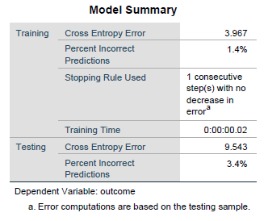
MLP Performance
Sadly, though, there was little room for in-sample improvement from the earlier discussed CART model (which correctly explained 99.5% of the given labels).
Still, our MLP did an excellent job and correctly classified 96.6% of in-sample data.

